Slide 1

Strengthening HIS with MOH in Malawi
Data Use Community
September 29, 2022

Slide 2
HIS progress in Malawi
EMR introduced in 2004 in phases
Currently 211 point-of-care sites (real-time entry), 517 eMastercard sites (retrospective entry), 22 sites other EMR system
  Point-of-care sites cover over 70% of PLHIV
  ~96% of PLHIV on ART covered with EMR system
Both MOH and PEPFAR use EMR for HIV care & treatment and reporting

Slide 3
Building
Requirements gathering for various modules
  Anti-retroviral Therapy
  HIV Testing Services
  Antenatal Clinic
  Out-patient Department
  Cervical Cancer Screening
Building HIS Infrastructure is required to maintain our systems
  Over the years infrastructure improvements have been made across these areas; power, network connectivity and system upgrades
Building capacity
  Capacity building and collaboration with health facilities, district hospitals/offices and national level- Department of HIV and AIDS

Slide 4
Utilizing
Trainings on troubleshooting and infrastructure (Community Health Sciences Unit, Department of HIV and AIDS, Digital Health Division)
Supervision visits use EMR reports (Department of HIV and AIDS)
CRVS monthly bulletins (National Registration Bureau, local government)
Malawi Analytics Platform dashboard at central level (Department of HIV and AIDS, Digital Health Division, implementing partners)

Slide 5
Improving
HIV surveillance quarterly reporting activities
Civil Registration Vital Statistics system supervision visits
Digital Health Division HIS strategic plan
Building a one lab information management system
Back-2-care and Active Index testing applications
Interoperability (exchange of data between EMR and MOH aggregate data system)

Slide 6
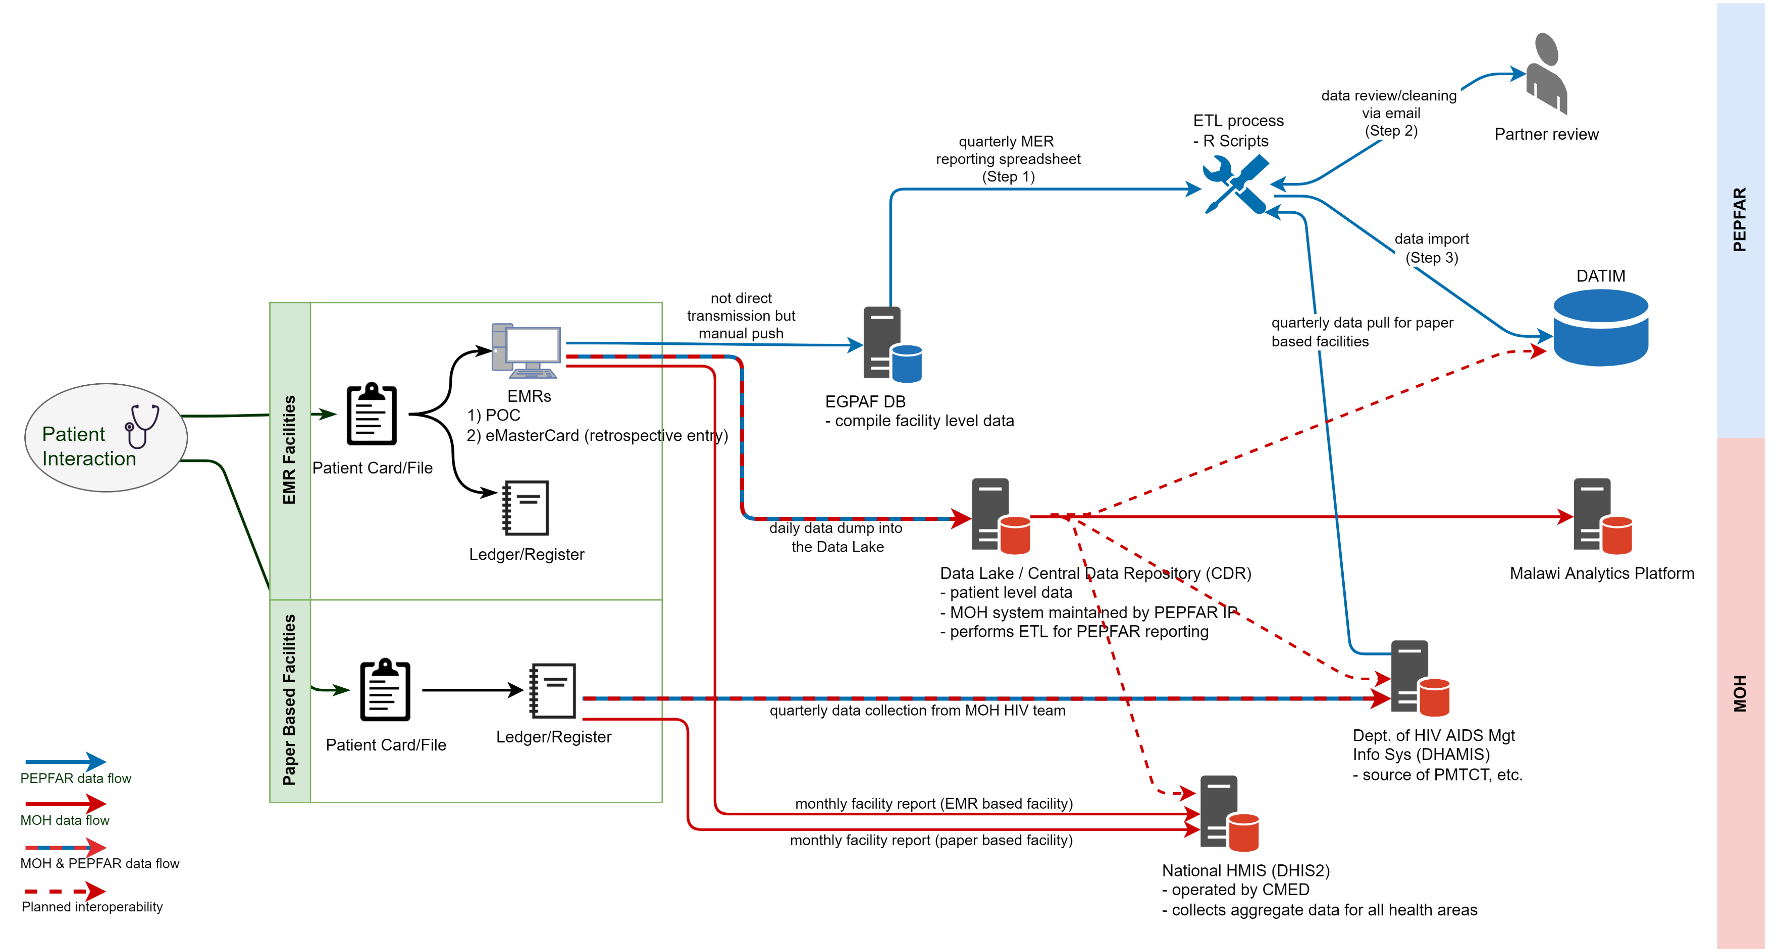
Data flow: where we are, where are going

