Slide 1

Government of the Republic of Zambia
Ministry of Health
Zambia Interoperability and Patient Identity Management Landscape
31st July 2024
Data Use Community

Slide 2
Background
Zambia has implemented various digital solutions in response to health sector needs
  EHR – SmartCare (Legacy, Plus and Pro)
  LIS – DISA
  LMIS – eLMIS
  Immunization Registry – ZEIR
  Covid Immunization – COVAX Register
However, implementation of these solutions has been done in SILOs
This led to a fragmented digital health eco-system with multiple systems that can’t speak to each other
Many clients have also been duplicated across the various systems
Zambia Digital Health Eco-system Interoperability Landscape

Slide 3
Objectives
Create a Client registry with unique identities of clients.
Enable unique identification of clients across various systems
Enable continuity of care by providing a linking mechanism for health records from various systems for a given client
Establish standards for data exchange and terminology
Zambia Digital Health Eco-system Interoperability Landscape

Slide 4
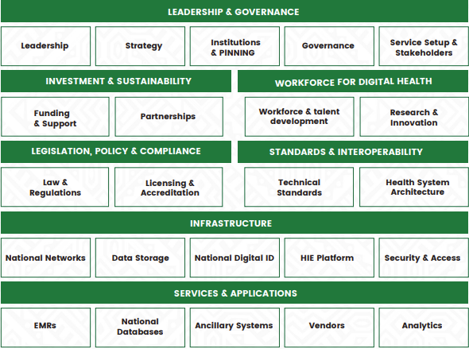
Background
Developed the Digital Health Strategy to ensure coordinated efforts in the development of digital health solutions
Zambia Digital Health Eco-system Interoperability Landscape

Slide 5





Advances Towards Interoperability
Governance
Structures established to support implementation of interoperability
IO and Standards Sub-Committee
Established under the Digital Health Technical Working Group
DHS and IAF
Digital Health Strategy and Inter-operability Architectural Framework developed
Simplified Eco-system
Key systems(EHR, LIS, LMIS) identified and streamlined
Health Information Exchange
HIE developed
Zambia Digital Health Eco-system Interoperability Landscape

Slide 6
Advances Towards Interoperability
Interoperability identified as a one of the cornerstones of a fully digitized Healthcare eco-system
Developed Master Facility Register
Mapped Drugs/Medicines in SmartCare EHR to World Health Organization Collaborating Centre (WHOCC ATC Standard
ICD10 implemented in SmartCare EHR
Integration of SmartCare EHR with DISA LIS
  Data exchange implemented with HL7 v2.5
Integration of SmartCare with eLMIS
Adopted LOINC standard and Health Information Systems (EHR, LIS, eIDSR)
CR development at requirements gathering stage with Minimum Dataset defined
Zambia Digital Health Eco-system Interoperability Landscape

Slide 7
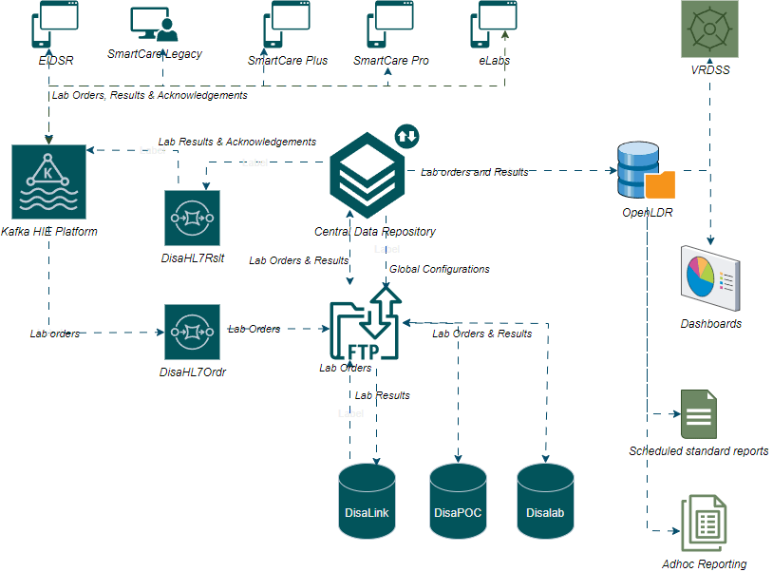
Advances Towards Interoperability
  LIS-EHR Integration
  Laboratory data exchanged between DISA LIS and
      SmartCare
      eLabs
      EIDSR
      VRDSS
    EHR-eLMIS Integration
    EHR exchanging prescription and dispensation data with eLMIS
Zambia Digital Health Eco-system Interoperability Landscape

Slide 8
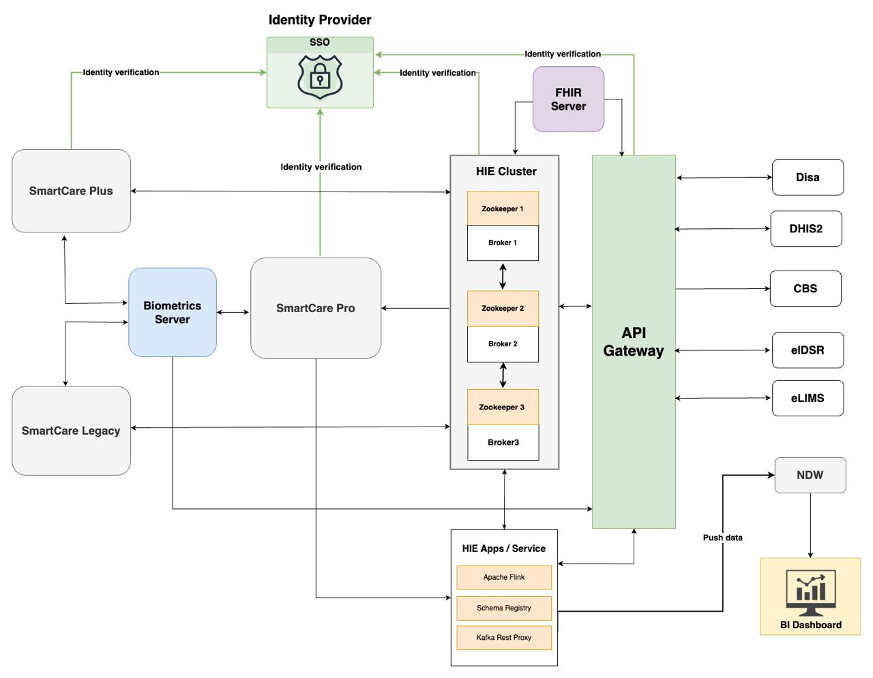
Advances Towards Interoperability - Architecture
Zambia Digital Health Eco-system Interoperability Landscape

Slide 9
CR Minimum dataset
Primary
First Name
Middle Name
Last Name
Married Name
Other Name
Marital Status
Date of Birth
Sex
Secondary
(Block: 1)
Birth Certificate Id
NRC
Passport Number
Driver’s License
Marital Status
NHIMA Id
Province of Birth
District of Birth
Secondary
(Block: 2)
Cellphone Number
Present Address
Secondary
(Block: 3)
Biometric Subject Id
Enabling Continuity of Care with the Client Registry

Slide 10
Challenges
No established standards for messaging across the health ecosystem
No established Terminology Services for HIE.
Inconsistent/limited engagement of clinical experts in multi-disciplinary team discussions around IO
Limited continuity of work done by previous partners.
Lack of/limited internal expertise in certain key institutions
Limited financial capacity to support all digital health priorities
Zambia Digital Health Eco-system Interoperability Landscape

Slide 11
Way forward
Client Registry
Terminology Services
FHIR
API Gateway
Zambia Digital Health Eco-system Interoperability Landscape

Slide 12
Way forward
Implement the shared Health Record by enabling data exchange between several systems
Leverage open-source (Global Goods) Solutions
Establishing a Common Data Pipeline Architecture
Leverage more Government funding for Digital Health
Collaborate with Global community to build capacity
Zambia Digital Health Eco-system Interoperability Landscape

Slide 13









Acknowledgements
Zambia Digital Health Eco-system Interoperability Landscape

Slide 14
Thank you

