Slide 1
Public Health Information, Surveillance Solution, and Systems — PHIS³
Nigeria Patient Identity Management System
^{Data Use Community}
^{September 2024}

Slide 2






















National Biometrics Collaborative
Government of Nigeria
Funders
Implementing Partners
Government of Nigeria

Slide 3
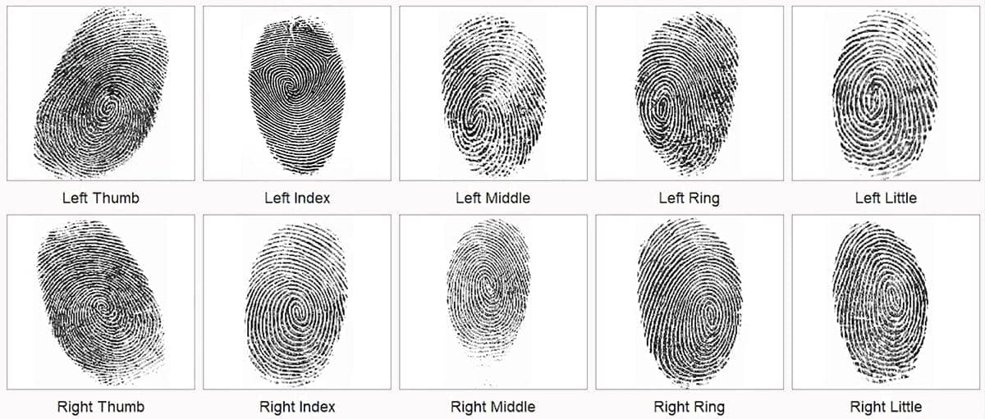
Biometrics Implementation Background
In Nigeria, the HIV program struggles with inquorate client identification numbers, which is useful for effective healthcare delivery. Current data systems often lack unique identifiers, making it difficult to track and manage the care of people living with HIV (PLHIV).
As the program's data systems evolve, they face challenges in creating consistent patient identities and capturing continuity of care for PLHIV. Without reliable identification, ensuring ongoing treatment and support becomes increasingly difficult, affecting the program's overall effectiveness.
To tackle these issues, in 2017-2018 we implemented a Patient Biometrics Systems (PBS) that uses fingerprint biometrics to collect a minimum of 6 and a maximum of 10 fingerprints from each client.
By January 2022, over 80% of clients receiving Antiretroviral Therapy (ART) had their biometrics captured, indicating significant coverage despite concerns about duplicates. This collection provides a valuable opportunity to assess progress toward epidemic control.
The system improves client identification accuracy and enhances data integrity and continuity of care and strengthening the fight against HIV in Nigeria.

Slide 4
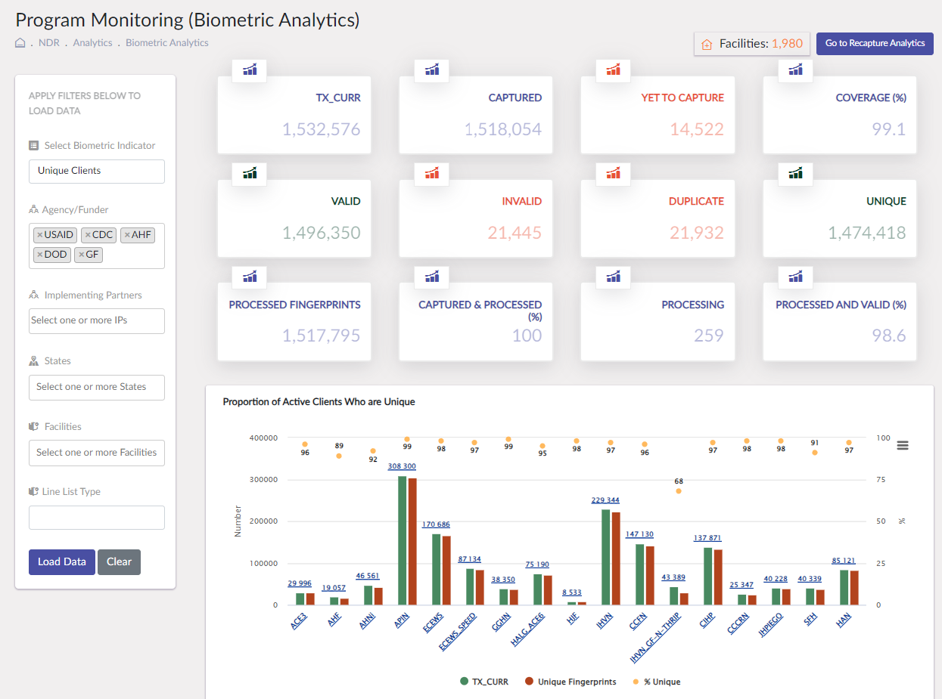
Biometrics Coverage Snapshot Country Wide on Sept 24th, 2024

Slide 5
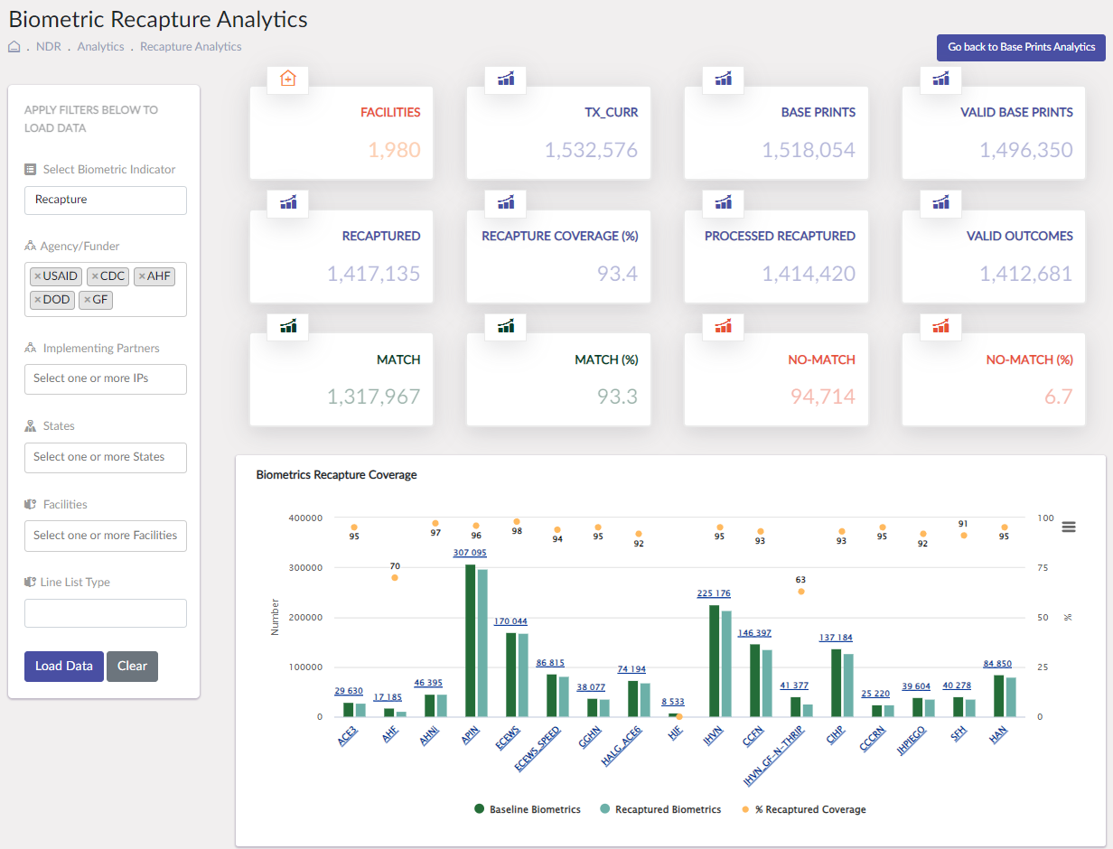
NDR Recapture Snapshot Country Wide on Sept 24th, 2024

Slide 6
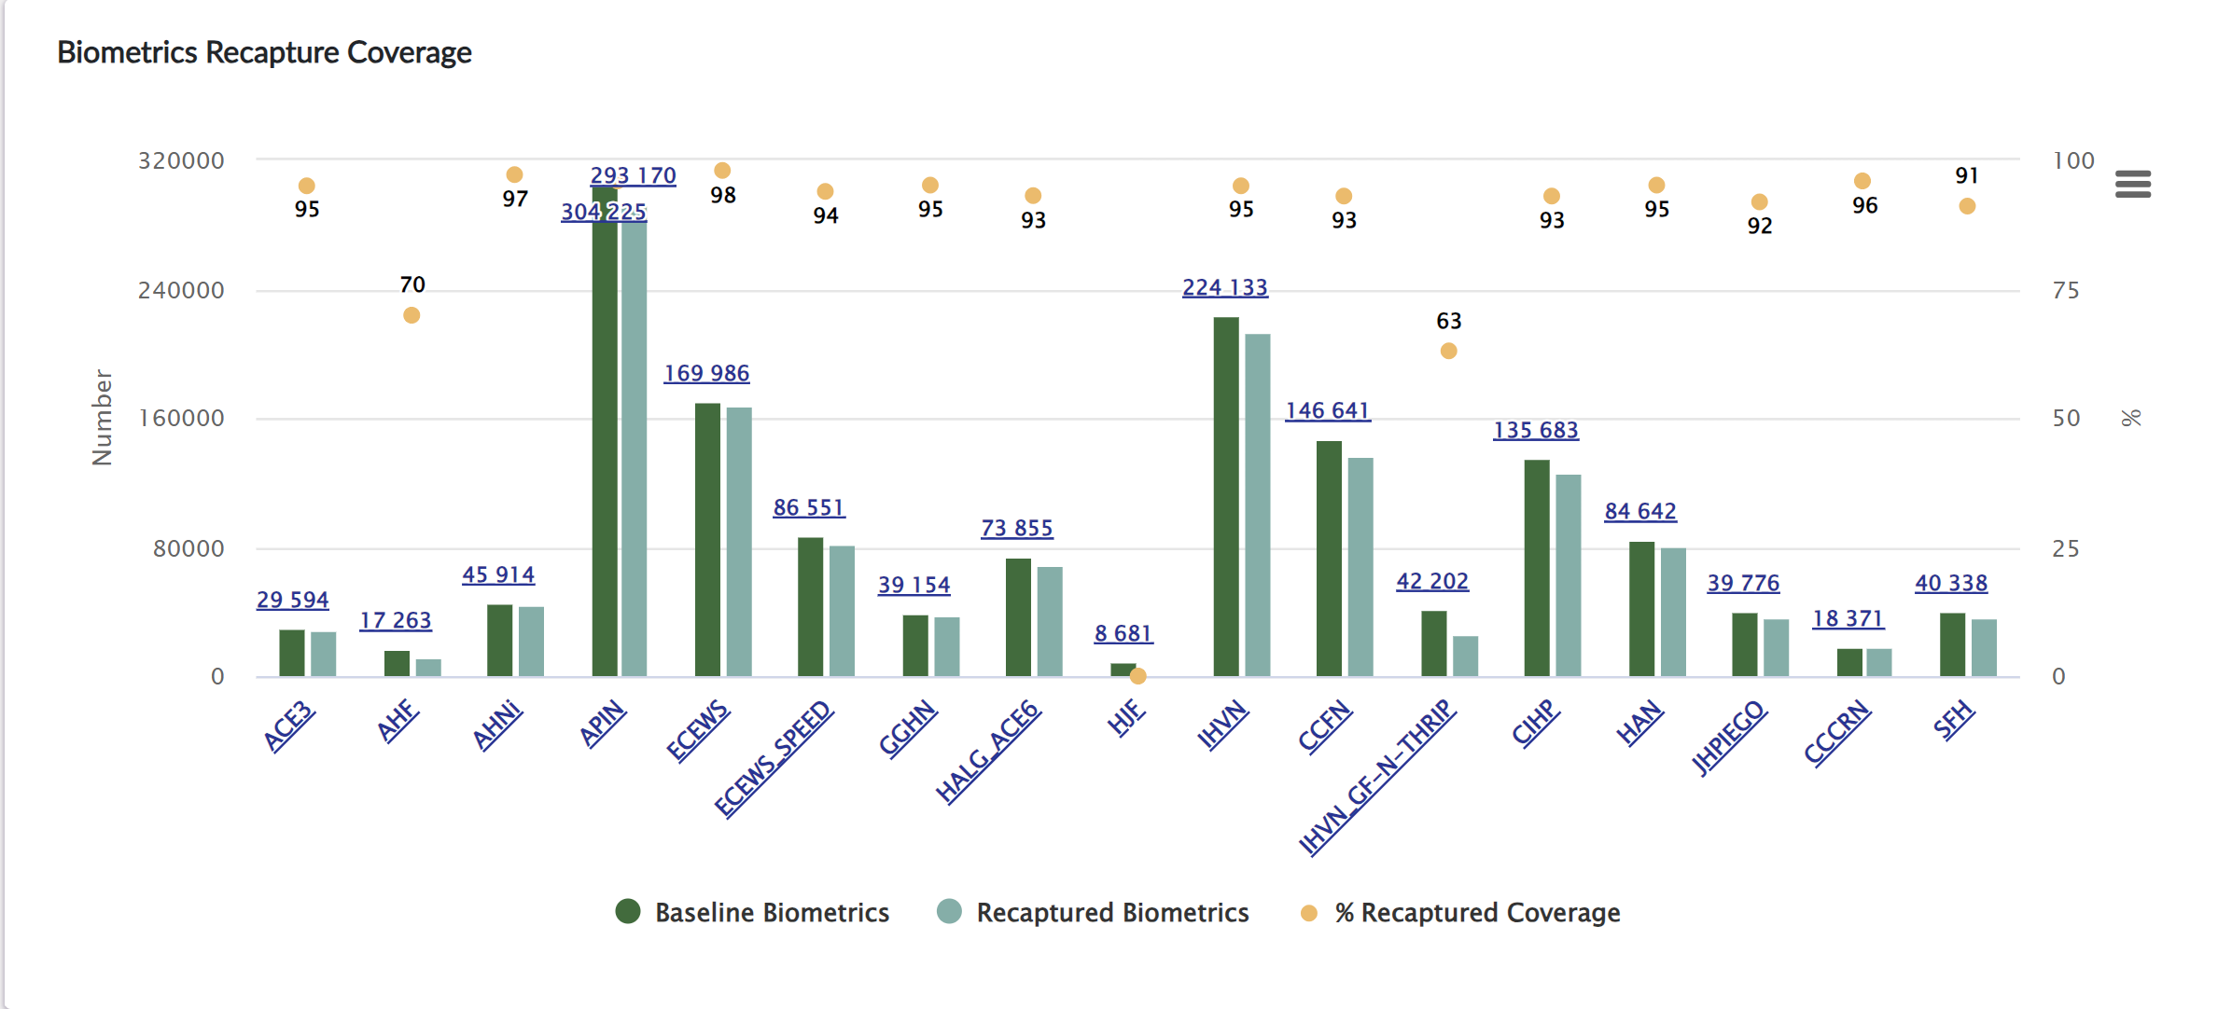
Snapshot of the IPs Biometric Recapture Coverage
As of 20th Sept 2024

Slide 7
Recapture Coverage Trend - National
As of 20th Sept 2024

Slide 8
Match Prints Rate
By Implementing Partner

Slide 9
Match Rate – By IP 1/3
As of 20th Sept 2024

Slide 10
Match Rate – By IP 2/3

Slide 11
Match Rate – By IP 3/3

Slide 12
All IPs Recapture Rate 20th September 2024
IP | Tx_CURR Sept 20th. 2024 | Patients with Fingerprints | Base Coverage | Finger Recaptured | Recapture Coverage
ECEWS_ACE5 | 170,660 | 169,986 | 100% | 167,249 | 98%
AHNI_ACE1 | 46,081 | 45,914 | 100% | 44,615 | 97%
CCCRN | 18,471 | 18,371 | 99% | 17,727 | 96%
APIN | 305,395 | 304,225 | 100% | 293,170 | 96%
HAN_KPCARE1 | 84,924 | 84,642 | 100% | 80,609 | 95%
IHVN | 228,281 | 224,133 | 98% | 213,388 | 95%
HSCL_ACE3 | 29,971 | 29,594 | 99% | 28,145 | 95%
GGHN_ACE2 | 39,439 | 39,154 | 99% | 37,201 | 95%
ECEWS_SPEED | 86,873 | 86,551 | 100% | 81,539 | 94%
CIHP | 136,362 | 135,683 | 100% | 126,384 | 93%
CCFN | 147,370 | 146,641 | 100% | 136,112 | 93%
HALG_ACE6 | 74,860 | 73,855 | 99% | 68,333 | 93%
JHPIEGO | 40,405 | 39,776 | 98% | 36,587 | 92%
SFH | 40,400 | 40,338 | 100% | 36,749 | 91%
AHF | 19,168 | 17,263 | 90% | 12,156 | 70%
IHVN_GF-N-THRIP | 43,949 | 42,202 | 96% | 26,389 | 63%

Slide 13
All IPs Match Rate 20th September 2024
IP | Tx_CURR Sept 20th. 2024 | Patients with Fingerprints | Base Coverage | Finger Recaptured | Recapture Coverage | Match | % Match
AHNI_ACE1 | 46,081 | 45,914 | 100% | 44,615 | 97% | 43,358 | 98%
HSCL_ACE3 | 29,971 | 29,594 | 99% | 28,145 | 95% | 27,470 | 98%
HAN_KPCARE1 | 84,924 | 84,642 | 100% | 80,609 | 95% | 77,700 | 97%
ECEWS_ACE5 | 170,660 | 169,986 | 100% | 167,249 | 98% | 160,717 | 97%
CCCRN | 18,471 | 18,371 | 99% | 17,727 | 96% | 16,871 | 95%
APIN | 305,395 | 304,225 | 100% | 293,170 | 96% | 278,172 | 95%
GGHN_ACE2 | 39,439 | 39,154 | 99% | 37,201 | 95% | 35,258 | 95%
ECEWS_SPEED | 86,873 | 86,551 | 100% | 81,539 | 94% | 76,630 | 94%
HALG_ACE6 | 74,860 | 73,855 | 99% | 68,333 | 93% | 64,088 | 94%
SFH | 40,400 | 40,338 | 100% | 36,749 | 91% | 33,895 | 93%
JHPIEGO | 40,405 | 39,776 | 98% | 36,587 | 92% | 33,180 | 91%
CCFN | 147,370 | 146,641 | 100% | 136,112 | 93% | 122,493 | 90%
IHVN | 228,281 | 224,133 | 98% | 213,388 | 95% | 189,399 | 89%
CIHP | 136,362 | 135,683 | 100% | 126,384 | 93% | 111,627 | 88%
AHF | 19,168 | 17,263 | 90% | 12,156 | 70% | 10,442 | 87%
IHVN_GF-N-THRIP | 43,949 | 42,202 | 96% | 26,389 | 63% | 22,134 | 84%

Slide 14
Patient Identity Management System (PIMS)

Slide 15
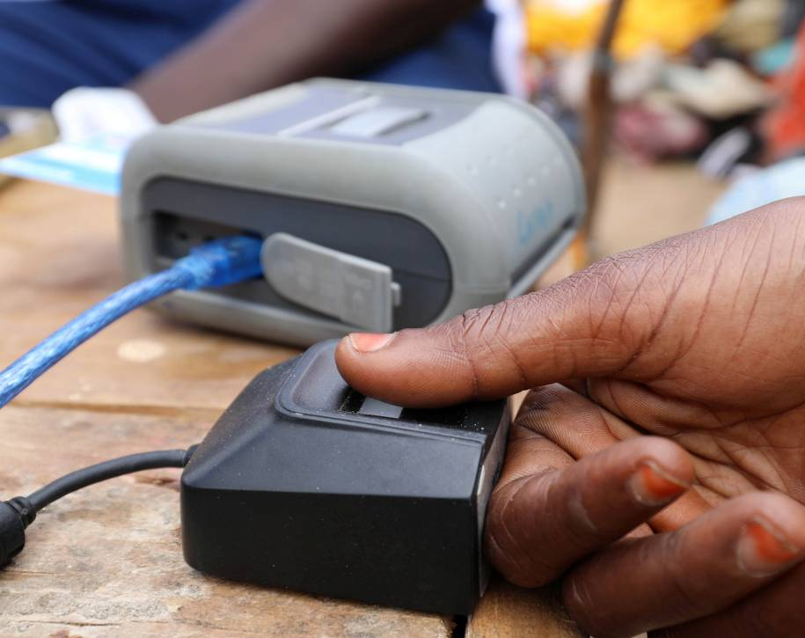
Development of Patient Identity Management System (PIMS)
In November 2022, PHIS3 commenced the requirement gathering to develop PIMS, an advanced extension of our Client Registry System.
By early 2023, we began collaborating with the CDC TAP consortium partners, notably Jembi Health Systems, leveraging their expertise with the JEMPi platform.
PHIS3 successfully built the Patient Identity Management System with the primary goal of identifying patients at registration points to prevent double registration.
The system now allows patients to access services at their preferred hospitals, with records seamlessly uploaded to the National Data Repository (NDR) linking their unique IDs to biometric fingerprints.
The system was tested in selected hospitals across various cities in Nigeria, yielding excellent results.
We conducted several stakeholder engagement meetings to sensitize Ministry of Health and implementing partners on the use, functions, and capabilities of PIMS.

Slide 16
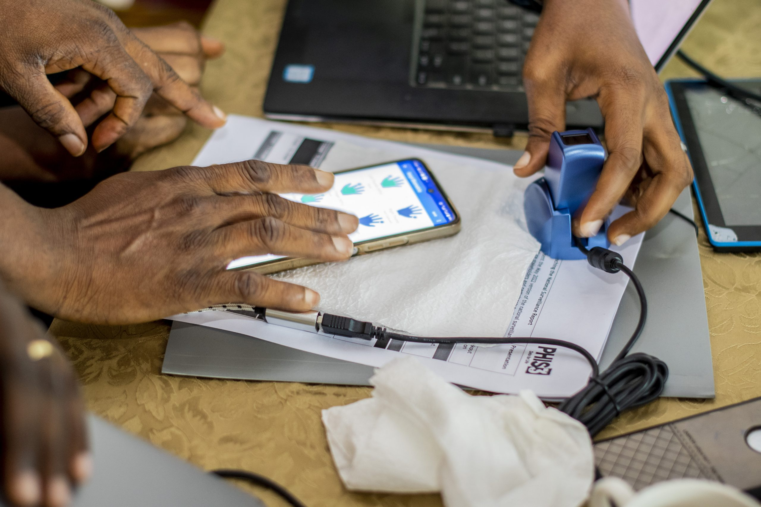
PIMS Current Status
Current Status
Continue to optimize the PIMS for optimal performance.
Currently pilot testing the system with stakeholders.
The Ministry of Health plans to integrate PIMS with the National Identity Numbers (NIN) developed by the National Identity Management Commission (NIMC).
PHIS3 is working with the Ministry to obtain access to APIs for seamless integration with the National ID system.
All local Electronic Medical Records (EMRs) are connected to the PIMS platform.
Next Steps
Phase rollout of the PIMS after successful linking with the NIN system.

Slide 17
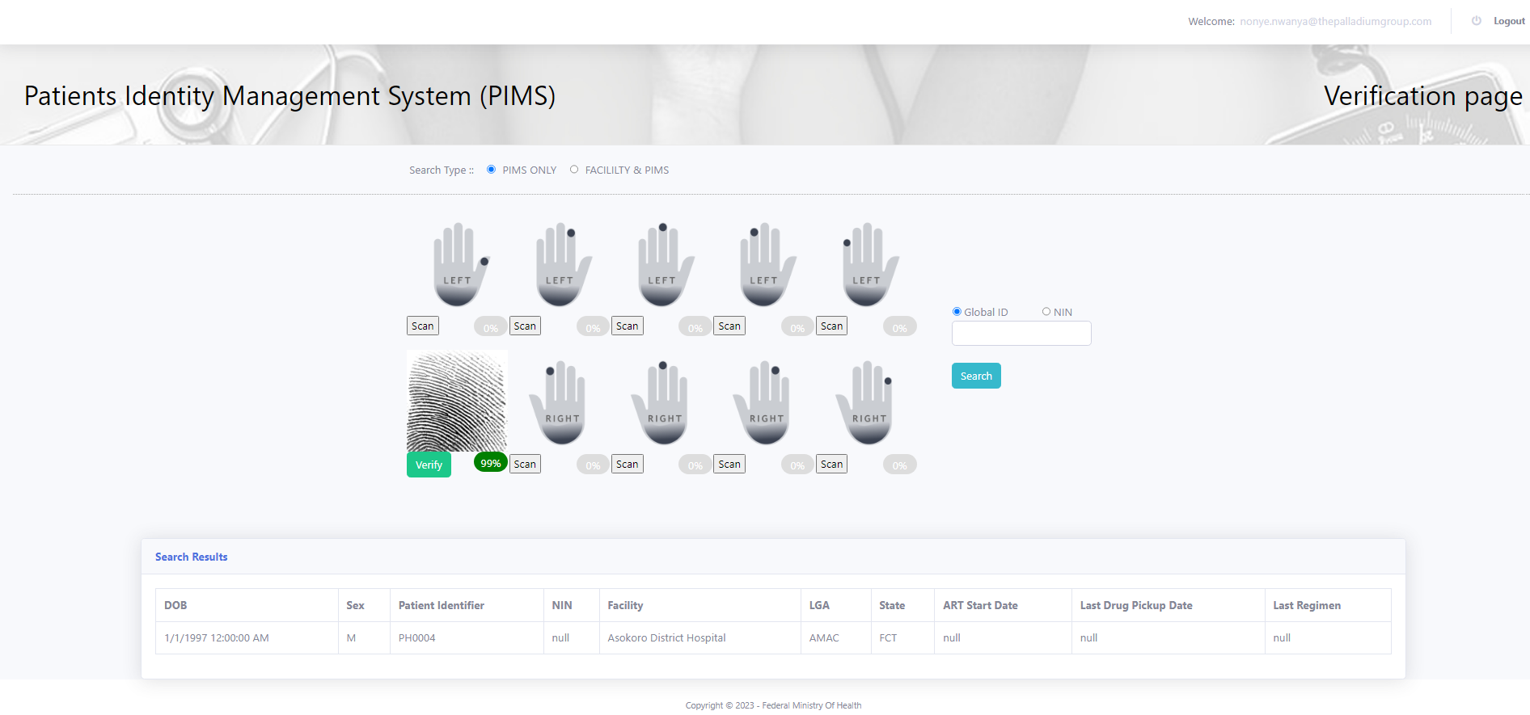

Slide 18
PHIS3 / TAP
Patient Identity Management
Efforts

Slide 19
Goals
Goals:
Improve identity management capabilities to augment matching in an expanding population in a sustainable and scalable way
Proposed Methods:
Add secure/encrypted national ID and demographic data to matching process
Use encrypted tokens (PPRL)
Establish a framework for measuring accuracy

Slide 20
Current Availability of HIV Matching Data
HIV population Biometric (fingerprints)
All patients do not yet have a national ID and with similar programs like the U.S. SSN, we expect issues as the effort scales.
Not all patients can use biometrics.
Not all patients have quality demographic data in the EMR.
National ID Not yet captured in EMR
EMR Demographic Data
This is an opportunity to further develop matching competencies that strengthens existing and build new capabilities to expand matching capabilities.

Slide 21
Current to Future State Strategies
 | Current State | Future State
Linking Use Case | Eliminate duplicate patient records to support more accurate PEPFAR metrics | Eliminate duplicate patient records to support more accurate PEPFAR metrics Moving toward a strategy supporting broader use cases such as patient care
Matching Attributes | Fingerprints | Fingerprints National ID Demographics Other Regional IDs (Facility_ID + ART_ID)
Match quality and accuracy assessment | Continuous technical / systems testing | Continuous technical / systems testing Strategy for ongoing monitoring and management match performance

Slide 22
Process
Develop a deep understanding of current state
Assess attributes for matching (more on next slide)
Identify places in the process for enhancement / intervention
Analyze possible tokens (on going)

Slide 23
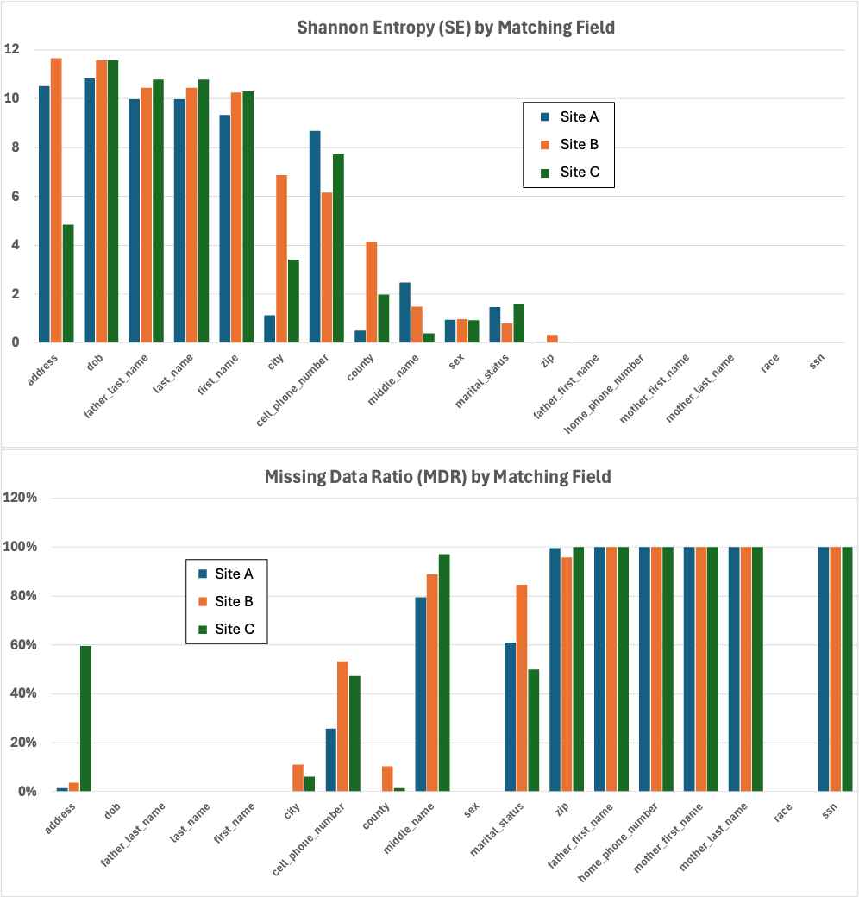
Data Quality
Assessment
(Larger is better)
(Smaller is better)

Slide 24
Current HIV Matching Process
Data Capture
EMR Extract
Transport to NDR
NDR Matching Process
Linkage Review
1
2
3
4
5
Data Capture
Import Into NDR
Fingerprint Matching
Linkage Review
Generate Extract File
Obtain fingerprints and demographics
XML file with the added token for NIN and demographics
Linkage line listing shared with facilities for review and duplicate resolution
Create the extract file with fingerprints
Use current process for fingerprint matching
Data | EMR Storage | Transport to NDR | NDR Storage for Matching
Fingerprint | Digital Template | Digital Template | Digital Template
Existing

Slide 25
Recommended HIV Matching Process
Grey = New
Data Capture
EMR Extract
Transport to NDR
NDR Matching Process
Linkage Review
1
2
3
4
5
6
7
8
Data Capture
Data Preprocessing
Generate Extract File
Import Into NDR
Fingerprint Matching
PPRL Matching
Matching Assessment
Linkage Review
Get fingerprints and demographics
XML file with the added token for NIN and demographics
Use current process for fingerprint matching
See Demographic matching tokens
Linkage line listing shared with facilities for review and duplicate resolution
Validate and standardize data
Generate the extract with fingerprints, NIN and tokens
Flow chart used for determining matches
Data | EMR Storage | Transport to NDR | NDR Storage for Matching
Fingerprint | Digital Template | Digital Template | Digital Template
Existing
NIN | Stored Encrypted | Encrypted PPRL token with “salt” | PPRL token with “salt”
Demographic Data | Stored in clear case | Encrypted PPRL tokens with “salt” | PPRL tokens with “salt”
New

Slide 26
Proposed Initial HIV Matching Approach
Start
Fingerprint match?
No
Match on
regional IDs (ART_ID+Facilty_ID)?
No
No
Match on national ID?
No
Match on Demographics?
Yes
Yes
Yes
Yes
Match
Match
Match
Match
This flow will be revised as data and data collection practices evolve. The approach will be data-driven.
Non-Match

Slide 27
Security Concepts
Concepts | Description
Encryption | Encryption is the process of translating plain text data (clear human readable text) into something meaningless (ciphertext). Decryption is the process of converting ciphertext back to a human readable format. This is done using keys to unlock the ciphertext.
Privacy Preserving Record Linkage (PPRL) | PPRL allows records to be linked together without revealing identifying information. With PPRL, records from two different sources are linked by encrypting ("hash-ing") each person's identifying information within each record. Uses a one-way encryption that can not be decrypted. (An example follows).
Salt | Adding a random text before using one-way encryption. This helps defend against attacks that use precomputed tables (e.g. rainbow tables), by significantly growing the size of table needed for a successful attack.

Slide 28
Data Hashing
Hash-codes make it nearly impossible with current computing technology to learn their original input values
Brute-force dictionary attack (try all known possible input values) and all known hash-encoding functions can be overcome by adding a secret key (known only to database owners) to input values before hash-encoding.
For example, with a token or “salt”: ‘i9=!e@Qt8?4#4$7B’
Frequency attack still possible (compare frequency of hash-values to frequency of known attribute values)
Credit: Peter Christen

Slide 29
Privacy Preserving Record Linkage: Hashing
Example EMR Biometrics
Mathematical Hash
Function
National Level (NDR)
(Matching across facilities)
Thomas
Tomas
43f5b0d6c54c5f0c4a6767c2886a762d
e906f58a4ebf7be536bb2716b62af011
#
ThomasJohnson
Johnson1970
4aca522ced2011e9877c3a079a7e593a
8d5deeb8679e951517588023d78498fa
#

Slide 30

PPRL Process
Facility A
John Smith
03/27/1945
Facility B
John Smith
03/27/1945
nWTsK5n1iehqbe
nWTsK5n1iehqbe
Hash to create the token
Encrypt - Prepare the data for transport to a central repository (NDR)
Hoaig5eo9nahaFif
Ksa4fhksjfke0q2df
NDR decripts and processes and links records
nWTsK5n1iehqbe
Facility A
nWTsK5n1iehqbe
Facility B
MatchID_007 | PEPFARID_001 | Facility A | nWTsK5n1iehqbe
MatchID_007 | FTC_999 | Facility B | nWTsK5n1iehqbe
MatchID_007 | OSK_3ž0 | Facility C | nWTsK5n1iehqbe
Result
PPRL Process

Slide 31
Example Demographic Tokens
Token # | Description
1 | Date of birth + last name + first name + sex
2 | Year of birth + month of birth + last name + first name + sex
3 | Year of birth + Day of birth + last name + first name + sex
4 | Date of birth + father’s last name + first name + sex
5 | Date of birth+ cell + sex
6 | Year of birth + month of birth + cell + sex
7 | Year of birth + Day of birth + cell + sex
8 | First name + city + cell + sex
9 | Last name + first name + cell + sex
Token # | Description
10 | father’s last name + first name + cell + sex
11 | Date of birth+ last name + cell + sex
12 | Year of birth + Day of birth + last name + cell + sex
13 | Day of birth + father’s last name + cell + sex
14 | Day of birth + last name + first name + city + sex
15 | Day of birth + last name + first name + cell
16 | Year of birth + month of birth + last name + first name +cell
17 | Year of birth + Day of birth + last name + first name + cell
Note: If any token data fields are Null, the token is not generated. Token recommendations are preliminary pending validation using Nigerian real-world data.

Slide 32
Highlights
Exchanged deep technical knowledge on the Nigerian process for the EMR data capture, biometrics matching and the NDR
Exchanged deep technical knowledge on matching practices
Developed the physical process and plan for incorporating NIN and Demographics into the HIV patient matching process
Performed linkage evaluation using sample data
Created a strategy for protecting the data and ensuring alignment with privacy and security policies and best practices
Outlined a strategy for continuous evaluation

Slide 33
Summary of Recommendations
Understand quality of attributes that can be used for record linkage
  Completeness
  Quality
Use Privacy-Preserving Techniques to Augment Patient Matching with Additional Match Fields
Use Data Protection and Encryption to incorporate demographic match data
Use Privacy-Preserving Techniques
Establish Data Quality, Validation, Standardization, and Monitoring for Patient Matching
Use manual review to establish a gold standard of the “truth” for actual matches
Establish routine monitoring practices
Implement processes for standardization of data inputs and data collection practices
Long-Term Adaptation and Sustainability in Patient Matching Systems
Adapt to Evolving Needs as use cases and data changes
Perform Ongoing Review and Make Adjustments
Ensuring Data Integrity, Security, and Fraud Detection in Patient Matching Systems
Handle data integrity issues
Protect sensitive Data

Slide 34
PHIS3 EMR / NDR teams: Dr. Oludare, Dr. Olaposi, Gibril, Dr. Kehinde, Tobechi, Steve, Kenneth, Johnson, Nnamdi, etc.…
CDC Nigeria: Dr. Dalhatu, Dr. Ademola, Isah, Nalda, Dr. Richard, Dr. Stephens, etc.…
TAP / PATH: Agbons Oaiya, Sam Wambugu
Regenstrief: Dr. Shaun Grannis, Dr. Toan Ong, Jennifer Shivers, Paul Biondich, etc.….
THANK YOU
Public Health Information, Surveillance Solution, and Systems PHIS3
Plot 492, Mike Akhigbe Way, Jabi, Abuja
info@phis3project.org.ng
+234 810 743 9098

