Slide 1


Identity Management Toolkit: Biometrics Session
25 October 2023

Slide 2

Patient identity management initiatives taking place in Ethiopia

Slide 3
What is PIMS
A PIMS is a healthcare information technology solution designed to accurately and securely manage and maintain the identities of patients receiving healthcare services.

Slide 4
Why we need patient identity management system
Patient Safety minimizes the risk of medical errors, such as administering the wrong treatment or medication to a patient.
Quality of Care: to access a patient's medical history, allergies, and other critical information, enabling them to make well-informed decisions.
Data Integrity: It reduces the likelihood of duplicate or incorrect records, which can lead to fragmented care and incomplete patient histories.

Slide 5
Why PIMS….
Interoperability: seamless exchange of health information.
Cost Reduction: Reducing duplicate records and administrative errors lowers healthcare costs.
Efficiency: reducing waiting times and improving the overall patient experience.
Longitudinal Patient Records: longitudinal patient records, providing a comprehensive view of a patient's health history.

Slide 6
PIMS initiatives in the Ethiopian health sector

Slide 7
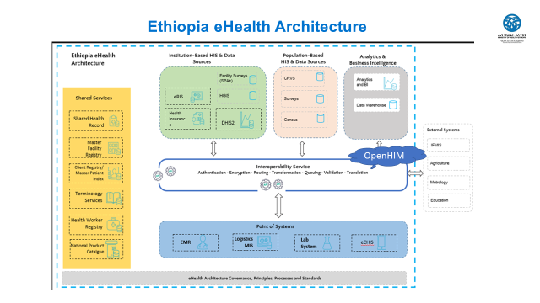

Slide 8
Medical Record Number(MRN)
EMR implementation in Ethiopia started on 2008 ,
At the beginning it was Smart Care , now Bahmini
The MRN in the EMR system serves only with in the facility
The number could only be given once and is never re-assigned to others even when the patient dies.
The MRN is the exact copy of the number that is written on the patient's Medical Record Folder or Master Patient Index

Slide 10
Biometrics in eCHIS(Simprints)
Objectives:
Create digital unique identifiers for households and individuals to facilitate targeted service delivery and improve efficiency and effectiveness of healthcare delivery at community level
Approach:
HEWs will be able to enroll and biometrically identify/verify clients to:
  Facilitate referals
  Quickly locate records
  Continuity of care

Slide 11
Biometrics in eCHIS(Simprints)
Enrolment data
● 51,957 enrolments
  ○ Oromia=28,596
  ○ SNPPR=23,361

Slide 12
Biometrics in eCHIS(Simprints)
Challenges
- Tablets are ow capacity taking HEWs long
time
- Data syncing continued as a challenge (non-functioning sim cards)

Slide 13
ART unique number
Regionnumber/facilitytypecode/specificfacilitycode/ patient/client assignednumber.
Eg. 01/08/001/00001

Slide 14
National ID program
is a 12 digit unique identification number issued by NIDP (National ID Program) of Ethiopia
biometric digital ID
National ID (Fayda ID Number - FIN): 963042760547
Fayda Alias Number(FAN):2705691325784016

Slide 15
National ID program…
There is work on progress to adopt the National ID with the health sector
Health insurance with EMR

Slide 16
Challenges
Infrastructure(health net)
Cost and Funding
Political and Regulatory Challenges
Rural and Remote Access
Capacity building

Slide 17
Thank You!
OpenHIE Email: openhie@gmail.com
DUC Email: info@datausecommunity.org

