Slide 1
Patient Identity Management In Cote D’Ivoire
Paul Henri Assoa, Casey Iiams-Hauser, Reagan Makoba
October 30th, 2024
Notes:
1. Title Slide
Project Title
Your Name and Position
Date
Organization Logo (if applicable)

Slide 2
Introduction
Effective patient identity management is necessary to provide quality care to a population by ensuring accurate patient identification at the point of care and deduplication of patient records in health information systems (HIS).
Duplicate patient records, inaccurate patient identification, and incorrect association between patients and records are some of the major data quality issues in Côte d’Ivoire.
Poor data quality diminishes the ability of health facilities to make informed decisions on health care delivery as well as the Ministry of Health (MOH) and implementing partners to monitor and ensure quality of care.
Therefore, a patient identity management solution is crucial to improve the quality of health data and good continuity of care.

Slide 3
Project Background
PEPFAR has supported Cote d'Ivoire for many years to provide a solution to improve data quality through the unique identification of HIV patients to improve healthcare services.
After establishment of unique ART patient code using site code, year and chronologic number, the program started a UPID project for patient identification based on fingerprints in 2020
This solution, while effective in the sites installed and among patients enrolled, was insufficient because it is limited to patients who are able to provide fingerprints.
In addition, other systems have their patient identification and the MOH sought a solution that could combine them as well as integrate with the national health insurance identification once available. A solution was needed to optimize patient monitoring and conduct deduplication across systems and within existing site EMR databases.

Slide 4
Project Background
The PIM Project started in 2022 under PATH and DIGI through the TAP project funded by CDC. In 2023, DIGI sub-contracted with ITECH CIV for local implementation. Since 2024, ITECH CIV has been responsible for implementing this project through CDC Cote d'Ivoire's support and guidance from the National HMIS Technical Working Group, chaired by MOH.

Slide 5
Goals and Objectives
Deduplication while creating a new patient in EMR (SIGDEP) : when the patient is not present, and the new ART ID has already been created on the paper-based patient chart (i.e., retrospective data entry and deduplication)
This solution should be based on the existing patient identification codes already implemented and should be coupled, if possible, with the EMR used in all sites.
Regular deduplication on all existing site EMR (SIGDEP) databases
The algorithms must take into account the data most likely to be reported and which are sufficient to allow reliable identification of individuals.
The solution must allow the deduplication of data from the different site databases and offer results of perfect or potential matches based on the established algorithms.
It must allow automatic deductions through the algorithms and provide manual checking and decisions as well.

Slide 6
PATIENT IDENTITY MANAGEMENT SOLUTION APPROACH
Principles Driving Solutions: Digital Health Global Goods & Standards
Principle of re-use & leveraging existing open source solutions
Strong collaborations and leadership with Global Goods communities to accelerate work and given opportunities to share/leverage others work
Data standardized solutions & workflows
IHE Profiles: PIX/PDQ, for cross referencing patient identifiers to ensure consistency and querying and retrieving demographics information about patients from different systems

Slide 7
Implementation Highlights
Requirements collection, Users cases establishment and Algorithms development based on variables selected by MOH
Deduplication Pilot made on the OpenCR Server with Algorithms checking
Features testing and validations, user guide and training materials updated
2022
2023
Sept 2024
2022
March 2024
Nov 2024
Open Source selection and features development
Algorithms reviewed, EMR feature development started and OpenCR features added after pilot requirements
Pilot of EMR UI at sites for deduplication during new patient creation

Slide 8
OPENCR COMPARISON
Compare and Contrasting OpenCR with other Patient Matching Global Goods at 2022:
OpenCR vs SanteMPI study showed:
  OpenCR has a significantly higher accuracy in matching
  faster processing times for high record volume
  more functionality available to implementers for deduplication
OpenCR vs OpenEMPI - significant scaling issues in production, changes in licensing and pricing, (e.g. Haiti) that led to replacing with OpenCR
OpenCR vs JeMPI - currently in development as an improved matching engine (not full PIMS), but not tested, piloted, or production-ready; once ready, DIGI considering future integration into OpenCR as part of the larger PIMS solution.

Slide 9
DIGI PIMS EXPERIENCE
Côte d’Ivoire OpenCR PIMS with Lab and EMR
Botswana OpenCR PIMS with National ID system (NIDS) and OpenHIE with Lab and EMR
Zimbabwe OpenCR PIMS in OpenHIE with EMR, Lab, NDR/Reporting
Haïti PIMS with Continuum of Care and Lab Orders-Results Workflows

Slide 10
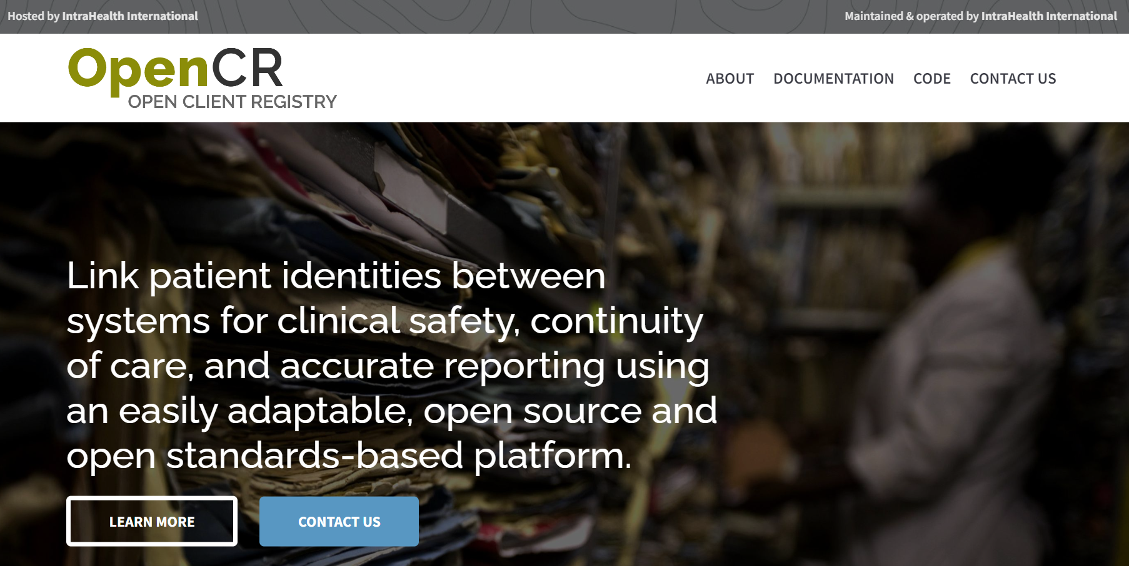
OPENCR PATIENT IDENTITY MANAGEMENT SOLUTION
OpenCR is a Digital Health Global Good
Open source, stewarded by Intrahealth, emerging community of collaborators across this and other PIMS initiatives to improve patient matching overall. DIGI is key contributor to OpenCR codebase.
Built to address the problem of patient identity at scale within a country HIS architecture
Intended to work within a larger standards-based architecture for priority use cases (point of service workflows, human adjudication for de-duplication)

Slide 11

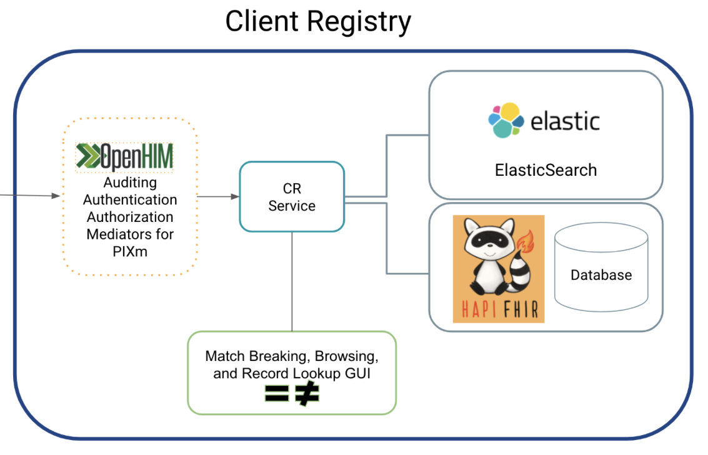



OPENCR TECHNICAL ARCHITECTURE
Point of Service (POS)
System(s)
Interoperability Layer
Auditing
Authentication
Authorization
Mediators for PIXm
Shared Health Record
Notes:
FHIR-first allows for fairly seamless integration into a modern architecture
Ability to utilize within an ecosystem that includes a national identification system (NIDS) for the larger country population
Ability to integrate with fingerprint technologies and other biometric solutions
User configurable management of patient matching algorithms

Slide 12
Key Activities and Milestones
Variables (2022, reviewed in March 2024)
  UPID number, ART code , DOB or Age, Gender, First Name, Last Name, cell phone
  3 auto matches decisions:
    UPID Number and ART Code exact matching
    Auto match if 5 out of the 7 variables match
  8 potentials matches decisions:
    Potential if 4 variables are the same
    Potential match if 3 are exacts and the last one reach the defined threshold

Slide 13
Key Activities and Milestones
Deterministics and Probabilistics Algorithms (2023, reviewed in march 2024)
  Jarold Winkler, Exceeds score threshold on names
  Concatenation all First names
  best probabilistic with swap (month and date) for DOB
  Double metaphone for names have been postponed for next release as the similarity of names presented many issues after the first pilot.
Features Development
  Algorithms development and tests in openCR (July 2023)
  Reviewed Algorithms development in OpenCR (March 2024)
  Add new feature to check auto match in OpenCR (January 2024)
  Add new UI during patient creation in SIGDEP3 /OpenMRS platform (April - Sept 2024)

Slide 14
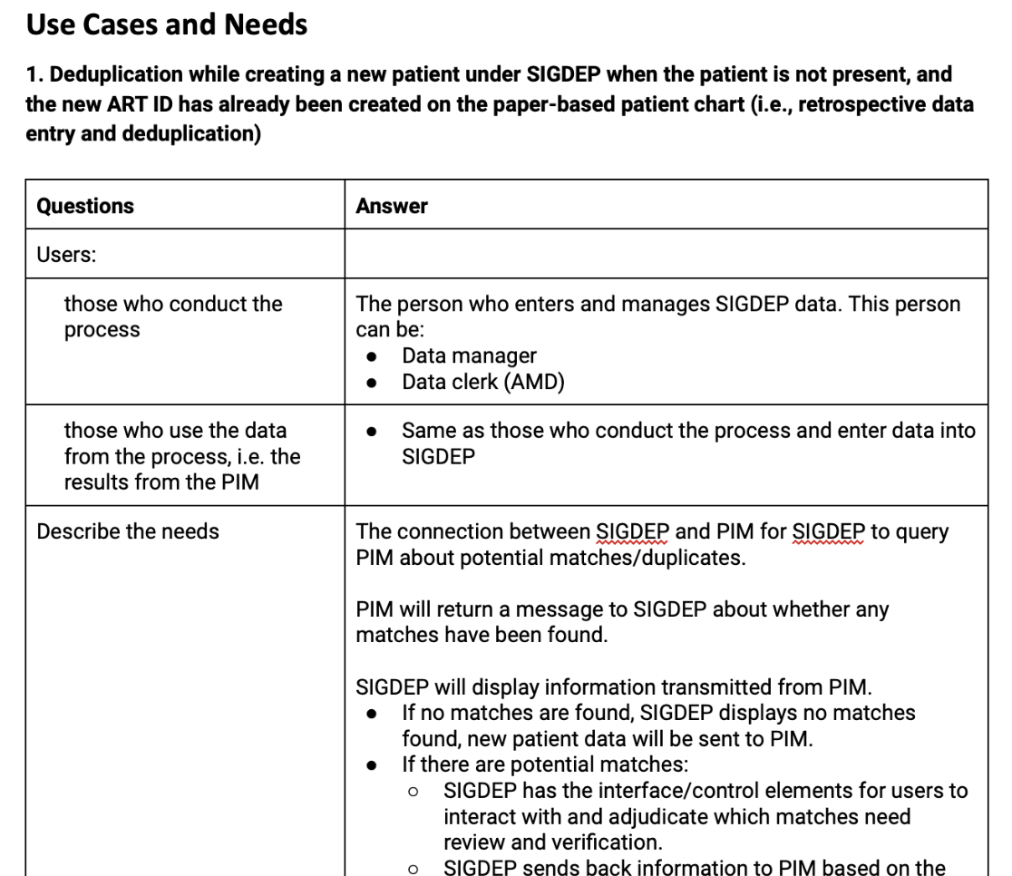
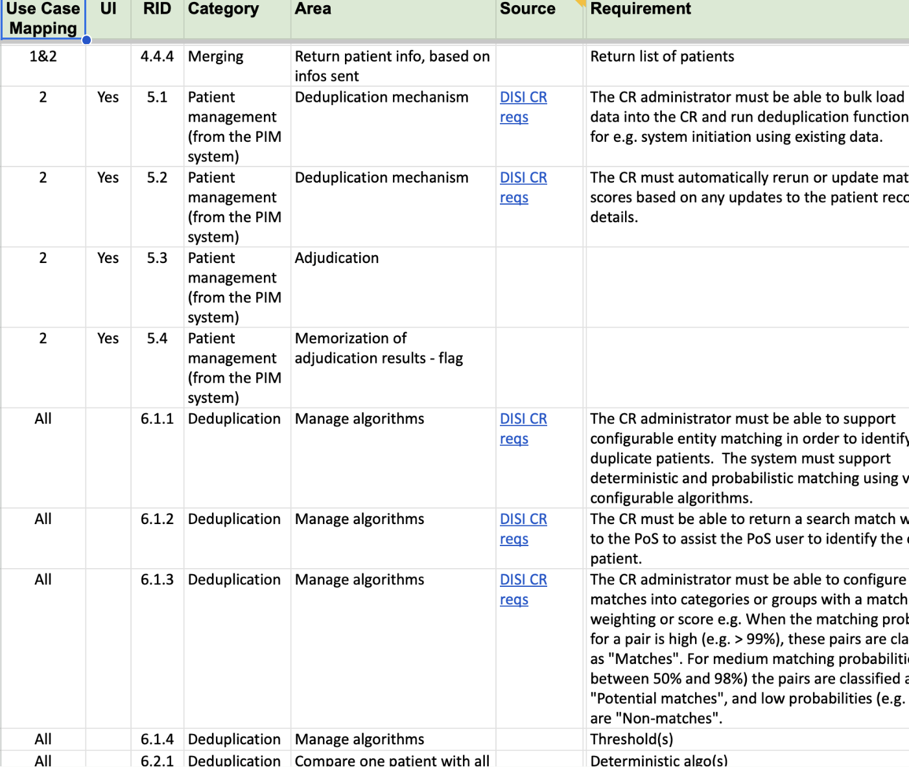
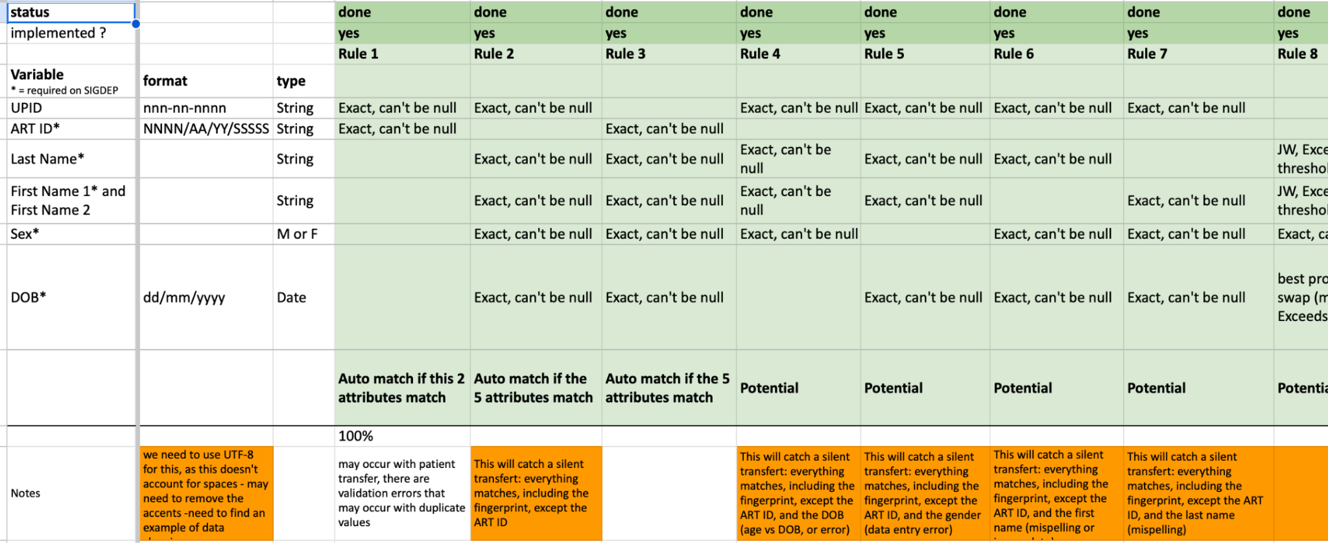
Outcomes and Impact
Use cases
Clarify use cases for
Understanding data
Making matching algorithms

Slide 15

Outcomes and Impact
OpenCR Presentation
https://drive.google.com/file/d/1C1iyWQaa1-FIVdjy9dtMlKkbUDaSxHJe/view?resourcekey

Slide 16
Outcomes and Impact
EMR (SIGDEP-3) User Interface presentation
https://drive.google.com/file/d/1GdLPsiP_4xs2vZvNDOK73DMmVEyWQWDB/view?resourcekey

Slide 17
Outcomes and Impact
Patient creation process updated
  Guide and training materials updated
  Checking before patient creation for potentials matching
Variables
  Patient status added on OpenCR data to help for adjudication

Slide 18
Challenges Faced
Delay to define important variables and algorithms
Constant update asked on User interface to prevent data confidentiality

Slide 19
Lessons learned
PEPFAR is a pioneer in helping MOH to create master patient registry. Whatever the system, we will able to uniquely identify the patient.
Start from existing data and informations
Define realistic variable
Have simple algorithms definition
Work closely with final users to understand practices, processes and define goals together to have real value

Slide 20
Next Steps
Conduct second pilot phase using PIM for patient creation from November 2024 to January 2025
Restitution of the pilot phase findings and improvement of the solution
Deployment of the upgrade version of SIGDEP-3/PIM across sites.
Configuration of OpenCR on a local MOH Server
Training of MOH staff to manage the PIM solution
Advocate to use of PIM solution to conduct deduplication in other MOH databases

Slide 21
Acknowledgement
Acknowledgement to :
Pr Samba Mamadou, DGS
Dr Pongathie, DIS
Mr. Blehiri, DISD
Pr Ehui, PNLS
CDC Senior Management Team
Nicolas De Kerorguen, CDC Atlanta
Nicoue Aime, CDC Côte d'Ivoire
Amani Jean Bernard, CDC Côte d'Ivoire
Côte d'Ivoire HMIS TWG

Slide 22
Q&A Session

