Slide 1

EVOLUTION AND USE OF NATIONAL SYSTEMS
UGANDANS AND AMERICAN
IN PARTNERSHIP TO FIGHT HIV/AIDS
PEPFAR
Leveraging National Systems for PEPFAR Reporting in Uganda
A Uganda Country Presentation to the Data Use Community
September 29, 2022

Slide 2
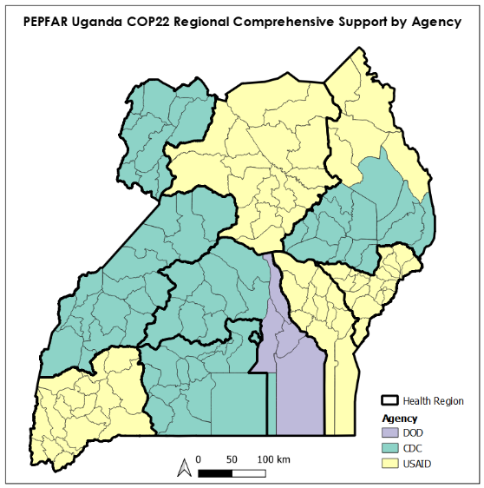
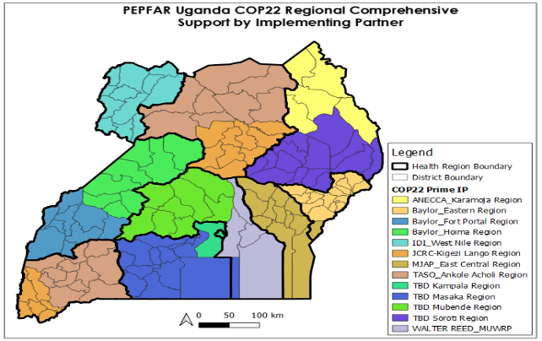
Background:COP22 support by Agency & Prime IM
CDC
USAID
USAID
CDC
CDC
CDC
USAID
DOD WRAIR
Additional mechanisms present across districts:
1) Uganda Prison Service (UPS)
2) Faith Based Organizations: Uganda Protestant Medical Bureau (UPMB) and Uganda Episcopal Conf (UEC)
3) Peace Corps
4) OVC mechanisms (IDI, TPO, Integrated Child Dev, Agency for Cooperation & Research in Dev, MUCOBADI, UG Women’s Efforts for Save Orphans, Youth Alive UG, RHITES SW)
5) MoH, KCCA, G2G mechanisms
6) Military
7) State UNHCR
USAID
CDC
Notes:
A quick snapshot here for PEPFAR regional support.

Slide 3
Alignment of Data Management and Reporting Periods
GOU and PEPFAR Reporting Period Alignment
Period |  | Reporting Systems
Start | End |  | PEPFAR | GOU
Jan-01 | Mar-31 |  | Q2 | Q3
Apr-01 | Jun-30 |  | Q3 | Q4
Jul-01 | Sep-30 |  | Q4 | Q1
Oct-01 | Dec-31 |  | Q1 | Q2

Slide 4
Aggregate data systems
System | Maintenance and administration | Reporting role | Obtainable PEPFAR report
NATIONAL DHIS2 | The Ministry of Health | HF and District staff | HF aggregate data
OVCMIS | Ministry of Gender | CSOs, District staff | OVC Data
PIRS | PEPFAR above Site M&E agent | IPs | Additional PEPFAR data
DATIM/DATIM4U | USG team | IPs/USG (Data import) | Reported indicator data

Slide 5
Other systems (aggregate & patient level)
System | Maintenance/administration | Reporting role | Obtainable PEPFAR data
DREAMS tracker | M&E agents | IPs | DREAMS data
KP tracker | M&E agents | IPs | KP data
EMR | MoH/M&E agent | HF staff
Lab Information System (LIS) dashboard | MoH/CPHL | CPHL staff | VL data EID Data
VMMC nerve center | M&E agent |  | VMMC AE
Notes:
VL dashboard is a component of the Lab Information System (LIS)

Slide 6
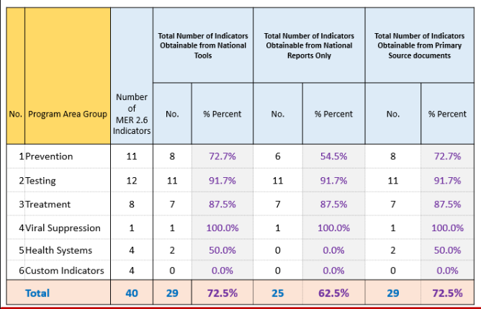
MER 2.6 Indicators Mapped to National Tools

Slide 7
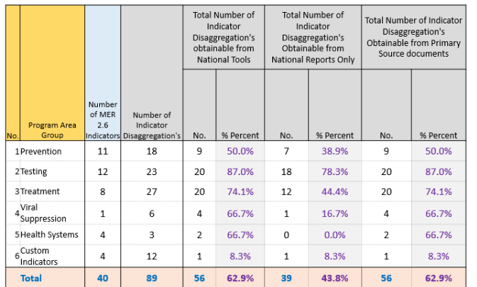
MER 2.6 Indicators Disaggregation Mapped to National Tools

Slide 8
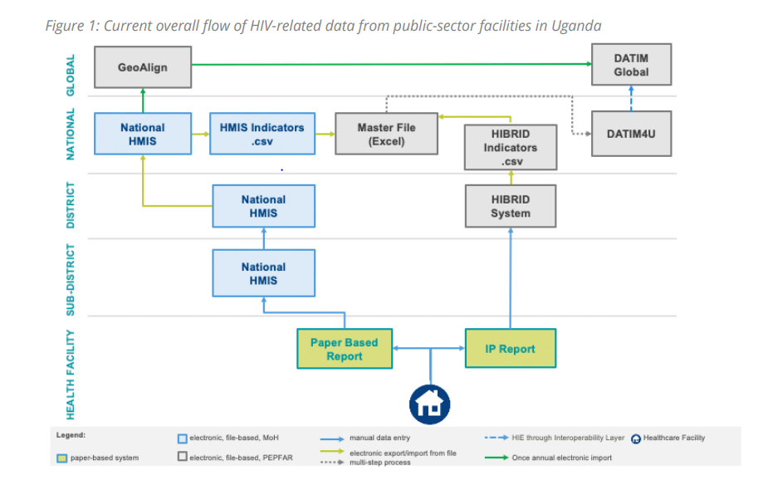
Current Data Management and Reporting Processes
Cleaning & Synchronization Tools
DAPTS
Monthly & Quarterly Reports
Pre-primary & Primary Tools; Registers

Slide 9
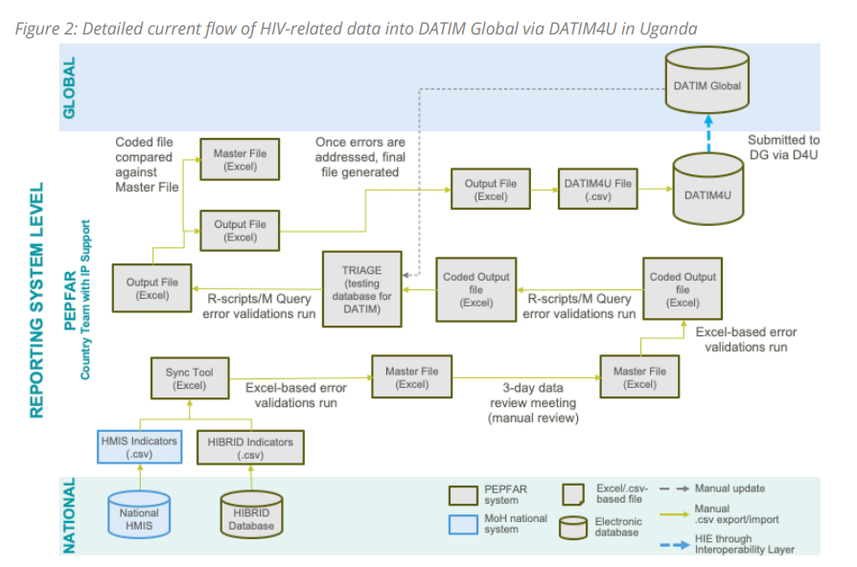
Current Data Management and Reporting Processes

Slide 10
Leveraging National Systems
Indicator Reporting Alignment and Consistency
Integration/alignment of national & PEPFAR requirements
Harmonization of Data collection and reporting tools
Harmonization of Data quality management processes and capacity building
Support to and Use national aggregate site level reporting system (The national system is the Gold standard)

Slide 11
Sub-Process Engagement & Leveraging of National Systems
PEPFAR Reporting Sub Processes
1. | Site Level Data Collection, Report Generation
Use of national tools at HFs Working with site level staff Routine IP engagement at site (with district team) Support to monthly and quarterly reports generation and review

Slide 12
Sub-Process Engagement & Leveraging of National Systems
PEPFAR Reporting Sub Processes
2. | Quarterly Data Cleaning
Collaborative data cleaning processes at HFs (engagement of IPs) Routine (monthly and quarterly cleaning at site & district levels) Standard quarterly cleaning (focusing on critical updates to the reports submitted in the National system)

Slide 13
Sub-Process Engagement & Leveraging of National Systems
PEPFAR Reporting Sub Processes
3. | PEPFAR Quarterly Indicator Data Generation, Synchronization & Report Aggregation
Generation of PEPFAR supported services data Using national system HF reports Using a PEPFAR tool (DAPTS). At the site level; By technical area; By IP

Slide 14
Sub-Process Engagement & Leveraging of National Systems
4. | Quarterly PEPFAR IP MER Data Feedback
- Based on the principal “ The National System is the Gold standard” If data is expected in the national system, it is either reported there or it is of not authentic

Slide 15
Sub-Process Engagement & Leveraging of National Systems
PEPFAR Reporting Sub Processes
5. | Narrative Writing and Submission
6. | PEPFAR Indicator Master File Generation; QA/QC; Coding
- These are PEPFAR specific sub-processes
7. | External Stakeholder Review and Feedback
MoH may review/query consistency with Nationally reported data CSOs may provide feedback after review of PEPFAR reported and national datasets
8. | PEPFAR Indicator Data Pre-submission Checks & Deduplication Process
- This is a PEPFAR specific sub-process

Slide 16
Gaps/Challenges/Issues
Alignment
Gaps in availability of PEPFAR requirements in national system lead to other options/approaches
Routine changes in PEPFAR requirements
Challenges:
Burden of reporting
Burden/cost of printing tools
Other System Issues
Incomplete process for patient unique identification

Slide 17
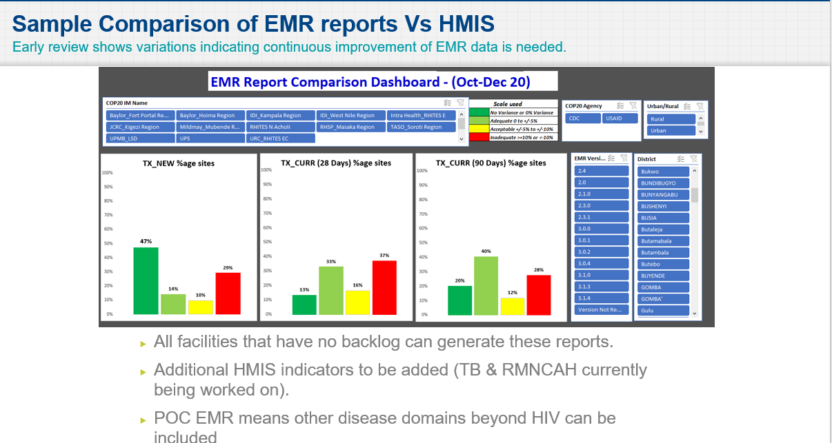
Looking Ahead : Strengthen Use of EMR

Slide 18
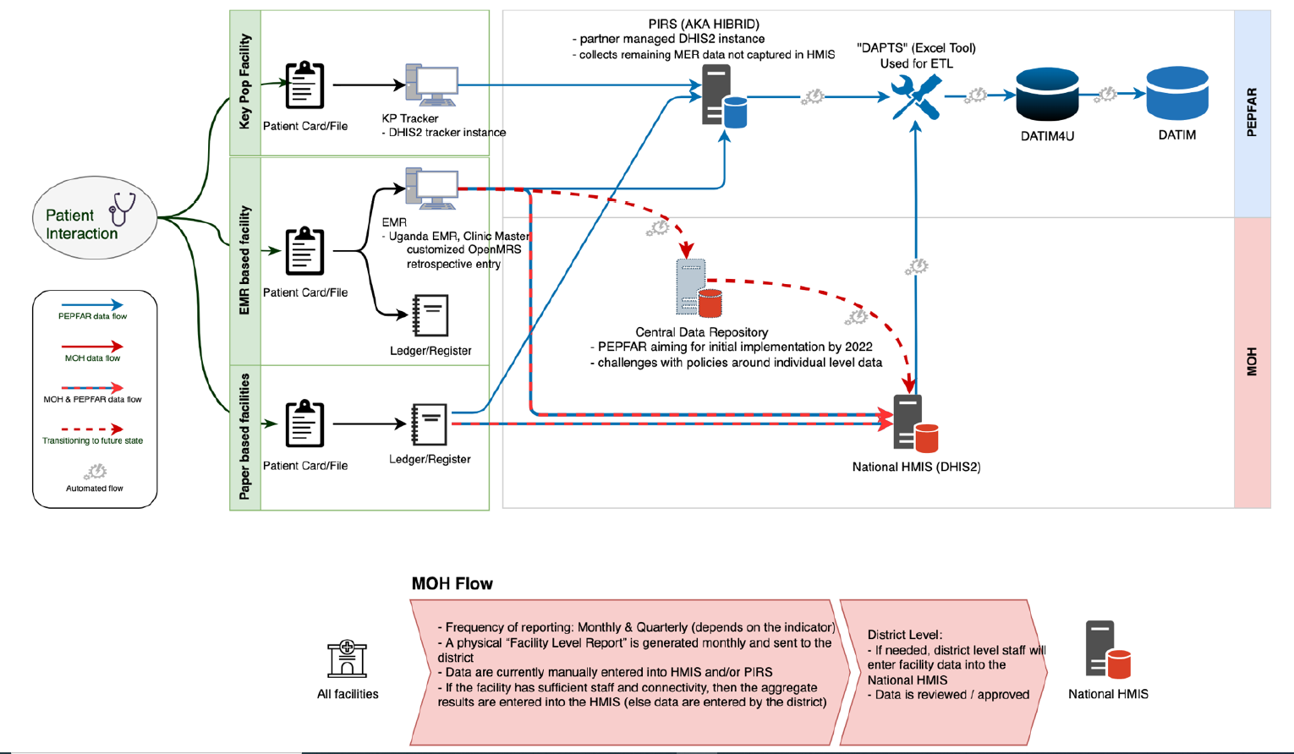
Looking Ahead : Systems Integration

Slide 19
Looking Ahead: HIS Interventions and Innovation
Reviews and roll out of in-country policies and procedures
Improve automation and remove redundancies
Build System integration approaches
Support/Expand interoperability

Slide 20
Looking Ahead: Consider WHO Guidance
The New guidance focuses on
Person centered/patient centric data
Longitudinal Monitoring
Sustainability
Strengthening digital health strategies

Slide 21
Questions/Discussion

