Slide 1

Finance & Insurance HIE
The Example of openIMIS
OHIN - 2024-04-03
The openIMIS Initiative

Slide 2
openIMIS - Introduction

Slide 3
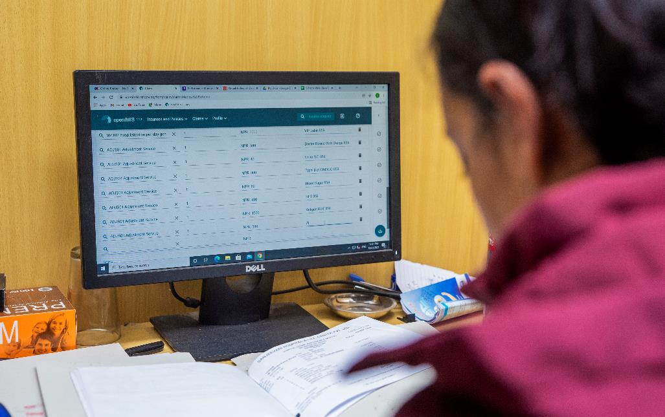
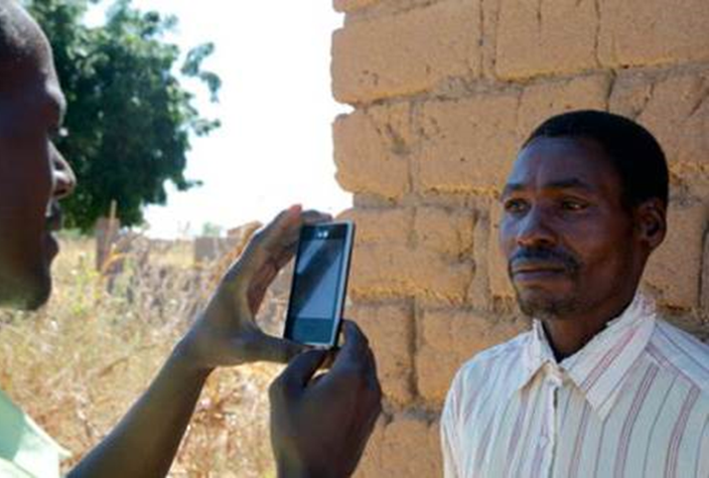
What is openIMIS?
DPG
openIMIS is an
open source software for manging social protection processes. It helps digitzing the link between beneficiaries, providers and payers of benefits.
It is supported by a
community of developers, users and implementers
With the joint mission to
Increase and improve universal health coverage (UHC) and universal social protection (USP)
Global Good

Slide 4
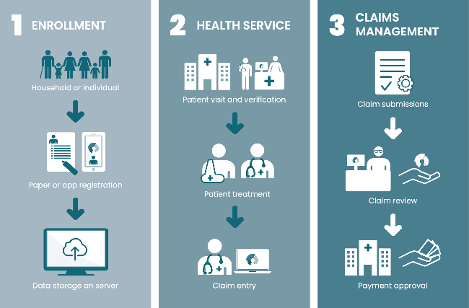


Health Insurance Solution powered by openIMIS
SERVICE UTIL
REIMBURSMENT
Also Employers!
Submit service details
BETTER REVIEW!
Review service details
AI assisted review of services
Record service details
Calculate capitation, payment amount

Slide 5


Interoperability using openIMIS
Standard Interface (e.g. HL7 FHIR)
Beneficiary Management Systems
Aa
Employer Data
Employee Data
Modules
Beneficiary management
Health Service Utilization
Electronic medical record systems
Banking/Payment
Systems
Claims
Feedback
Hospital
Reimbursement
Contribution
Collection
Claims Management
Insurance Scheme Definition
Data Analysis

Slide 6
openIMIS Interoperability
Standards & Networks

Slide 7






openIMIS Interoperability Standards
IHE
OpenHIE
(Health)
Convergence Initiative
(Social Protection)
openIMIS
OpenG2P
(Payment Layer)
GovStack
(Whole-of-Government)
existing standard
emerging standard

Slide 8
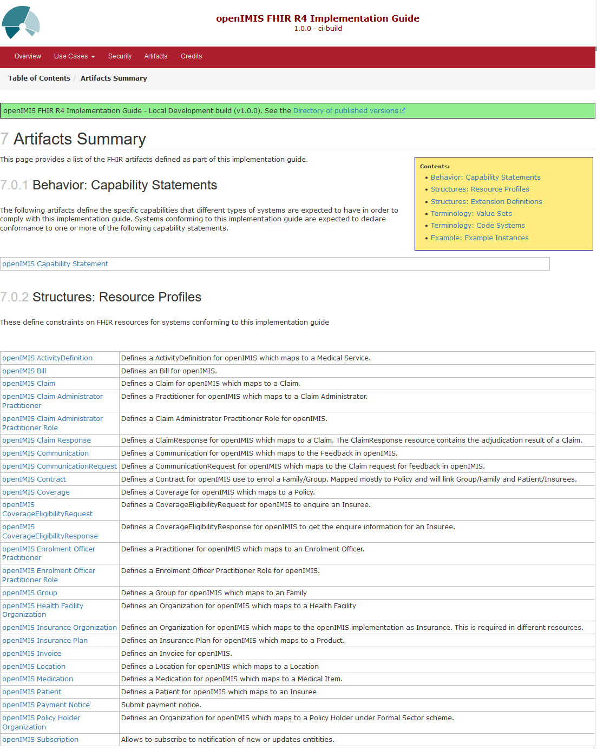
openIMIS Interoperability Options
FHIR APIs & implementation guide (https://fhir.openimis.org), e.g.
  Enrolment
  Claiming
plugin architecture for custom APIs
integration into GovStack
upcoming:
  APIs for Digital Convergence Initiative
  contribution to IHE
  openIMIS sandbox (tender coming)

Slide 9
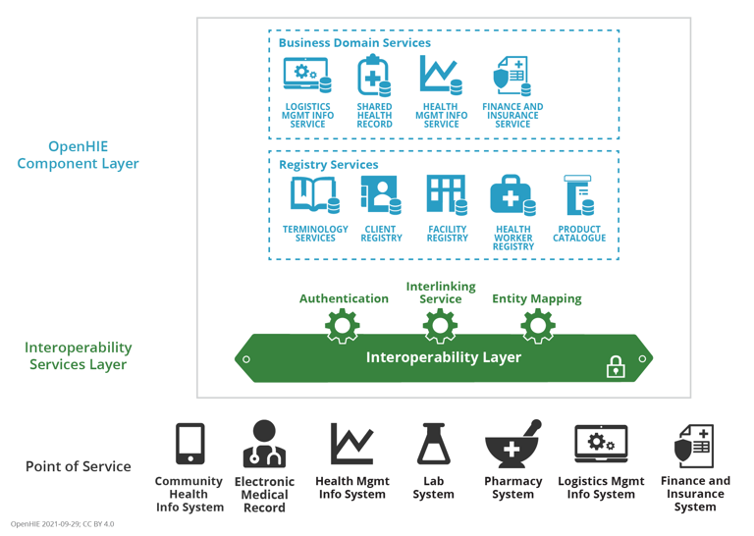

openIMIS in the OpenHIE Context
primary role as FIS
potential touchpoints to every other OpenHIE component
potential provider of central registry services due to normative nature of health financing schemes

Slide 10













Tools: Production & Proof of Concept
Civil Registration
Payment
External Systems
Custom Build

Slide 11
Interoperability in Action
Examples from the field

Slide 12
Map of Implementations
Mauritania
Chad
Niger
The Gambia
Burkina Faso
Nigeria
Ethiopia
Cameroon
Kenya
Bangladesh
Nepal
DRC
Tanzania
Laos
Malawi
openIMIS Implementations
openIMIS implementations in 12 countries for …
11 health financing (Tanzania, Cameroon, Nepal, DRC, Chad, The Gambia, Mauritania, Malawi, Nigeria) and
5 social protection schemes (Moldova, the Gambia, Nepal, Bangladesh, Niue).
As of March 2024, close to 16,4 million people are covered by openIMIS managed schemes.
Planning

Slide 13



openIMIS Implementation Cameroon
Impact
Type of scheme
Status: implemented (from 2013), on-going
Beneficiaries:
  UHC scheme: 3.000.000 enrolled beneficiaries (since 10/2023), potentially 28.000.000 nationwide
  BEPHA: 66,878 Adherents enrolled into the openIMIS, out of them 35,526 women = 53%
  HIV fee elimination scheme: 148,000 in 2 pilot regions
Bamenda Ecclesiastical Province Health Assistance (BEPHA): community based micro health insurance scheme, providing services through 140 hospitals
HIV Fee Elimination: program for the elimination of user fees for HIV treatment and services, providing testing and treatment services from 3043 health facilities with 95 piloting the openIMIS
Chèque Santé: a national voucher scheme for maternal and child health
Health care purchasing scheme for IDPs and vulnerable persons in 4 Regions
EduCash: a conditional cash transfer scheme to support children of targeted households for their education
In the pipeline:
Ministry of Social Affairs to use openIMIS as a National Beneficiary Registry
Operator
Ministry of Public Health – UHC scheme
Micro health insurance scheme - Bamenda Ecclesiastical Province Health Assistance (BEPHA)
HIV fee elimination scheme – The Regional Fund for Health Promotion, MoPH
Special aspects of implementation
Standards based digital tool (openIMIS) allowed for a National UHC Scheme, incorporating diverse, multiple health financing schemes.
Implementation: Funding: BMZ, SDC, Misereor, AFD GIZ, UNFPA, AFD On the ground: Y-Note & SwissTPH

Slide 14






Tooling in Cameroon
CHC
Civil Registration
Payment
External Systems
DAMA
Custom Build
2024-04-03
openIMIS Interoperability

Slide 15

openIMIS Implementation The Gambia
Impact
Type of scheme
Status: Implemented for cash transfer (2020)
National Health Insurance – software ready
Beneficiaries:
  National Health Insurance scheme, potentially 3 Mio beneficiaries
  Cash transfer to 83.000 households in 30 of the poorest districts, with 6-8 members per household (30% of Gambian population
National Health Insurance
Nafa quick (cash transfer): money transfer system in rapid response to the COVID-19 crisis
Operator
National Health Insurance, under MoH
National Nutrition Agency (NaNA) Together with Department of Community Development, Ministry of Lands and Regional Government & Department for Social Welfare of the Ministry of Women, Children and Social Welfare
Special aspects of implementation
First openIMIS implementation in social protection systems other than health, demand-driven: ideation
and initiation of openIMIS
use from 2M Corp.
Population coverage
‘Nafa quick’ 30%
‘Nafa money’ +40% planned
of the overall
Population (2 Mio)
Implementation: NaNA, MoH Funding: MoH (World Bank)
On the ground: 2M Corp, BlueSquare

Slide 16
Tooling in The Gambia
Civil Registration
Payment
External Systems
Custom Build

Slide 17

openIMIS Implementation Nepal
Impact
Type of scheme
Status: implemented (from 2016), on-going
Beneficiaries
  Social Health Insurance (HIB): 7,7 Mio, 52% women
  Social Security (SSF): 490,000
Health services have been provided to 1,505,698 beneficiaries through HIB
458 empaneled health facilities (HIB), 126 (SSF)
accelerated claims management through openIMIS AI claims adjudication module (HIB receives 25.000 claims/day)
HIB: Voluntary Social Health Insurance scheme, targeting the informal sector. Coverage for all levels of health service.
SSF: Mandatory health and accident injury insurance scheme for formal sector employees.
Operator(s)
Health Insurance Board (HIB), Social Security Fund (SSF)
Role in the community
Users
HIB has been part of openIMIS community since 2016 – sharing experiences + knowledge with wider community; uses community as platform for exchange and regularly reports on updates
close collaboration with regional hub AeHIN
hosting ‘study tours’ for potential users - Cambodia 2018, Pakistan 2019, Cameroon & Nigeria 2019
HIB 8.000 users, SSF 120 users
over 750 health facility personnel
140 HIB staff
24 claims review
3 IT officers at HIB
Implementation: GIZ Nepal, ILO Funding: BMZ, SDC
On the ground: SwissTPH + BlueSquare + Tinker Tech

Slide 18
Tooling in Nepal
Civil Registration
Payment
External Systems
Custom Build

Slide 19

openIMIS Implementation Tanzania (mainland)
Impact
Type of scheme
Status: implemented (from 2012), on-going
Beneficiaries (as of 04/2023):
  5,907,290 individuals or 1,258,168 households insured
  56% insured individuals are women and
  54% household heads are women
Significant gains achieved in
  Overall scheme efficiency
  Improving data quality
  Simplified decision-making processes
  Fund management
Improved Community-Health Fund: community-based health insurance, providing services from 6,400 health facilities; targeting informal sector, set up as cost contributory scheme for public health system, Low cost premium (now 30K for upto family of 6 outside of Dar)
Operator
President’s Office Regional Administration and Local Government (PORALG)
Geographical coverage
iCHF: All (26) regions in the mainland Tanzania are now using openIMIS 100%
Users
Role in the community
About 22,000 users = staff at scheme
operator and health facilities
About 21,800 enrolment officers with access to and can submit enrolment data in IMIS
Contribution of new developments (main contributor for new features on legacy version), Knowledge Sharing, Testing of releases, Feature requests
Implementation: Swiss TPH Funding: SDC
On the ground: Swiss TPH, Tanzania (HPSS project)

Slide 20
Tooling in Tanzania
Civil Registration
Payment
External Systems
Custom Build

