Slide 1

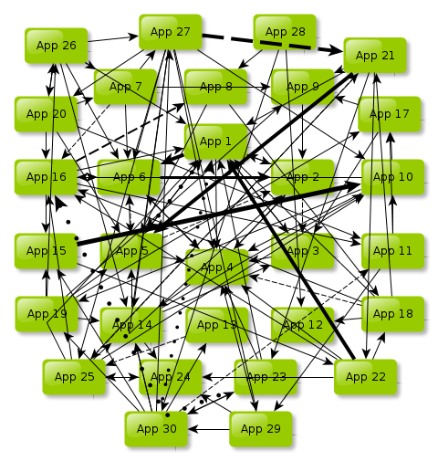
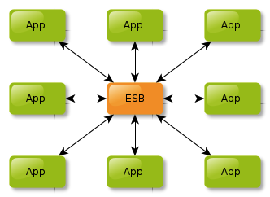
OCL Collaborative
Terminology Management
May 6, 2015
OpenHIE Terminology Services Community
Jonathan Payne, MS
Sr. Technical Advisor, United Nations Foundation
Director, Open Concept Lab
Adjunct, Boston University School of Public Health
paynejd@gmail.com
Open Concept Lab
Notes:
OCL’s value proposition to selected markets (e.g. OHIE, OMRS, etc.)
Where are we positioned in the TS/Content space?
How does OCL fit into the OHIE/OMRS ecosystem?
Functionality, etc.
OCL is (almost) ready to use!
Get users started…process, documentation, etc.
We will reach out for your feedback after you’ve gotten the chance to test run it
OCL’s model
Proposed subscription model
Open-source
Make it clear that OCL will provide a valuable service that cannot survive without support (e.g. show the high number of expected initial users relative to those willing to pay)
Consortium (?)

Slide 2

Columbia International eHealth Laboratory:
Interface Terminology Dictionary
Developed to support multi-country health data collection & reporting for Millennium Villages Project
~50k interface concepts covering primary care, maternal health, oncology, etc.
Maps to ICD-10, SNOMED CT, LOINC, ICPC, CPT, RxNorm provided, in part, by Intelligent Medical Objects (IMO)
Maps to AMPATH and PIH dictionaries
200+ subscribers, 100+ implementations, 20+ countries
CIEL dictionary packaged by default with OpenMRS v1.9+
New concepts submitted by users via email to CIEL for curation and addition to the dictionary
New dictionary versions released approximately monthly

Slide 3
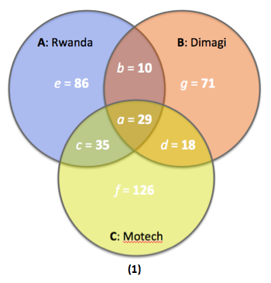
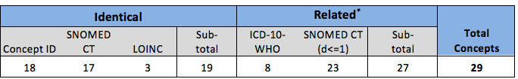
Core Dataset Engineering Example
Notes:
Top-down Approach
Bottom-up Approach -

Slide 4
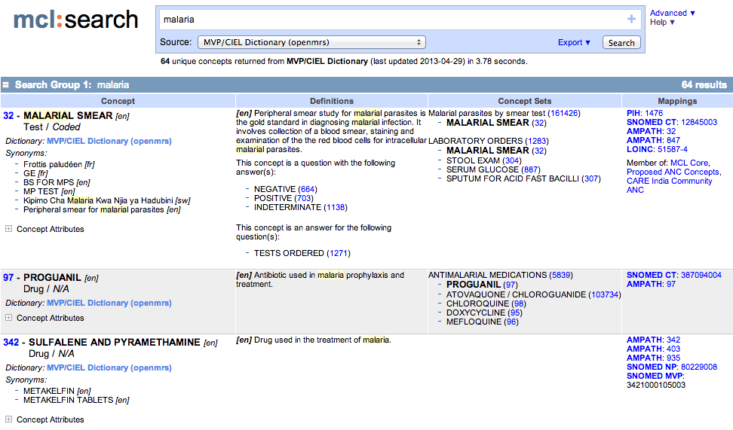
http://www.maternalconceptlab.com/search.php
Notes:
Goal: Improve ACCESS to standardized terminology
1000s of uses each year from 30+ countries

Slide 5
Lessons learned from MCL
There is high demand and need for improved access to curated terminology sources (i.e. CIEL)
Access is really important—but not nearly sufficient
Transparent, participatory process for proposing, reviewing, and adopting new content is needed
Local terminology service often not practical and often not required among LMIC implementations
Cloud-based tooling to facilitate terminology management and governance addresses one of the biggest challenges to data interoperability

Slide 6
What is Collaborative Terminology Management?
Access to Content – Search and browse existing terminology dictionaries (e.g. CIEL, ICD-10, SNOMED CT)
Create New Sources – Create and manage your own sources of concepts and mappings (e.g. PIH)
Build Collections – Create and manage collections of concepts and mappings from across sources (e.g. value sets, subsets, etc.)
Collaborate – collaborate with other users through organizations
Community Content – view and reuse “community content” (concepts, sources, collections, mappings, etc.) – don’t reinvent the wheel!
Exports – export content in common formats (e.g. JSON)
Open API – all operations based on the API
OpenMRS Subscription – subscribe to a source in OpenMRS using the OCL Subscription Module
Cloud-based – no need to setup a local server
Versioning – all edits to sources/concepts are versioned, just like GitHub
Indicators – single platform for both terminology and indicators
WARNING: A lot of this is still aspirational!

Slide 7
OCL Use Cases – Part 1
1. Clinician-led implementation of OpenMRS at a small number of clinics
  Access to CIEL dictionary
  Easy and automated subscription to updates
  Access to a community of users and existing subsets
  Ability to maintain integrity of local concepts when updating to latest version of a dictionary
  Cloud-based server – do not want to setup more software
2. Academic Researcher harmonizing maternal health registries from multiple countries to develop, publish and validate a maternal health core dataset
  Access to reference terminologies
  Maps between reference and interface terminologies to facilitate comparisons
  Ability to manage collections of terms from one or more standard sources
  Ability to create indicators with links to the terms
  Ability to digitally publish a core dataset

Slide 8
OCL Use Cases – Part 2
3. M&E Officer or Data Manager responsible for managing, streamlining and deploying data dictionaries and indicator definitions for an organization that directly supports care delivery, possibly in multiple countries.
  Ability to create custom dictionaries with custom concepts and mappings
  Ability to collaboratively manage collections of terms from multiple custom and reference sources
  Ability to export and subscribe to custom collections of terms in multiple formats
  Support for users to propose modifications and new terms
  Ability to maintain multiple versions of sources and concepts
  API to interface with other digital health information systems
4. Medical Informatics Officer at a healthcare enterprise (i.e. ministry of health, integrated delivery network) that supports governance of multiple enterprise-wide data dictionaries and indicator sets across many healthcare domains. Terminological resources are consumed by numerous entities within and outside of the direct control of the enterprise in variety of paper and digital formats.
  Service level agreement for support, including importing dictionaries and turnaround time for new curated interface terms, as appropriate (e.g. CIEL)
  Sandboxed enterprise workspace
  Role-based user and group management

Slide 9
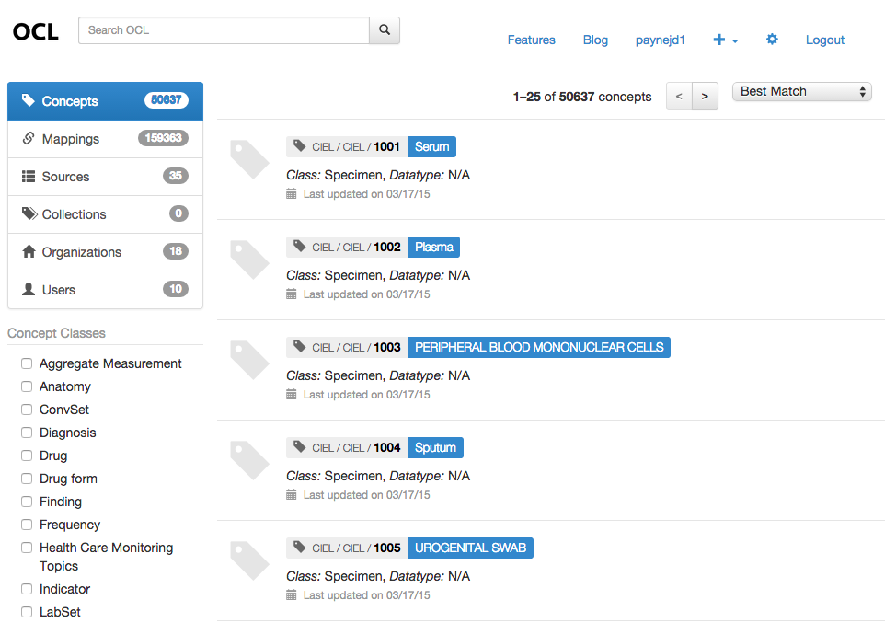
www.openconceptlab.org

Slide 10
OCL API
DOCUMENTATION: https://github.com/OpenConceptLab/oclapi/wiki/
ENDPOINT: http://api.openconceptlab.org/
EXAMPLES:
Top-level resources:
  http://api.openconceptlab.org/users/
  http://api.openconceptlab.org/user/
  http://api.openconceptlab.org/orgs/
Sources:
  http://api.openconceptlab.org/[owner]/sources/
  http://api.openconceptlab.org/users/[user]/sources/
  http://api.openconceptlab.org/orgs/[org]/sources/
Concepts:
  http://api.openconceptlab.org/[owner]/sources/[source]/concepts/
  http://api.openconceptlab.org/concepts/
  http://api.openconceptlab.org/orgs/CIEL/sources/CIEL/concepts/
  http://api.openconceptlab.org/orgs/CIEL/sources/CIEL/concepts/123/
Source and Concept Versions:
  http://api.openconceptlab.org/orgs/CIEL/sources/CIEL/v1.2/concepts/123/
  http://api.openconceptlab.org/orgs/CIEL/sources/CIEL/concepts/123/[version_number]/
Mappings:
  http://api.openconceptlab.org/[owner]/sources/[source]/mappings/
  http://api.openconceptlab.org/orgs/CIEL/sources/CIEL/mappings/
  http://api.openconceptlab.org/mappings/
Export:
  http://api.openconceptlab.org/orgs/CIEL/sources/CIEL/export/

Slide 11
OpenMRS Subscription
OCL Subscription
Module
OCL API
Open Concept
Lab
Open
MRS
Subscription Process
Create OCL user to get an OCL API token
Install OCL Subscription Module in your OpenMRS instance and configure to subscribe to a specific source
On first synchronization, pulls entire dictionary
On subsequent synchronization, pulls latest changes only (e.g. new concepts, updates, deletes, retires)
Does NOT overwrite local concepts or concept metadata (based on concept and concept metadata UUIDs)

Slide 12
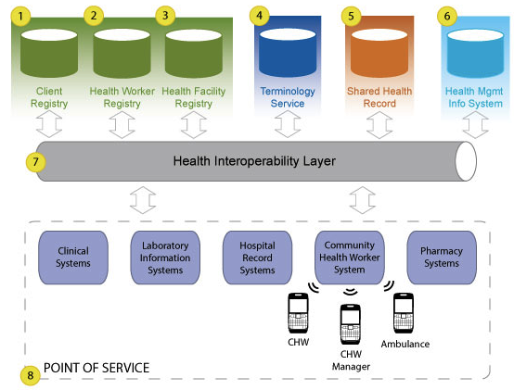
OpenHIE and Terminology
Management
Terminology Management Service
1
1
OCL as source of content for the TS.
Requires local TS.
Appropriate for high-volume, real-time transactions (e.g. code validation, lookups, transformations, etc.).
2
2
OCL provides canonical source(s) to HIE, subscription service, & collaborative management tool.
NOT for real-time, high-volume transactions.
Alleviates need for local service.
Notes:
Vocabulary is the single most important component for interoperability

Slide 13
Proposed OCL Sustainability Model
 | FREE | BASIC | PREMIUM | ENTERPRISE
Target | Existing CIEL User-base | Researchers, harmonization, terminology geeks | Dictionary managers, e.g. AMPATH and PIH | Governments or institutions managing terminology as a core service; require guaranteed level of service
Features | Access to all OCL functionality for CIEL dictionary only Limits on the number of subsets you can create/manage OpenMRS Subscription to CIEL dictionary Includes access to CIEL community content Limited API access | Access to major terminology sources in addition to CIEL (ICD-10, LOINC, SNOMED, etc.) No limit on collections | Create your own sources Full API Access | Guaranteed level of service for terminology curation Assistance importing local/proprietary terminology sources Configuration of organizational workspace Additional training and services available
Initial User Base | OpenMRS + CIEL Subscriptions: >100 MCL: 16k lookups/searchers; 2k unique visitors in last year | THRIVE/WHO | Partners In Health | Kenya Ministry of Health

Slide 14
Proposed Roadmap
2015 Q2
OCL Launch!
Basic functionality complete:
  Full-text search
  Create users and organizations
  Build your own sources and create/edit concepts and mappings
  Export of sources using AWS
CIEL dictionary imported
All functionality implemented through APIs
OpenMRS subscription to a single source (e.g. CIEL dictionary)
2015 Q3
Friendlier user interface
Optimized search (e.g. better weighting of search terms to improve likelihood of finding the correct result)
Full support for creating and managing collections (i.e. references to concepts from other sources)
Import WHO ICD-10 source
CIEL transition to managing dictionary on OCL instead of in OpenMRS
Secured access to OCL website and API (e.g. https encryption)
Stability and performance improvements (esp. imports, exports)
Potential Future Features
Import additional sources, including SNOMED CT, LOINC
RSS feeds of changes to sources, collections, and concepts
Social functionality
Improved organization management - better control of access to content for members of an organization
Ability for users to "star" sources, collections, and concepts
Collection/source comparisons
Ability for users to "follow" organizations or other users
FHIR API compatibility

Slide 15
Getting Started with OCL
http://www.openconceptlab.org/
Documentation:
  User Docs: https://github.com/OpenConceptLab/ocl_web/wiki
  API Docs: https://github.com/OpenConceptLab/oclapi/wiki
Submit bugs:
  Website: https://github.com/OpenConceptLab/ocl_web/issues
  API: https://github.com/OpenConceptLab/oclapi/issues
  Email me at paynejd@gmail.com
Listservs
  Developers: https://groups.google.com/forum/#!forum/ocl-dev
  Users/Implementers: https://groups.google.com/forum/#!forum/ocl-users
Specific Areas for Feedback
  API Specs and Exports
  Sustainability models
  Roadmap & Killer Use Cases
  User Experience

Slide 16
Open Concept Lab: Resources
May 2015

Slide 17
OCL Resources
Resource | Example Name | Example Mnemonic / Short Code | Example URL
Users | John Doe | johndoe | /users/johndoe/
Organizations | My Standards Development Organization | MySDO | /orgs/MySDO/
Sources | Standardized Nomenclature for Vegetable Terms | SNOVEG | /orgs/MySDO/sources/SNOVEG/
Concepts | Carrot | 1094893 | /orgs/MySDO/sources/SNOVEG/concepts/1094893/
Mappings | (Carrot) [YUMMIER THAN] (Celery) | uuid | /orgs/MySDO/sources/SNOVEG/mappings/[uuid]/
Collections | Oncology Core Dataset | CoreOncology | /orgs/MySDO/collections/CoreOncology/

Slide 18
Versioning of Sources and Concepts
Updated: May 2015

Slide 19
Versioning of Sources and Concepts
Actions:
Org: MySDO
Source: RainMED
7. New concept
RainMED:2962
6. Update concepts
5. New version 1.0
4. New concept
RainMED:150198
47tj
x6h3
dm83
w8fr
bg35
3. New concept
RainMED:26091
df38
ac61
2. New concept
RainMED:1234
Version 1.0
h83i
5hk9
d938
1. New source
RainMED
1234
26091
150198
2962

Slide 20
Versioning of Sources and Concepts
Actions:
Request:
GET /orgs/MySDO/sources/RainMED/concepts/
Concepts:
MySDO:RainMED:1234[47tj]
MySDO:RainMED:26091[x6h3]
MySDO:RainMED:150198[dm83]
MySDO:RainMED:2962[bg35]
Org: MySDO
Source: RainMED
7. New concept
RainMED:2962
6. Update concepts
5. New version 1.0
4. New concept
RainMED:150198
47tj
x6h3
dm83
w8fr
bg35
3. New concept
RainMED:26091
df38
ac61
2. New concept
RainMED:1234
Version 1.0
h83i
5hk9
d938
1. New source
RainMED
1234
26091
150198
2962

Slide 21
Versioning of Sources and Concepts
Actions:
10. Update concepts
9. New version 1.1
8. Update concept
RainMED:2962
Org: MySDO
Source: RainMED
7. New concept
RainMED:2962
6. Update concepts
B70v
n8f3
5. New version 1.0
Version 1.1
4. New concept
RainMED:150198
47tj
x6h3
dm83
1d35
w8fr
bg35
3. New concept
RainMED:26091
df38
ac61
2. New concept
RainMED:1234
Version 1.0
h83i
5hk9
d938
1. New source
RainMED
1234
26091
150198
2962

Slide 22
Versioning of Sources and Concepts
Actions:
Request:
GET /orgs/MySDO/sources/RainMED/concepts/
Concepts:
MySDO:RainMED:1234[B70v]
MySDO:RainMED:26091[x6h3]
MySDO:RainMED:150198[dm83]
MySDO:RainMED:2962[n8f3]
10. Update concepts
9. New version 1.1
8. Update concept
RainMED:2962
Org: MySDO
Source: RainMED
7. New concept
RainMED:2962
6. Update concepts
B70v
n8f3
5. New version 1.0
Version 1.1
4. New concept
RainMED:150198
47tj
x6h3
dm83
1d35
w8fr
bg35
3. New concept
RainMED:26091
df38
ac61
2. New concept
RainMED:1234
Version 1.0
h83i
5hk9
d938
1. New source
RainMED
1234
26091
150198
2962

Slide 23
Versioning of Sources and Concepts
Actions:
Request:
GET /orgs/MySDO/sources/RainMED/1.0/concepts/
Concepts:
MySDO:RainMED:1234[h83i]
MySDO:RainMED:26091[5hk9]
MySDO:RainMED:150198[d938]
10. Update concepts
9. New version 1.1
8. Update concept
RainMED:2962
Org: MySDO
Source: RainMED
7. New concept
RainMED:2962
6. Update concepts
B70v
n8f3
5. New version 1.0
Version 1.1
4. New concept
RainMED:150198
47tj
x6h3
dm83
1d35
w8fr
bg35
3. New concept
RainMED:26091
df38
ac61
2. New concept
RainMED:1234
Version 1.0
h83i
5hk9
d938
1. New source
RainMED
1234
26091
150198
2962

Slide 24
Versioning of Sources and Concepts
Actions:
Request:
GET /orgs/MySDO/sources/RainMED/1.1/concepts/
Concepts:
MySDO:RainMED:1234[47tj]
MySDO:RainMED:26091[x6h3]
MySDO:RainMED:150198[dm83]
MySDO:RainMED:2962[1d35]
10. Update concepts
9. New version 1.1
8. Update concept
RainMED:2962
Org: MySDO
Source: RainMED
7. New concept
RainMED:2962
6. Update concepts
B70v
n8f3
5. New version 1.0
Version 1.1
4. New concept
RainMED:150198
47tj
x6h3
dm83
1d35
w8fr
bg35
3. New concept
RainMED:26091
df38
ac61
2. New concept
RainMED:1234
Version 1.0
h83i
5hk9
d938
1. New source
RainMED
1234
26091
150198
2962

Slide 25
Versioning of Sources and Concepts
Actions:
Request:
GET /orgs/MySDO/sources/RainMED/1.1/concepts/150198/
Concepts:
MySDO:RainMED:150198[dm83]
10. Update concepts
9. New version 1.1
8. Update concept
RainMED:2962
Org: MySDO
Source: RainMED
7. New concept
RainMED:2962
6. Update concepts
B70v
n8f3
5. New version 1.0
Version 1.1
4. New concept
RainMED:150198
47tjd
x6h3
dm83
1d35
w8fr
bg35
3. New concept
RainMED:26091
df38
ac61
2. New concept
RainMED:1234
Version 1.0
h83i
5hk9
d938
1. New source
RainMED
1234
26091
150198
2962

Slide 26
Versioning of Sources and Concepts
Actions:
Request:
GET /orgs/MySDO/sources/RainMED/1.0/concepts/150198/
Concepts:
MySDO:RainMED:150198[dm83]
10. Update concepts
9. New version 1.1
8. Update concept
RainMED:2962
Org: MySDO
Source: RainMED
7. New concept
RainMED:2962
6. Update concepts
B70v
n8f3
5. New version 1.0
Version 1.1
4. New concept
RainMED:150198
47tjd
x6h3
dm83
1d35
w8fr
bg35
3. New concept
RainMED:26091
df38
ac61
2. New concept
RainMED:1234
Version 1.0
h83i
5hk9
d938
1. New source
RainMED
1234
26091
150198
2962

Slide 27
Versioning of Sources and Concepts
Actions:
Request:
GET /orgs/MySDO/sources/RainMED/concepts/150198/
Concepts:
MySDO:RainMED:150198[dm83]
Notes:
Omitting the source version always refers to the latest version the concepts in the source
10. Update concepts
9. New version 1.1
8. Update concept
RainMED:2962
Org: MySDO
Source: RainMED
7. New concept
RainMED:2962
6. Update concepts
B70v
n8f3
5. New version 1.0
Version 1.1
4. New concept
RainMED:150198
47tjd
x6h3
dm83
1d35
w8fr
bg35
3. New concept
RainMED:26091
df38
ac61
2. New concept
RainMED:1234
Version 1.0
h83i
5hk9
d938
1. New source
RainMED
1234
26091
150198
2962
Notes:
Note: if we like this modeling, then we can probably just get rid of the “latest” magic keyword, since omitting it results in the same thing, plus allows us to grab specific concept versions

Slide 28
Versioning of Sources and Concepts
Actions:
Request:
GET /orgs/MySDO/sources/RainMED/concepts/150198/w8fr/
Concepts:
MySDO:RainMED:150198[w8fr]
Notes:
Get a specific version of a concept without considering source versioning. This is the only way to get a prior version of a concept that is not part of a source version.
10. Update concepts
9. New version 1.1
8. Update concept
RainMED:2962
Org: MySDO
Source: RainMED
7. New concept
RainMED:2962
6. Update concepts
B70v
n8f3
5. New version 1.0
Version 1.1
4. New concept
RainMED:150198
47tjd
x6h3
dm83
1d35
w8fr
bg35
3. New concept
RainMED:26091
df38
ac61
2. New concept
RainMED:1234
Version 1.0
h83i
5hk9
d938
1. New source
RainMED
1234
26091
150198
2962

Slide 29
Versioning of Sources and Concepts
Actions:
13. New version 1.2
12. Update concepts
11. Retire concept
RainMED:150198
10. Update concepts
Org: MySDO
Source: RainMED
9. New version 1.1
8. Update concept
RainMED:2962
7. New concept
RainMED:2962
Version 1.2
xy19
x6h3
mP42
n8f3
6. Update concepts
B70v
n8f3
5. New version 1.0
Version 1.1
47tjd
x6h3
dm83
1d35
4. New concept
RainMED:150198
w8fr
bg35
3. New concept
RainMED:26091
df38
ac61
2. New concept
RainMED:1234
Version 1.0
h83i
5hk9
d938
1. New source
RainMED
1234
26091
150198
2962

Slide 30
Versioning of Sources and Concepts
Actions:
Request:
GET /orgs/MySDO/sources/RainMED/concepts/
Concepts: (Note that retired 150198 is excluded unless the “includeRetired” parameter is set to true)
MySDO:RainMED:1234[xy19]
MySDO:RainMED:26091[x6h3]
MySDO:RainMED:2962[n8f3]
13. New version 1.2
12. Update concepts
11. Retire concept
RainMED:150198
10. Update concepts
9. New version 1.1
Org: MySDO
Source: RainMED
8. Update concept
RainMED:2962
7. New concept
RainMED:2962
Version 1.2
xy19
x6h3
mP42
n8f3
6. Update concepts
B70v
n8f3
5. New version 1.0
Version 1.1
47tjd
x6h3
dm83
1d35
4. New concept
RainMED:150198
w8fr
bg35
3. New concept
RainMED:26091
df38
ac61
2. New concept
RainMED:1234
Version 1.0
h83i
5hk9
d938
1. New source
RainMED
1234
26091
150198
2962

Slide 31
Versioning of Sources and Concepts
Actions:
Request:
GET /orgs/MySDO/sources/RainMED/1.2/concepts/
Concepts: (Note that retired 150198 is excluded unless the “includeRetired” parameter is set to true)
MySDO:RainMED:1234[xy19]
MySDO:RainMED:26091[x6h3]
MySDO:RainMED:2962[n8f3]
13. New version 1.2
12. Update concepts
11. Retire concept
RainMED:150198
10. Update concepts
9. New version 1.1
Org: MySDO
Source: RainMED
8. Update concept
RainMED:2962
7. New concept
RainMED:2962
Version 1.2
xy19
x6h3
mP42
n8f3
6. Update concepts
B70v
n8f3
5. New version 1.0
Version 1.1
47tjd
x6h3
dm83
1d35
4. New concept
RainMED:150198
w8fr
bg35
3. New concept
RainMED:26091
df38
ac61
2. New concept
RainMED:1234
Version 1.0
h83i
5hk9
d938
1. New source
RainMED
1234
26091
150198
2962

Slide 32
Versioning of Sources and Concepts
Actions:
Request:
GET /orgs/MySDO/sources/RainMED/concepts/150198/
Concepts: (retired concept is returned since requested explicitly)
MySDO:RainMED:1234[mP42]
13. New version 1.2
12. Update concepts
11. Retire concept
RainMED:150198
10. Update concepts
9. New version 1.1
Org: MySDO
Source: RainMED
8. Update concept
RainMED:2962
7. New concept
RainMED:2962
Version 1.2
xy19
x6h3
mP42
n8f3
6. Update concepts
B70v
n8f3
5. New version 1.0
Version 1.1
47tjd
x6h3
dm83
1d35
4. New concept
RainMED:150198
w8fr
bg35
3. New concept
RainMED:26091
df38
ac61
2. New concept
RainMED:1234
Version 1.0
h83i
5hk9
d938
1. New source
RainMED
1234
26091
150198
2962

Slide 33
Mappings Scenarios
Updated: May 2015

Slide 34
Mapping Scenarios based on CIEL:116125
ICD-10:B50-B66 Protozaic Diseases
ICD-10:B54 Unspecified Malaria
narrower than
SNOMED:77957000 Intermittent Fever
SNOMED:248437004 Malarial Fever
same as
ICPC-2:A73 Malaria
same as
CIEL:116125 Malarial Fever
same as
AMPATH:123 Malaria
* All map types are written from the perspective of CIEL:116125

Slide 35
OCL Mappings Model
Generic:
from_concept
Maps define a relationship of “map_type” originating from the “from_concept” to the “to_concept”.
map_type
to_concept
Example:
CIEL:116125 Malarial Fever
CIEL:116125 Malarial fever “is narrower than” ICD-10:B54 Unspecified Malaria
narrower
than
ICD-10:B54 Unspecified Malaria
Internal
“to”
Concept:
CIEL:116125 Malarial Fever
The “from_concept” is always specified by the “from_concept_url”. If the “to_concept” is defined in OCL, it is specified in the actual map using the “to_concept_url”.
from_concept_url:
/orgs/Columbia/sources/CIEL/concepts/116125/
same as
ICD-10:B54 Unspecified Malaria
to_concept_url:
/orgs/WHO/sources/ICD-10/concepts/B54/
External
“to”
Concept:
CIEL:116125 Malarial Fever
If the “to_concept” is not defined in OCL (e.g. for licensed content that you cannot access), the concept is specified using the “to_source_url”.
Note that the “to_source” must always be defined in OCL.
same as
from_concept_url:
/orgs/Columbia/sources/CIEL/concepts/116125/
ICPC-2:A73 Malaria
to_source_url:
/orgs/WHO/sources/ICD-10/concepts/B54/
to_concept_code:
A73
to_concept_name:
Malaria

Slide 36
Scenario 1
Org: Columbia University
Org: IHTSDO
Source: CIEL
Source: SNOMED
CONCEPTS
CIEL:116125 Malarial Fever
…
MAPPINGS
CIEL:116125 = SNOMED:248437004
CIEL:116125 ~ ICD-10:B54
CIEL:116125 = AMPATH:123
CIEL:116125 = ICPC2:A73
…
CONCEPTS
SNOMED:248437004 Malarial Fever
SNOMED:77957000 Intermittent Fever
…
MAPPINGS
SNOMED:77957000 [parent of] SNOMED:248437004
…
NOTES:
All concepts and mappings within a source are exported together

Slide 37
Scenario 2
Org: Columbia University
NOTES:
Organizations can organize mappings into useful groups by packaging them into separate sources – a way to divide up management
A user of the CIEL source, after downloading CIEL need only import the CIEL-ICPC2 Maps if of interest
AMPATH could also decide to manage the CIEL-AMPATH Maps within its own source rather than have CIEL curate these
Source: CIEL
Source: CIEL-AMPATH Maps
Source: CIEL-ICPC2 Maps
CONCEPTS
CIEL:116125 Malarial Fever
…
MAPPINGS
CIEL:116125 = SNOMED:248437004
CIEL:116125 ~ ICD-10:B54
…
MAPPINGS
CIEL:116125 = AMPATH:123
…
MAPPINGS
CIEL:116125 = ICPC2:A73
…
Org: IHTSDO
Org: AMPATH
Source: SNOMED
Source: AMPATH
CONCEPTS
SNOMED:248437004 Malarial Fever
SNOMED:77957000 Intermittent Fever
MAPPINGS
SNOMED:77957000 [parent of] SNOMED:248437004
CONCEPTS
AMPATH:123 Malaria
MAPPINGS
AMPATH:123 = CIEL:116125

