Slide 1
OpenHIE Alerting Workflow
Carl Leitner, Ed Jezierski, Dykki Settle

Slide 2
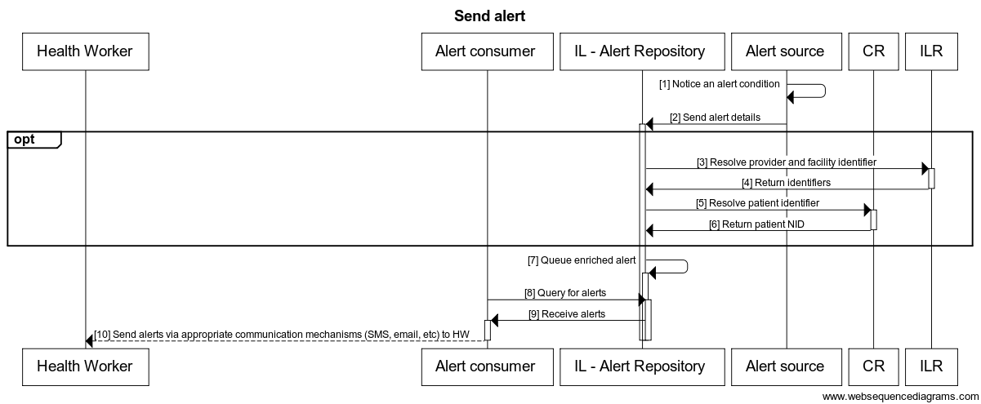
Current DRAFT workflow
Use Case: The send alert workflow allows the infrastructure services to register alerts
with an alert service. The alert service allows alert consumer to query for these alerts and
send them out to health workers in whatever format is appropriate (sms, email, etc).

Slide 3
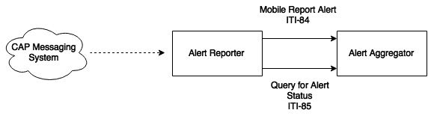
Mobile Alert Communication Management (mACM) Use Case #1
Use Case: In response to a crisis or emergency situation, such as the 2014 and 2015
outbreaks of Ebola in western Africa, it is critical to communicate to health workers
across organizational and national boundaries, and to verify receipt of such alerts.

Slide 4
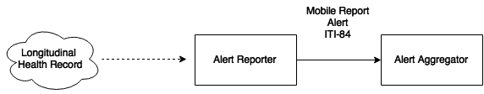
Mobile Alert Communication Management (mACM) Use Case #2
Use Case: A subject of care may receive care from multiple providers across multiple
health care networks, and coordination of care across providers and networks is difficult.
If an Electronic Medical Record or Longitudinal/Shared Health Record is present, Care
Reminder alerts can be triggered through the examination of clinical records about the
subject of care. Care Reminder alerts are sent either to the subject of care or a
designated health worker.

Slide 5
Workflow – Health Worker vs Client
DRAFT workflow only referenced health worker
mACM references health worker and
client/subject of care
Should we do both?
Should these be two distinct workflows?

Slide 6
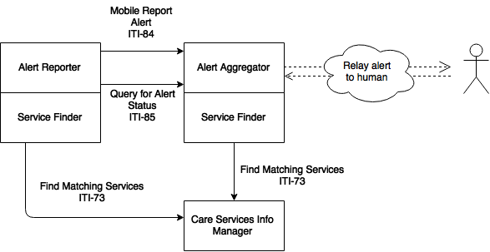
mACM Interaction Diagram - (Inter-Linked) Health Worker Registry

Slide 7
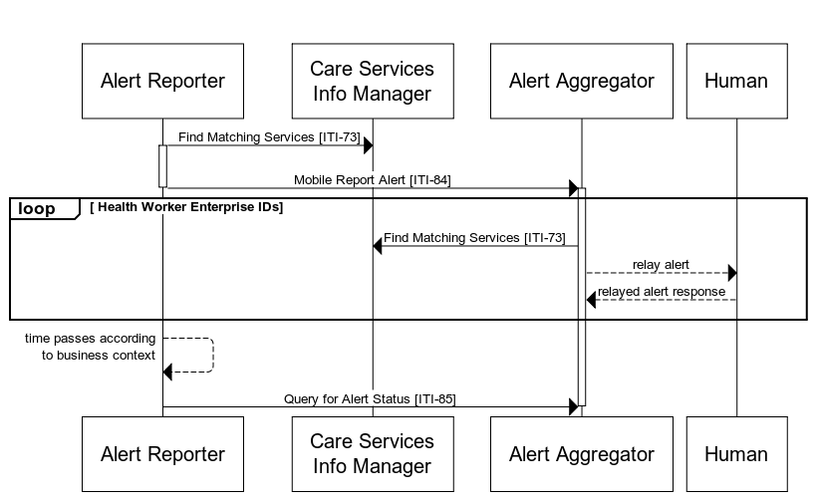
mACM SequenceDiagram - (Inter-Linked) Health Worker Registry

Slide 8
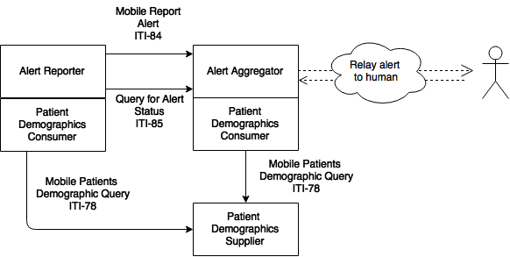
mACM Interaction Diagram - Client Registry

Slide 9
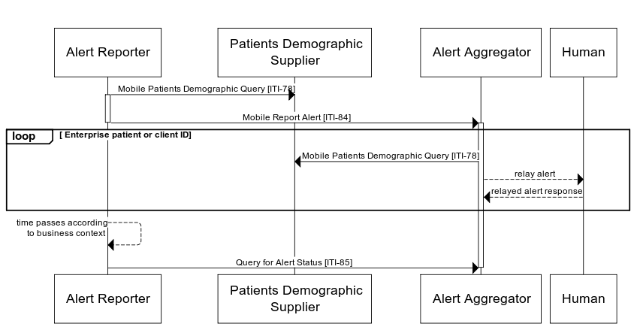
mACM Sequence Diagram - Client Registry

Slide 10
Organizations to contact for input
Dimagi – CommCare
Fio – Fionet
Grameen – MOTECH
Medic Mobile – Medic Mobile
UNICEF – RapidPro
mHealth Working Group
Others?

