Slide 1
ADX Workflows
James Kariuki, Centers for Disease Control and Prevention
Denise Johnson, MEASURE Evaluation
August 25, 2015
Virtual OpenHIE Architecture Meeting

Slide 2
The challenge of aggregate data exchange
  Electronic data systems have evolved to manage health data. But …
  In some cases facility based routine data are printed from EMR and reported to the health district office for manual entry
  There is no agreed upon internationally recognized, standard way of representing and exchanging aggregate data,
  Therefore ad-hoc and de-facto methods used to exchange data between levels in the health system hierarchy
    Between the HMIS and other national, regional and international data warehouses
    Between EHR systems and the HMIS
    Between the HMIS and health worker registries
Interoperability Layer
Interoperability Layer

Slide 3
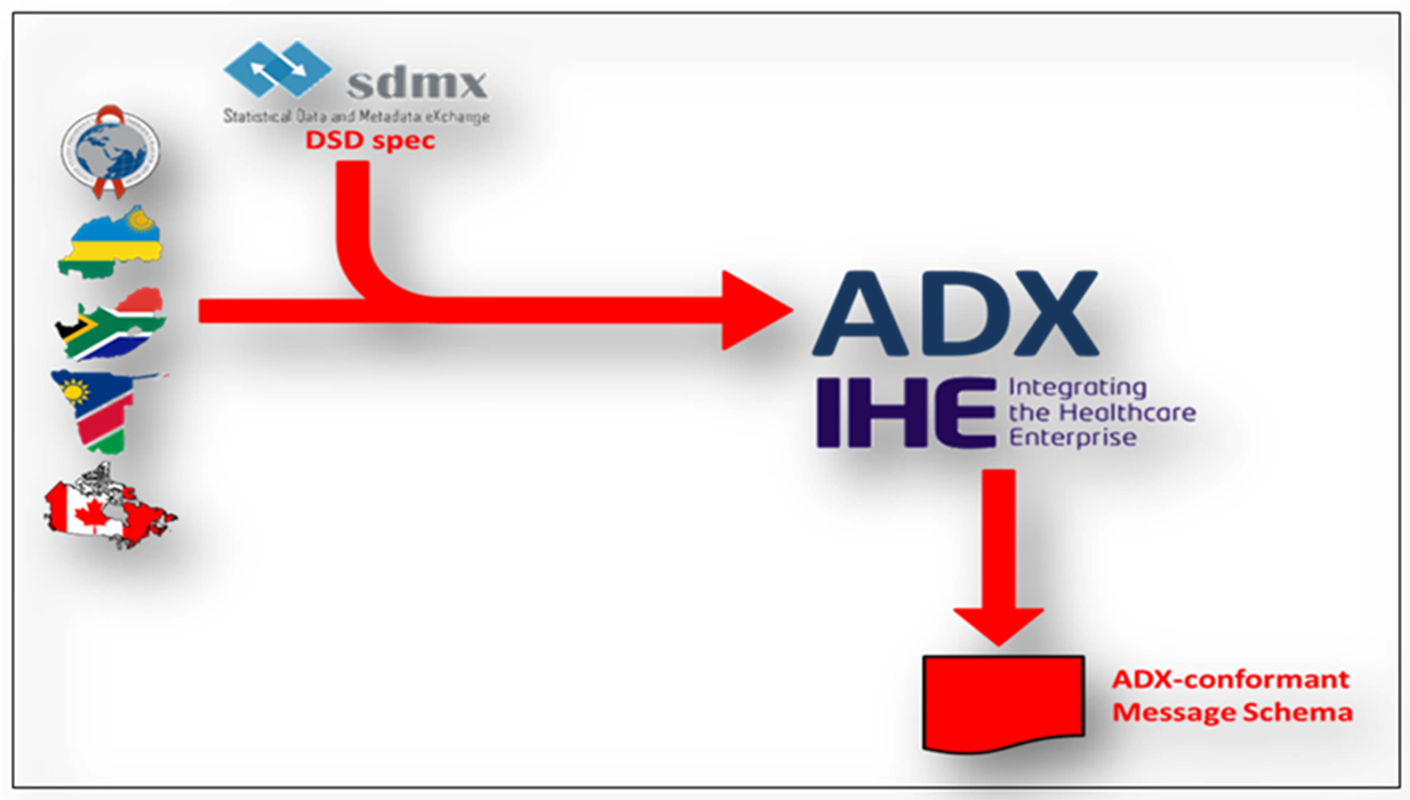
ADX Profile
Interoperability Layer
Interoperability Layer
More information on ADX Profile can be found here:
http://www.ihe.net/uploadedFiles/Documents/QRPH/IHE_QRPH_Suppl_ADX_Rev1.0_PC_2015-05-29.pdf

Slide 4
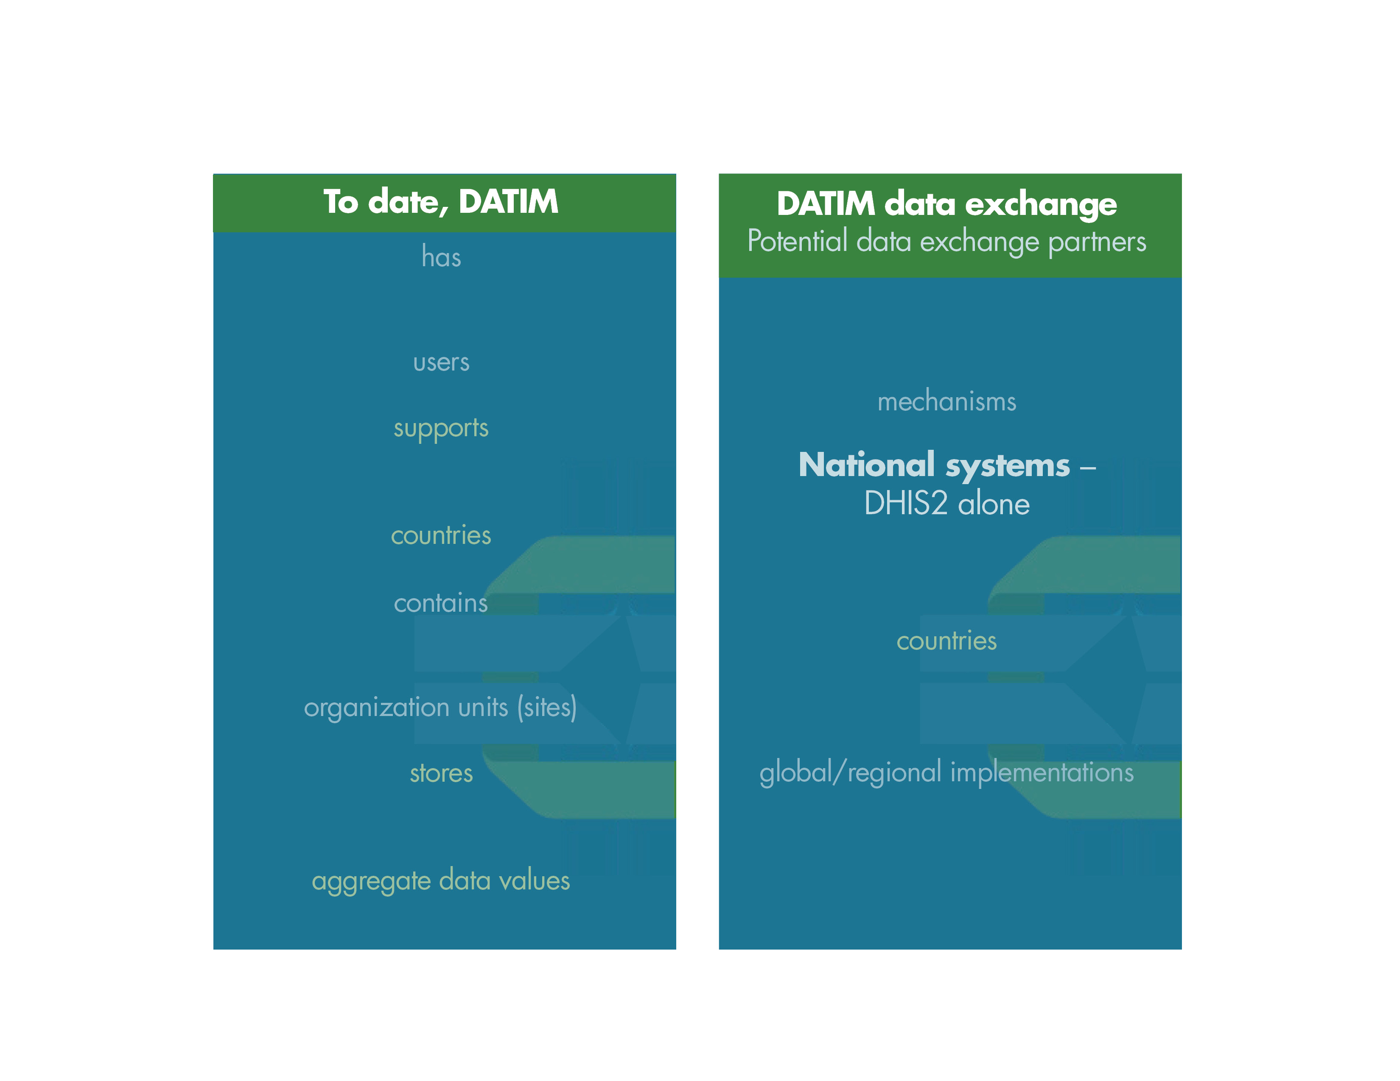
DATIM Use Case
9618
50
70,084
9,753,679
2747
47
8
Interoperability Layer
Interoperability Layer

Slide 5












DATIM Workflows - Overview
FR
TS
CR
SHR
HWR
HMIS
4. Send Metadata Updates
  Mechanisms
  Indicators
  Organizations
DATIM Global
2. Validate and Save Aggregated Data
InfoMan
FactsInfo
Interoperability Layer
Metadata
Aggregate Data
Interoperability Layer
3. Request Metadata Updates
  Mechanisms
  Indicators
  Organizations
1. Export Aggregated Data
HMIS
InfoMan
DATIM Node
(IP/MOH)
Not included: Generate and export data from patient-level system

Slide 6
Export Aggregate Data
DATIM Node Activity
1 Initiate the transaction. | HMIS
2 Generate an ADX compliant message from the aggregated data in HMIS | HMIS
3 Secure the message in transport. | IL
4. Route the message to an authenticated receiver | IL
5. Store a copy of the message for review by support personnel at the DATIM Node. | IL
6. DATIM Global Processes the message | GLOBAL
7. Receive DATIM Global response1 (message received, but not yet processed by the HMIS). | IL
8. Log message receipt acknowledgement | IL
9. Poll for response to ADX processing | IL
10. DATIM Global Sends out response that the message has been processed. | GLOBAL
11. Receive DATIM response 2 (message successfully processed) or Error message | IL
12. Log response and pass it to the HMIS | IL
13 Display the response for the user | HMIS

Slide 7
Validate and Save Aggregate Data
1. Receive an ADX message | IL
2. Initiate ADX message validation | IL
3. Fetch ADX-conformant message schema | IL
4. Validate ADX message format | IL
5. Log message format validation results- Notify sender if format invalid | IL
6. Send ADX message to DATIM | DATIM
7. Parse ADX message | DATIM
8. Validate ADX message metadata content -org units, data element and period | DATIM
9. Log metadata content validation results | DATIM
10. Send validation error message to ADX message sender to initiate metadata update | IL
11. Save ADX message | DATIM
12. Log save message results | DATIM
13. Display save response to the user | DATIM
14. Send data saved acknowledgement to HMIS | IL

Slide 8




The information presented here has been supported in part by the United States Agency for International Development (USAID) under the terms of the MEASURE Evaluation Cooperative Agreement AID-OAA-L-14-00004 and implemented by the Carolina Population Center, University of North Carolina at Chapel Hill in partnership with ICF International, John Snow, Inc., Management Sciences for Health, Palladium Group, and Tulane University. The views expressed in this presentation do not necessarily reflect the views of USAID, CDC or the United States government.

