Slide 1


Sharing Data Import Experiences
Mozambique
PEPFAR Data Exchange Implementer Community Call
December 9, 2015
Notes:
Opening:
Thankyouforthatgraciousintroduction.
IampleasedtobeheretodaywithallofyouaswebeginwhatIhopewillbeaproductivethreedaystogether.
IwanttothankAmbassadorGaspard,CounselorsGeneralTaylorRugglesandEricaBarksRuggles,DCMVirginiaPalmer,PEPFARCoordinatorJamesMaloneyandtheentireSouthAfricanPEPFARCountryTeamfortheirincrediblehospitality.Iknowthismeetingwasdelayed,butIamdelightedthatwe’reallhere!!
MygoalforthismeetingistobeginadialoguethatcontinuesthroughoutmytenureasGlobalAIDSCoordinator….31monthsand19days…butwhoiscounting?!

Slide 2
PEPFAR DevResults System
Log in (Web based)
Partner dashboard
Entering data (MS Excel sheet)
Logic checks
Extracting MER raw data

Slide 3
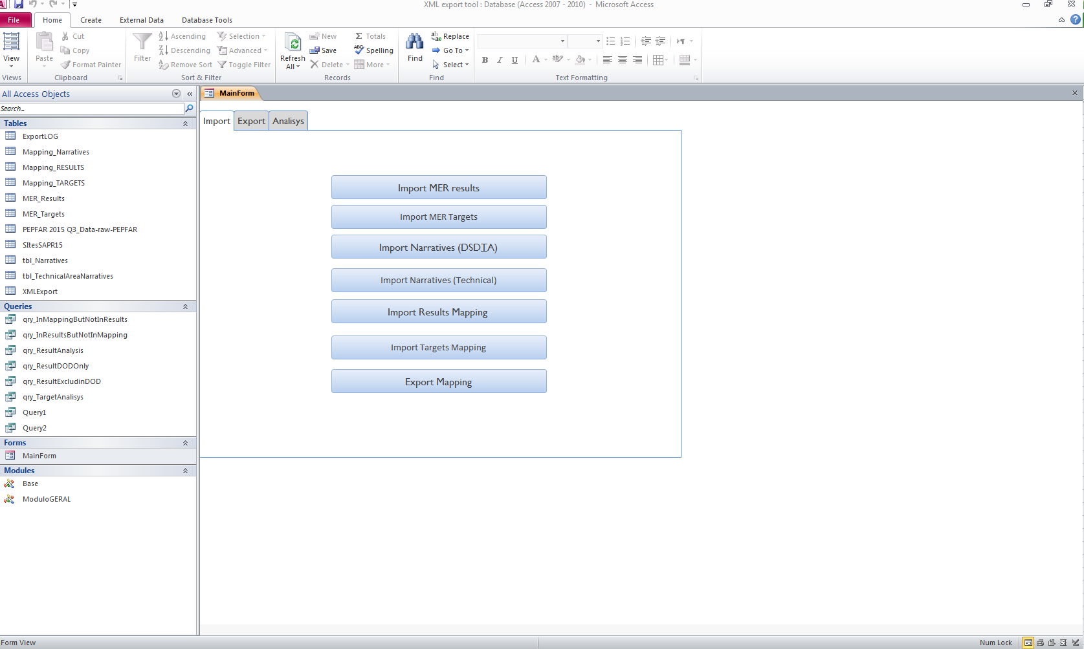
XML Export tool

Slide 4
XML Export tool
MS Access database
Mapping indicators
Importing MER raw data
Querying and creating the XML file
Narratives (Point of view)
Submit XML file to DATIM

Slide 5
Challenges
DATIM validations - should be able to run validation checks independently (without relying on Tier 3 support).
Synchronization between the live environment with the test environment, most of the times these two systems are misaligned. This is very important for testing prior to submission.
Ambiguous or “duplicated” mapping of DATIM versus MER indicators
Invalid data elements which exist in the DATIM mapping

Slide 6
Thank You!
Obrigado!
Kanimambo!
Notes:
Opening:
Thankyouforthatgraciousintroduction.
IampleasedtobeheretodaywithallofyouaswebeginwhatIhopewillbeaproductivethreedaystogether.
IwanttothankAmbassadorGaspard,CounselorsGeneralTaylorRugglesandEricaBarksRuggles,DCMVirginiaPalmer,PEPFARCoordinatorJamesMaloneyandtheentireSouthAfricanPEPFARCountryTeamfortheirincrediblehospitality.Iknowthismeetingwasdelayed,butIamdelightedthatwe’reallhere!!
MygoalforthismeetingistobeginadialoguethatcontinuesthroughoutmytenureasGlobalAIDSCoordinator….31monthsand19days…butwhoiscounting?!

