Slide 1






Intensive Outreach & targeted outreach adherence within the TASQC HIV programme in Zimbabwe
Data Use Community Meeting
09 May 2024
Dr Efison Dhodho, SIEL Director
Notes:
Checking presenter view

Slide 2
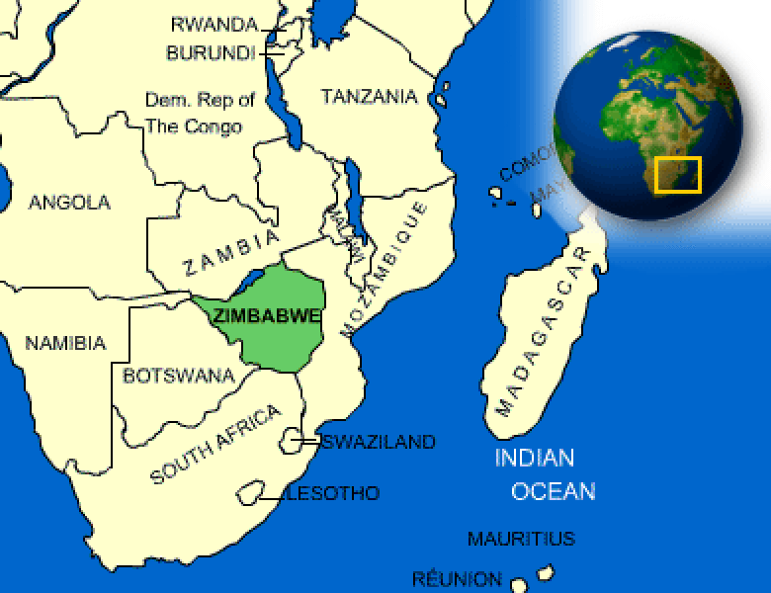
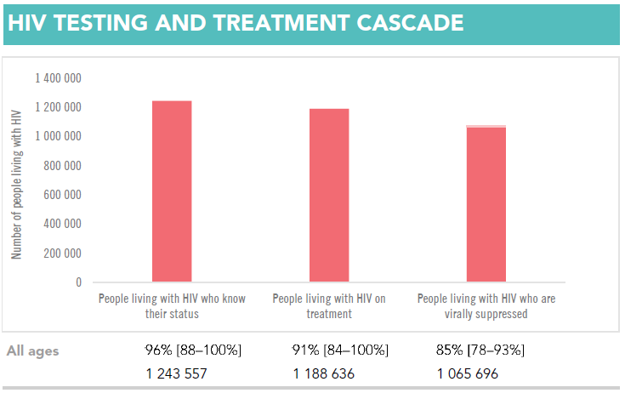
Zimbabwe Country Context
Zimbabwe is heavily burdened by HIV/AIDS & TB
1,3M PLHIV (2022 estimates)
HIV Prevalence: 11.01% (15-49 age group) (2022 estimates)
HIV Incidence: 0.17 % in 2022 (2022 estimates)
  -down from 1.42% in 2011, 0.98% in 2013
TB/HIV co-infectivity rate of 53% [Global TB Report, 2022]
Source: UNAIDS Data 2022
Notes:
This slide gives a background of HIV burden in Zimbabwe and were Zimbabwe is located given the international audience who will be attending this meeting. Additionally we also show the progress made towards achieving the UNAIDS 95-95-95 goals

Slide 3
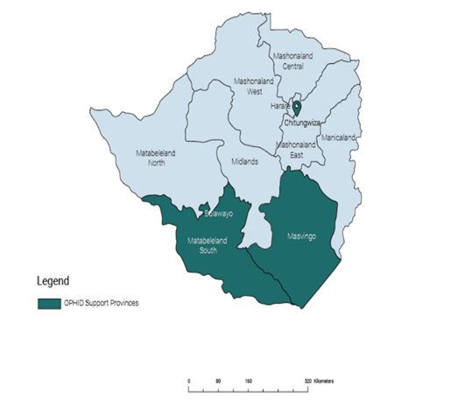
Overview of the USAID Funded TAQSC Program
The goal of the TASQC (Target Accelerate & Sustain Quality HIV Care) program is to contribute to the achievement and sustainability of HIV epidemic control in Zimbabwe through the provision of technical, financial, and material support towards the management, coordination and provision of comprehensive clinical care services within the national HIV program.
TASQC Partnerships
  To implement a data-driven, clinically-sound program that focuses on strengthening facility and community implementation.
    OPHID (Prime)
      Chitungwiza, Bulawayo & Mat South
    J.F KAPNEK (sub-partner)
      Masvingo (note – Bikita is a TA district)
  To strengthen facility-community monitoring and advocacy for an accelerated and comprehensive HIV response.
    ZNNP+ (sub-partner)
      All provinces
      Mobilization
      Monitoring
Geographical Location:
      15 out of 63 districts in Zimbabwe
      327 public health facilities
      330,735 ART clients
Notes:
This slide gives an overview of the OPHID and the TASQC HIV grant, which provinces we work in and the scale of ART clients under our care

Slide 4
Omalayitsha DSD model
Data for patient-centered care for migrant populations

Slide 5
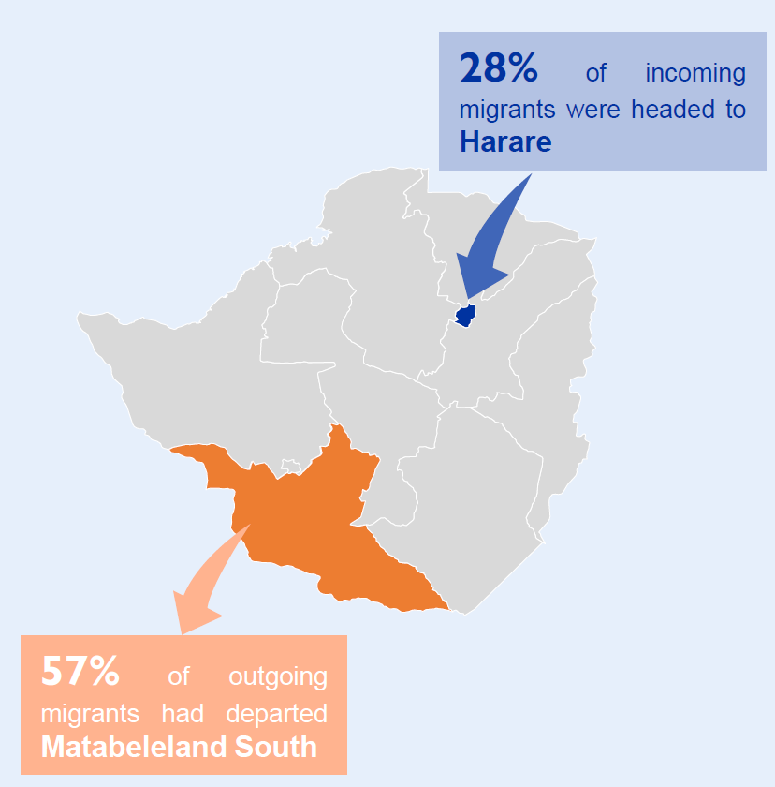
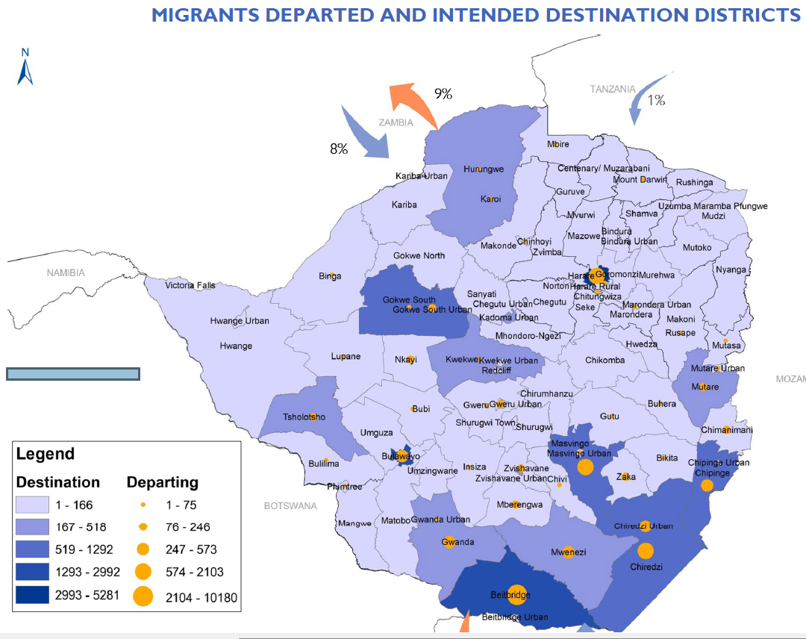
IOM Zimbabwe Flow Monitoring Report March 2024
In March 2024 alone, the South Africa-Zimbabwe corridor recorded the highest movement of 52,976 (91%). 56% of movements along the South Africa-Zimbabwe corridor were short-term movements, 21% were family reunification movements whilst 19% were long-term economic movements.
Notes:
This slide aims to show the high mobility of Zimbabwean nationals in and out of Zimbabwe with this data showing that mobility is highest in the Southern region were OPHID is implementing its HIV treatment and Care program. This sets the scene for the need to implement patient-centered DSD models to cater for these migrant populations

Slide 6
Mobile & Cross-Border HIV Care & Treatment Assessment findings (2019)
We identified 3 distinct categories of mobile clients.
3 categories of mobile clients have specific needs for documentation, referral and differentiated care for treatment and retention:
Cross-border Mobile Zimbabweans: treatment monitoring gaps as clients employ formal/informal mechanisms to maintain access to HIV treatment, yet do not present to the facility for required monitoring appointments (e.g. VL testing).
Internally Mobile (Inter-District/Provincial):
linkage gaps as clients test HIV positive and fail to initiate ART, with intention to initiate ART at their home facility.
Non-Zimbabweans accessing HIV care in Zimbabwe:
retention gaps as clients HIV test, receive ARVs in Zimbabwe and then return to their home country.
Cross border workers, deportees, migrant workers, ‘border jumpers’ (illegal migrants), smugglers, government workers employed at borders, seasonal workers, truck drivers, sex workers and local communities around the border lines were the common categories of mobile clients who access HIV services at the facilities.
Notes:
This is data from a deep dive conducted in We identify 3 distinct types of mobile clients with varying implications upon HIV care and treatment service documentation and provision of differentiated services to enhance linkage and retention on ART.

Slide 7






Omalayitsha DSD Model Design
Patient-centered design to ensure migrant populations continue receiving services in their countries of domicile in line with UNAIDS recommendations
Site level focal person (approachable, good comm skills & counseling) responsible for monitoring, tracking, and communicating with diaspora clients on their platform of choice (preferrable Primary Care Counselor)
Focal person creates a database of all diaspora clients with up-to-date client contact details.
Enrolment criteria include consent to follow-ups, completion of DSD enrolment form & entry in DSD register, TLD transition unless on 2nd line ART
Client review & refill dates alignment with the major public holidays to increase chances of seeing the clients physically and offer VL sample, TB screening, TPT initiation and VIAC screening for eligible clients.
Creation of a WhatsApp/Telegram broadcast list for health education & 3- or 6- monthly client reminders of clinic reviews & VL monitoring
Client use of cross-border transporter “Omalayitsha” for fast track 6- or 12- MMD ART refills & delivery in country of domicile through prior prebooking via Whatsapp/Phone call

Slide 8
Demographic characteristics of Omalayitsha DSD model clients
Most Omalayitsha DSD model clients are in Beitbridge which is a border district with South Africa were most migrant clients
Reside and is the busiest border crossing in Africa. Nearly two-thirds of clients are females in alignment with % of national
ART clients and most clients are of the productive age groups (25-49 years)

Slide 9
Evaluation of the Omalayitsha DSD model
Aim: To evaluate whether clients ART care retention, VL coverage and viral suppression rates post-Omalayitsha DSD model enrolment
Methods: Data abstracted from individual ART client booklets from 22 out of 78 randomly selected sites with Omalayitsha DSD enrolments for 899 clients one-year pre- and post- Omalayitsha DSD model enrolment
Findings:
Variable | Omalayitsha DSD Model enrolment |  | P-value
 | Before, n (%) | After, n (%)
 | N = 670 | N = 899
VL sample collected | 405(60) | 519(58%) | <0.05
VL results documented | 318(83) | 462(86) | <0.05
VL suppression (<1000 copies/mL | 284(97) | 433(98)
Retention post-Omalayitsha model enrolment | N (%)
Total | 899
Active on treatment | 881 (98)
Defaulters | 14 (1.6)
Interuption in treatment | 3 (<1)
Transfers out | 1 (<1)
Key Takeaways:
There is feasibility of ensuring patient-tailored service provision to “undocumented" migrant populations who wouldn’t be accounted for officially through inter-country collaboration.
High VL suppression is testament that clients were adherent to life-long ART medicines though innovative collaboration to improve VL coverage of these migrants is needed.

Slide 10
The Uzwelo Approach: Improving client retention in ART care

Slide 11
Evolution of Evidence, Learning & Interventions on Continuation of Treatment : Post Covid-19
Phase 3 : Observational Deep Dives
Quasi-experimental trial
Root Causes of “high IIT”
Short-staffing leading to poor documentation
RoC mobility increased post covid
Health system not responsive to their changing needs
Phase 1: Establishing Baseline
An Intervention Designed using HCD approaches with the objective of improving RoC , CoT through empathetic engagements
Problem Identification
Physical Count of ART booklets to establish status of RoC in the TASQC programme
Variances between reported figures and count noted -IIT
Facilities such as Northern Suburbs in Byo noted to have high variances- Covid effect
FY23Q1
Dec 22-April 23
FY22Q1
Aug 2022
FY21Q2
Dec 20-Mar 21
Phase 4: Root Cause Analysis
FY21Q1
Nov 2020
2020
Covid-19 Disruptions of Health System
Establishing root causes of failures to establish final outcomes of IIT RoC
Persistence of challenges with returning RoC to care
Complaints from RoC when tracked at home while they are in care
Phase 2 : Observational Deeps dives
Understanding basic causes of variances
Poor documentation of RoC visits
Incompleteness of records in Greenbooks and EPMS
Low Implementation fidelity of Covid-19, Visitor SOP implementation

Slide 12
The Theoretical Framework for Uzwelo (Ndebele for Empathy)
This framework is Based on the Irving and Dickson (2004) conceptual framework for empathy in health care professionals adapted to engagement with receipients of care (RoCs) next-of-kin (NoK) .
The framework consists of three components:
  Affective attunement: A quick recognition of their emotional state.
  Perspective taking: A verbalized understanding of their point of view and creation of a connection.
  Communicating understanding: Co-creation of a shared solution
The team added a fourth dimension of ubuntu which is respect since most NoK are mature older females/males.
It seeks to shift away from a bio-medical lens to patient care to a more wholistic ecological lens established in socio-behavioral sciences.

Slide 13
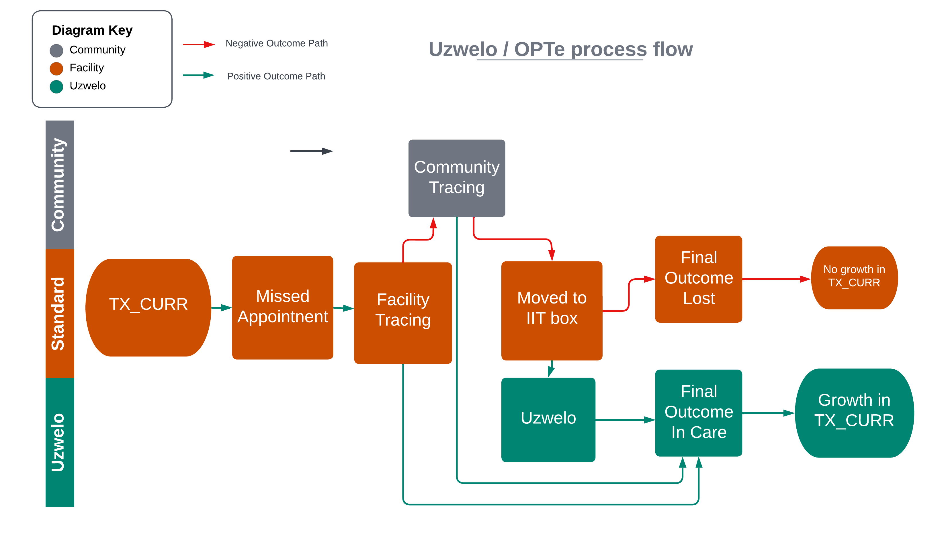
Optimizing Processes for Tracing through Empathy (OPTe)/ Uzwelo
Method
How to make the engagement
Use the facility or work issued staff phone number.
Introduce yourself and ask for a few minutes of their time.
Recognize them as a key part of the ecosystem for the care of the RoC.
Let them know that the RoC had complete trust in them and selected them to be their next of kin.
Make it clear that the facility values their support to the patient and treats the call with absolute confidentiality.
State the reason for the follow up and the expected outcome of the call.
Close the call with thanks and do let them know that you will keep in touch as you work together with them in the support of the RoC.
Where there are no NOK details, or the contacts did not work.
Set the books aside.
Use a sticker to identify books without that vital detail.
Next visit, ensure that the one contact for the RoC and 2 for 2 NOKs are captured.
Uzwelo/OPTe
All the clients were subjected to the empathy based enhanced tracking algorithm using theirs or NOK phone contacts triangulated with feedback from community staff findings . The approach involved engaging with the NOK and RoC themselves in a non-judgmental empathetic manner, recognizing their value add to the care of the RoC and taking responsibility for the gaps in the health system and difficulties they may experience in accessing the care they need.

Slide 14
Comparison of tracking outcomes by client follow-up modalities among IIT clients
Tracking outcomes | Client follow-up modalities among IIT clients |  | P-values*
 | Routine phone calls | OPTe Uzwelo approach
 | n (%) | n (%)
Total clients followed up | 202 (100) | 202 (100)
Successfully reached | 91(45%) | 148(73%) | <0.01**
Active client | 49(24%) | 102(50%) | <0.01**
Self-transfer | 26(13%) | 28(14%) | 0.77
deceased | 12(6%) | 14(7%) | 0.68
refused | 4(2%) | 4(2%) | 0.99
Not reachable | 111(55%) | 54(27%) | <0.01**
*T-test for paired proportions; **significant at 5% significance level
Observations
Overall, there is a statistically significant difference in the proportion of clients reached through the OPTe approach compared to the routine calling of defaulter clients (P = 0.002 < 0.005).
When stratified by TX_CURR outcomes, Active, and Not Reachable categories showed a significant difference in proportion, while the category of Self Transfer, Deceased, and Refused exhibited a non-significant difference (P >0.05).

Slide 15
Conclusion of the Uzwelo approach for client follow & retention
The study design has limited internal validity due to non-randomization but the findings can be confidently generalized in the Zimbabwe settings as they were done in real life settings.
The Next of Kin is a critical ingredient in the Continuation of Treatment care pathway
Within the first year of starting ART, NoK details may not assist. This could be explained by disclosure issues associated with newly initiated RoC.
There is a significant association between establishment of final outcome through NoK for RoC who have been on ART for more than 1 year than those below 1 year.
The NoK contacts should be updated during the viral load collection at least a year after initiating ART
The NoK should be engaged with empathy and respect as most of them expressed a sense of being overwhelmed by the responsibility of looking out for the RoC
The RoC should be engaged very respectfully and be put at the center of their decisions on how best they can access care. No talking down on them
OPTe/Uzwelo if built into routine tracing , can reduce the tracing workload and improve the way the nurses handle their RoC.
Establishing RoC treatment status brought significant relief/satisfaction to the nurses and could be a key motivator for better tracing processes
Next Step : Develop OPTe/Uzwelo into a hybrid type 2 (effectiveness-implementation) trial incorporating more HCD depth in client-centred care for better continuation of treatment – and refine into a Model of patient Centred Care

Slide 16
TASQC Management Information System (TMIS)

Slide 17
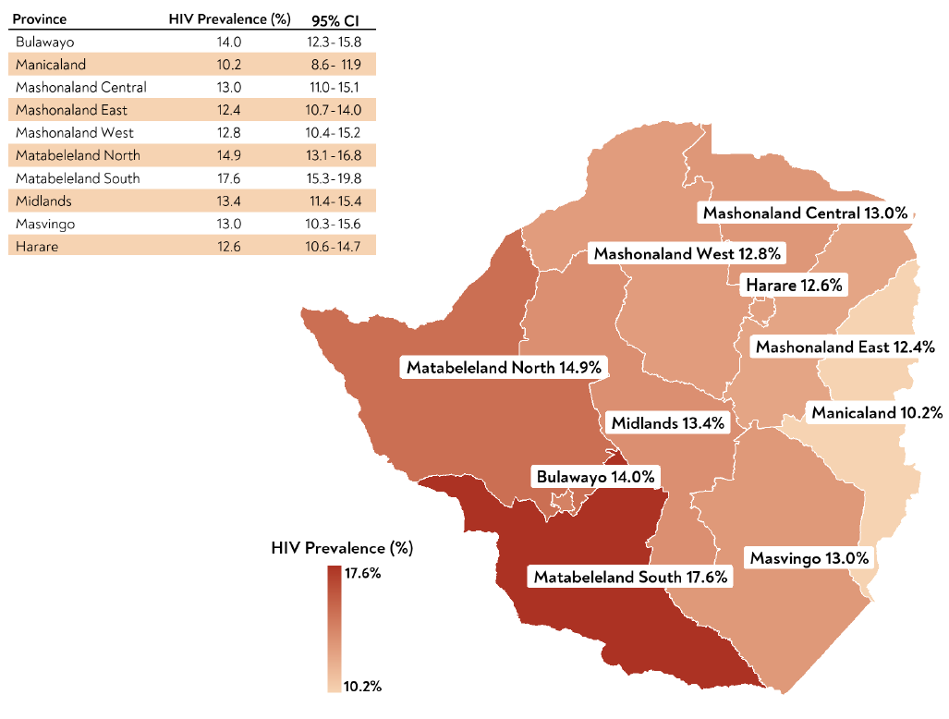
Key Population and health access metrics
Metrics | National data | Matabeleland South
Population | 15.2 million | 760,345
Population Density (persons/sqm | 38.8 | 14.4
HIV prevalence | 14.8% | 17.6%
The TASQC programme operates in the South region which is has hard-to-reach areas, is sparsely populated having the lowest population density in Zimbabwe hence communities face challenges in accessing health services
This is despite having the highest HIV prevalence and largest need in identifying missing HIV cases and ensuring uninterrupted provision of HIV treatment and care services

Slide 18
TASQC Management Information System (TMIS) description
Co-created with OPHID Community Outreach Agents (COAs) and incorporating their user requirements.
Utilizes Open Data Kit (ODK) for data collection on smart phones and feeding into a form server.
Offline data capture, with integration possibilities for additional data systems.
Integrates with DHIS2 for advanced analytics and data visualization..
Facilitates communication between community-based service providers for coordination and targeted routine data quality audits.
Enables tracking and tracing of clients in the community and linkage to facilities for various HIV-related services e.g. viral load monitoring, HIV testing, cervical cancer screen, ART medication refills etc.

Slide 19
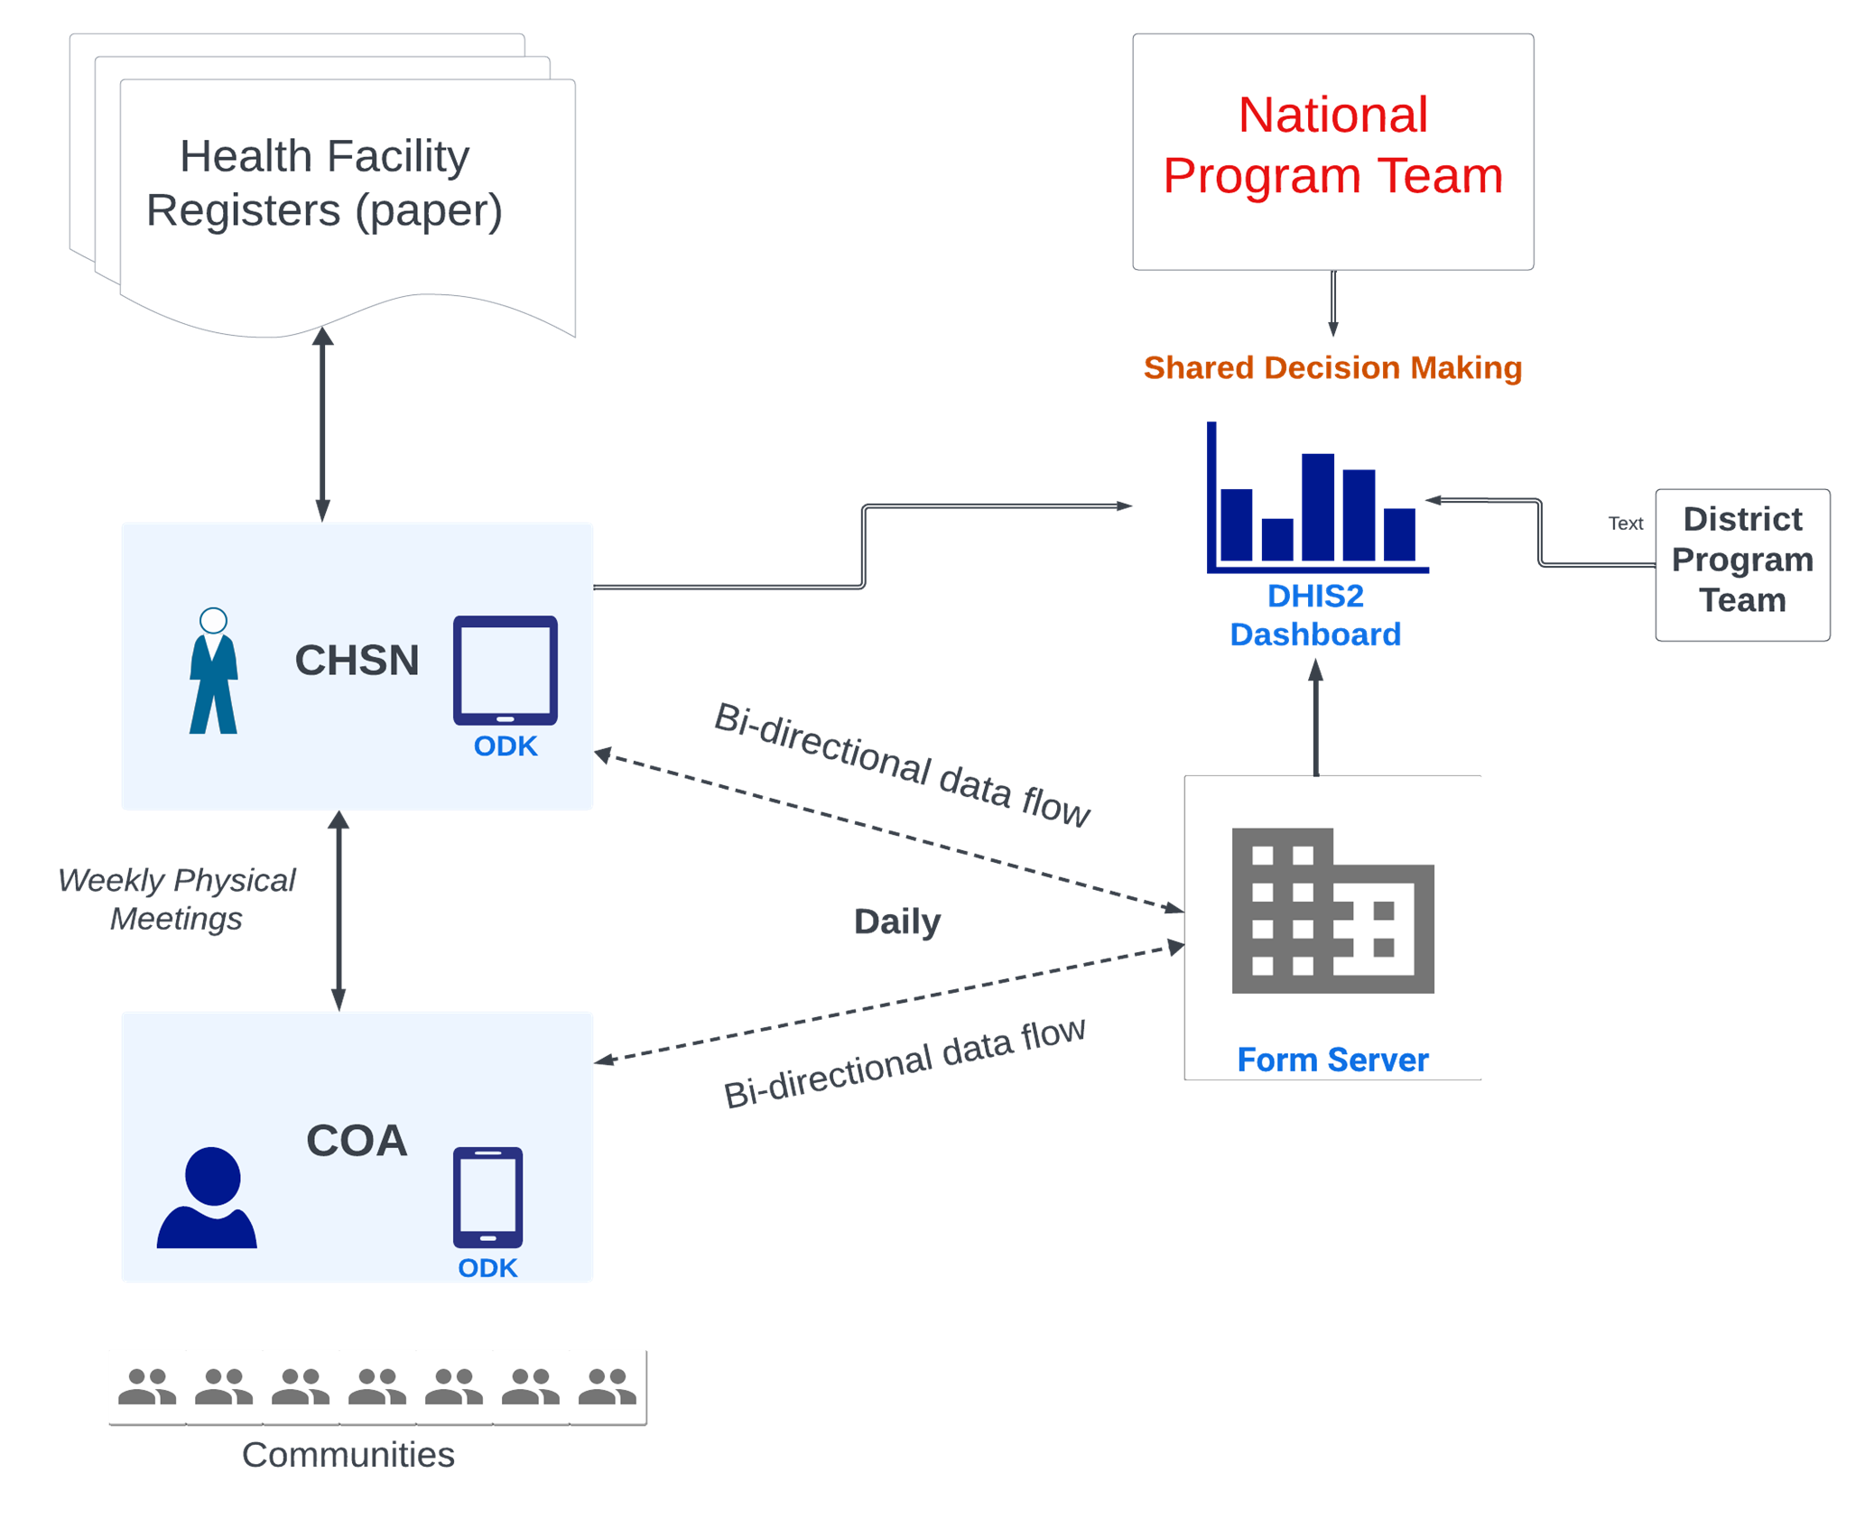
TMIS Data Flow process

Slide 20
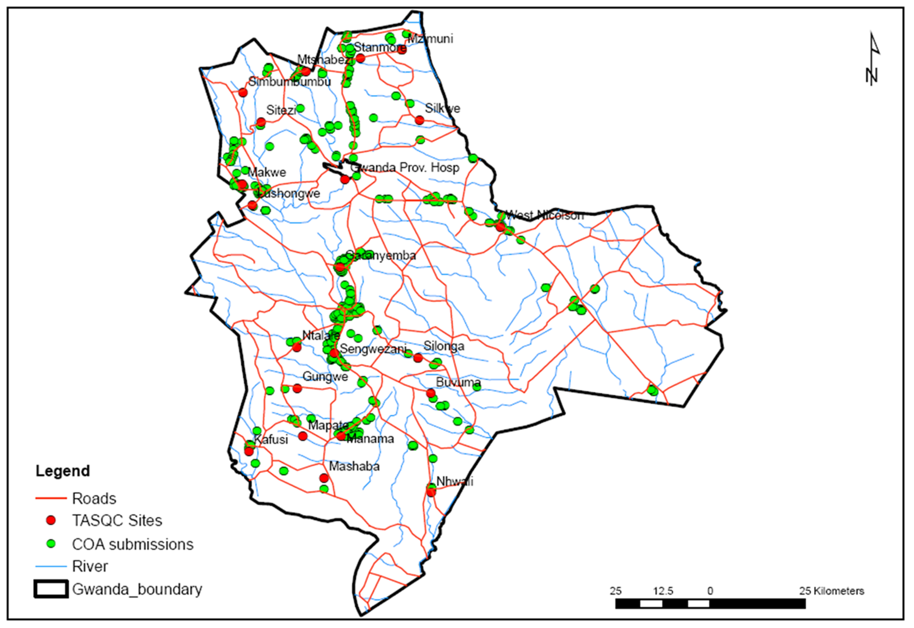
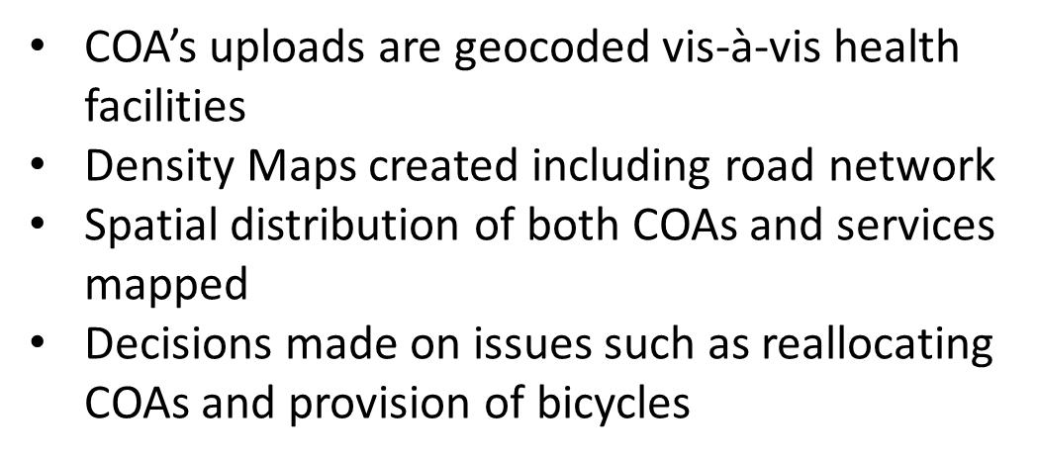
TASQC Management Information System (TMIS) outputs (1)
Equitable distribution of CHWs using Spatial Analytics:
Enabled real-time community tracking enabling performance-based output monitoring, and location optimized deployment of CHWs proportional to RoCs hence reducing overall cost of community programming and enhancing performance.

Slide 21
TASQC Management Information System (TMIS) outputs (2)
Improved community-based HIVST and treatment monitoring coverage:
Successful linkages between community mobilization for HIV testing and service provision increased from 25% to 62% from 2021 to 2023
Community mobilization efforts contributed to a significant increase in viral load coverage, from 41% to over 71%, in Matabeleland South Province from 2021 to 2023.
Table 1 – Reasons recorded in CHWs ODK tool for reasons for client community tracking in TASQC districts
District | Women due for cervical cancer screening | VL sample collection | Others | Missed appts. | Due for TPT | Interrupted Treatment | Index contact tracing | Hi VL sample collection | Other lab results | Due for EID sample collection | TB sputum collection
Gwanda | 515 | 891 | 124 | 78 | 846 | 87 | 20 | 45 | 6 | 1 | 1 | 2614
Insiza | 24 | 594 | 61 | 501 | 129 | 146 | 12 | 16 | 4 | 1 | 1 | 1489
Chitungwiza | 155 | 351 | 507 | 102 | 290 | 621 | 86 | 12 | 0 | 1 | 0 | 2125
Chivi | 149 | 399 | 683 | 189 | 100 | 57 | 13 | 8 | 1 | 5 | 2 | 1606
Chiredzi | 230 | 2379 | 208 | 490 | 1146 | 207 | 147 | 58 | 18 | 4 | 39 | 4926
Zaka | 489 | 1134 | 125 | 748 | 202 | 281 | 144 | 65 | 11 | 7 | 1 | 3207
Masvingo | 2536 | 5608 | 395 | 666 | 2173 | 225 | 173 | 113 | 18 | 24 | 9 | 11940
Beitbridge | 5 | 228 | 10 | 278 | 82 | 224 | 43 | 14 | 0 | 0 | 5 | 889
Mwenezi | 570 | 1066 | 107 | 94 | 475 | 189 | 28 | 15 | 5 | 2 | 5 | 2556
Gutu | 675 | 1927 | 299 | 533 | 612 | 157 | 246 | 74 | 5 | 2 | 9 | 4539
Bulilima | 89 | 306 | 150 | 38 | 261 | 13 | 1 | 7 | 0 | 0 | 0 | 865
Matobo | 67 | 70 | 5 | 22 | 79 | 22 | 4 | 0 | 4 | 0 | 0 | 273
Bulawayo | 1 | 2 | 1 | 78 | 3 | 2 | 0 | 0 | 0 | 0 | 0 | 87
Umzingwane | 4 | 31 | 8 | 7 | 17 | 4 | 0 | 2 | 0 | 0 | 0 | 73
Mangwe | 242 | 491 | 83 | 127 | 187 | 19 | 29 | 23 | 0 | 2 | 0 | 1203
Total | 5751 | 15477 | 2766 | 3951 | 6602 | 2254 | 946 | 452 | 72 | 49 | 72 | 38392
 | 15% | 40% | 7% | 10% | 17% | 6% | 2% | 1% | 0% | 0% | 0%

Slide 22
TASQC Management Information System (TMIS) outputs (3)
Enhanced data for decision-making and program efficiencies
Improved Monitoring and Reporting: real-time monitoring and reporting of program activities and outputs, enhancing data-driven decisions.
Enhanced Coordination and Resource Management: geospatial capability allowed for precise location tracking of activities, facilitating effective coordination and allocation of resources.
Table 2 – Performance output monitoring of CHWs based on ODK tracking & tracing activity output reporting in TASQC districts
Province | District | Number of COACs in place (August 2021) | Active COACs (August 2021) | % COACs Active | Number of Sites in District | Active Sites | % Sites Active | Number of Clients Listed
Masvingo | Mwenezi | 18 | 20 | 111% | 22 | 19 | 86% | 2664
Masvingo | Gutu | 45 | 49 | 109% | 29 | 31 | 107% | 5418
Masvingo | Zaka | 34 | 42 | 124% | 25 | 27 | 108% | 4037
Masvingo | Chiredzi | 40 | 42 | 105% | 31 | 30 | 97% | 4565
Masvingo | Chivi | 32 | 30 | 94% | 23 | 22 | 96% | 2651
Masvingo | Masvingo | 45 | 55 | 122% | 34 | 36 | 106% | 8806
Mat South | Bulilima | 8 | 6 | 75% | 16 | 10 | 63% | 1488
Mat South | Insiza | 9 | 10 | 111% | 17 | 15 | 88% | 1683
Mat South | Gwanda | 14 | 20 | 143% | 22 | 23 | 105% | 2833
Mat South | Beitbridge | 13 | 13 | 100% | 20 | 15 | 75% | 1764
Mat South | Chitungwiza | 11 | 11 | 100% | 6 | 7 | 117% | 1489
Mat South | Matobo | 7 | 15 | 214% | 18 | 13 | 72% | 668
Mat South | Mangwe | 9 | 14 | 156% | 15 | 16 | 107% | 3697
Mat South | Umzingwane | 5 | 5 | 100% | 16 | 8 | 50% | 442
Bulawayo | Bulawayo | 3 | 6 | 200% | 22 | 7 | 32% | 462
TASQC |  | 293 | 338 |  | 316 | 279 | 63% | 42667

Slide 23
Conclusions
The Omalayitsha DSD model emphasizes need for HIV programs to profile heterogenous ROC groups and co-designing patient-tailored care services provision to retain them in life-long ART care.
Integration of empathetic health worker interventions to clients are crucial and complimentary to quality biomedical service provision and lead to improved patient engagement and retention in care
The TMIS demonstrates high impact of user-centered technology combined with community strategies for enhancing HIV care in low-resource settings and monitoring progress towards HIV epidemic control.

Slide 24
Thank you

