Slide 1
Kenya’s approach to identifying and resolving data issues
Experience from Kenya
Data Use Community Webinar
Wednesday October 23rd, 2024

Slide 2
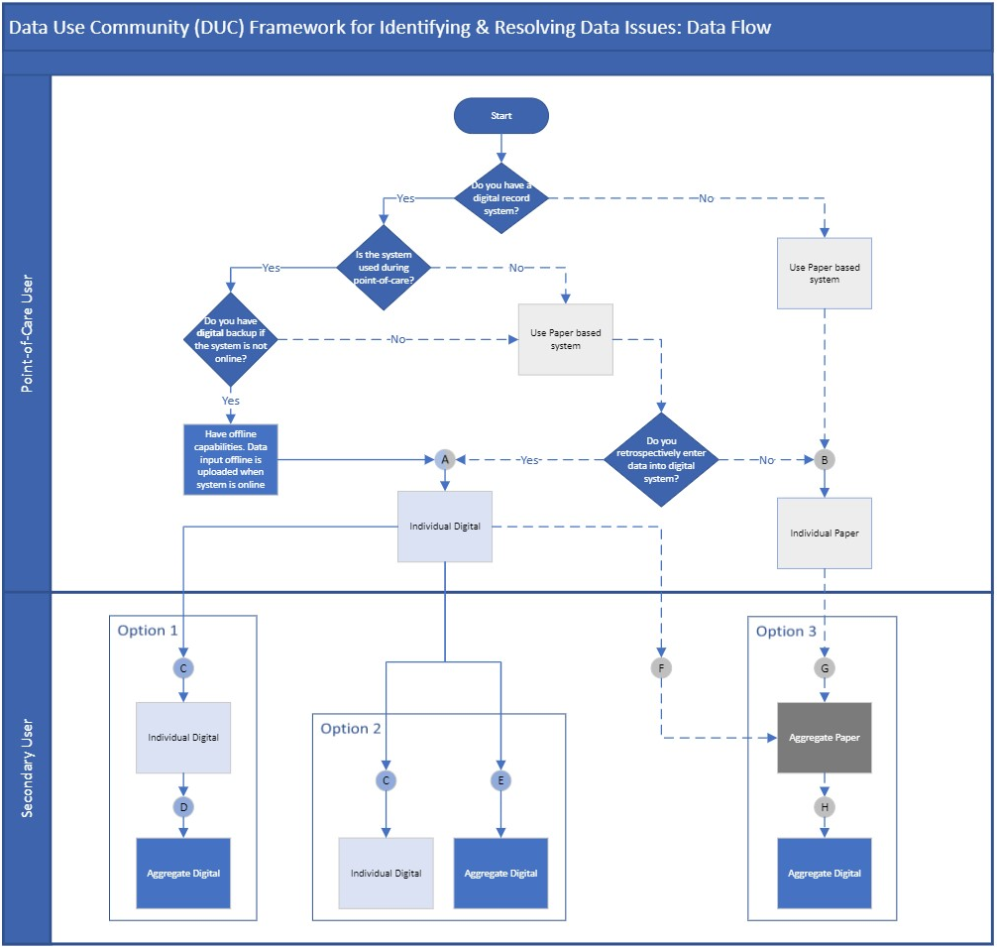
Each lettered gate represents an opportunity to identify data issues
NDW
KHIS
KHIS
Notes:
The framework outlines 3 potential data flow options after point of service with designated nodes as entry points to identify and resolve data issues. Option 1 represents a full digital system with data entered at service delivery into an individual digital system and then flowing to an individual digital system above site and then into an aggregate digital. Option 2, also starts as individual digital at site level but then flows to either an aggregate digital or individual digital above site. Option 3, starts out at the service delivery point as individual paper and is then aggregated into aggregate paper and entered into aggregate digital above site.

Slide 3
HIV Program : EMR Facilities Potential Contribution
Potential contribution by indicator
Actual contribution by Indicator
Data Source : KHIS Period : Oct 2023 – Aug 2024
Data Source : KHIS & NDW Period : Oct 2023 – Jul 2024

Slide 4

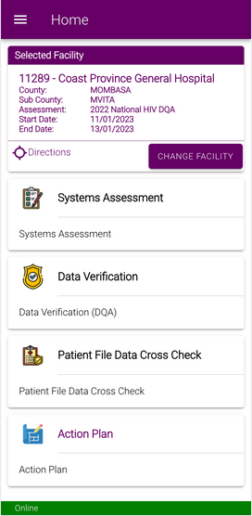



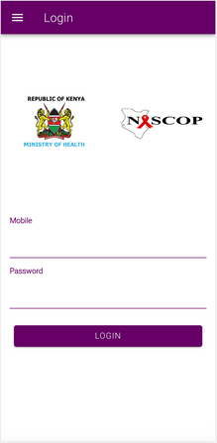

MoH DQA Policy Framework & Tool ​
HIV e-D/SQA tool: developed to standardize Data & Service Quality Assessment process and support national and routine DQAs at all levels
Modules:
Systems Management
Data Verification​
Patient File Cross Check​
Service Quality Assessment
Facility Assessment Report
Action Planning
Assessment Team Management
Aim: To standardize implementation of data quality assessment in the HIV program in Kenya to improve data quality.
Notes:
OBJECTIVES:
Define essential parameters for conducting DQA for the HIV program, with standardized methods and tools.
Define roles and responsibilities of relevant stakeholders in the HIV program DQA.
Promote effective dissemination, use of assessment findings for quality improvement, evidence-based decision making and promote continuous learning.
Provide a framework for developing and monitoring Data Quality Improvement (DQI) plans
Envisioned a DQA Maturity Model
Available on IoS and Android
Creation of users disseminated to counties and partners, NASCOP creates admins
Supervision/ Team Lead doesn’t need to be present physically at all the facilities

Slide 5


Welcome

Slide 6
Identifying & Resolving Data Issues
Aggregate Level Systems

Slide 7
Presentation Outline
Summary of key data quality gaps & strategies to address these
Data alignment
DQA chart abstraction & follow up
Indicator understanding
Reporting & Data Validity Monitoring
Remote D/SQA & follow up

Slide 8
Key Gaps & Strategies to Address : Aggregate Data Systems
Data Quality Gaps
Key Strategies
Under/ Non-reporting
  Monitoring reporting rates (National HIV Dashboard)
Data inconsistency across KHIS, NDW, DATIM
misunderstanding/ variation in indicator definitions,
incomplete data entry,
transcription errors,
missing reports
  Data concordance monitoring (National HIV Dashboard)
  Facility level data verification
  Conducting routine DQAs
  Development of a HIV program indicator reference manual
Data Integrity
  Facility level data verification
  Conducting routine DQAs
Notes:
Data quality gaps noted and what we are doing
Inconsistency in data
Data concordance monitoring – data pull (HIV dashboard) – at county and national
Data at facility verification – facility register
Routine DQAs – using standardized tools
Interoperability?? – record once use multiple times
Incomplete reporting – monitoring reporting rates – HIV dashboard
KHIS – WHO data quality tool
Under reporting - monitoring reporting rates – HIV dashboard/KHIS
Data integrity – routine DQAs,
Duplication - UPI (paper based??), p survey
Data alignment – standardization of indicator definitions, indicator ref manual

Slide 9
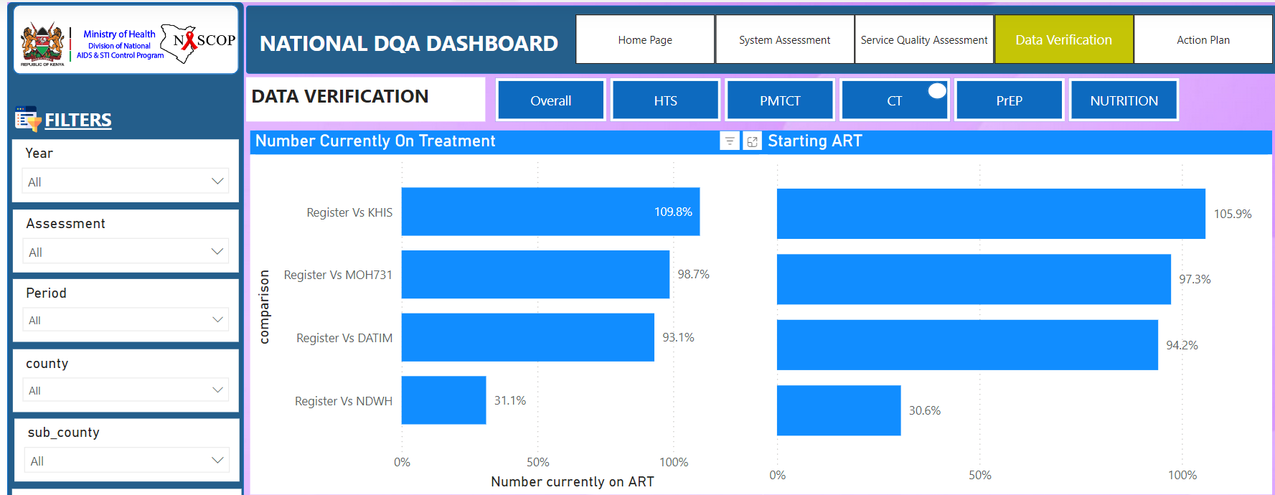
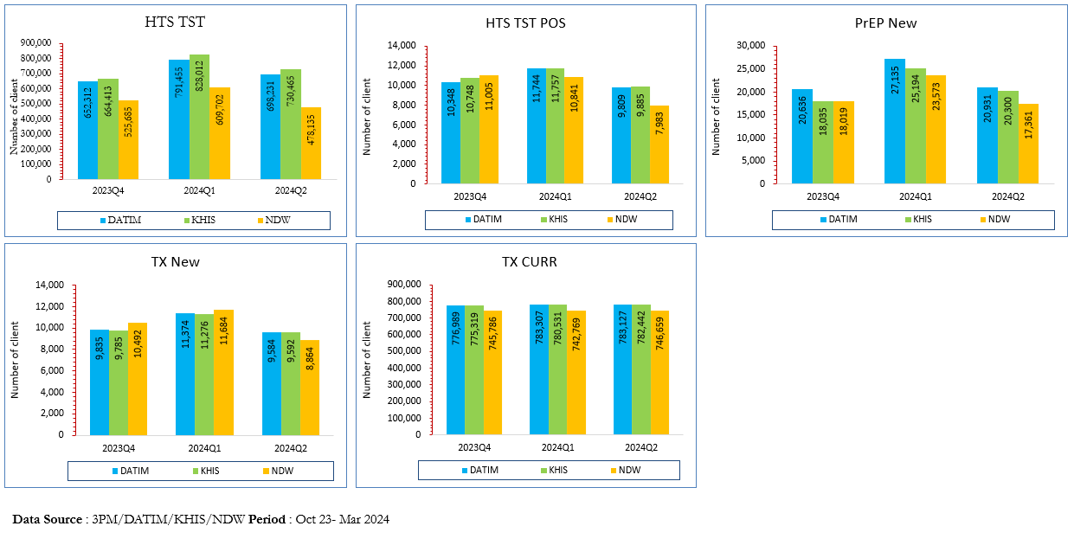
Data Alignment
(NDW, KHIS, DATIM vs primary data sources)
​
DQA Data Concordance Dashboard
Routine Data Concordance
Routine monitoring of data concordance
Dashboard drill-down capability
Report disseminated & action taken
Adopt a county strategy for follow-up
Notes:
Focus on data concordance (NDW, KHIS, DATIM vs primary data sources): Show results and the ability to drill down to facilities for resolution
Add screenshot for concordance from DQA & aggregate level - David

Slide 10
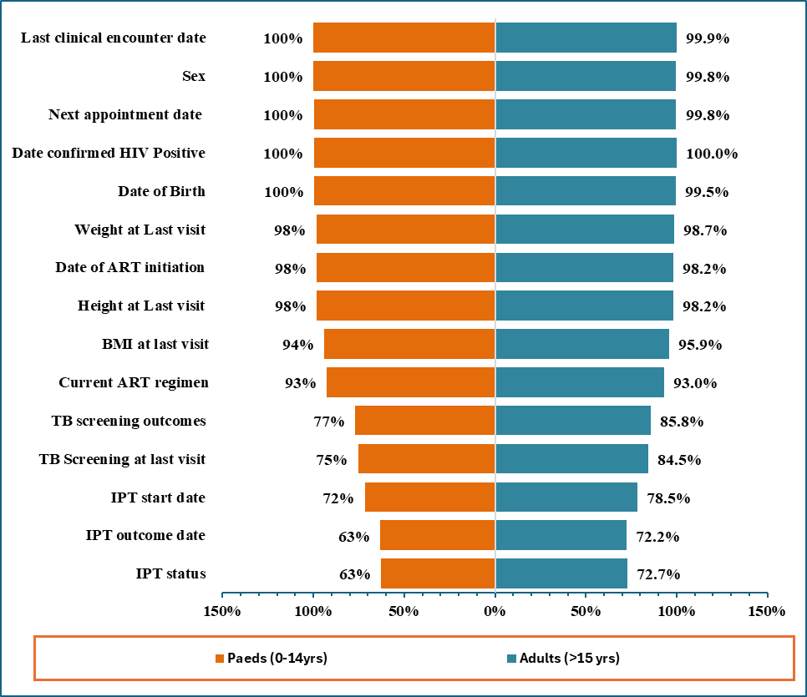
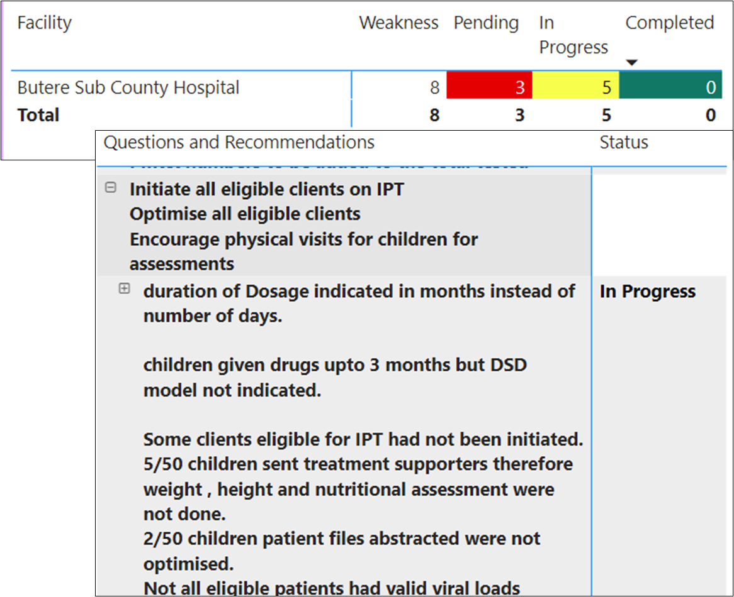
DQA Chart Abstraction & Follow-up
Review and scoring of selected variables from sampled patient records
Based on score, action plans developed
Follow up of action implementation monitored remotely
Chart Abstraction result by Age group
Follow up and action plans
Data Source : DQA Tool Period : Year 2023

Slide 11
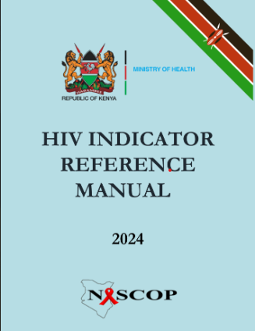
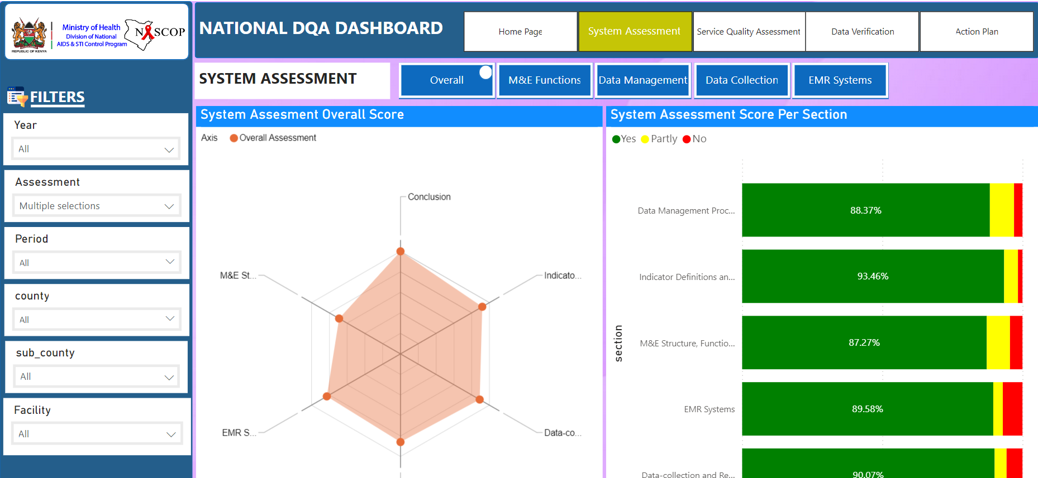
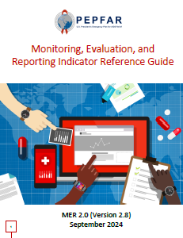
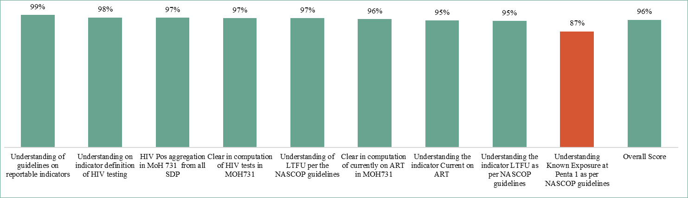
Indicator Understanding
HCW understanding of HIV indicator definitions assessed during DQAs – system assessment module
Gaps identified corrected immediately, mentorship and facility-based CMEs
Data Source : DQA Tool Period : Year 2023

Slide 12
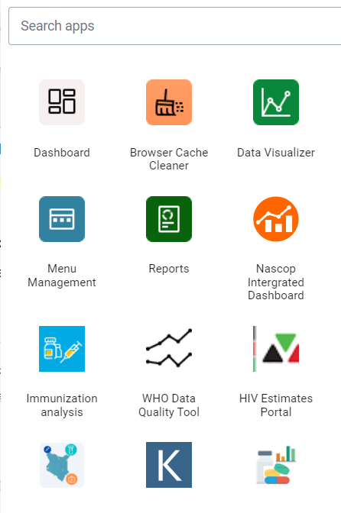
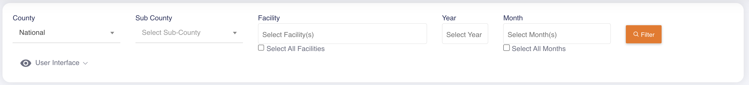
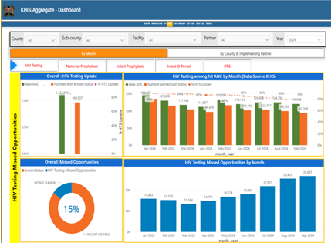
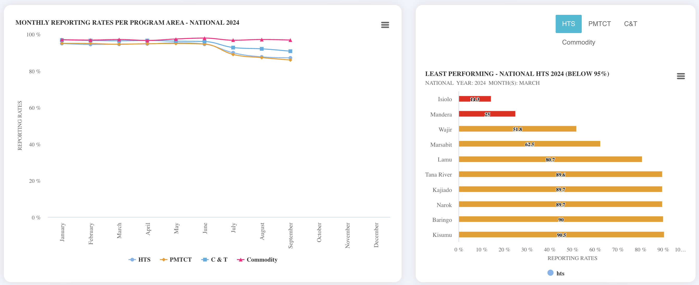
Reporting & Data Validity Monitoring
WHO Data Quality Tool to monitor reporting rates, data completeness and integrity
  PMTCT Missed Opportunities Dashboard for tracking and timely identification of documentation gaps and true missed opportunities for action.
National HIV Dashboard to monitor under/non-reporting across program areas and facilities
Source: KHIS, National HIV Dashboard
Notes:
Automated indicator reporting from EMR to KHIS.

Slide 13
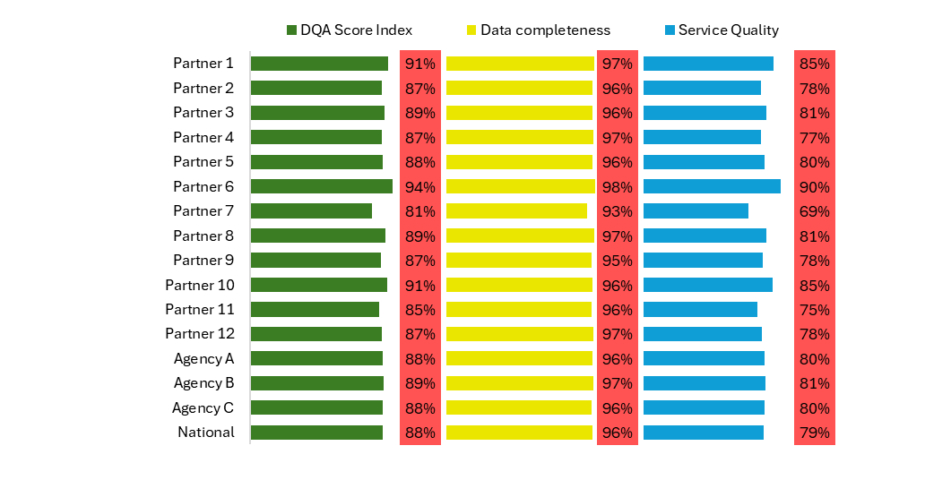
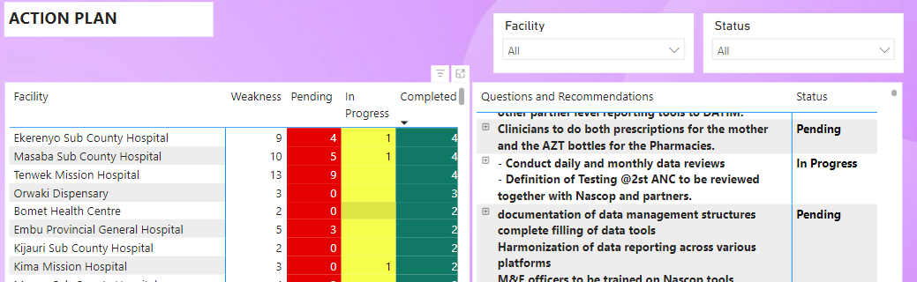
Remote D/SQA & Follow Up
Step 1 : Review and Mapping of the Indicators
Remote DQA Results
Systematic examination of program indicators.
Mapping of indicators to D/SQA modules mapping
Step 2 : Data extraction
Systematic gathering of relevant data from the database ensuring that all necessary information is compiled for further analysis.
Step 3 : Data analysis and presentation
Examination and interpretation of collected data
Packaging of results in a clear and accessible format for reporting and decision-making
Step 4 : Report Dissemination & Action
D/SQA Results dissemination (narrative & power-point presentation) to relevant stakeholders for informed decision-making and action.
Insights in the D/SQA module within the National HIV Dashboard
Facility specific reports submitted via email for action planning

Slide 14
Identifying and Resolving Data Issues
Individual Level Data Systems
KenyaEMR and Datawarehouse solutions

Slide 15
Outline
Identifying and resolving data issues
  At source (EMR)
  During transmission
  At national level
    Single Point Of Truth (SPOT)
    Indicator concordance analysis
    Data use & feedback
    Bidirectional communication between NDW and EMR

Slide 16
Prevention of data issues in the EMR
Use of EMR as Point of Care which reduces the risk of transcription errors, allows completeness in data collection, accommodates for data verification across programs
The EMR has other features for preventing data issues at the EMR level including;
  User interface controls (Checkboxes, Dropdown Lists and Buttons) that reduce data entry errors.
  Range checks and logic checks that do not allow user to enter incorrect data, save a form without filling the required fields, and validates information to be documented as per the laid down business rules.

Slide 17
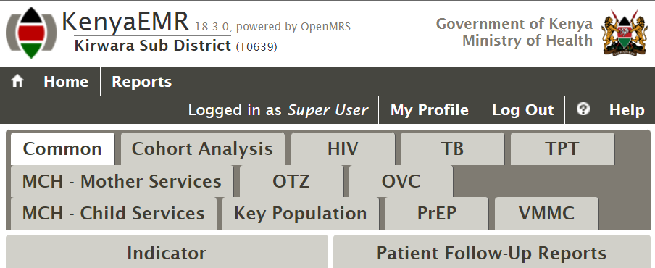
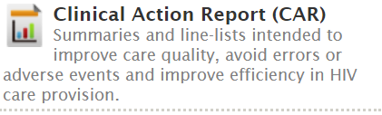
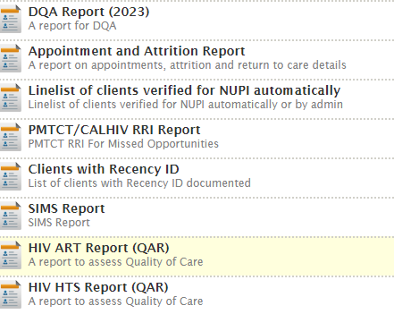


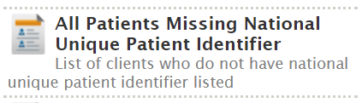

Detection of data issues in the EMR
Availability of RQDA report, SIMS report and Comparison of TX_CURR from two reporting periods which allow users to access data with quality gaps for corrective action.

Slide 18
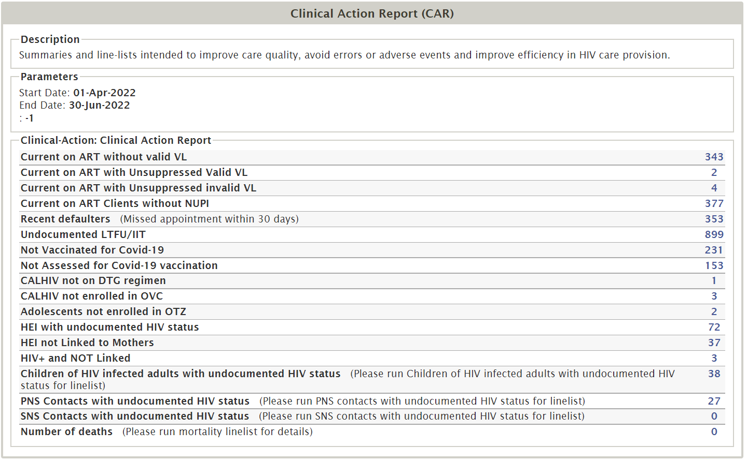
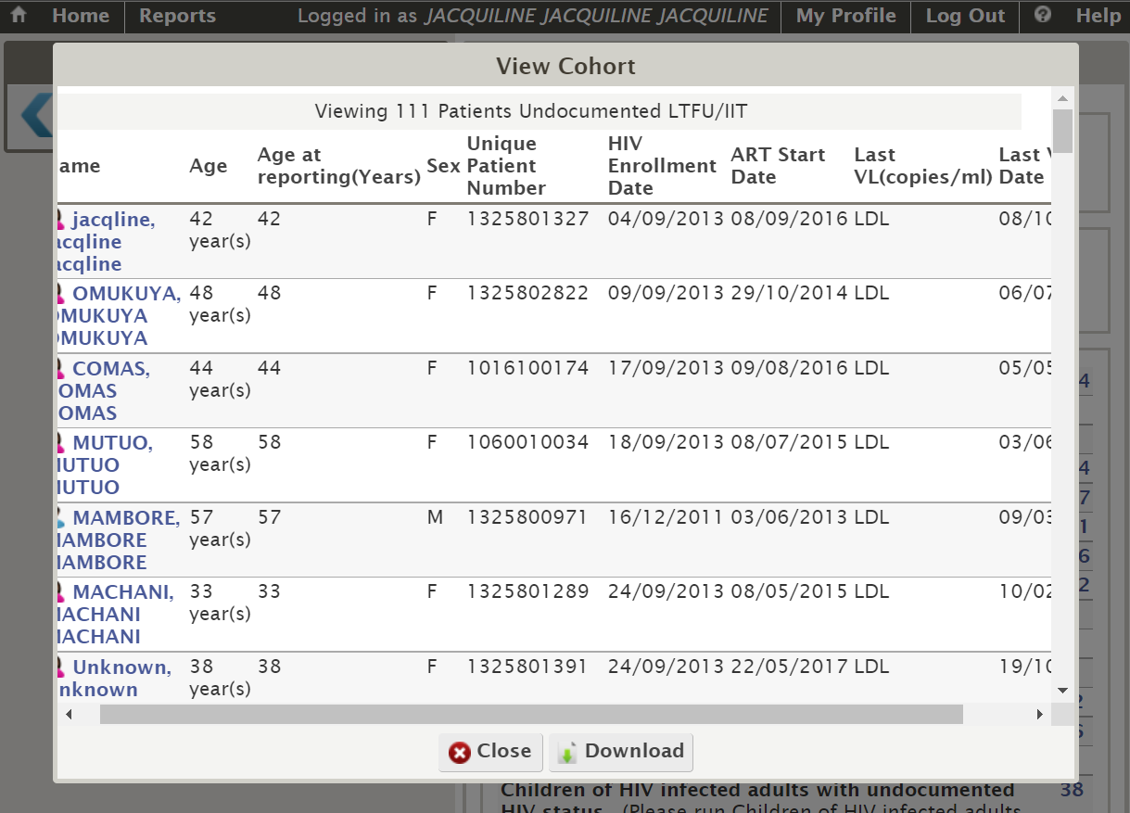
Detection of data issues in the EMR
Actionable oriented reports:
Clinical Action Report
Provides a one stop point for gaps identification in areas of high priority for the program
Form a basis for quality improvement team discussions
As with other standard reports, allows for drill down to patient levels
It's a call to action for health care providers to achieve improved health outcomes

Slide 19
Identifying and resolving data issues at Data transmission - DWAPI
Stale database check. This check helps notify the facility that some visits are missing as they are not meeting the threshold of expected visits for the facility and should recheck to make all data has been fed correctly into the system.
Last refreshed ETL in KenyaEMR check. This check helps notify the facility that their ETL has not been refreshed and to do so before attempting to load data to make sure it is up to date.
Load and send time must be between 24 hours check. This check gets the time difference between the time loaded CT and sending. In the past, some facilities loaded data outside the reporting period and sent it days later during the reporting period. It created an issue with metrics as the metrics loaded were incorrectly dated
The NDW utilizes checks on stale database and the last refreshed ETL to ensure the Timeliness and Completeness metrics of the data in the NDW

Slide 20
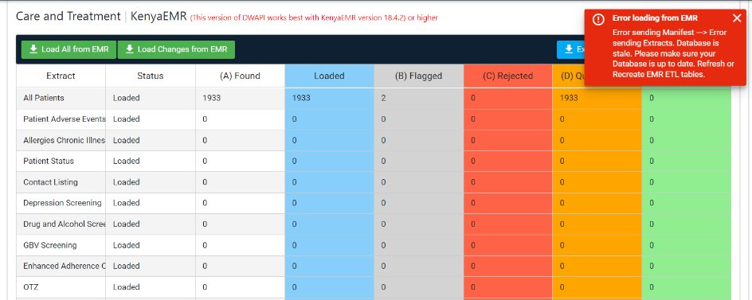
Example stale DB warning check
Notes:
Number of Checks before transmission: Stale,

Slide 21
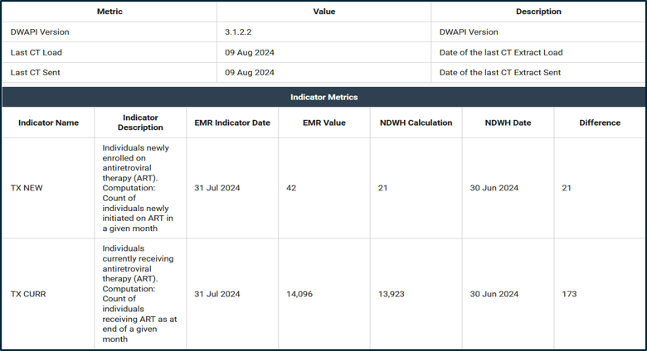
Identifying and resolving data issues at NDW - SPOT
SPOT is used to display metrics collected from the EMR eg Tx_Curr and compare the NDW calculation of the same metrics based on the data received in NDW.

Slide 22
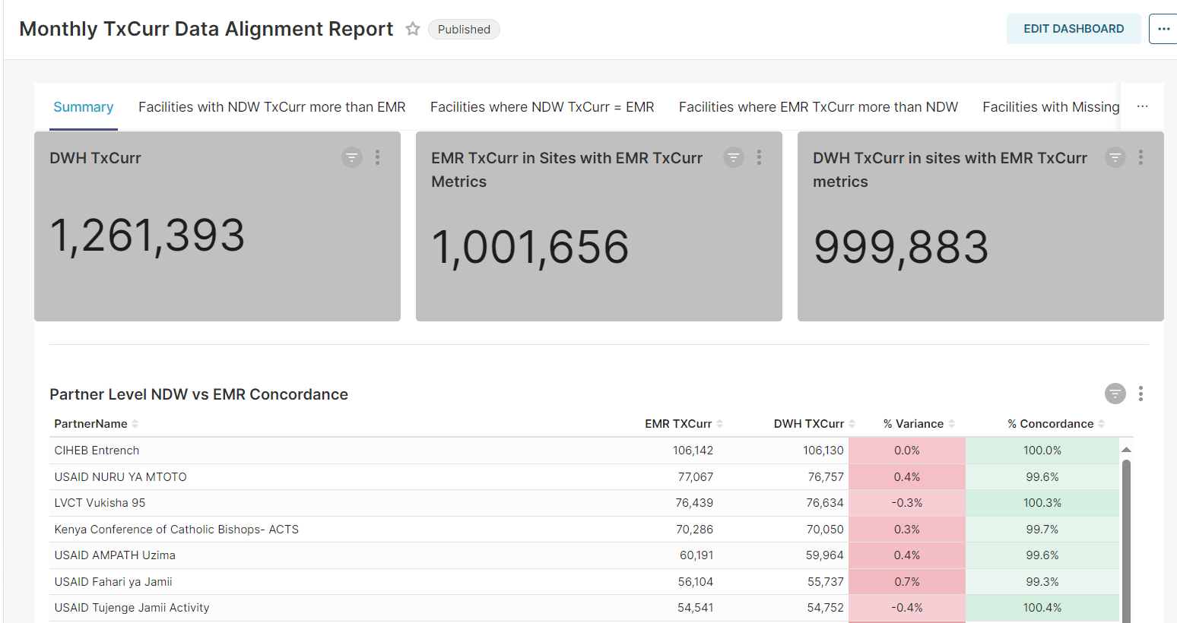
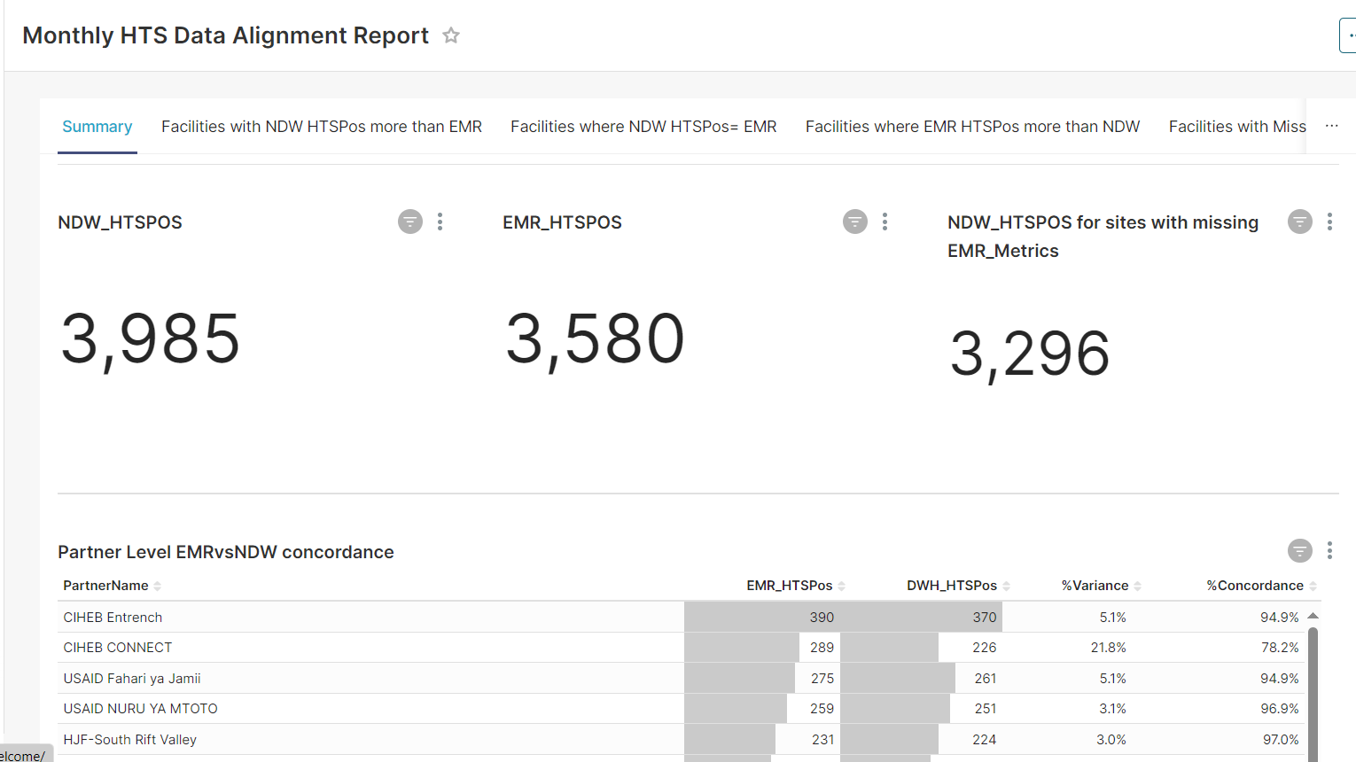
Identifying and resolving data issues through tracking EMR vs NDW concordance
These are concordance reports that track variations between key indicators of interest in the EMR and NDW
The reports aid in showing data quality gaps at an aggregate level & also broken down at facility, partner and county levels

Slide 23

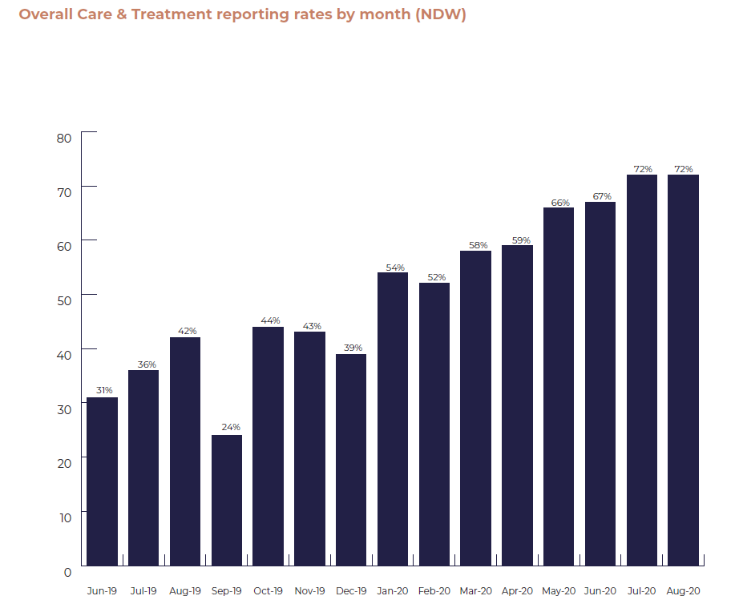
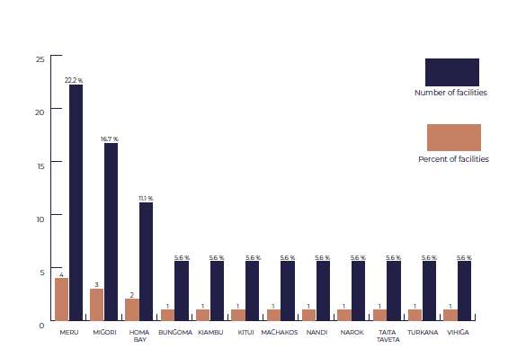
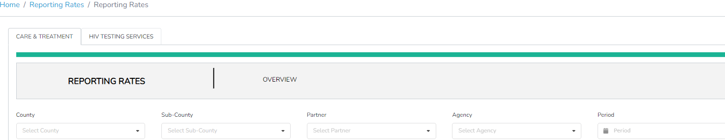
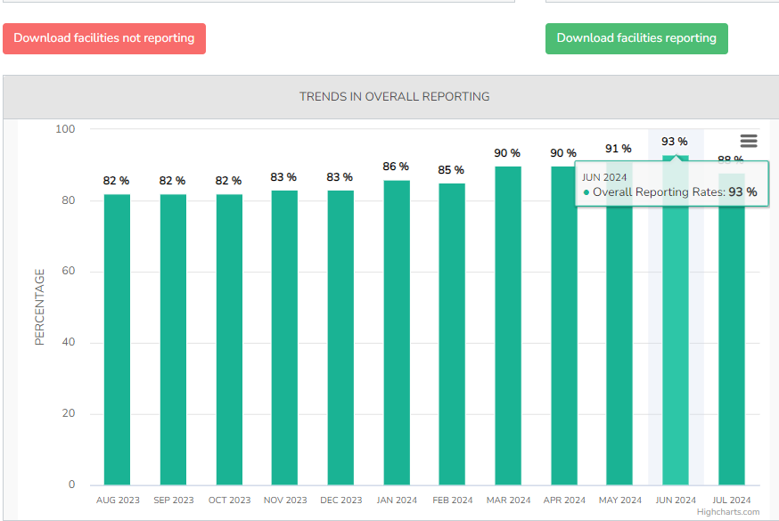
Identifying and resolving data issues through data use & feedback (1/3)
Monthly Bulletins - Later automated as dashboards
NDW Reporting Rates Dashboards
  Tracks monthly
    Reporting rates
    Reporting trends over time
    Reporting consistency
    Downloadable list of non-reporting facilities
  Action
    Encourages real-time tracking and county & partner accountability
Facilities that uploaded stale databases

Slide 24

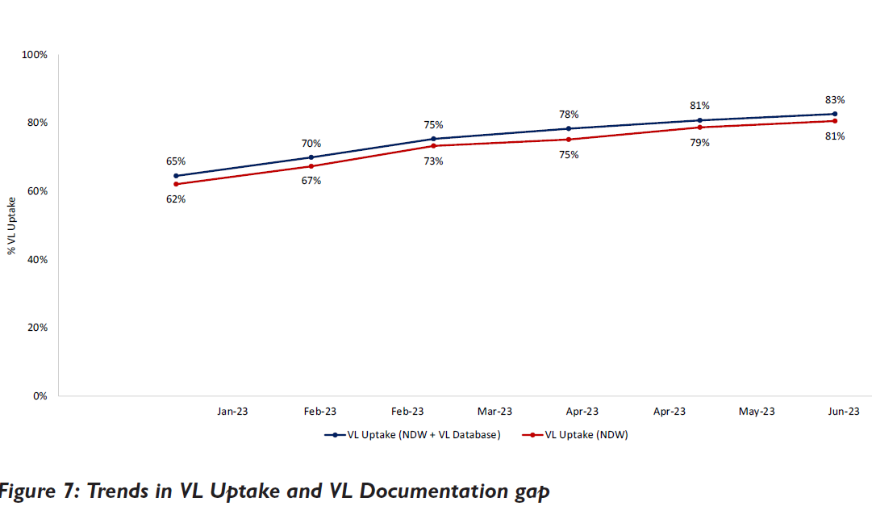
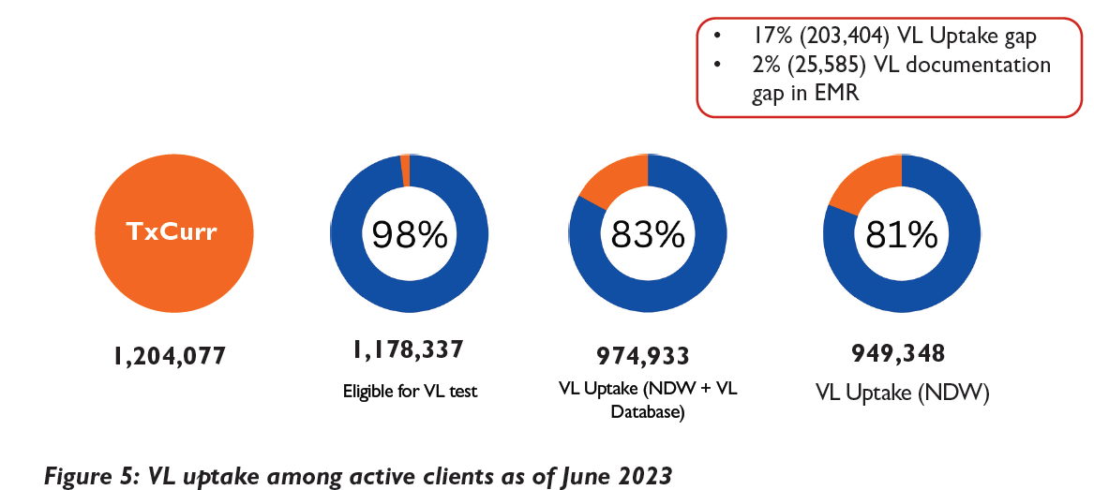
Identifying and resolving data issues through data use and feedback (2/3)
Routine Analysis Approach
  Identify data quality gaps during routine analysis
  Investigate cause: transmission related, logic related, or user errors
  Engage partners/Counties for corrective action
This is an example of a bulletin highlighting data quality gaps in VL monitoring among ART patients.

Slide 25
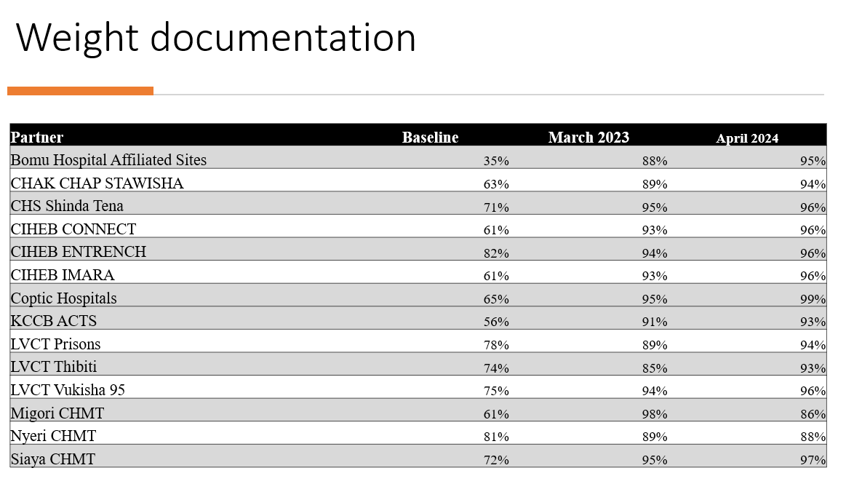
Identifying and resolving data issues through data use & feedback (3/3)
Monthly Tracking of Topline Indicators Approach
Identify data quality gaps jointly with program TAs
Select topline indicators for monthly tracking
Program TAs support facilities to address the gaps
Examples
Paediatric topline indicators
Weight, height, regimen documentation etc.
PMTCT topline indicators
Documentation of HEI final outcomes etc.
Comparison at baseline Sept 2023 and April 2024

Slide 26
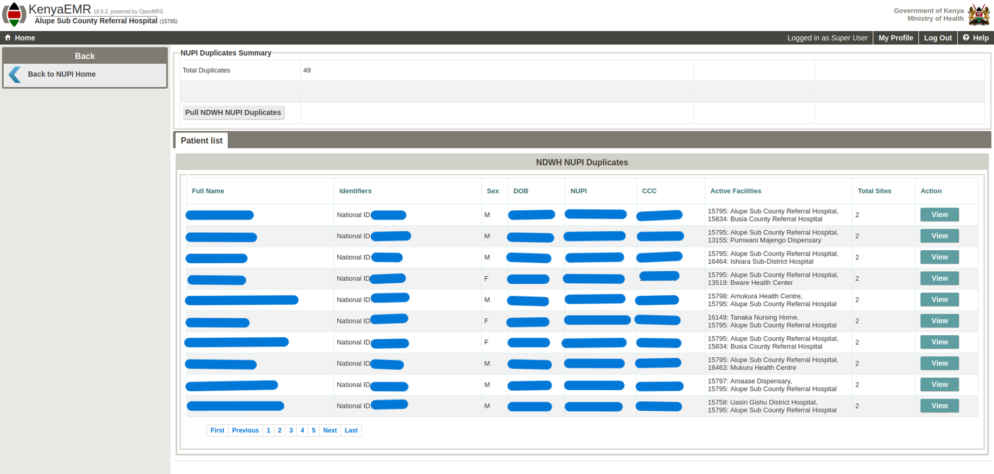
Identifying and resolving data issues through bidirectional communication between NDW and EMR
The Master Patient Index (MPI) offers a reliable API for the exchange of client demographics between the NDW and EMRs.
We have leveraged on MPI to identify duplicate clients from the NDW and send a duplicates report to the EMR.
A duplicates SOP have been developed to support facilities to resolve duplicate clients.

Slide 27
Thank You

