Slide 1

Data Use Community
Kenya’s approach to DQA
Thursday September 12th , 2024

Slide 2









For all Site typologies
Data sources and Reports
Focus on all existing reporting systems including:
DATIM, KHIS(DHIS2), NDW/R
Standard process that covers all source systems:
Paper and EMR
Assessment domains:
Systems assessment
Reviewing the systems that facilitate data collection and reporting
Data comparison/ verification
Comparing what is reported vs what exists in source documents/ systems
Patient chart abstractions
Gauge completeness of data contributing to the expected reports
Team composition
All-inclusive MOH (National and County), Implementing partners, USG agencies, UN family, CSO groups.
Focus on follow up on gaps identified and action points.
Leveraging on digitization of this process to track this entire process with fidelity.

Slide 3
Focus on Individual level data systems- EMR and NDW component
Transition from RDE to point of care systems, focus on clinical care with reports and surveillance as secondary outputs, inclusion of all required reports and registers generated passively.
Minimal free text, Incorporation of range and logical checks.
Availability of line lists for every report to facilitate validation.
Data quality checks at transmission to the NDW
Data concordance reports
Data use, increased access and availability, and actionable feedback as avenues to improve data quality and program performance

Slide 4





Welcome

Slide 5
AGGREGATE HIV DATA QUALITY
Data Use Community Webinar

Slide 6
Presentation Outline
MoH DQA Policy Framework
DQA Maturity Model
HIV Program D/SQA
Overview of e-D/SQA tool
D/SQA Implementation Process: Set Up, Conducting the D/SQA, Reporting and Action Planning
D/SQA data dashboards
Remote D/SQAs: DREAMS D/SQA as a Use Case
Lessons Learnt & Areas for future improvement
Technology Stack
Notes:
Overview of eDQA and eSQA rationale, access, and functionalities including allocated follow up action points and resolutions for the same, any automated reports? National level DQA dashboard including the ability to drill down to counties and facilities.
Overview of DQA protocol if not available running through the components of the DQA app will show how this was operationalized.
Data concordance reports.
Feedback and follow up action including adopt a county.
lessons learnt and areas of future improvement

Slide 7



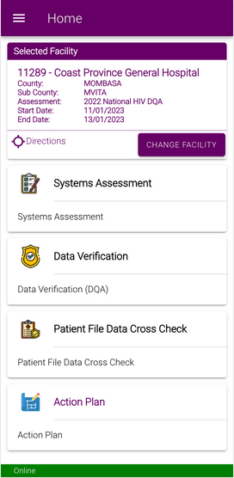



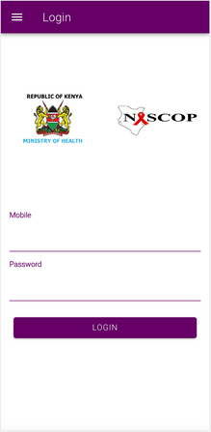
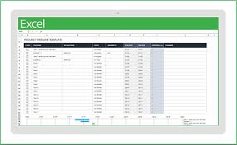
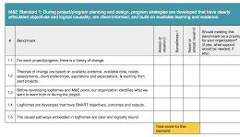

D/SQA Evolution Course​
<2009
2009
2010-2013
2014-2015
2017-2019
2020
No D/SQAs
Paper Based D/SQAs
Excel Based D/SQAs
Modified Excel Templates
Proprietary ODK Tool
Open Source
e-D/SQA Tool

Slide 8
MoH DQA Policy Framework ​
AIM:
To standardize implementation of data quality assessment in HIV program in Kenya to improve data quality.
OBJECTIVES:
Define essential parameters for conducting DQA for the HIV program, with standardized methods and tools.
Define roles and responsibilities of relevant stakeholders in the HIV program DQA.
Promote effective dissemination, use of assessment findings for quality improvement, evidence-based decision making and promote continuous learning.
Provide a framework for developing and monitoring Data Quality Improvement (DQI) plans
Envisioned a DQA Maturity Model
Notes:
Available on IoS and Android
Creation of users disseminated to counties and partners, NASCOP creates admins
Supervision/ Team Lead doesn’t need to be present physically at all the facilities

Slide 9
DQA Maturity Model​
Integrated
Optimized
Emerging
Structured
Nascent
County lacks DQA capacity & does not follow the national protocol.
DQA activities happen by chance ad hoc.
DQA/DQI not included in JDs for accountability.
Staffs not sensitized on DQA policies, standards & tools/ Tools
DQA forums nonexistent.
No budgetary allocation to DQA/DQI, reliance on partner funding.
Managers not committed to implement actions from DQA findings
County has defined DQA structures & processes in line with the national protocol but not well documented.
No formal DQA or DQI activities but their efforts to conduct DQAs per the national protocol.
Ad hoc DQA forums/ Paper based HIS tools available but not sufficient.
Staff sensitized on DQA and DQA/DQI included in JDs for accountability.
Ad hoc DQAs, not included AWPs/ DQAs fully funded by partners.
Managers aware of data quality gaps, but do not prioritize them.
County has documented DQA structures * processes as per the protocol.
Formally defined DQA.
Staffs sensitized on DQA.
DQAs conducted as per national protocol/
HIS tools available but not sufficient nor used optimally.
DQA included in AWP, however partner funded.
Structured DQA forums in place but irregular.
DQA assessed in staff appraisals/managers prioritize DQI activities.
County adhere to the national protocol & implement SOPs.
DQA metrics systematically used.
Managed and measured DQA.
HIS tools sufficiently available & used.
Desk review approaches for DQA adopted.
Structured & routine DQA forums in place
DQA included in AWP & partially funded by county/ DQA allocation in county budget.
Staff have DQA capacity/ DQA assessed in staff appraisals/ Managers prioritize DQI activities.
County routinely review & utilize DQA findings.
Continuous improvement of DQA.
Full county ownership, resource commitment & oversight of DQA/DQI.
DQI teams/ DQA forums functional & regular
HIS tools digitized/ Data alignment across sub-systems.
Annual DQA plan available & adhered to/ County fully funds DQA/DQI.
M&E/HIS unit steer DQA/DQI
Critical mass of staff have DQA capacity.
DQA capacity/ DQA assessed in staff appraisals/ Managers prioritize DQI activities.
Notes:
Available on IoS and Android
Creation of users disseminated to counties and partners, NASCOP creates admins
Supervision/ Team Lead doesn’t need to be present physically at all the facilities

Slide 10
HIV program D/SQA ​
Annual national DQA in sampled sites
At least quarterly at facility level
Core set of system and program indicators identified for longitudinal monitoring
Gaps:
Conducting DQAs was expensive (resources, data availability) – utilization of a proprietary mobile data collection tool
Disparate tools across stakeholders
Use of Excel based and paper tools, access to DQA reports
Lack of an SQA component
Minimal accountability on DQI initiatives
Leveraged on technology to improve efficiency
Notes:
Available on IoS and Android
Creation of users disseminated to counties and partners, NASCOP creates admins
Supervision/ Team Lead doesn’t need to be present physically at all the facilities

Slide 11
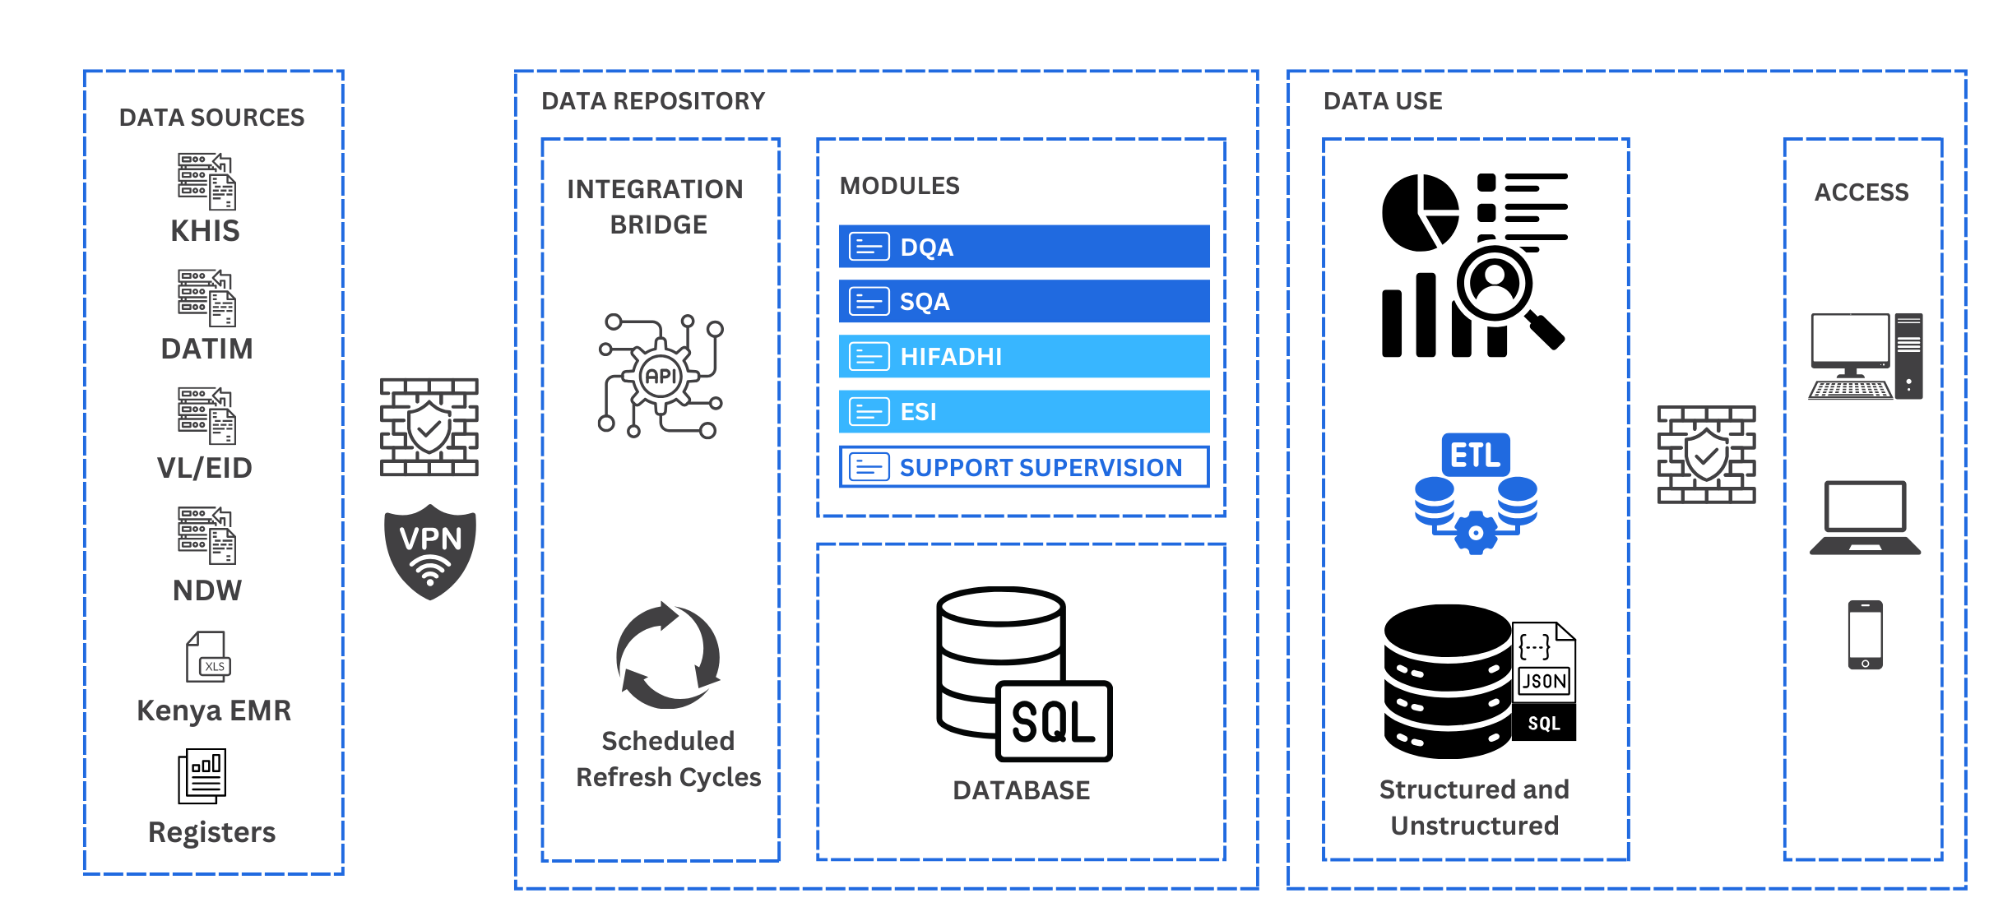
Data & Service Quality Assessment Tool
Notes:
System Assessment​
Data Verification​
Patient File Cross Check​
Service Quality Assessment
Realtime Facility Assessment Report
Action Planning
Assessment Team Management
System Assessment​
Data Verification​
Patient File Cross Check​
Service Quality Assessment
Realtime Facility Assessment Report
Action Planning
Assessment Team Management

Slide 12
HIV e-D/SQA Tool​
HIV e-D/SQA tool developed to standardize Data & Service Quality Assessment process and support national and routine DQAs at all levels
Modules:
Systems Management
Data Verification​
Patient File Cross Check​
Service Quality Assessment
Realtime Facility Assessment Report
Action Planning
Assessment Team Management
Successes:
  Standardized D/SQA process at National & Sub National levels
  Tool used to conduct National DQA for last 3 years
  Provides a repository for previous D/ SQA and longitudinal data monitoring
  Sustainability – tool routinely utilized, improved quality of data
  Remote monitoring of DQA process and supervision of teams
Notes:
Available on IoS and Android
Creation of users disseminated to counties and partners, NASCOP creates admins
Supervision/ Team Lead doesn’t need to be present physically at all the facilities

Slide 13
D/SQA Implementation Process
Post D/SQA
During the D/SQA
Dissemination of findings to relevant stakeholders
Can be accessed through the National HIV Dashboard (https://hiv-dashboards.nascop.org/)
D/SQI work plan implementation and follow up
Pre-D/SQA (Preparation process)
Data collection – collection of data for all the modules (Systems Assessment, Data Verification​, Patient File Cross Check​ and Service Quality Assessment)
Feed back and development of D/SQI work plan
Automated site report
DQA/SQA Preparation process
  Defining the scope
  Set up assessment in the e-tool
  Facility and Indicator selection
  Team Formation
  Training teams, access rights to the tool, communicating with facilities
  Pre-pull KHIS and DATIM data and populate the assessment tool
Notes:
DQA Implementation process remains the same

Slide 14
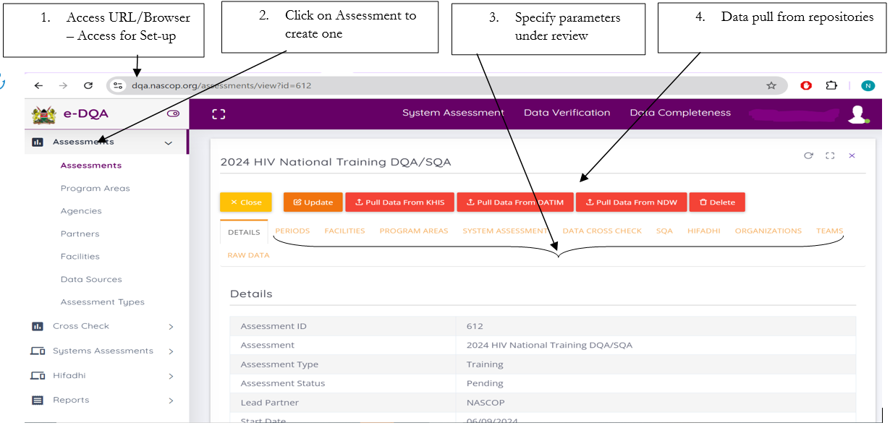
Pre-D/SQA – Assessment Set up
Notes:
To access the URL and be able to set-up for an assessment, one has to be set-up as an admin at National/County/Sub-County/Facility levels

Slide 15
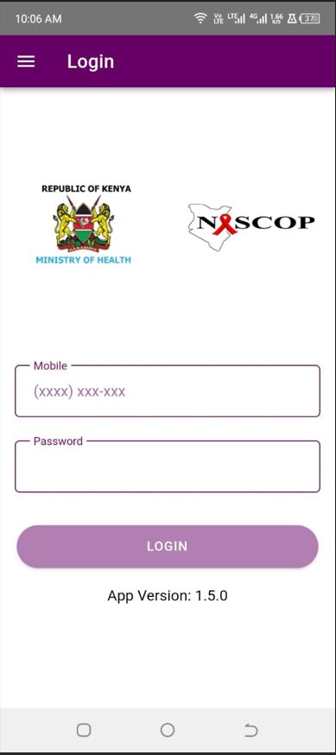
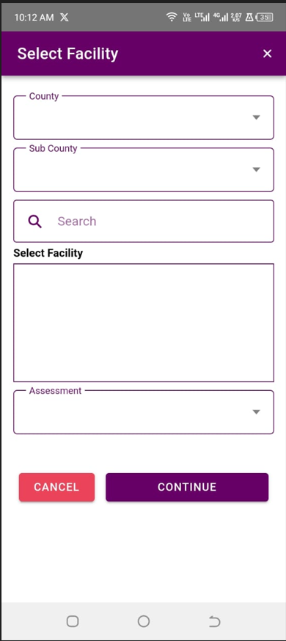
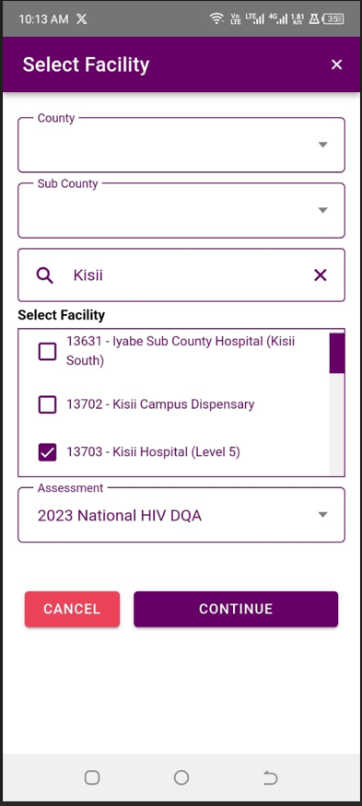
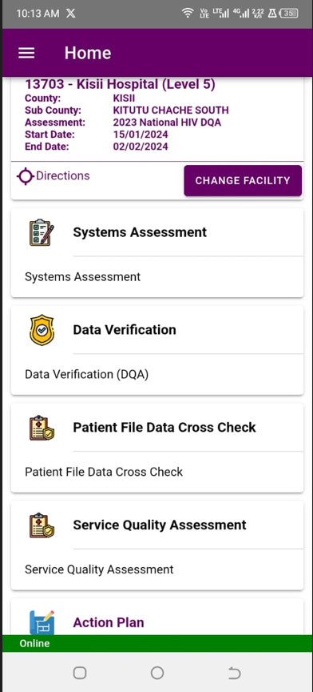
Conducting D/SQA
Access: Tool available in Play store/Appstore
Authentication needed to log in
Access to site – user must be a team member and assigned the site
Upon successful login, search facility to assess and select the assessment
The App loads all the modules for assessment
Indicates when user has internet connection
Notes:
To access the e-D/SQA tool for the assessment, one has to be set-up as a system user and given log in credentials, and download the Application from Playstore/AppStore.

Slide 16
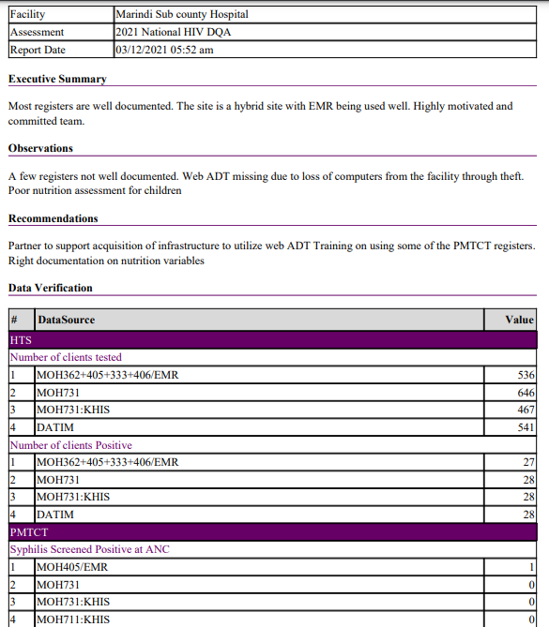
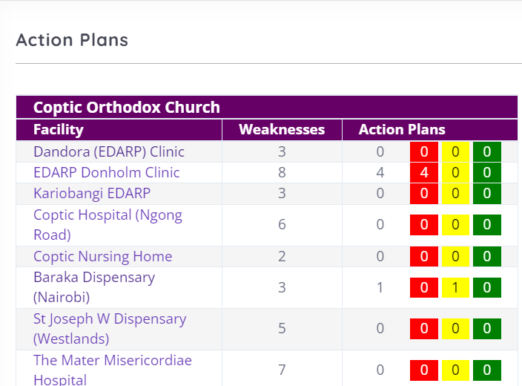
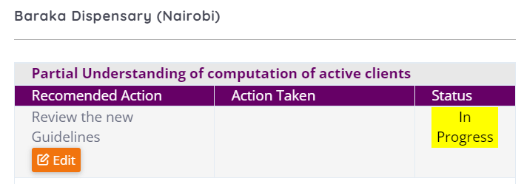
Post D/SQA – Reports and Action Planning
Facility report – Summary generated after assessment
Provision for action plan monitoring

Slide 17
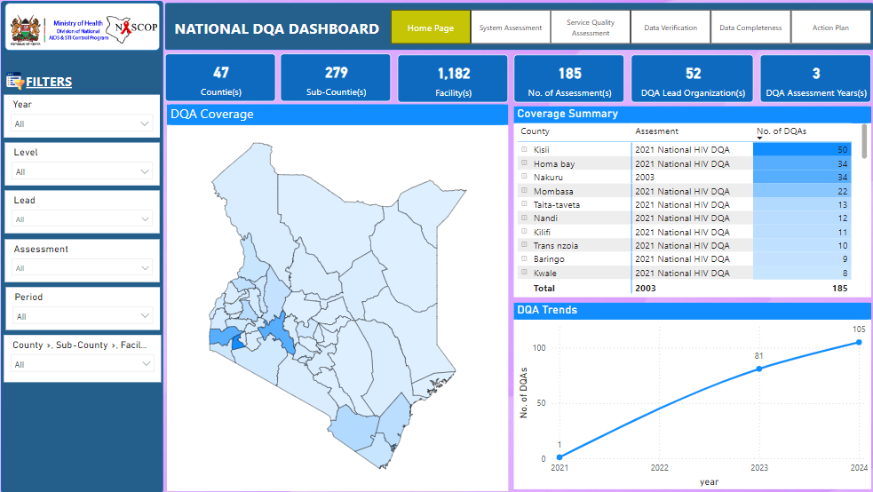
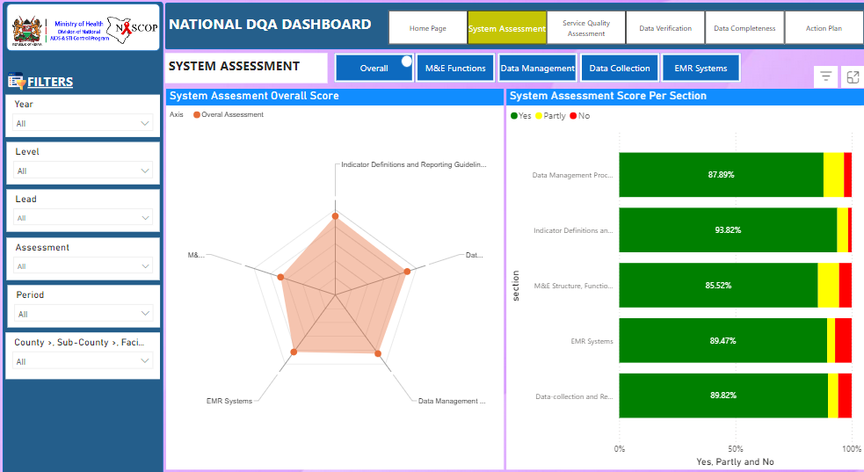
HIV e-D/SQA Dashboard
Interactive dashboard for decision making on the D/SQA’s outcomes, at National, County and facility level

Slide 18
Remote D/SQAs: DREAMS D/SQA as a Use Case
Step 1 : Review and Mapping of the Indicators
Systematic examination of program indicators.
Mapping of indictors to D/SQA modules mapping i.e., completeness and service quality for a thorough D/SQA desk review analysis
Step 2 : Data extraction
Systematic gathering of relevant data from the DREAMS database ensuring that all necessary information is compiled for further analysis.
Step 3 : Data analysis and presentation
DREAMS D/SQA DESK REVIEW PROCESS
Examination and interpretation of collected data to uncover patterns, trends, and insights
Packaging of results in a clear and accessible format for reporting and decision-making
Step 4 : Report Dissemination & Action
Dissemination of final report and key findings to relevant stakeholders for informed decision-making and action.
Format: D/SQA report narrative, PowerPoint presentation and insights in the D/SQA dashboard module within the National HIV Dashboard

Slide 19
Data Completeness Results : Overall
Color code
 | 100% |  | 95%-99% |  | 90-94% |  | <90%
Data Source: DREAMS database Assessment: 2024 Desk Review Period: As of 23rd Aug 2024

Slide 20
2023 DREAMS D/SQA Action Plans Follow Up
Data Source: e-DQA Tool Assessment : 2023 DREAMS DQA Period: As of 23rd Aug 2024

Slide 21
Challenges and Mitigation
Challenges Faced | Mitigation Measures
1. Slow Uptake of the e-tool – existence of varying DQA tools across different levels | Change Management: Policy, Capacity building and support (Webinars, D/SQA e-course and TA support). Decentralization of user admin function
2. Varying interests and wanting to add indicators beyond the core indicators | Consensus on minimum set of core indicators and a provision for additional indicators of interest

Slide 22
Lessons Learnt & Areas for Future Improvement
Stakeholder involvement during development process improves buy in and uptake
Don’t wait for perfection to start, begin with what you have and improve as you go along
Areas for Future Improvement
Expansion of the e-D/SQA tool to include other program areas – HIFADHI (IIT), support supervision and other health programs
Utilization of digital D/SQA tool for desk reviews to inform targeted site level assessments or TAs.

Slide 23
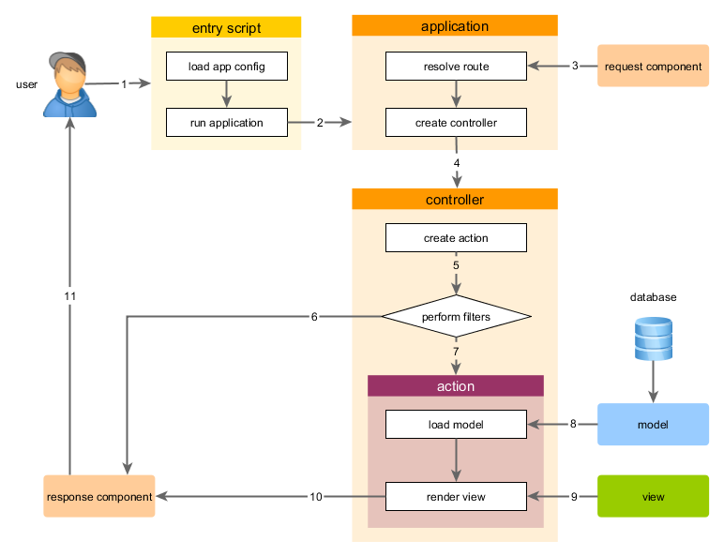
Backend Engine - YII2 Framework
PHP
HTML5
CSS
MySQL
MVC (Model-View-Controller)
Supports
  Relational databases
  NoSQL databases
RESTful API
Power BI Dashboards
Highcharts Dashboards

Slide 24
Ionic Framework Cross-Platform Mobile Development
Angular
Capacitor
HTML5
CSS
IOS
Android
Web

Slide 25
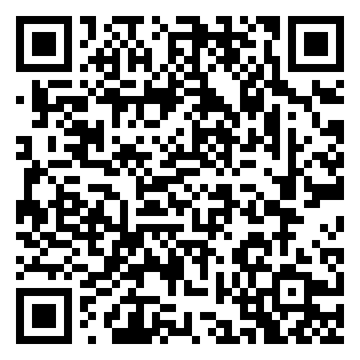
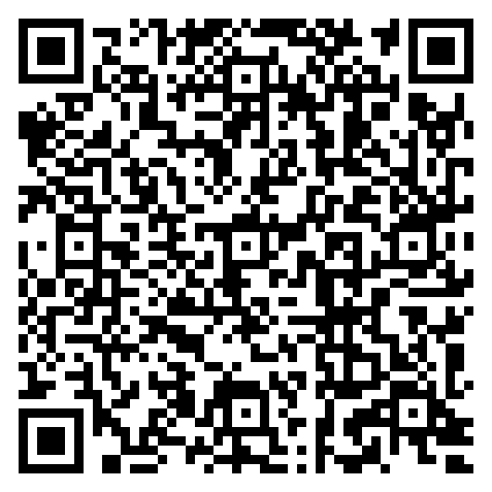
Accessing The Tool
Where to find
Available on iOS and Android
QR Code
e-D/SQA Tool – IOS
e-D/SQA Tool - Android

Slide 26
Strengthening Data Quality within EMRs and the NDW in Kenya

Slide 27
Outline
Introduction: Understanding Data Quality in Kenya
Overview of the HIS landscape in Kenya
Our approach to strengthening data quality
Data collection
Data use and feedback
Data warehousing

Slide 28
Introduction: Understanding Data Quality in Kenya
Definition: We define quality for data generated through our eHealth and mHealth solution as meeting the program’s expectations of accuracy, validity, completeness, consistency, timeliness, and reliability
Importance
  When data is reflective of reality it increases its demand and use
  Quality data promotes evidence-based decision-making
  Use of quality data support program improvement towards achieving and sustaining HIV epidemic control

Slide 29
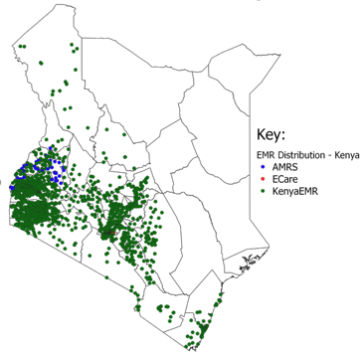
Overview of HIS landscape in Kenya
EMR distribution as of July 2024
- 2,392 Active EMR Sites
- 2,298 KenyaEMR Sites,
- 80 AMRs Sites,
- 14 E-Care Sites,
- 88% of EMR sites reported in the month of July 2024 to NDW
National Data Warehouse | Dashboard (nascop.org)
Module uptake as of July 2024
1,702 (89%) sites are utilizing HTS module
2,392 (99%) sites are utilizing C&T module
2,221 (93%) sites are utilizing PMTCT module
1,470 (74%) sites are utilizing PrEP module
Active PLHIV as of July 2024
- 94% (1,276,487) of CurrART Patients were seen at a site actively using the EMR. (KHIS Data)
-99% (1,261,372) of CurrART Patients seen at EMR Sites had records in NDW.(NDW Data)

Slide 30
Our approach to strengthening data quality
A. Robust Data collection system

Slide 31
i) Point of Care (POC)
Data is collected at the location where patient care is provided, that is the service delivery points.
Accuracy is maintained as patient’s information is directly entered into the system during service delivery, which
  Reduces the risk of transcription errors
  Allows completeness in data collection
  Accommodates data verification across programs
Use of the system as point of care allows EMRs to be used as tools that facilitate patient-centric care while secondarily collecting and transmitting required data for reporting and surveillance

Slide 32
ii) EMR Functionalities that Support Data Quality
The EMR has user interface controls (Checkboxes, Dropdown Lists and Buttons) that reduce data entry errors.
Similar and publicly available logic for indicator computation in both EMR and NDW. This improves data concordance.
The EMR has business rules that does not allow clients to put in data that is not validated
The EMR has RDQA and Clinical Action Reports (CAR) reports that allow users to access data with quality gaps for corrective action.

Slide 33
iii) Routine Data Quality Assessment (RDQA)
  The EMR has RDQA and Clinical Action Reports (CAR) reports that allow users to access data with quality gaps for corrective action.
  This enhances;
    Data accuracy, as the reports and linelists can be used at the facility level to cross-reference and validate data, and hence ensuring that data submitted to the NDW is an accurate representations of the actual situations at the facility
    Data consistency, as these are also used to ensure that aggregate reporting of all reportable indicators in different platforms such as MOH 731 form, KHIS, and DATIM can be supported by linelists generated at the facility, and that the same data is reproducible at the NDW using individual level data

Slide 34
iv) Logic alignment between EMR and Reporting guidelines
EMR has been enhanced to ensure that it follows the MER 2.7 guidelines and latest MOH reporting guidelines.
All MOH, donor reports and other custom reports can be generated from the EMR alongside accompanying line lists. These reports cover;
  Prevention
  Testing
  Treatment
  Viral suppression

Slide 35
Our approach to strengthening data quality
B. Data warehousing: DWAPI

Slide 36
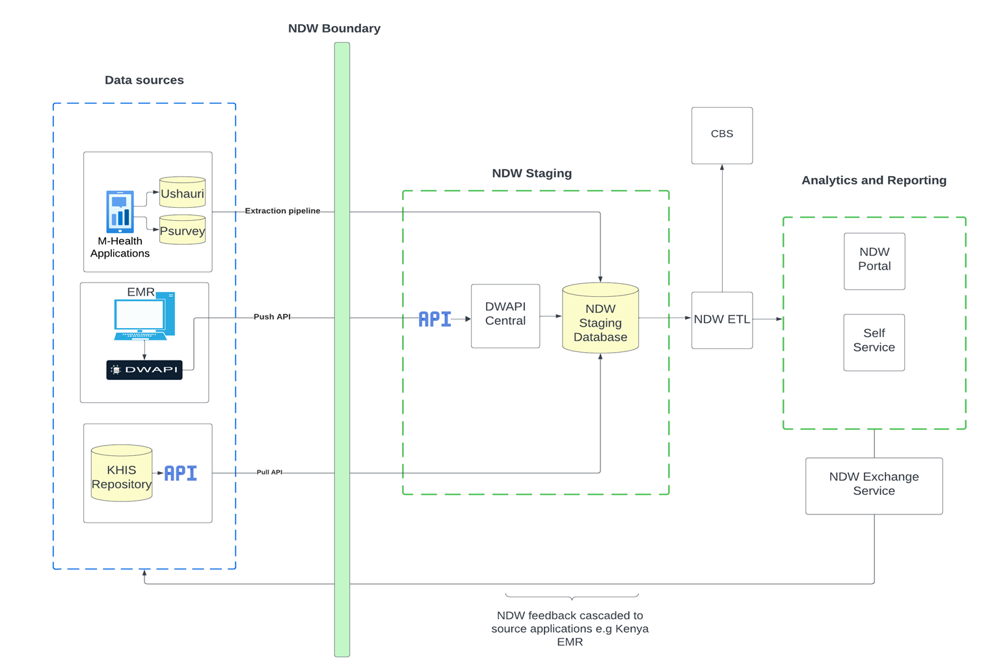
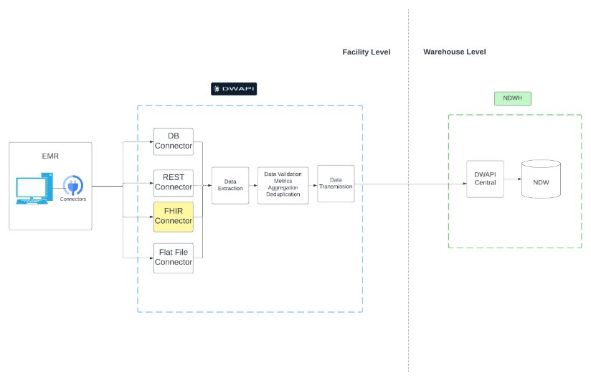
DWAPI
DWAPI Client is a cross-platform application that provides a mechanism for securely extracting data from source systems and transmitting to the NDW Staging

Slide 37
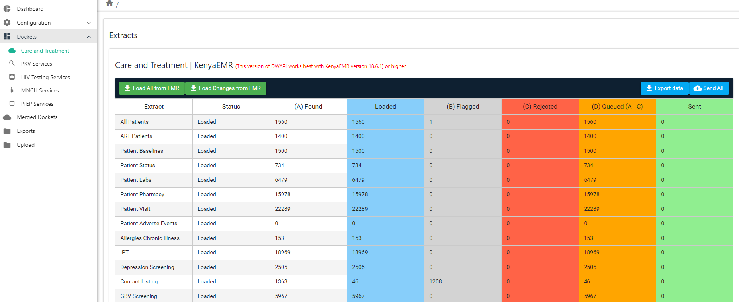
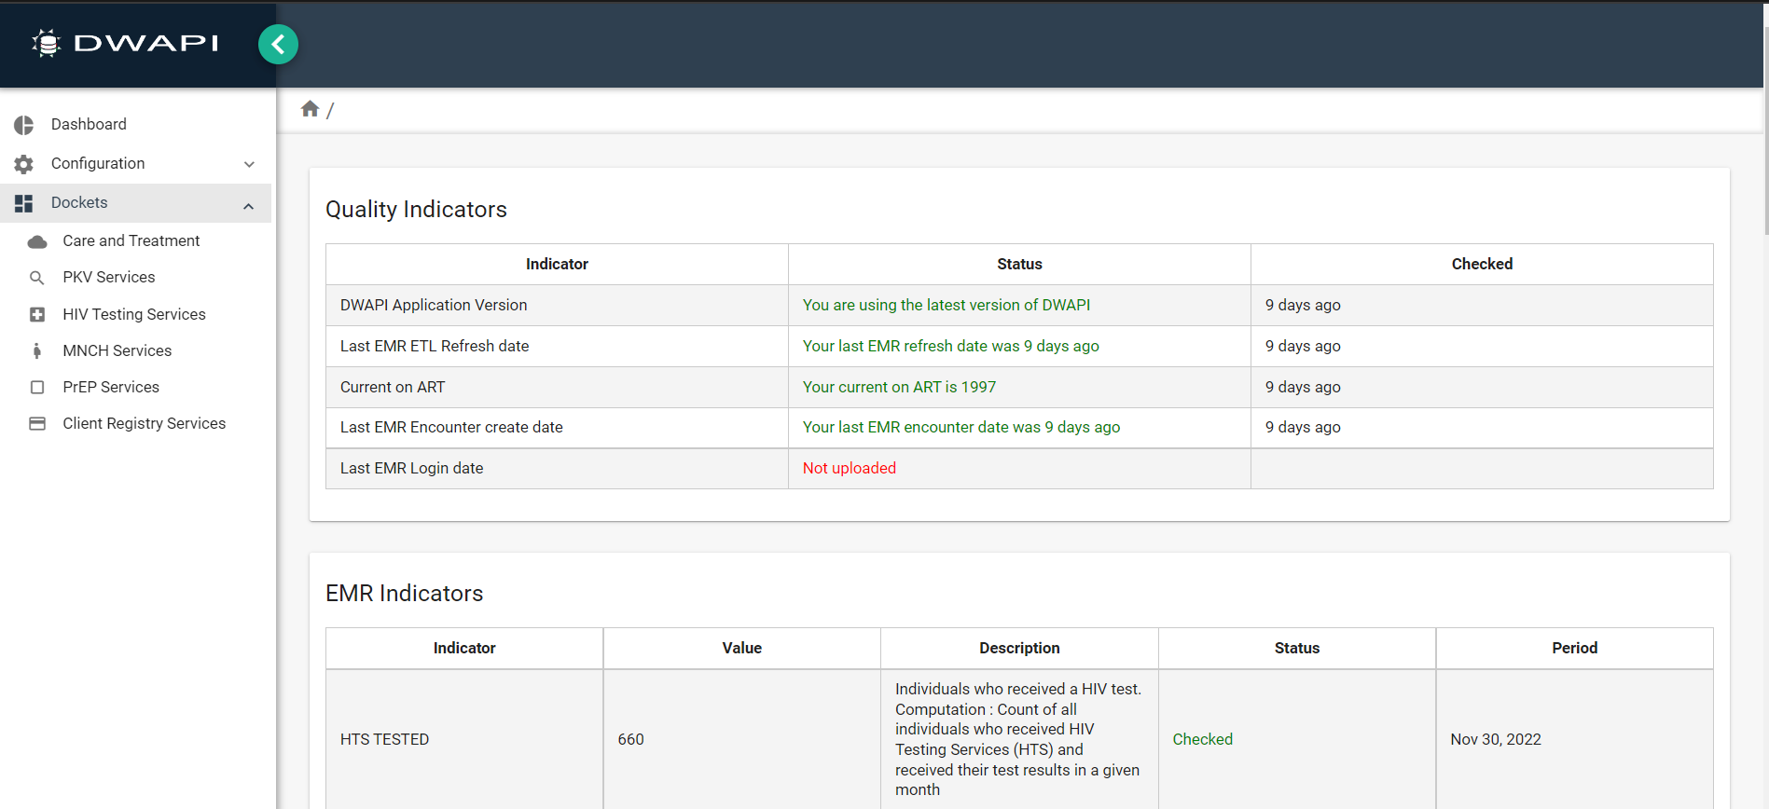
DWAPI
Datasets sent are CT, HTS, MNCH, PREP.
Flags that show which datasets are rejected

Slide 38
Data Quality Checks: Stale databases
Stale database check - this check helps notify the facility that some visits are missing as they are not missing the threshold of expected visits for the facility and should recheck to make all data has been fed correctly into the system.
Last refreshed ETL in KenyaEMR check. This check helps notify the facility that their ETL has not been refreshed and to do so before attempting to load data to make sure it is up to date.
Load and send time must be between 24 hours check. This check gets the time difference between the time loaded CT and sending. In the past, some facilities loaded data outside the reporting period and sent it days later during the reporting period. It created an issue with metrics as the metrics loaded were incorrectly dated
The NDW utilizes checks on stale database and the last refreshed ETL to ensure the Timeliness and Completeness metrics of the data in the repository

Slide 39
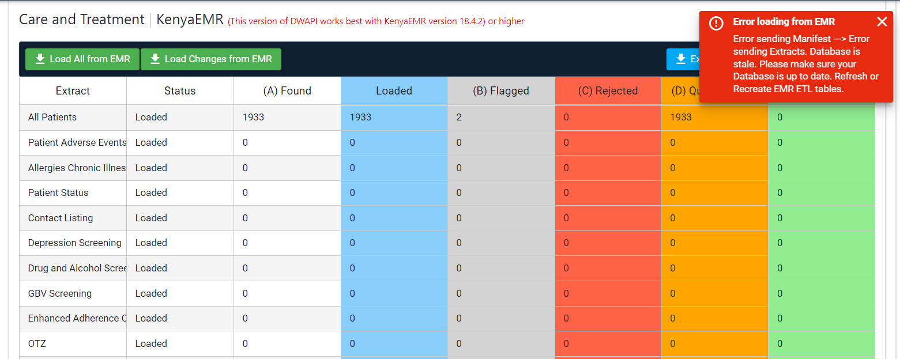
Example stale DB warning check

Slide 40
ii) Submission of Metrics
EMR indicator metrics are calculated and loaded along as part of the transmission package.
DWAPI Metrics service was automated to ease the process and avoid human errors in transmission (KenyaEMR only which accounts 99% of EMRs)
We are collaborating with other EMRs such as ECARE and AMRS to start calculating and sending metrics to the NDW.

Slide 41
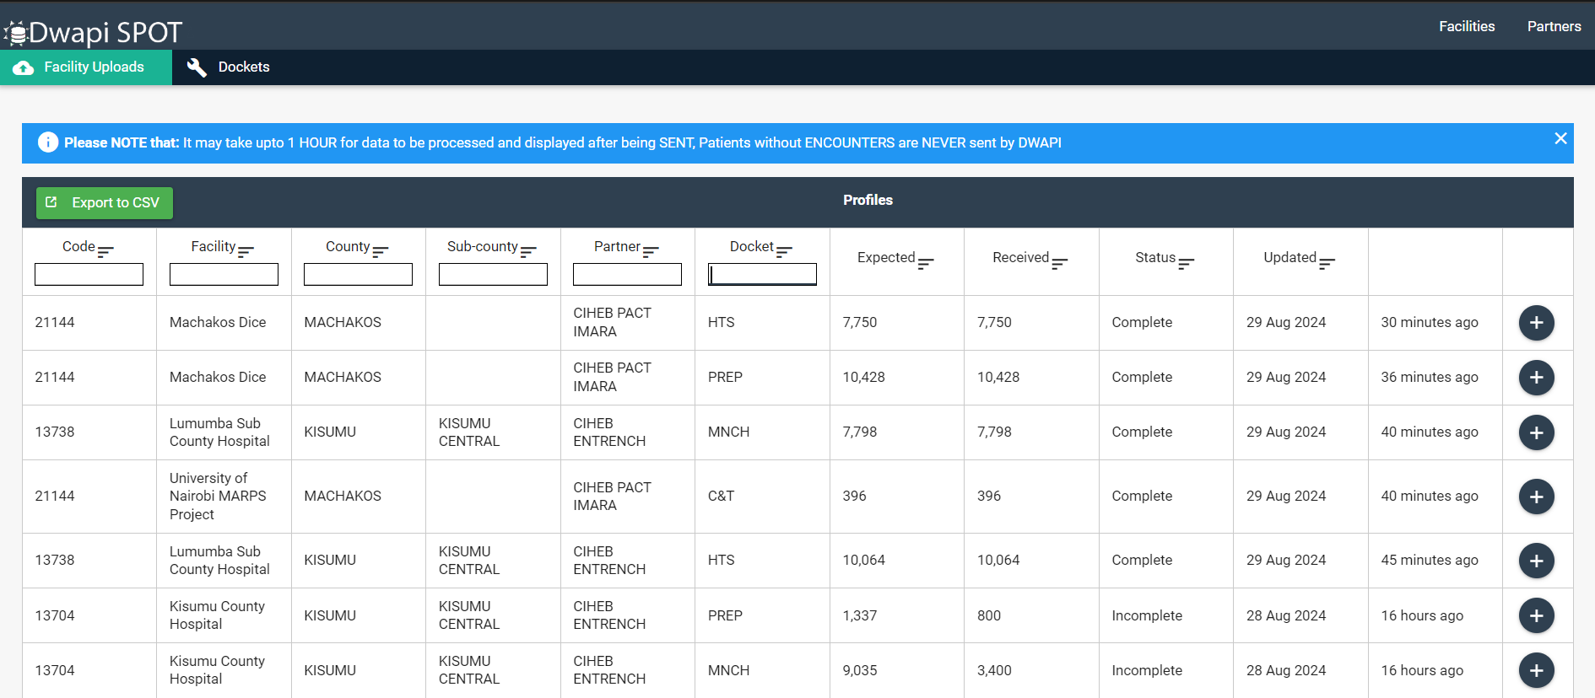
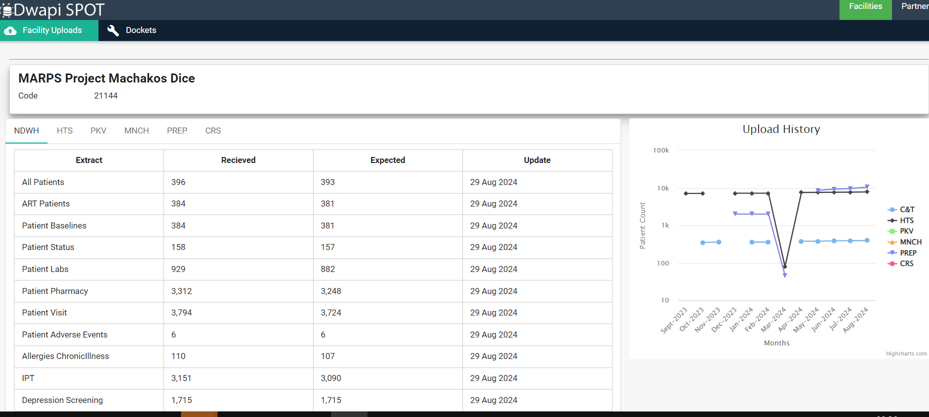
SPOT
SPOT (Single Point of Truth) is the DWAPI upload verification portal for NDW that allows facilities to check whether their upload was complete.
SPOT is also used to display metrics collected from the EMR eg TxCurr and compare the NDW calculation of the same metrics based on the data sent.

Slide 42
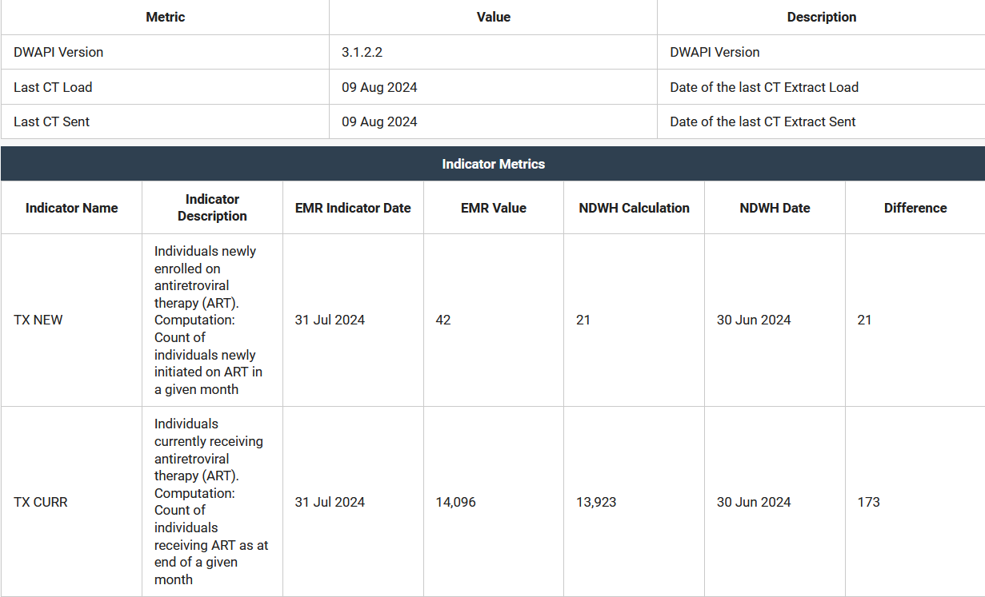
SPOT: Example EMR metrics sent and with a difference

Slide 43
iii) Bidirectional feedback on issues to be resolved
Bidirectional feedback is a process in which a facility can extract and review insights from the NDW for resolution in the EMR.
The Primary facility is then expected to investigate and act on the issues then update the client record accordingly
The updated data is then transmitted to the NDW/R for continued public health use at the national level
Feedback includes potential duplicates as identified in the NDW, Silent transfers, medication dispensation from another facility etc.

Slide 44
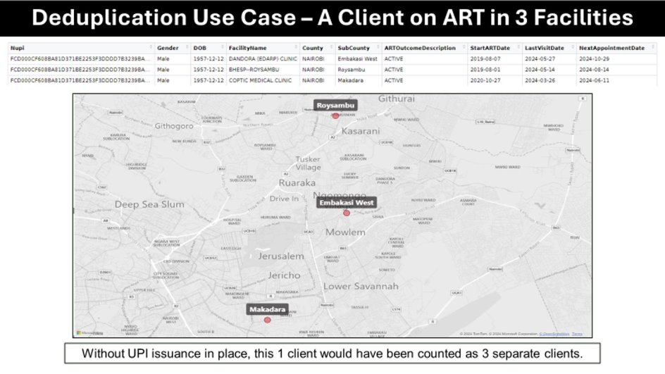
Bidirectional feedback

Slide 45
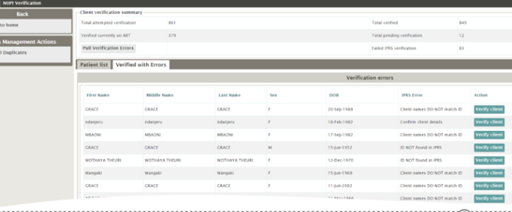
Bidirectional feedback

Slide 46
Our approach to strengthening data quality
C. Data use and feedback

Slide 47

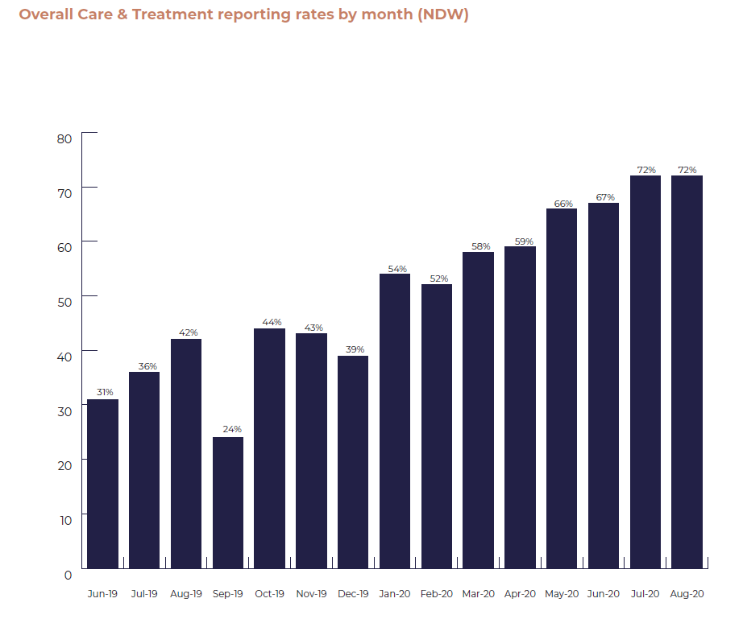
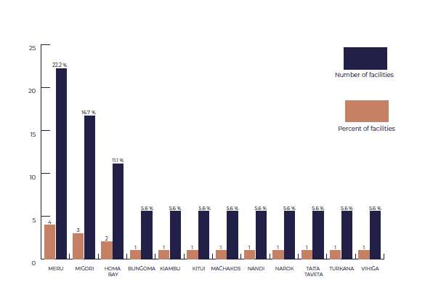
Monthly Reporting Rates Bulletins
Action
  Initially analyzed NDW data and packaged it as a monthly bulletin and send to partners
  Later automated as dashboard
Outcome
  Reporting rates improved from 24% to >90%
  Partners gained clear insights into their performance and data submission trends
Facilities that uploaded stale databases

Slide 48
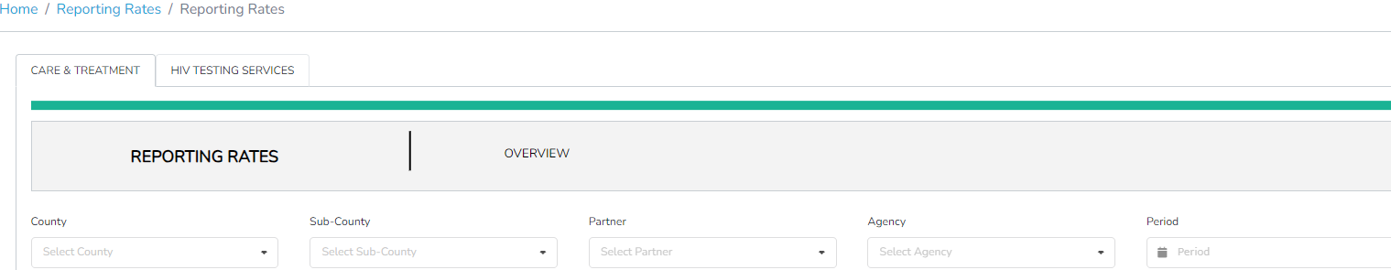
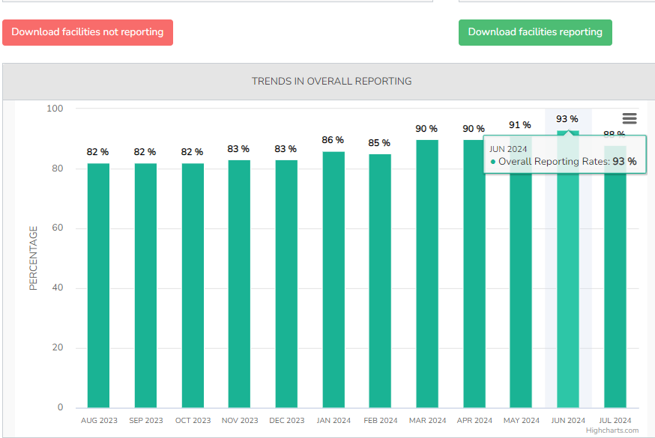
NDW Dashboard Monitoring & Reporting
Tracks monthly
  Reporting rates
  Reporting trends over time
  Consistency of reporting
  Downloadable list of non-reporting facilities
Action
  Encourages real-time tracking and county & partner accountability

Slide 49
Improving Data Quality Through Data Use
Rationale
  Increased program use of data helps improve data quality
Tools
  Information products
    Bulletins, program briefs, blog spots, abstracts, manuscripts, slide decks etc.
  Self-service portal
    Stakeholders use data for decision making, and identify & address data quality issues at facility level
    Democratizes data scrutiny and drives user-led improvements
  Data use Communities of Practice (CoP)
    Have access to data through self-service
    Facilitate shared learning of best practices among partners
    Provide feedback on data quality using WhatsApp groups etc.
  Data alignment
    Comparison of data between NDW & KHIS to ensure consistency and accuracy

Slide 50
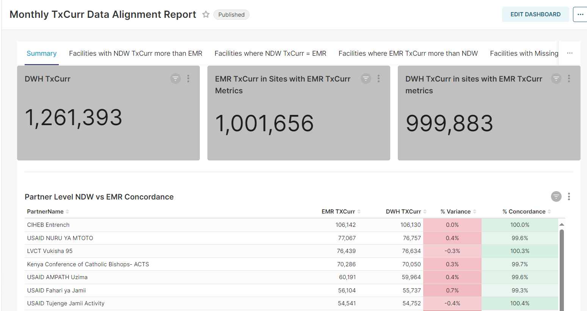
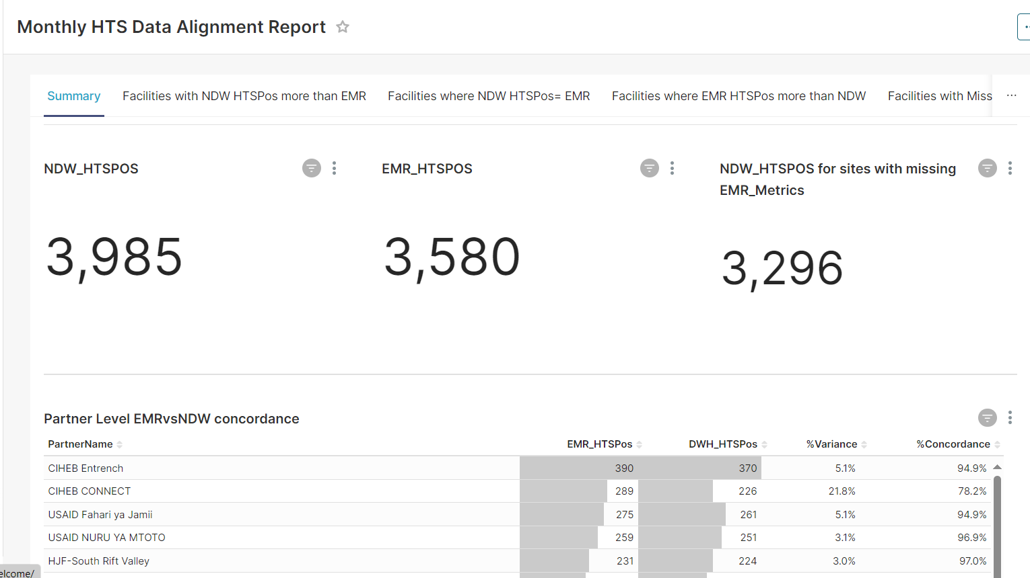
Concordance Reports on Self-service platform
These are concordance reports that track variations between key indicators of interest in the EMR and NDW
The reports aid in showing data quality gaps at an aggregate level & also broken down at facility, partner and county levels

Slide 51

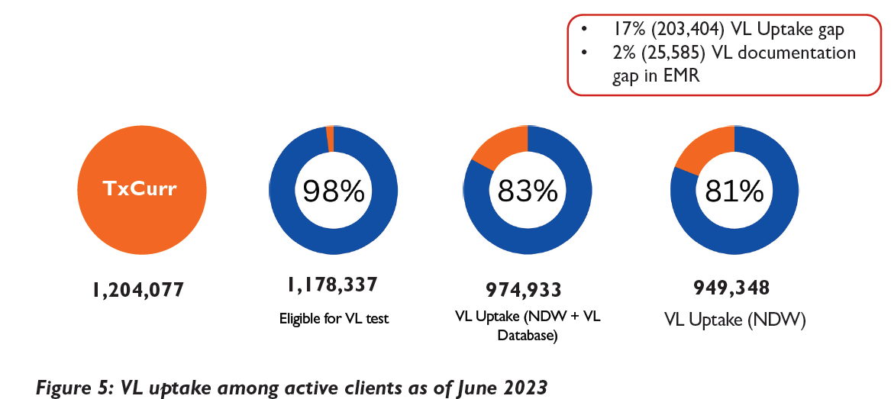
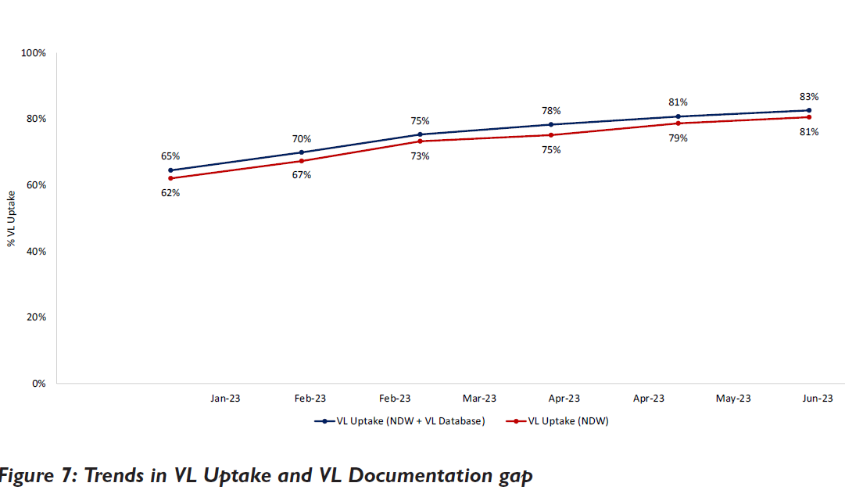
Improving Data Quality Through Data Use:
The VL bulletin example

Slide 52
Approach for engaging stakeholders to resolve Data Quality Issues
Detect
Identify data quality gaps during routine analysis
Engage partners/Counties for corrective action
Investigate & Act
Investigate cause:
Data transmission related, logic related, or user errors
Actions:
Correct data transmission missteps,
NDW-EMR Indicator logic alignment
user data entry/upload errors
Feedback Sessions
County cluster meetings,
Data quality review webinars, trainings etc.
Direct discussions of quality gaps, discuss best practices and suggest improvements

Slide 53
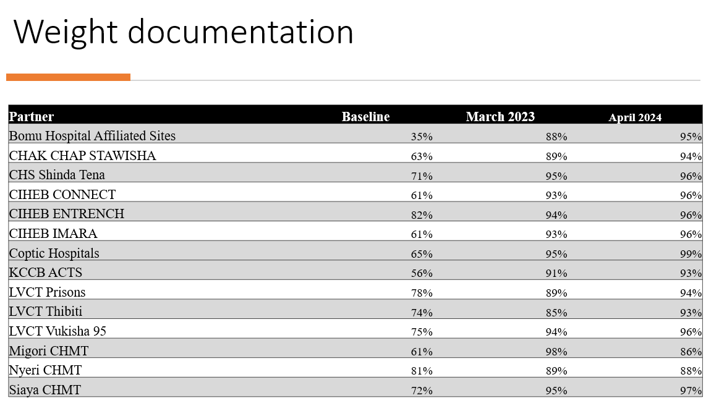
Monthly Tracking of Topline Indicators
Approach
Identify data quality gaps jointly with program TAs
Select topline indicators for monthly tracking
Program TAs support facilities to address the gaps
Examples
Paediatric topline indicators
Weight, height, regimen documentation etc.
PMTCT topline indicators
Documentation of HEI final outcomes etc.
Comparison at baseline Sept 2023 and April 2024

Slide 54
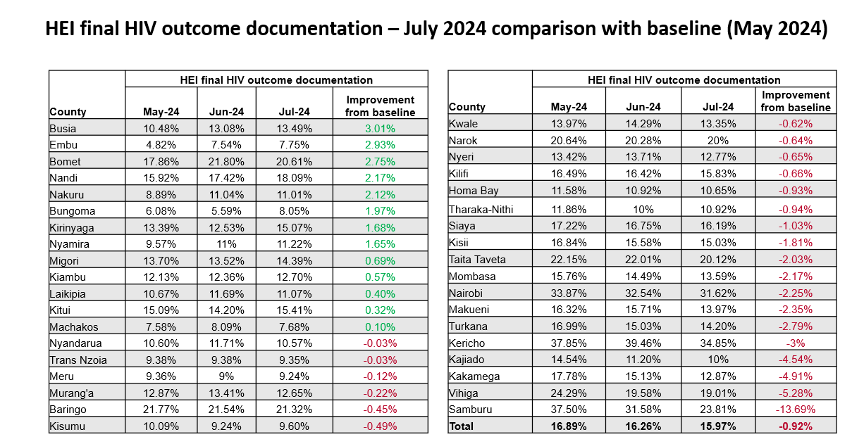
Monthly tracking of topline indicators: PMTCT Top Line Indicators
Notes:
A program brief highlighting data quality gaps among other gaps in PMTCT was developed and disseminated through a webinar which targeted program TAs and facility personnel. Top line indicators were agreed upon for tracking data quality

Slide 55
Summary of our approach to strengthening data quality
Data collection
Minimal data entry
Logic alignment between EMR and MER guidelines
Data quality checks and alignment with EMR logic
Submission of metrics to facilitate comparison between NDW and EMR
Bidirectional feedback on issues to be resolved
Reporting rates tracking – Bulletins & Dashboards
Improving Data Quality Through Data Use: Data alignment, self-service, Data use CoP
Information products: Bulletins, Program Briefs etc.
Data use and feedback
Data warehousing
Point Of Care(POC)
Topline Indicators
Routine Data Quality Assessment(RDQA)

Slide 56
THANKYOU

