Slide 1


“System Thinking”
Liberia’s Pathway to building a resilient Health Information System (OHIE experience)
J. Mike Mulbah
Director, Monitoring & Evaluation & Coordinator, HIS Interoperability Initiatives
Ministry of Health, Republic of Liberia
Ally Shaban
Intrahealth
Emily Nicholson
Senior Informatics Officer, IntraHealth

Slide 2
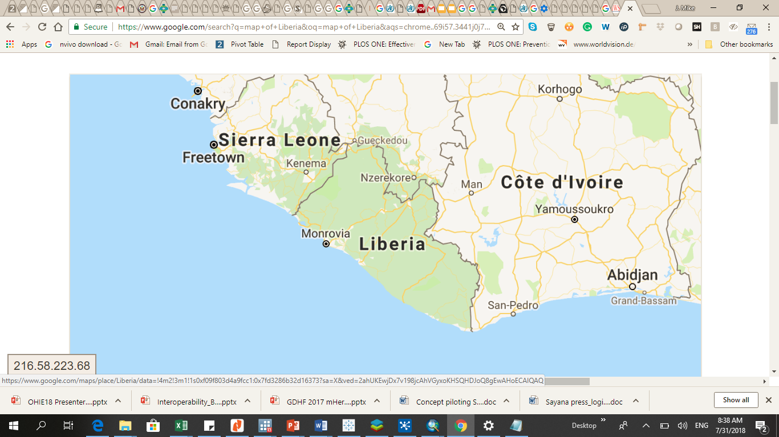
County Profile
Area: 42,999.8 mi²
Population: 4,278,750 (2018)
Population Density: 35 per sq/km
Political Subdivisions: 15 counties
Health Districts: 92
Mobile phone users: 74.5/100 inhabitants.
Internet Penetration: 8%
Number of functional Health facilities: 831
Public Health Facilities: 54%
Population within 5 Km of nearest Health facility: 71%

Slide 3
Liberia’s evolving Routine Health Information System
2006 - 2007
2010 - 2013
2014 – 2015
2016 - 2017
2008 - 2009
Key developments: 2008 - 2009
Nat. M&E Unit established
National M&E Strategy Developed
First Nat. Integrated reporting system developed
HMIS powered by DHIS 1.4 used
Nat. HMIS Policy & M&E Strategy and Policy developed
HMIS was the only functional sub –system in use
Notifiable disease reporting; less formal
Key developments: 2006
HIS Strategy 2015 – 2021 developed
HIS scale up and interoperability emphasized
NHP 2006 – 2010 developed
Primitive Paper based system & VHF radio
Fragmented Reporting
Program specific M&E system
National Health Disaster exposed gaps in HIS : Incomprehensive, uncoordinated HIS and poor feedback
Establishment of Counties M&E System
Lunch of the first national web based reporting system (DHIS2)

Slide 4
HIS and GIS Architecture (as-is) in the MoH, Liberia - May 2015

Slide 5
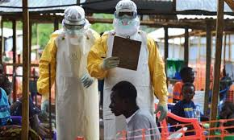
Lessons Learned from EVD response
Trigger/Alert Notification
Challenges:
Vertical reporting system
Lack of synergy and interoperability
Delays or the lack of capacity for timely reclassification case
Resulting lack of precision in outbreak reporting
Case Investigation
Case Outcome at Investigation: Alive
Unprecedented Health Disaster Strikes (March 2014)
Case Outcome at Investigation: Dead
No Epidemiological Link
Had Epidemiological Link
No Epidemiological Link
Had Epidemiological Link
Discharged Alive
Ebola Survivors
Suspected Ebola Case
Probable Case
Suspected Ebola Case
Probable Case
Burry Case
Laboratory Investigations
Isolation and case management
Re-classify confirmed
Enlist and Follow-up Contacts
Tested Negative
Discharged dead
Ebola Deaths
Discontinue contacts follow-up
Re-classify “not a case”
Tested Positive
The EVD outbreak underpinned the weakness of our surveillance system and pitched a stronger case for RHIS improvement (including interoperability)

Slide 6
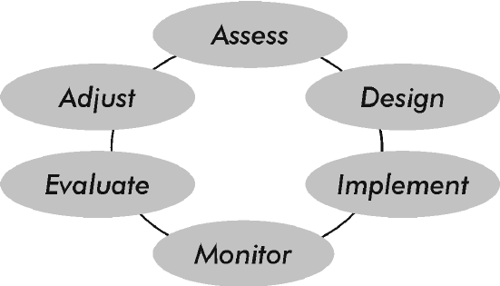
How do we?
System thinking
Plan
Organize
Prioritize
Implement
Learn
Improve

Slide 7
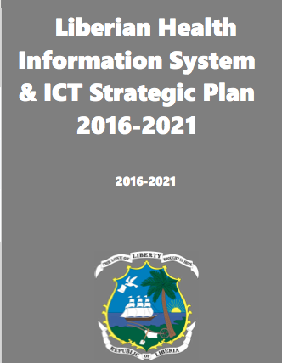
Liberia developed a HIS strategy (2016 – 2021) with emphasis on HIS interoperability
  89 mentions of interoperability
  SO 13: to develop HIS architecture and adopt an interoperability framework and standards; implement interoperability and data sharing across and beyond HIS subsystems
  13.4. Develop master facility registries and universal patient IDs to improve patient tracking

Slide 8
Our HIS Data Sources
    Population Based Data
    Censuses:
              Annual Health Workforce Census in 2016
              National Population & Housing Census
    Civil and Vital Registration:
      Population surveys: Liberia Demographic Health Surveys
      Liberia Malaria Indicator Survey,
      Etc.
    Institution Based Data
  Health Management Information System (HMIS)
    Disease Surveillance Information System (DSIS); now eIDSR
    Community Based Information System
    Integrated Human Resource Information System
    Laboratory Information System
    Logistic Management Information System
    *Financial Management Information system
    ** Electronic Medical Records
    ** Physical Assets Information System
    Assessments

Slide 9
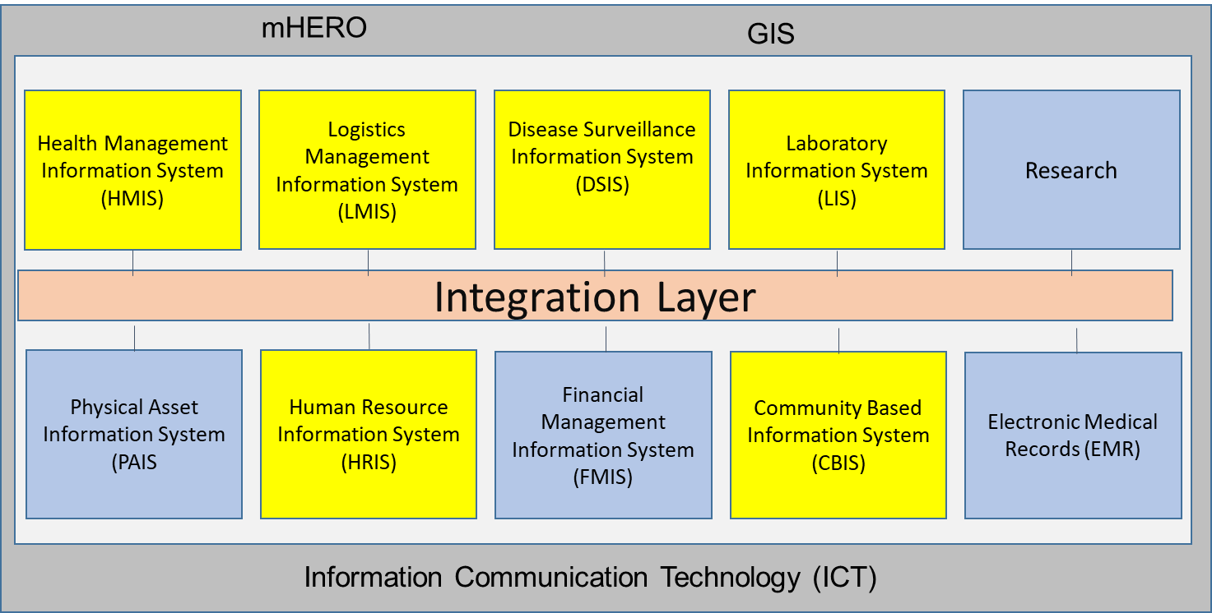
Liberia HIS Sub-Systems

Slide 10
Liberia HIS Interoperability Roadmap; Short term objectives
Implement priority registries
Adopt priority and available terminology standards
Create a data warehouse
Create a governance mechanism for adopting and maintaining standards
Develop a detailed five-year strategic plan and operational plan for the implementation of the Health Information Exchange for Liberia

Slide 11
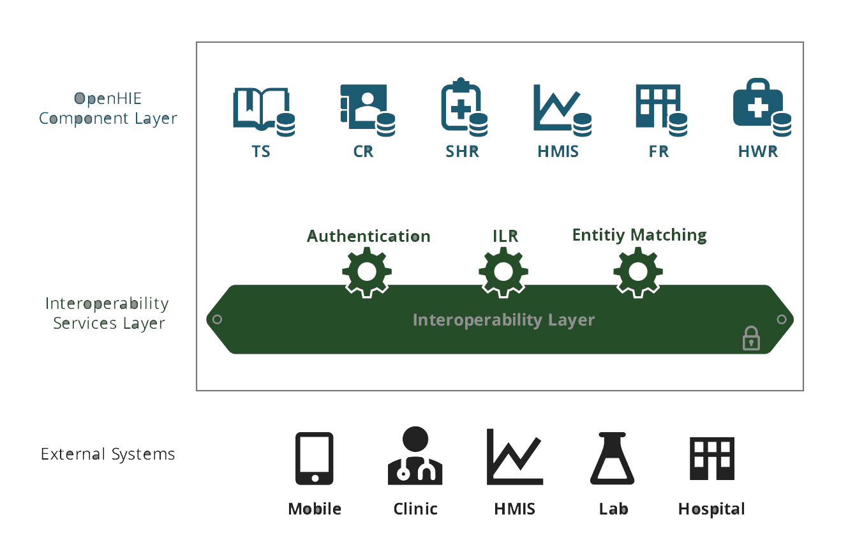
The OpenHIE Referenced Architecture

Slide 12
Architectural representation of Liberia HIE

Slide 13
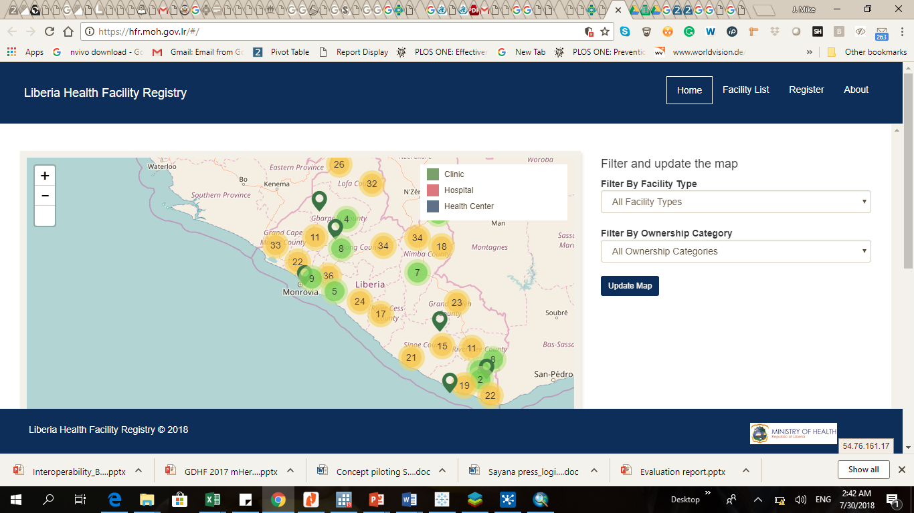
Master Facility Registry Development
Liberia’s Priority Registry #1: Master Facility Registry under construction

Slide 14
The MFL and MFR Development Process
Established institutional arrangement (Governance Mechanism)
Determine Information to be included in the MFL (includes building of consensus on scope of MFR as well as essential Information to be included therein):
  Signature domain
  Service domain
Identify Data Sources or Mapped out Information need to data sources

Slide 15
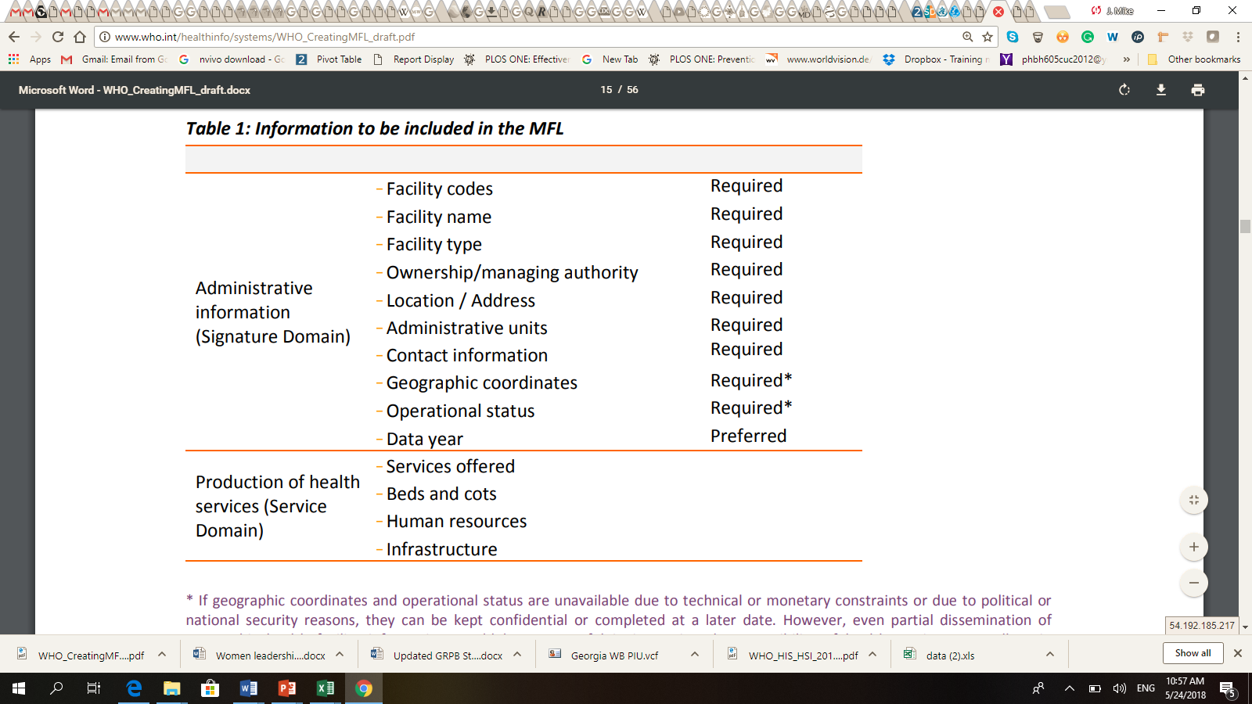
WHO Recommended Domains of a Master Facility List

Slide 16
The MFL & MFR Development Process
Populate of consolidate the HF List
Build Consensus on ID system
  Information bearing ID system
  Serial ID system
  Random ID system (suitable for lifetime ID) e.g. “KDF8”
  Hybrid ID system: “LRKDF8” where the prefix “LR” represents country code. Ideal for cross country referencing system
Generated a “one-time” unique life time ID
Assigned range of unique life time ID
Reserve unassigned ID for future use

Slide 17
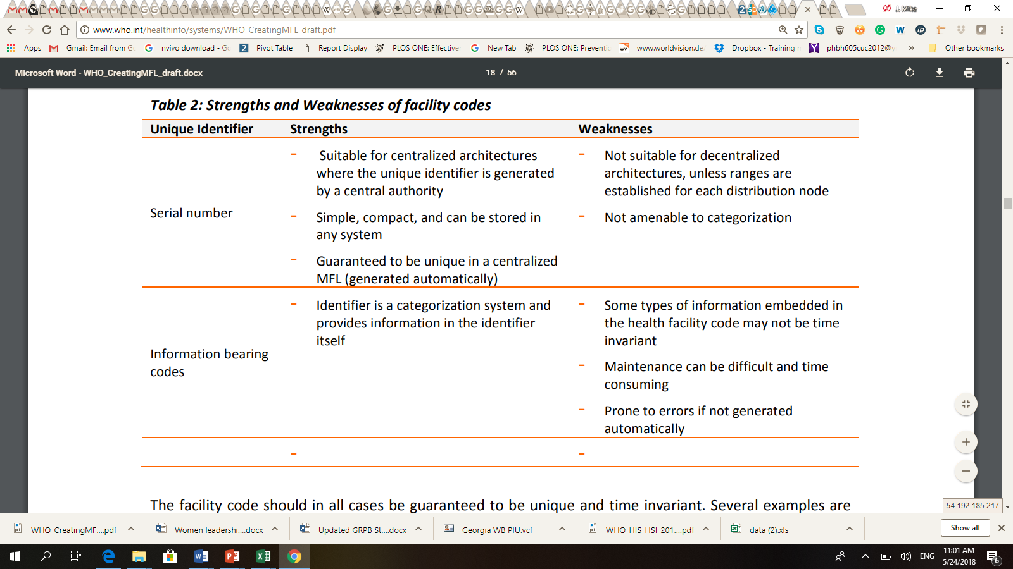
Considerations: ID system
Considerations for parent Child relationship in ID assignment??

Slide 18
From MFL to MFR
Develop Governance SOP
  Outlines mechanisms for:
    enrolling new facility
    updating attributes of existing facility
  Roles and responsibilities of stakeholders
    Who does what, when and how
Drafted workflow and wireframe for registry development based on predefined functional and user requirements
Implementation

Slide 19
Adoption of priority terminology standard
Adopted the Anatomical Therapeutic Classification (ATC) and DDD Standards
Incorporated ATC into eLMIS
Mobilizing resources for hoisting of Registries and Standards as well as all priority subsystems of our HIS
Adaptation of ICD pending
  Cost implication for implementation

Slide 20
Development of Provider registry (ongoing)
Current list in iHRIS is incomprehensive and un-standardized
Consolidation and validation of Health Worker listing ongoing; pending completion of Payroll Audit
Implementation of an in-country National Biometric ID system
Data Cleaning and adoption of ISCO standards for classification of Health Workers ingoing

Slide 21
Development of Client registry (differed)
Contingent on ICT Infrastructural readiness at Point of Service Delivery and on progress on implementation of National Identification registration system
Plan is to begin with Tertiary Health Facilities and later to Secondary Health Facilities and then Primary HFs
ICD implementation also a critical success driver

Slide 22
HIS Interoperability & Data Warehouse Pilots

Slide 23
HIS Interoperability Pilot Initiatives in Liberia
Three HIS Interoperability Pilots to date.
The eIDSR Pilot (IntraHealth, eHealth Africa and MOH)
The RMNCAH Interoperability Pilot (NPHIL/MOH, Zenysis Technology)
The Data Warehouse Pilot: (MOH & eHealth Africa)

Slide 24
Interoperability Pilots
RMNCAH Pilot: Ongoing
  Initially involved the following subsystems:
    DHIS2
    eIDSR or IDSR information system
    LIS (mainly line list)
  Involves data harmonization use cases
  Some impressive results so far

Slide 25
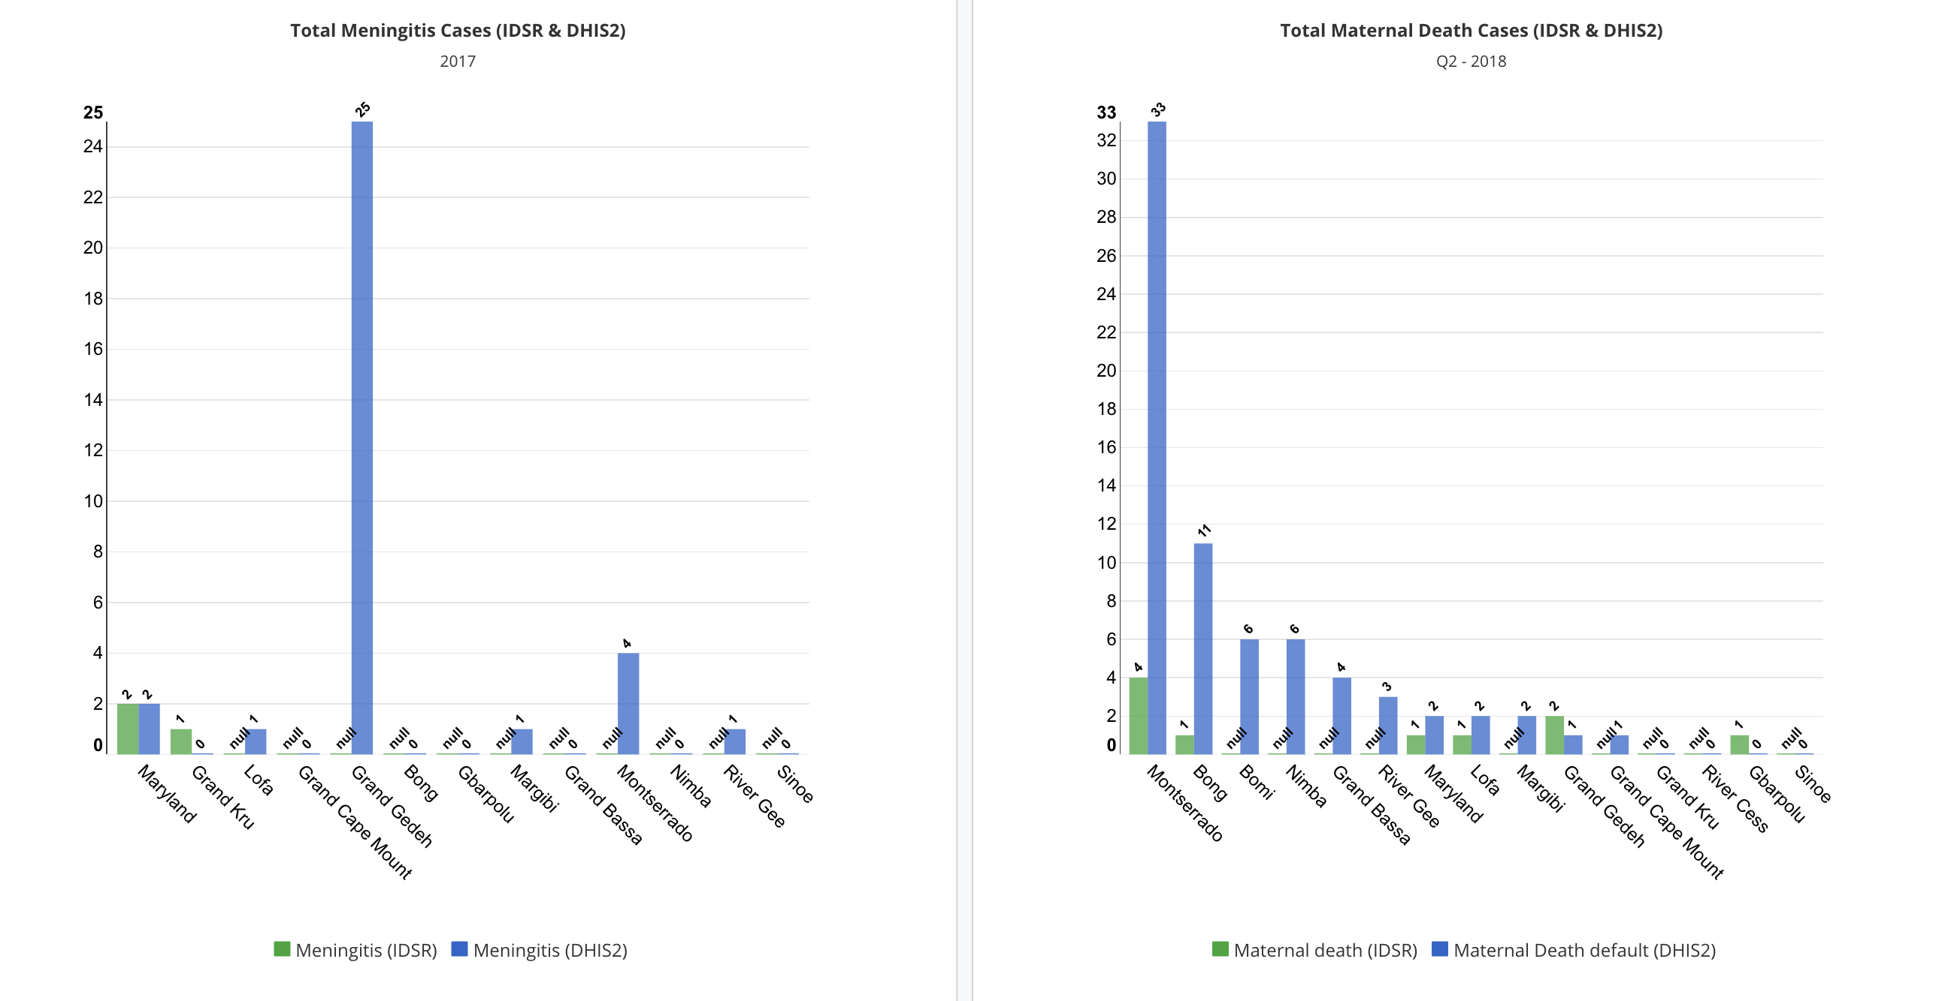
RMNCAH data interoperability Pilot: Data Harmonization Use Case

Slide 26
Data Warehouse Pilot
MOH in collaboration with eHEALTH Africa

Slide 27
Processes
Requirements Gathering
Data Source Investigation
Dimensional Modelling
Data Preparation
ETL Transformations
Data Presentation & Analysis using Tableau or Mondrian/Saiku

Slide 28
Requirements Gathering
  What do we want to know?
  What questions do we want to answer?
  Use Cases:
  Resource allocation efficiency
  Quality of service delivery
  Data quality

Slide 29
Use Case to assess resource allocation efficiency
Staffing level versus Service delivery outputs (Immunization, Antenatal Consultations, Family Planning Service Utilization and Delivery) (iHRIS & DHIS2)
Basic equipment and staffing level versus service utilization (SARA data, iHRIS & DHIS2)
Availability of basic amenities or essential medicine versus Service Utilization(SARA, LMIS & DHIS2)
Workload: Staffing level versus service utilization (iHRIS & DHIS2)
Efficient health financing: per capital expenditure versus Health system outputs (iFMIS, DHIS2, LMIS, LIS, SARA, DHS, MIS, CBIS, Other Surveys, Evaluation Data, etc.)

Slide 30
Use Case to assess Quality of service delivery
Staffing pattern versus quality of care index scores (iHRIS or health Workforce Census & QoC survey data)
Quality of care index scores versus health system inputs (QoC survey data & SARA data)
Quality of care index score versus service utilization(QoC survey data & DHIS2)

Slide 31
Use Case to assess Quality of Data
Consistency Checks across subsystems: e.g Notifiable event reporting (Cases or deaths) from Active surveillance system versus those reported by Passive surveillance system (eIDSR, LIS & DHIS2)

Slide 32
Use Case Prioritization
Availability of data source
Do we have the right data to satisfy our use case for interoperability?
Is it readily accessible?
Is the data structure malleable or comparable in some aspect?
    (Period dimension, Place dimension, etc.)

Slide 33
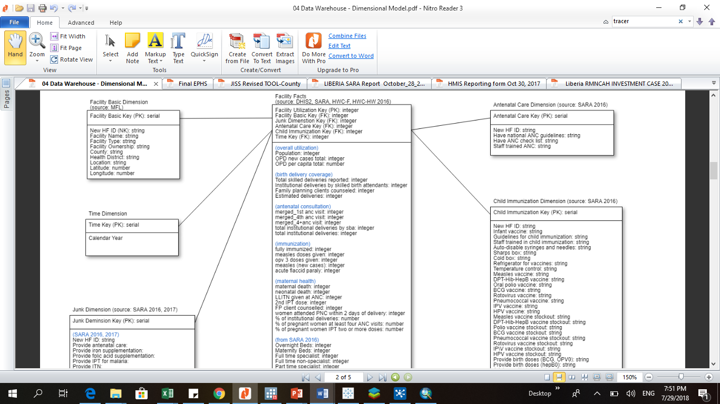
Dimensional Modelling
Dimension tables (Descriptive data)
Fact tables: (Measurements, numbers)
Junk Dimension (Yes/no, 1/0 data)
Time Dimension (Dates, weeks, months, years, fiscal years, etc)

Slide 34
Data Preparation
Involves cleaning and standardization of data based on priority fields or variables in the dimensional
  Insert unique ID
  Standardize date formats
  Insert year (where applicable)
  Standardize the data options (e.g Y/N, 1/0)
  Occasionally used STATA and OpenRefine for data cleaning

Slide 35
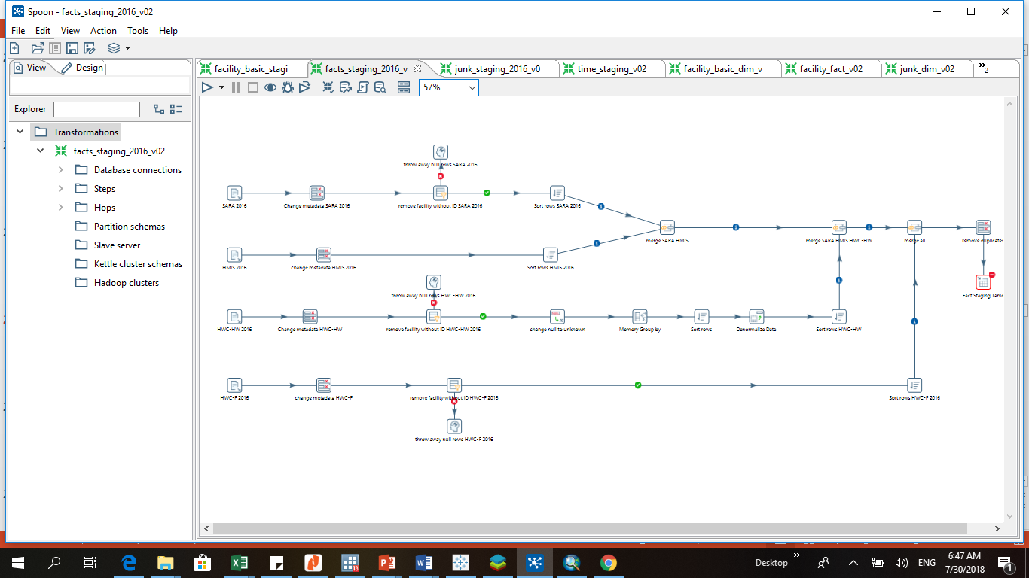
ETL Transformations
We use Pentaho Data Integration tool (Kettle) to build the ETL transformations to implement the data warehouse in PostgreSQL

Slide 36
Data Presentation & Analysis
Connect Data Warehouse with Tableau
Connect Data Warehouse with Mondrian/Saiku (open source application)

Slide 37
mHero

Slide 38



What is mHero?
What is your stock level of Personal Protective Equipment (PPE)?
What kind of disease agent causes Ebola? 1)Bacteria 2)Virus 3)Toxin 4)Parasite
25 PPE available
2) Virus
Could you confirm that you are an RN?
Yes, I am an RN
Notes:
mHero is a free, two-way, mobile-phone-based communications system that uses basic text messaging, or SMS, to connect ministries of health and health workers. mHero does not require a smartphone or tablet, but rather operates on simple talk and text mobile devices, allowing ministries of health to directly communicate critical messages and collect critical information from those on the front lines of care.

Slide 39
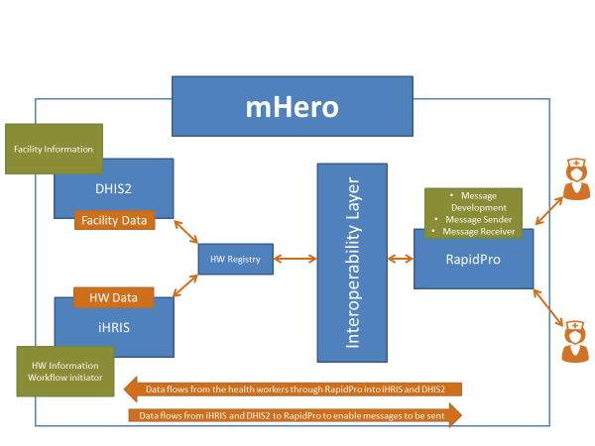
mHero Architecture

Slide 40
The eIDSR pilot

Slide 41
Objective
Improve the flow of public health surveillance data between the different levels of the health system in order to respond quickly to suspected outbreaks

Slide 42
Format of the initial SMS alert
The initial SMS you will send to 4636 is composed of four parts and should be written as follows:
alert.diseasecode.caseid.yes OR alert.disease code.caseid.no
alert = Start the message by just typing the word alert and a period: alert.
disease code = The code to use for the 14 reportable diseases, conditions & events.
caseid = The ID number that the case is assigned.
4. yes/no = Yes indicates that a specimen was taken and No means specimen was not taken.

Slide 43
Alert Confirmation and Additional Questions
After starting an initial SMS alert, you will receive:
1. A confirmation of the alert which includes the IDSR ID or notification that the alert submitted is incorrect
2. Two additional questions about the suspected case
3. Depending on the answer you provide regarding specimen collection, you may receive a question about the specimen
4. A confirmation of the completed alert

Slide 44
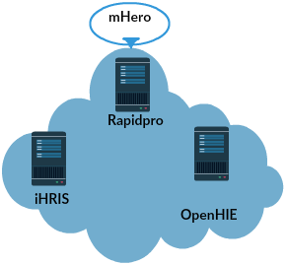


1.Case Alert

Slide 45
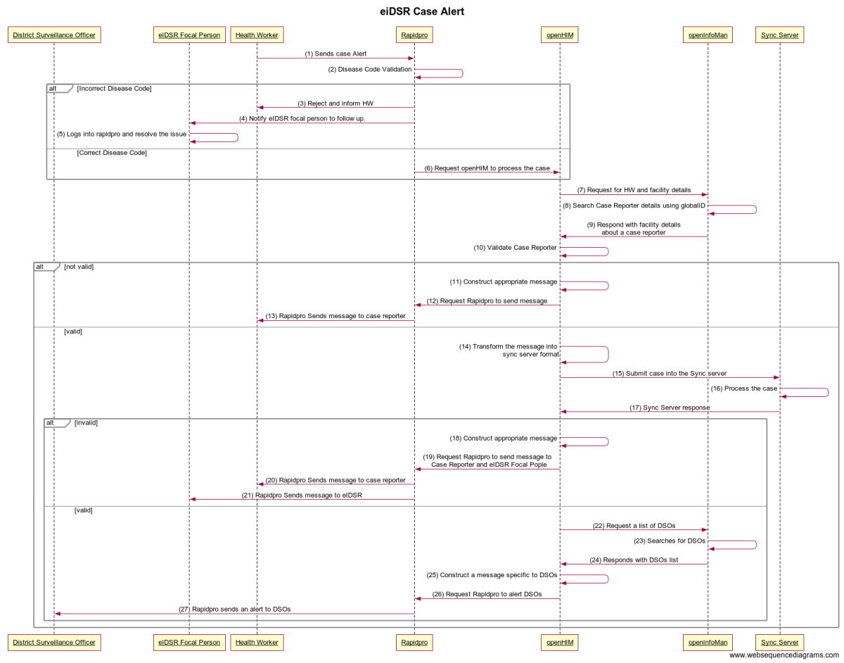

Slide 46
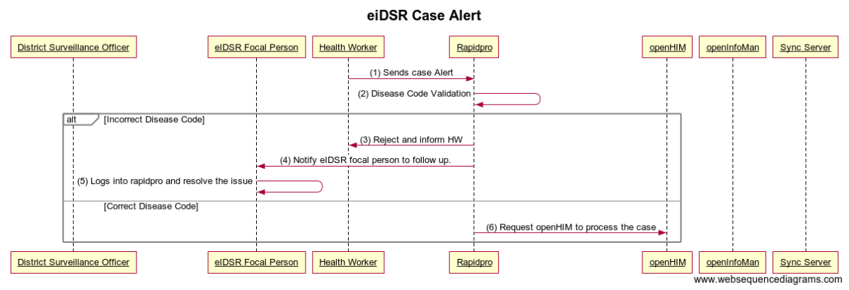

Slide 47
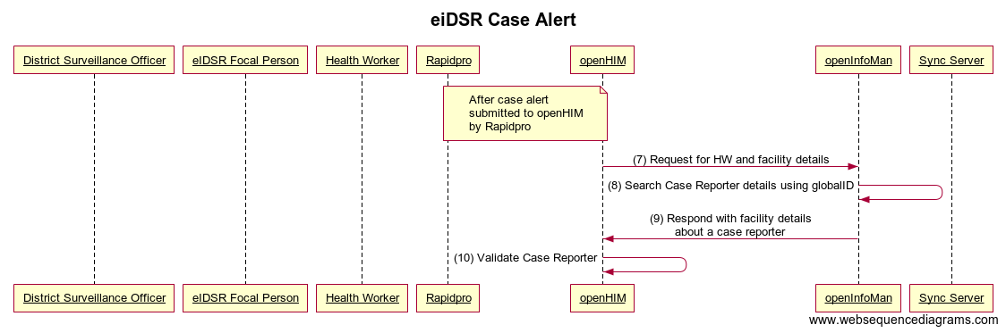

Slide 48
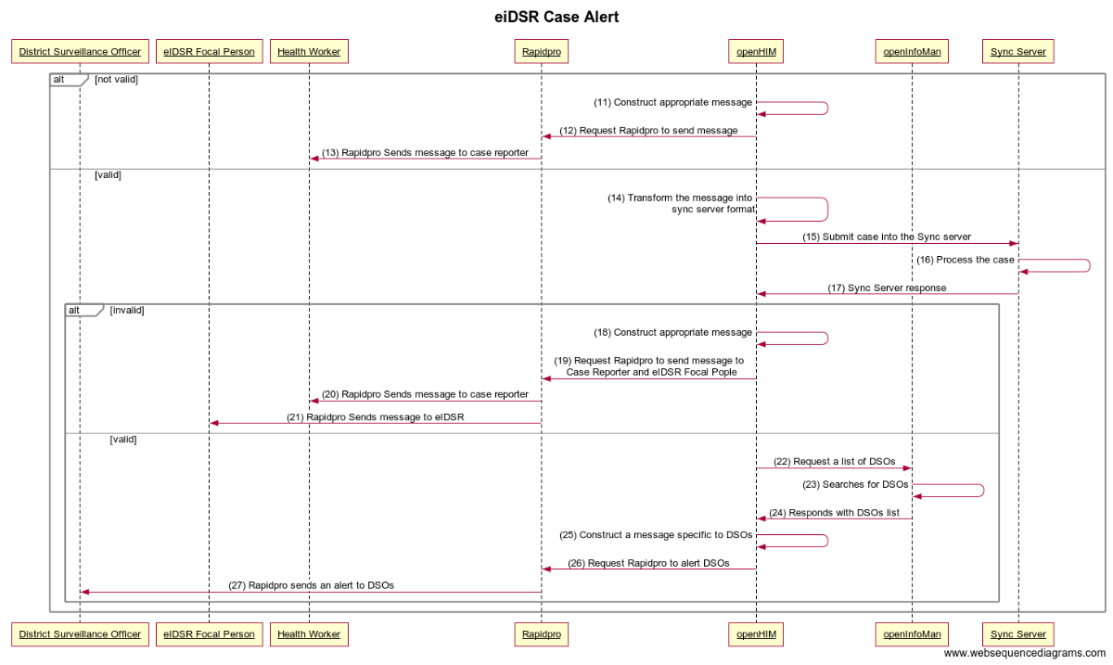

Slide 49
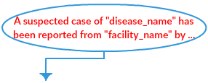
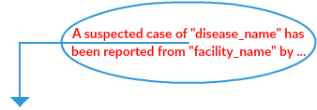
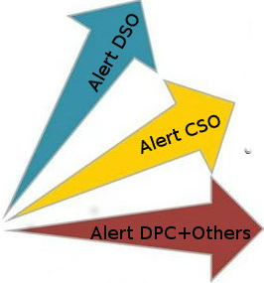




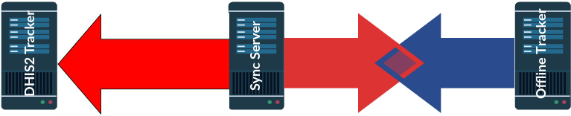
1.Case Alert

Slide 50
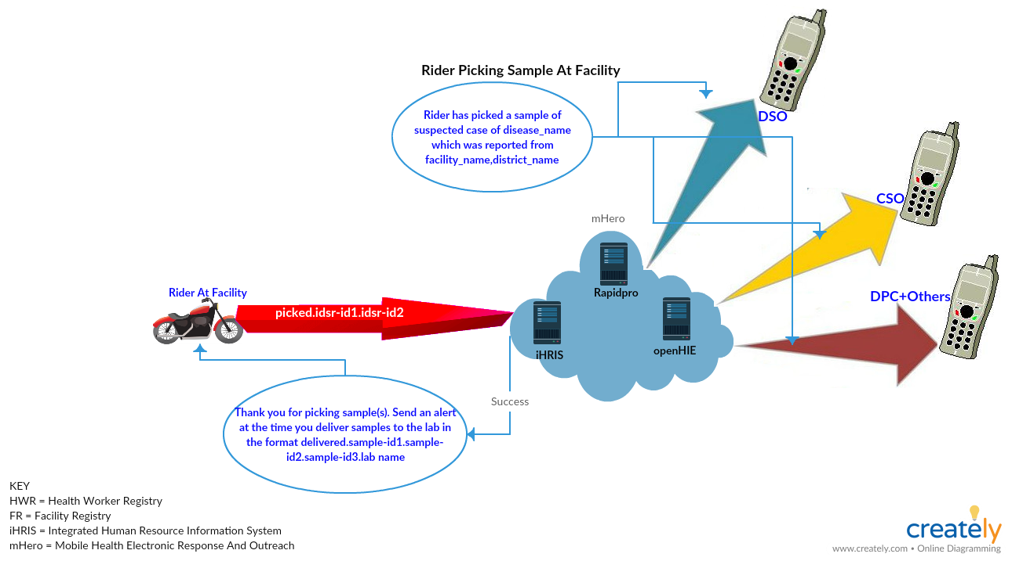
2.Sample Pickup

Slide 51
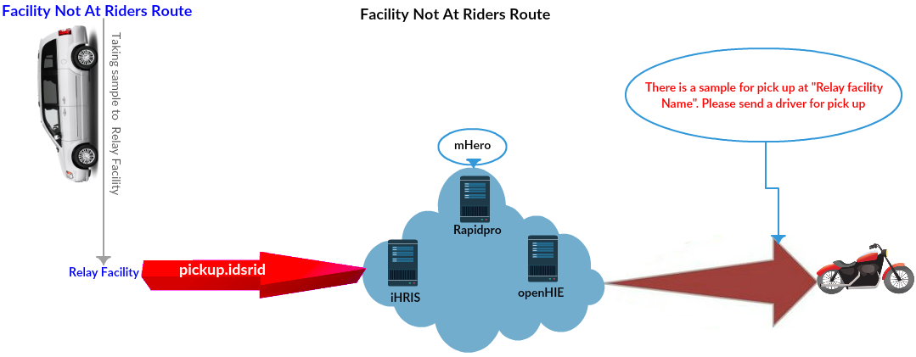
3.Sample Pickup Relay Facility

Slide 52
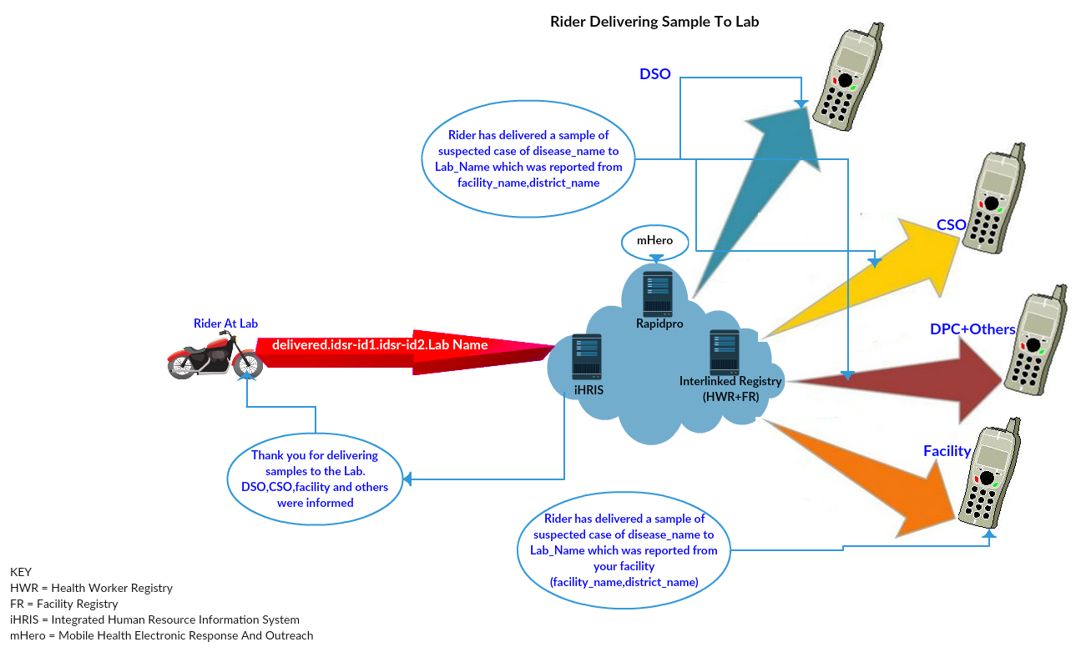
4.Sample Delivery

Slide 53
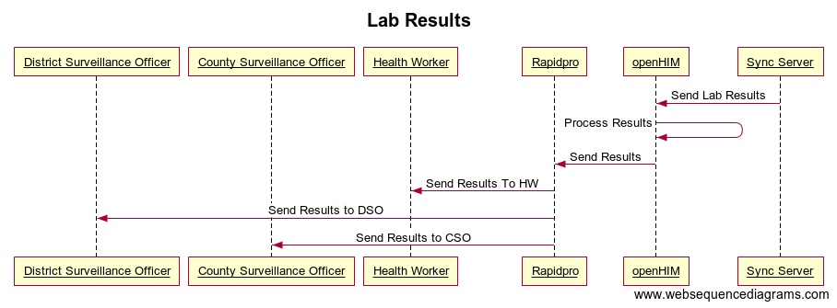
5.Lab Results ready

Slide 54





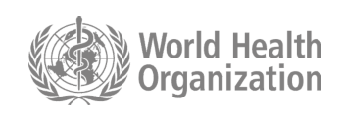




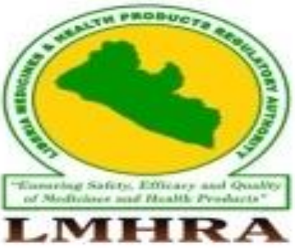

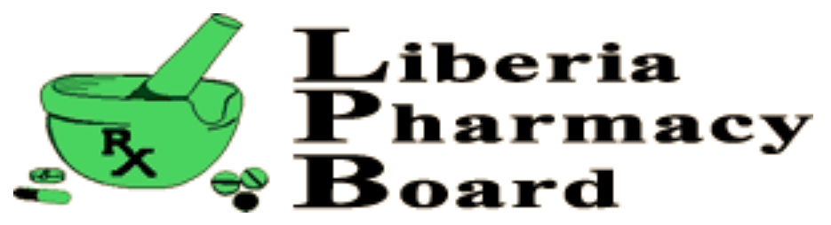
Acknowledgements
Donors
Technical/ Implementing Partners
Local technical Collaborating Partners

Slide 55

Wu ma ma wui tu su (in Lorma, Liberian dialect)
Meaning: thanks for Listening

Slide 56
References
Mobile Phone Users (2014): http://www.emansion.gov.lr/doc/CONSULTATION-DOCUMENT.pdf
Internet Penetration (2018): https://www.internetworldstats.com/stats1.htm

Slide 57
Wu ma ma wui tu su (in Lorma, Liberian dialect)
Meaning: thanks for Listening

