Slide 1
Botswana Patient Identity Management

Slide 2
Health Information Exchange:
Overview

Slide 3
Health Information Exchange Project
Initial phases of the project began in 2020
Goal: Design, implement, and test a Health Information Exchange (HIE) platform tailored to the Botswana Health System and managed by the Botswana Ministry of Health.
Initial Focus:
OpenHIE-based Architecture & Use of Open Standards (FHIR) and Global Goods
Base HIE Platform - Interoperability Layer, Client Registry, Shared Health Record, Kafka, etc.
Target Workflows
  Laboratory Order Interoperability between OpenMRS & PIMS and IPMS
  National Registries Workflows for Validation and Patient Registration
  Client Registry Workflows for patient matching by Identifier and/or Demographics

Slide 4
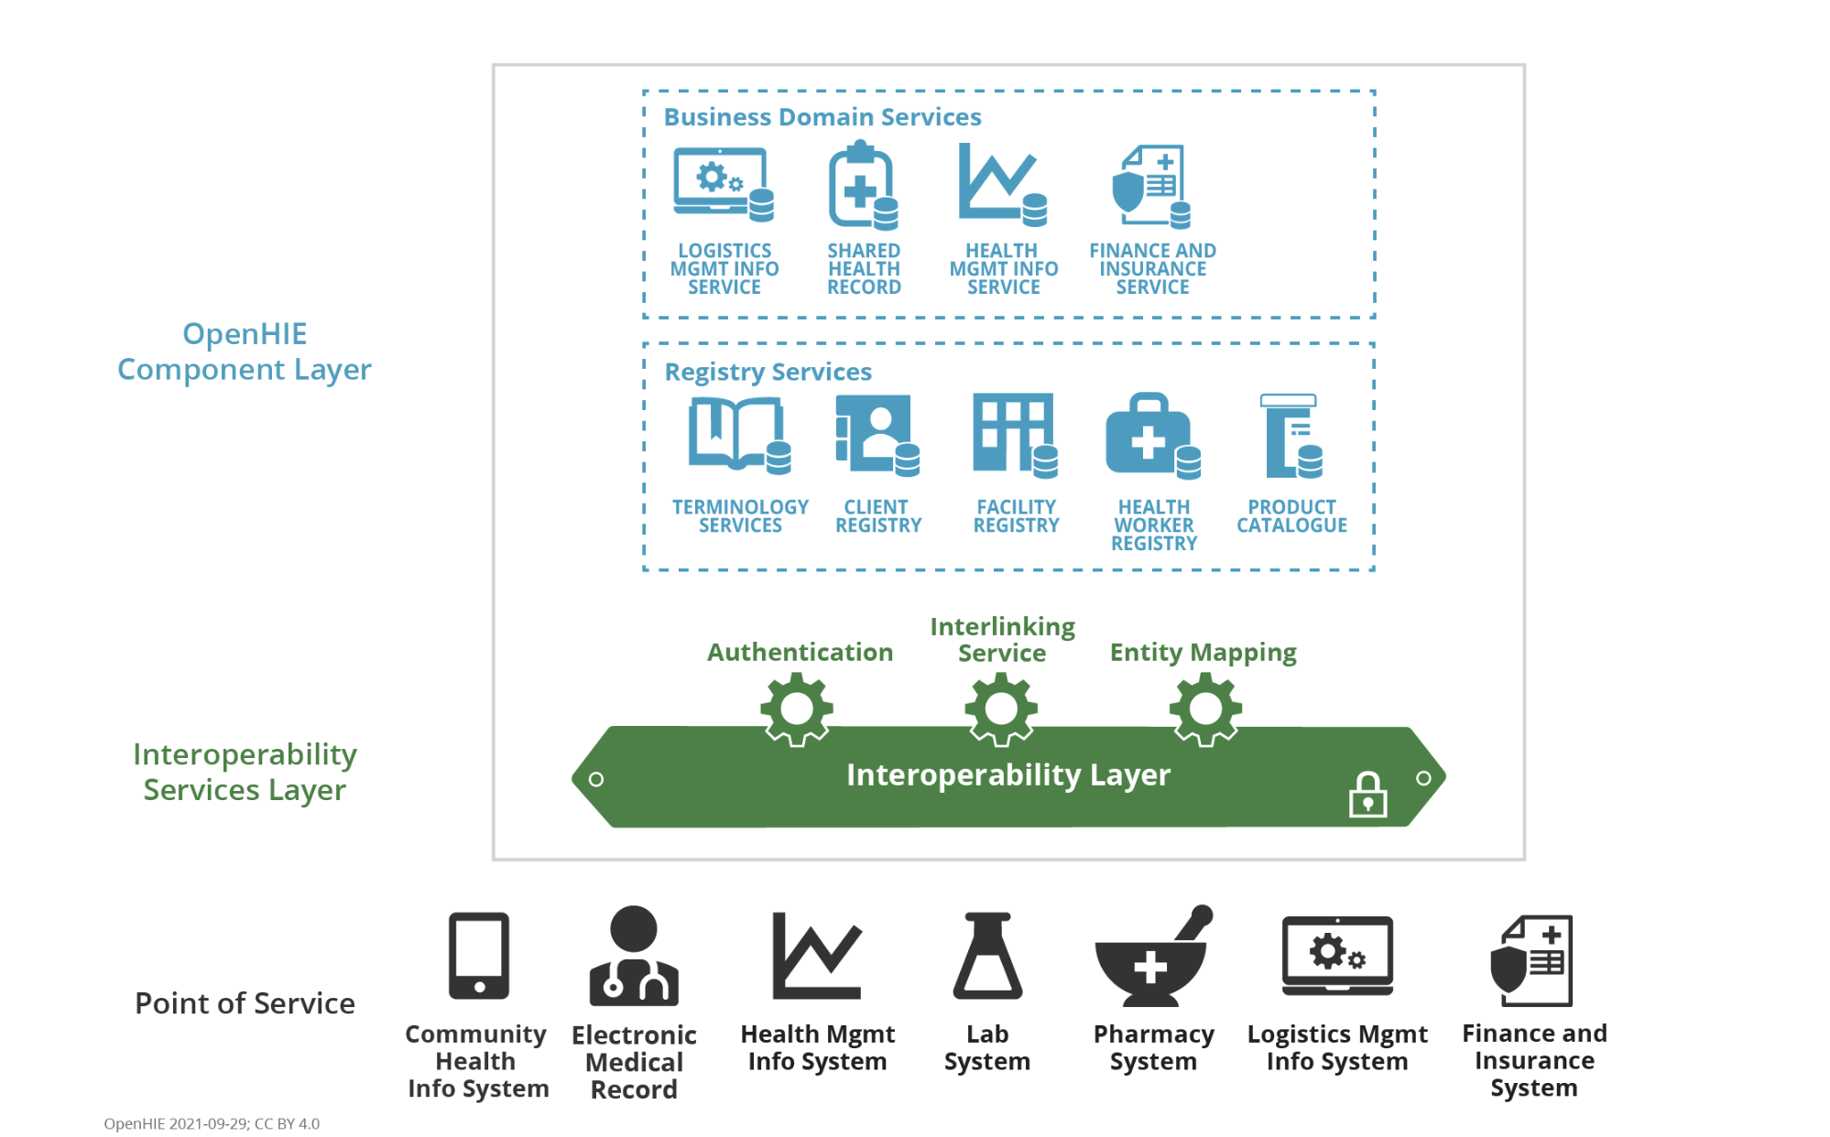
OpenHIE Architecture

Slide 5
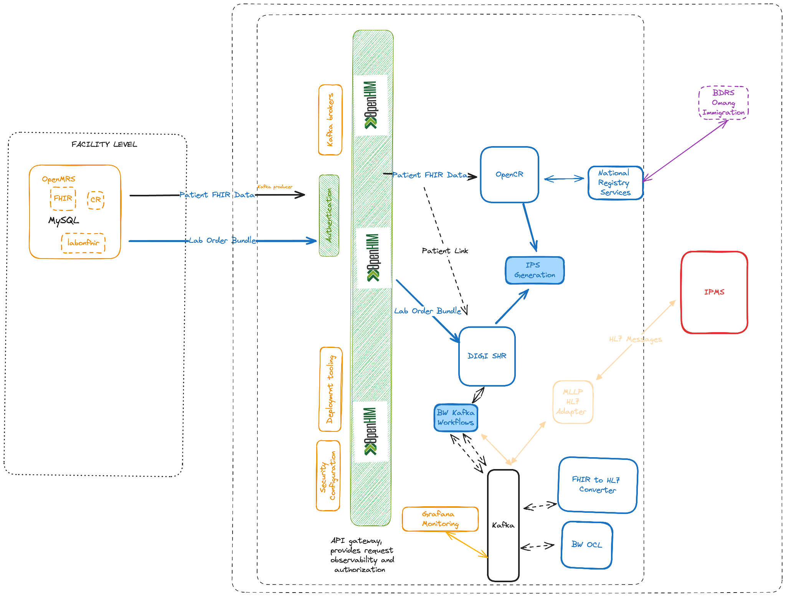
Botswana HIE Architecture

Slide 6
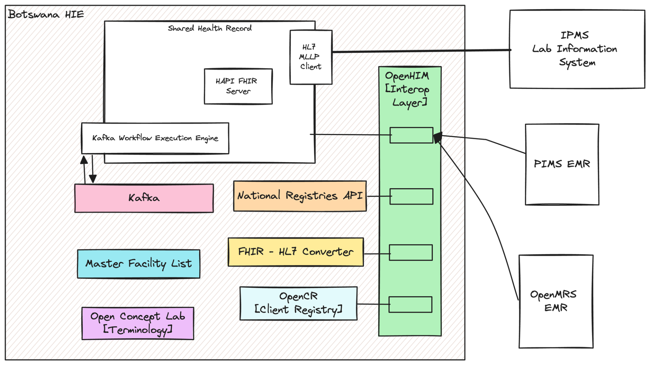
HIE Components - Laboratory Workflow

Slide 7
Patient Identity Management
Workflows

Slide 8
Objectives
Unique and unambiguous identification of patients across points of care
Deduplication of Patient data across the health system
Continuum of Care across health facilities for Patients

Slide 9
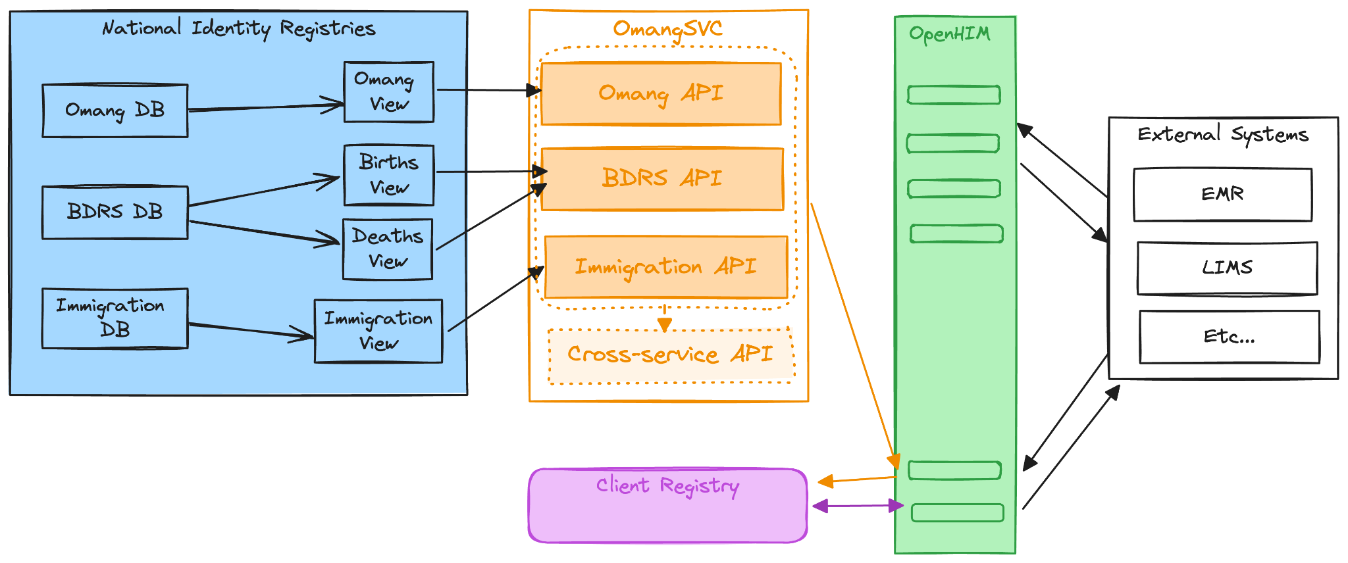
HIE Components - National Registry Workflow

Slide 10

Key HIE Components
Client Registry - Patient identity management using a FHIR-based global good called OpenCR. Also know as a Master Patient Index (MPI)
National Identity Registry API - A FHIR-based interface layer for the following 3 national registries:
Omang (National ID)
BDRS (Birth and Death System)
Immigration
Interoperability Layer - the gateway into the HIE implemented with the global good OpenHIM
Client Systems - EMR, LIMS or other systems that require Patient Identity services (IPMS, BotswanaEMR, PIMS)
Overview of Key Components required for the Patient Identity Workflows

Slide 11
Botswana Client Registry
“”The Client Registry is designed to assist in uniquely identifying individuals who receive health care services by:
Maintaining a central registry of all patients and their demographics and assigning a unique identifier to each patient.
Linking patient registration entries that result due to changes in patient demographics (patient moved to another location), data entry errors during patient registration, or missing demographic information.
Enabling health care workers to identify facilities at which a patient has received care.”
General Facts:
Implemented using OpenCR, a FHIR-based client registry that PIXm and PDQm support
Configured to match records on Omang (National Unique Identifier), Birth Certificate Number, and Passport Number
Able to match matching using common demographics when identifiers are missing
Current data sources include National Registries, IPMS, PIMS, and BotswanaEMR
https://guides.ohie.org/arch-spec/openhie-component-specifications-1/client-registry

Slide 12
Omang National Identification
Database
General Facts:
Developed FHIR-based API service for querying Omang system for Patient Identity information
Incorporated API into Client Registry workflows to load OpenCR with Omang data

Slide 13
Birth & Death Register
General Facts:
Developed API service for querying BDRS for relevant patient information.
Incorporated API into Client Registry workflows to load OpenCR with Omang data.

Slide 14
Immigration & Citizenship System
General Facts:
Developed API service for querying ICS for relevant patient information.
Incorporated API into Client Registry workflows to load OpenCR with Omang data.

Slide 15
HIE Interoperability Layer
“”While the roles of other OHIE components that provide services may be more easily understood, it is the IOL that secures and orchestrates the exchange of information. Similar to an orchestra conductor, the IOL provides the central force that enables all of the HIE components to work together and interact with Point-of-Service systems outside the HIE.”
General Facts:
Implemented using the OpenHIM global good
Provides secure channels of communication with client systems
Provides platform for HIE Mediators, including the CR and SHR
Provides security, auditing, monitoring, and transaction retry capabilities.
Includes integration with Kafka workflows
https://guides.ohie.org/arch-spec/openhie-component-specifications-1/openhie-interoperability-layer-iol

Slide 16
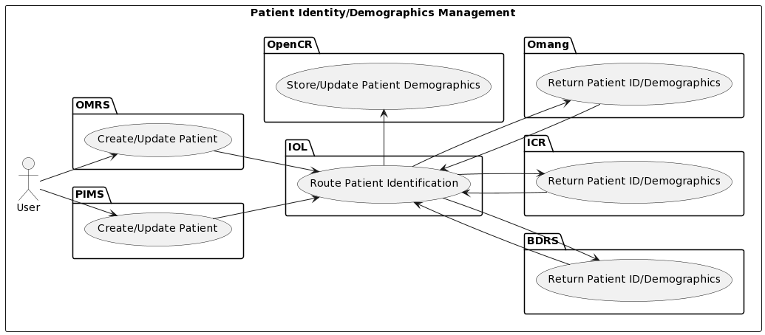
Patient Identity Management Workflow

Slide 17
Challenges
Ministry of Health POC
HI POC
IT POC
Government Data Network Availability and Connection
Firewall
Port Access
Unexpected Server Configuration Resets
Infrastructure
  Development/Acceptance/Production Environment
Communities or Environments to foster collaboration among the Ministry and other partners

Slide 18
Next Steps and Opportunities

Slide 19
Thank You!
Any Comments or Questions?

Slide 20


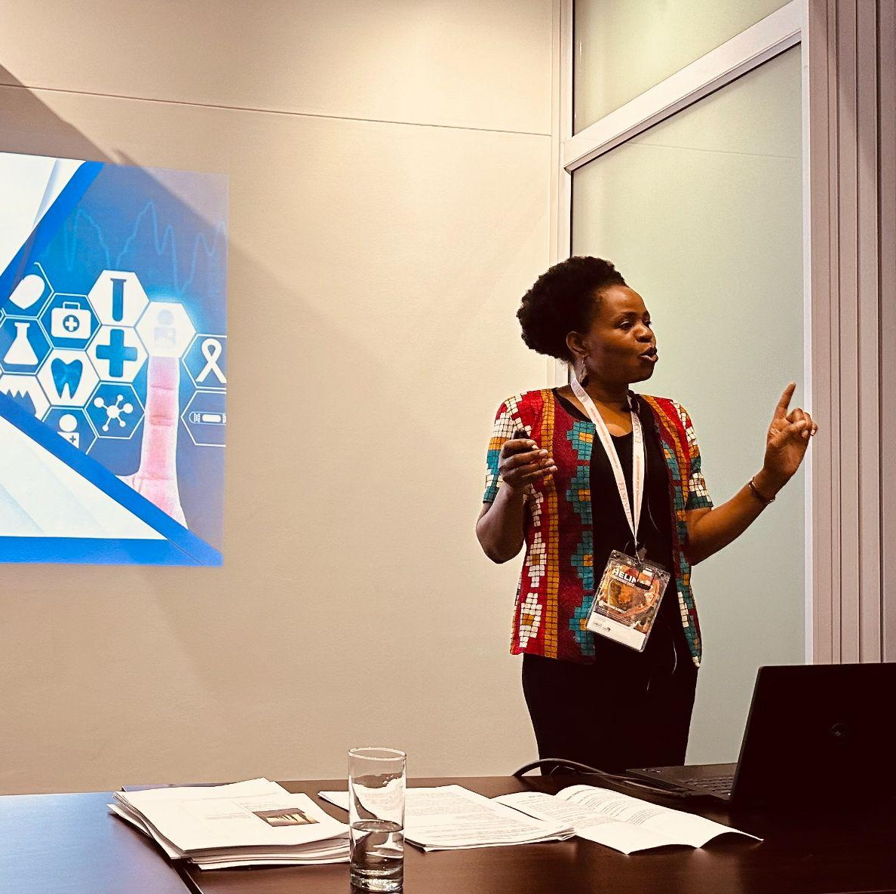



THANK YOU!
LET’S COLLABORATE!
To learn more about DIGI,
please email us at digit@uw.edu
or visit uwdigi.org

Slide 21
Useful Links
Reach out to me with any thoughts or requests at kgakge.tal@gmail.com!

