Slide 1


Aligning HIS to Epidemic Control
From
Data for Program management
To
Data for Operational Optimization
Nega Gebreyesus, D.Sc.
Notes:
In the last many years, HI (Health Informatics) has provided strategic support to country and international response to the HIV/AIDS Epidemic. Through upstream reporting systems, data was used to monitor country performance and make resource allocation decisions. At the country level, investments on HIS were made by both countries, donors, and implementing partners. In total, the HI investments have produced outcomes that have helped countries get closer to Epidemic Control. The Epidemic Control effort however has presented us with different data related challenges. Whereas we focused on aggregate site and above site data, today we are being challenged by the need for more granular patient level data. This presentation is my attempt to invite conversations around this new reality.
The ideas I bring to the forefront are based on my three to four years experience working at SGAC and OHA. My work has taken me to many different countries and observed how automation is implemented at all levels more often in uncoordinated ad-hoc manner. The current approach has proven to be lacking in the production and supply of data required to manage the patient in the treatment cascade and introduce course-corrections in due time.

Slide 2
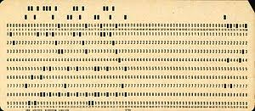
Programming from Machine Language to R from 0 and 1s to Functions
Basic,Fortran,Pascal,Lisp,Snobol,Cobol,Ada,C,C++,C#,PHP,Java,Javascript,PHP,Python,R
They are all the same – getting easier!
Hollerith Punch Card
Do You Know this?

Slide 3
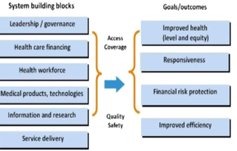
WHO Health System Building Blocks
Service Delivery
Health Workforce
Health Information Systems
Access to essential medicines
Financing
Leadership/Governance

Slide 4
HIS in Epidemic Control and 90-90-90
  Specific to programmatic objectives
  Increasing needs for patient-level data to follow patients through the treatment cascade
  Single sourced data e.g. EMR are incomplete to tell the bigger picture
  Data from other sources such as laboratory and logistics are required to increase retention
  Data exchange and interoperability is required to build an eco-system
  The data needs are changing both in variety and velocity
  We are moving towards close-to real-time availability of patient-level as well as aggregate data
Notes:
The programmatic objectives in any country depend on performance against expected outcomes. The programmatic objectives change depending on current needs.
There is a need to look at data as a shared national resource. The current siloed closed system of data ownership is not sustainable. It is expensive and ineffective.

Slide 5
The drivers: Epidemic Control and 90-90-90
Program Level
Site Level
Patient Level
The Treatment Cascade, Lost To Follow UP,…
Quality of service, operations, performance
Epidemic Control 90-90-90

Slide 6



Current Scenario
Disconnected Silos
Universal Indicators
RestrictiveTechnologies
Designed for upstream reporting
Diagnostic in nature
Long latency for relevance; long return period
Lack prescriptive and predictive capabilities
Too late for early intervention and course correction; Reactive by nature
Designed for site-level monitoring
Unusable for patient monitoring and case management
Top-down and inflexible
Indicators are universal and may not address local needs, including localized indicators for different site, community, or other sources
Indicators reflective of long term interventions quarterly or bi-annual
Designed for data store and proscriptive analytics
Diagnostic in nature
Unusable for patient monitoring and case management
Lacks prescriptive and predictive capabilities
Limited visualization
Limited data ingestion capabilities from alternate data sources
Analytics tightly coupled to the data store
Designed for aggregate data
Designed for aggregate data
Designed for aggregate data
Notes:
This current situation needs to be enriched, extended. It need to be aligned with the new business requirements.

Slide 7
Aligning HIS with Epidemic Control
The journey towards HIV Epidemic Control (the 90.90.90 objectives) requires increased use of newer and relevant technologies and thinking
  Data
    for increased effectiveness as well as determine early course corrections and interventions
  Indicators
    becoming more and more local and temporary focusing on specific programmatic activities
  Analytics and Visualization
    needs require more predictive and prescriptive approaches
  Technologies
    more use of machine learning and advances in visualization.
Notes:
The indicators we need depend on where performance has lagged. Or, the indicators may be new to provide insight into factors that influence specific programmatic objectives.
For example, if we are below on retention targets, we might have to create indicators of other extraneous factors such community support, patient wellness, quality of service.
Countries are now creating their own country specific pillars of retention. The indicators to manage the pillars will eb local to the country.
We are now in a new era where data is integrated from multiple-systems; indicators are local and temporary, and our analytics needs are moving predictive beyond the diagnostic paradigm.

Slide 8
Data for Epidemic Control
Feedback Loop from Lab systems
Monitor Viral Load Suppression
Case Based surveillance though treatment cascade
De-duplicated Patient Records
Feedback Loop from Logistics Systems
Seamless Data Exchange, Integration, and Inter-operability
Close-to-real time data ingestion , curation, classification, and joining
Guide us to action – course correction or early intervention
Allow create on-demand custom indicators
Secure Health Informatics Infrastructure for Epidemic Control

Slide 9
A Change in Thinking and Practice
Current Thinking
Future Practice
    Quarterly data reporting
    Universal Indicators
    Limited analytics capability due to data aggregation
    Close to real-time data collection and data use
    Country focus area specific indicators (local and transitory)
    Data when we need it, the way we want it.
    Data from multi-sources about multiple things on demand
Data
Management
    Manage programs along the results vs targets paradigm
    Report-focused
    Reactive programming
    Data used as a guide to action
    Course correction and intervention at the implementation level
    Proactive program management
Program
Management
To transition from current thinking to future practice, a new mindset is required to direct HIS resources away from head offices and towards service delivery centers within facilities and communities
Notes:
To transition from current thinking to future practice, a new mindset is required to direct HIS resources away from head offices and towards service delivery centers within facilities and communities

Slide 10
The New Normal in Data Use for Epidemic Control
  Aggregate data is not sufficient
  Patient level and granular data is a requirement
  We need some way to uniquely identify persons
  Data must be integrated from multiple-systems
  Indicators are local and temporary
  Volume of data grows exponentially
  Variety of data increase
  The speed of data generation is accelerated
  Diagnostics reporting and analytics is not sufficient
  We need predictive and prescriptive analytics
  We need to have a good picture of our HIS investments and landscape.
  We need to collaborate through communities of practice for best practices and emerging solutions.
The Two Main Foundations for this new normal are:
Inter-Operability and Standardization

Slide 11
The New Normal
Adjustable and flexible systems and processes
With standardized data exchange capabilities
Real time data availability
Dynamic indicators
Current Scenario
Notes:
The epidemic control data needs are dynamic.
Data types, volume, and frequencies keep changing.
Program owners and decision makers at all levels in a country need to have flexibility to analyze data against the most critical issues—moving away from universal indicators
Teams need to use all available data. Need to discover relationships and patterns in seemingly disjointed data sets.
We need to move from information products that are diagnostic (what happened) to predictive (what will happen) and prescriptive (how can I do better)

Slide 12
An Incremental Approach for Data Use
Developing a culture of data use and increased impact requires an incremental approach to data collection and use
Data as a collective, shared resource
Curated sets of electronic, patient level data
Innovation and new thinking at the bottom of the health delivery hierarchy
Data for action, early warning, course correction, and monitoring
Data capture and use at the facility and community level
Incremental approach to Electronic Medical Records (digitizing patient records, process automation, bedside use)
Notes:
We have to be very strategic in out investments. We need to do a good assessment of the capabilities of a country before we launch projects that will fail. For example, how many of us have conducted the real challenges/barriers to EMR? We deploy POC EMRs without considering the environment, behavioral, process, and governance issues. Power outages. Lukewarm buy-in from health practitioners. No processes and SoPs to manage down time. No clear roles and responsibilities among different stake owners (IP, MoH, Donors,..)
We often times treat HIS as just a procurement undertaking. It is beyond that. It is beyond buying gadgets and installing the software.

Slide 13
What does all these mean?
The business needs are dynamic – they keep changing
For example, in one surge country, the country set the following targets
  Treatment targets – 5000,000 Net New patients by 2020
  Viral Load targets – 90% of patients on ART are virally suppressed
Activities
  Case Finding
  Initiation
  Viral Load Testing
  Adherence
  Viral Load Suppression
  Multi-Month Dispensing
Patient Information
Site Information
Above site Information

Slide 14
We need timely data from automated systems
patients in the facility and community tested for HIV
persons related to PLHIVs
Persons tested through different modalities
Persons tested for VL testing
VL test results in time
VL coverage
Percent linked from community providers
Outcomes – transfers or death
Commodities supply and consumption patterns and status
Patients who are not adhering or dropped out of treatment
Patients eligible for differentiated services such a s MMD

Slide 15
We need an eco-system
We need systems for patient, site, and above-site levels data
These systems can not any longer be silos
These tasks require architecture and inter-operability
These systems must be take into consideration the sustainable issues of an Epidemic Control era
These systems must be owned by Countries
We must view data as a shared country resource
We must move towards to ‘capture once, use multiple time’ mode of thinking and operation.

Slide 16
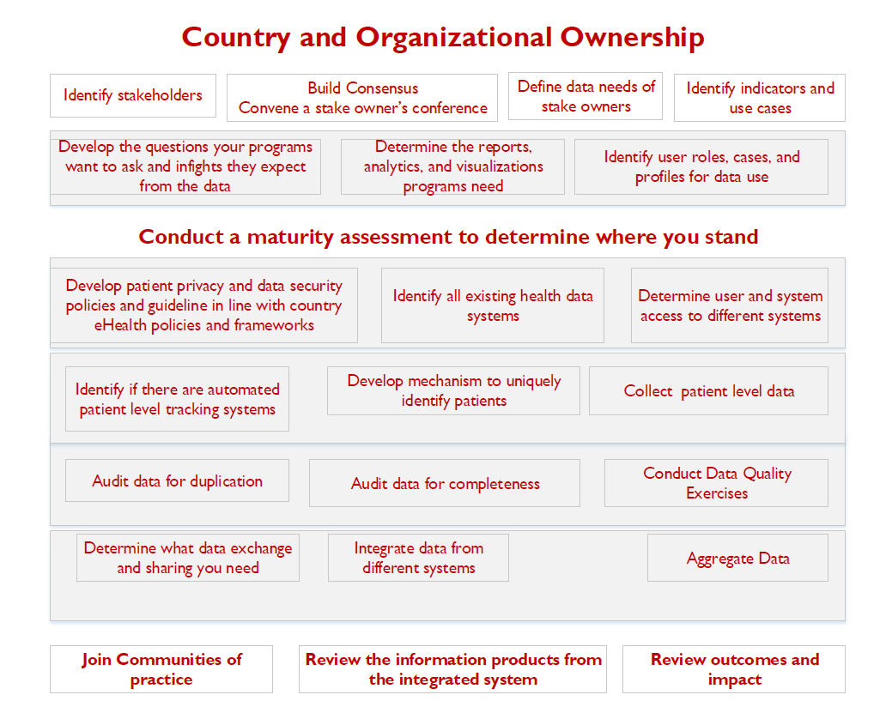
Develop your own Framework

Slide 17
Please Participate – We have a Community!
The Data Use Community is not officially announced as the newest OHIE community…but available to join.
You can Join Today!
You are our ideal early adopters…
To sign up now, scroll to the bottom of the page:
OHIE.org\DUC

Slide 18
Health Informatics
An Integral part of the Health Delivery System
IT Expertise
Shared resources
Subject matter Experts
Business Owners
Country Ownership
Collaboration
Architecture
Planning
HIS an Invisible and Ubiquitous Resource
The Journey
In environments with many constraints:
  Resource
  Patient Unique Identifier
  Duplicated Data
  Power Outages
  Poor Connectivity
  Parallel Systems
  Lack of Country Ownership and Governance
  But with Lots of Data
  Let us use it!!
  We cant wait for the perfect world.

Slide 19
THANK YOU!

