Slide 1
Working Group 2 Deliverable 1
Follow-on Discussion
August 16, 2019

Slide 2

Agenda
Agenda and Introductions
Discussion and Survey Results
Discussion

Slide 3
Discussion and Survey Results

Slide 4
Discussion and Survey Results
Need for a variety of use cases
  To illuminate different processes, how they fit in with the proposed approach, identify and resolve gaps etc.
Develop artifacts for stakeholders of various types and levels of IT expertise
  Artifacts should not be overly burdened with jargon to allow maximum engagement with a range of stakeholders at multiple levels of abstraction.
Provide methods for collaboration on design artifacts for the ST3 members to:
  Facilitate shared artifact development
Stepping back to consider other import aspects of case-based surveillance
  At least 7 additional areas of focus that need to be considered

Slide 5
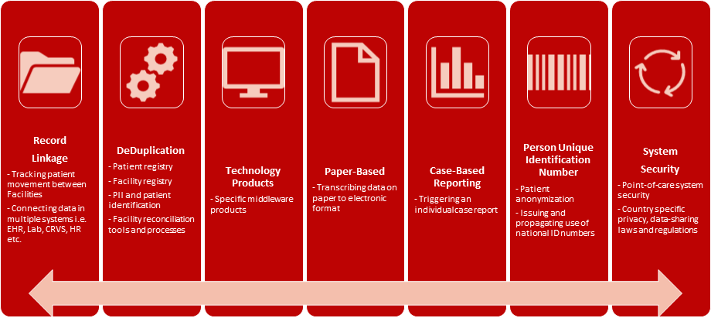
Consider Other Important Pieces
Case-Based Surveillance

Slide 6
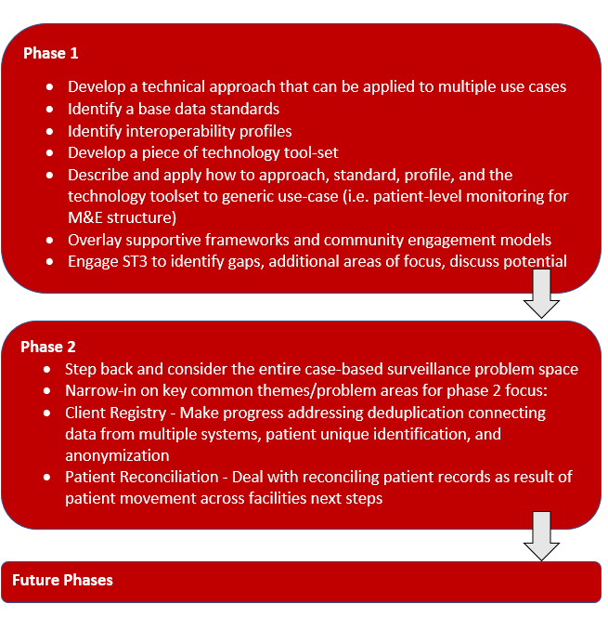
A Step-Wise Phased Approach

Slide 7
In-Person Use Case Meeting
Facilitate the identification of key priority use cases;
Detail-out each of the priority use cases’ main workflow by
identifying actors such as users,stakeholder groups, existing manual and automated systems, existing processes and their interactions within the workflow process as well as outline functional and data use requirements;
Determine next steps
Option 1
September 10-11, 2019
Option 2
September 11-12, 2019

Slide 8
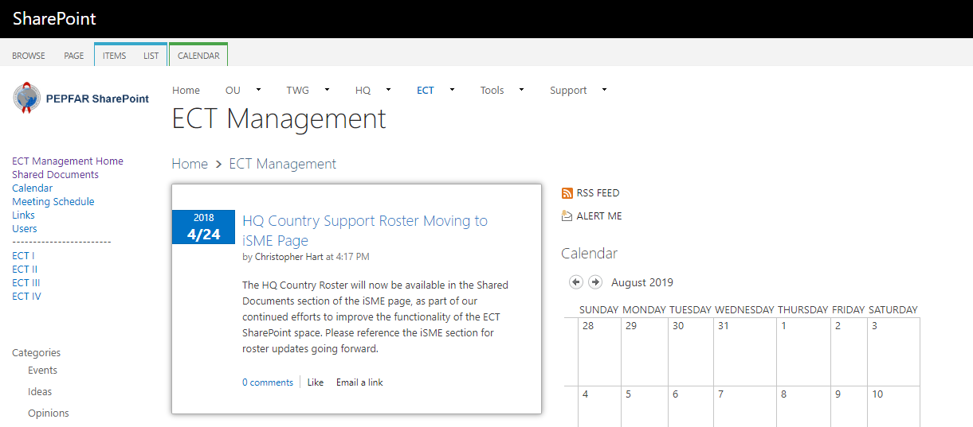
Shared Repositories for Collaboration
We will be hosting all of our group documents on SharePoint. The link will be sent out to everyone via email.

Slide 9
Discussion

Slide 10
Questions?

