Slide 1
COVID-19
Map and Match
DUC Outreach Discussion – September 1, 2020

Slide 2
The need for this work
A coordinated approach to digital investments is essential to quickly scaling access to time-sensitive data and information needed to inform an effective disease outbreak response. Without this critical alignment of funding to existing digital infrastructure, we risk deepening fragmentation of digital tools and data silos in a way that will hamper COVID-19 response efforts and undermine health systems.
Prioritize the use of existing digital health software systems in partner countries in order to accelerate the global COVID-19 response through increased access to actionable, data-driven insights and improved service delivery.
The Challenge
The Proposition

Slide 3
Goals of Map and Match
Map global good adaptations and implementations for COVID-19; match to country needs
Map and Match
Map existing adaptations and deployments; understand standards for interoperability; visualize gaps
Engage with USAID Missions and countries to match gaps based on needs
Advocate to adapt and scale in countries where gaps exist
Adapt and Scale
With additional resources, scale global good deployment where countries have need
Coordinate and share with USAID Missions, across global good community, and other stakeholders

Slide 4
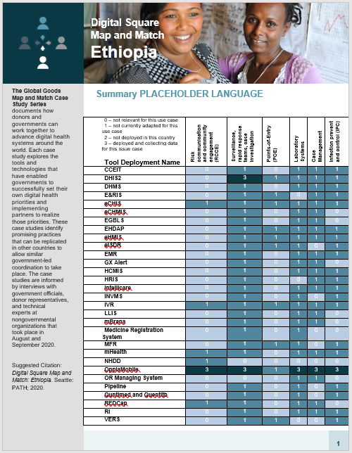
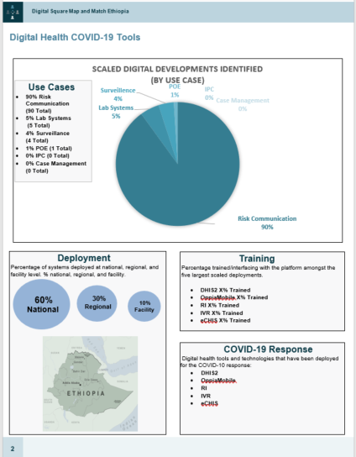
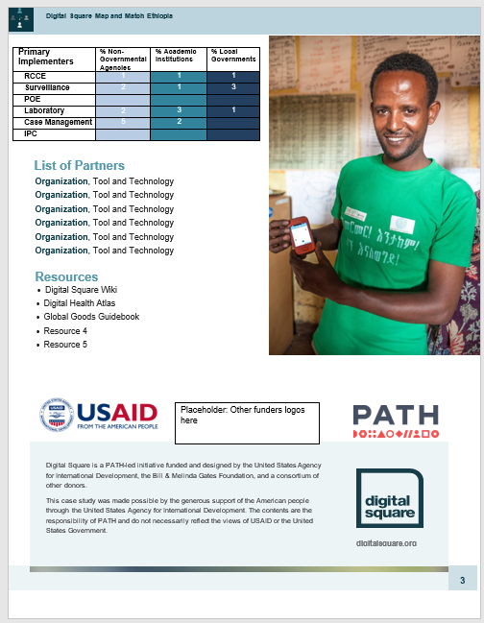
Project Output | Country briefs to increase visibility of in situ digital health tools that can support COVID-19 response
* Exemplary draft with placeholder language

Slide 5
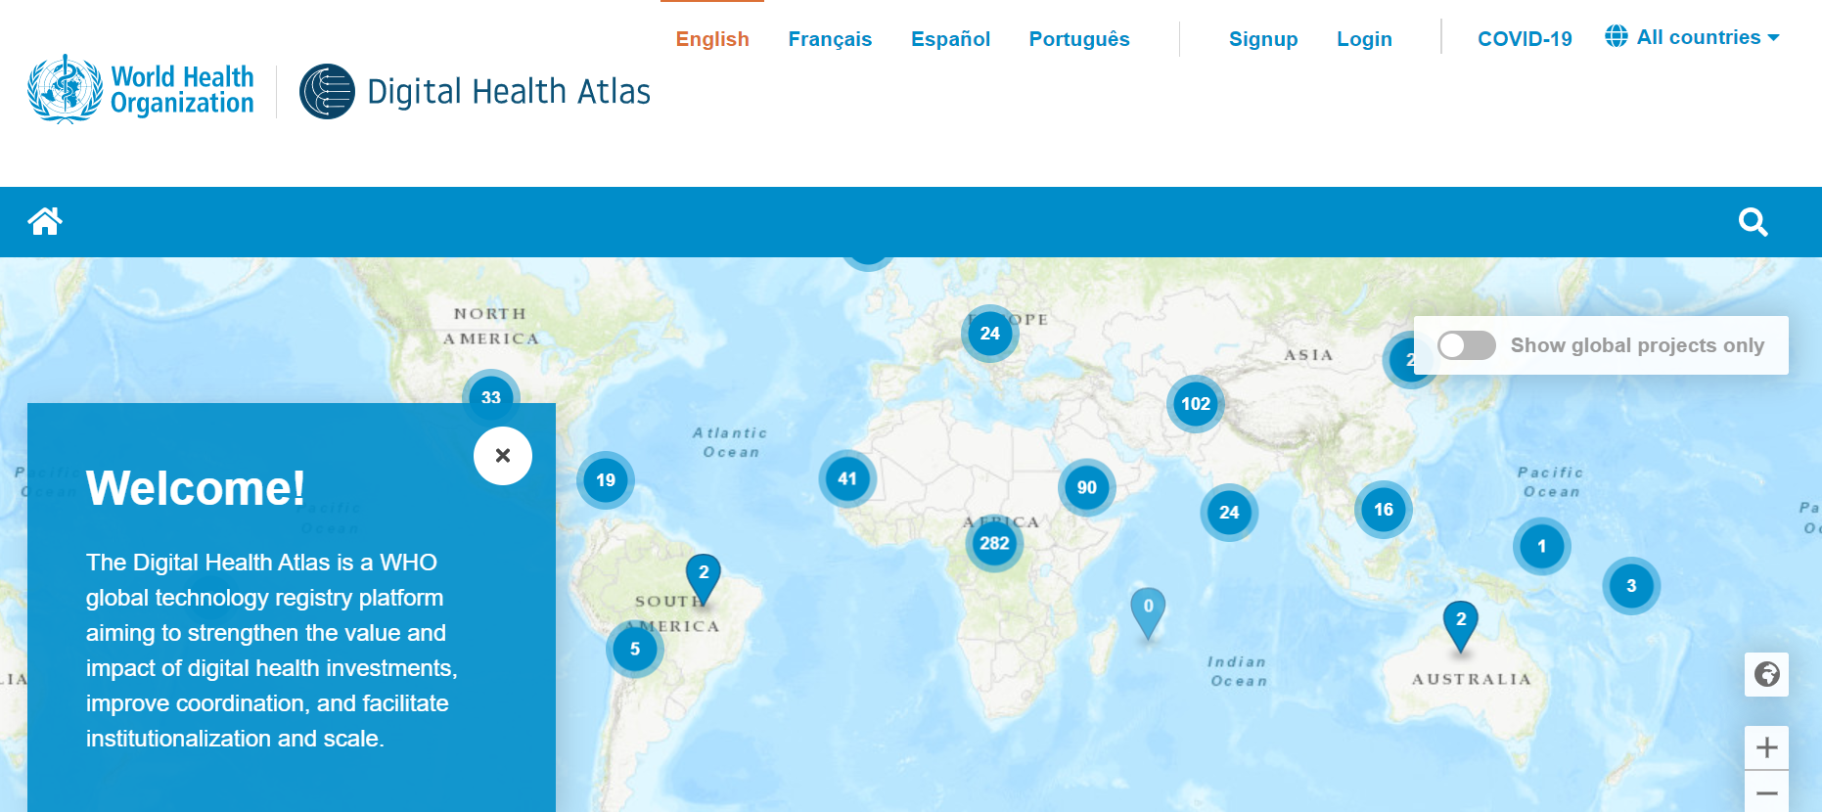
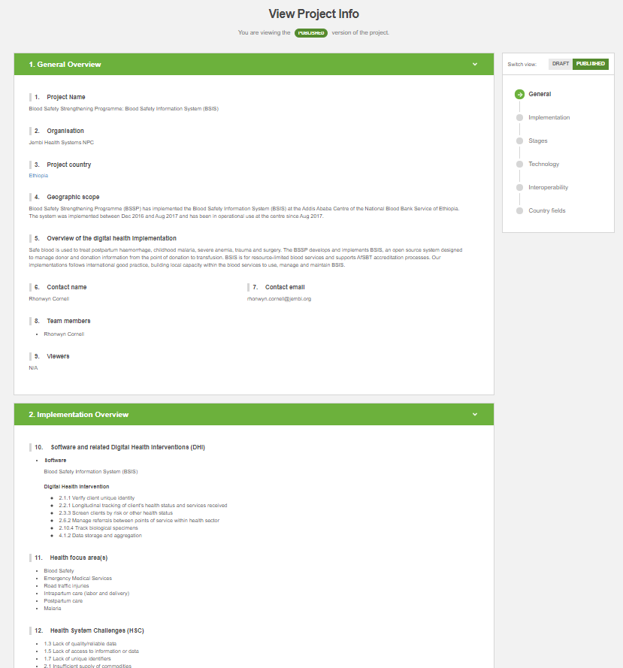
Digital Health Atlas Screenshots
The Proposition
Source: https://digitalhealthatlas.org/en/-/

Slide 6
Map and Match Overview and Timeline
Phase 1:
Initial Mapping
Rapid assessment and packaging
High-level gap analysis between deployment/adaptations across countries
Phase 2:
Expanded Mapping and Country Profiles
Expand research- KIIs, map to data standards
Identify pathways for dissemination including country engagement
Update mapping; develop country briefs
Phase 3:
Maintain Data and Plan for Scale
Maintain mapping data
Coordinate across partners (i.e. WHO DHA integration)
Accelerate with USAID Missions for “Adapt and Scale”
July 20 – August 2020
September – Mid-November 2020
Mid-November 2020 – January 31, 2021

Slide 7
Map and Match Overview

Slide 8
Phase 1: Initial Mapping
Goal: Rapidly package information about adaptations and deployment across global goods.
Digital Square desk review of existing documentation
Outreach to partners to share their own documentation of deployments, landscaping assessments, etc.
  NGO partners
  Moderators of listservs
  Digital Square Global Good Community
  Digital Square Peer Review Committee
  Other stakeholders

Slide 9
Phase 2: Expanded Mapping and Country Profiles
Goal: Expand our research and develop country profiles
Create selection criteria for deeper dives.
Focus deeper research on either countries, systems of use cases and supplement with key informant interviews (KII), surveys.
Develop 3-page country briefs to highlight tools deployed in countries.
"Match" - Match in situ tools that could be adapted for COVD-19 use cases.
Identify dissemination pathways for mapping collateral.

Slide 10
Phase 3: Maintain Data and Plan for Scale
Goal: Uphold integrity of tool, disseminate, and accelerate towards “Adapt and Scale”
Implement dissemination plans developed in Phase II.
Work with USAID and other donors to position for “Adapt and Scale”.
Coordinate with WHO to integrate research into the Digital Health Atlas.

Slide 11
Digital Health Atlas data elements (* = Required)
General overview
Project Name*
Lead Organization*
Country*
Geographic scope
Narrative summary of deployment*
Contact info (name,* e-mail,* editors,* viewers)
Implementation overview
Health focus area (10 options)*
Health systems challenges (39 options)*
Software platforms*
WHO Classification of Digital Health Interventions v.1 (28 options)*
Country Health Information Systems Supported (multi-select from 25)
Coverage (national vs subnational)
Regions covered*
# health care workers using the systems
# facilities using the system
# clients using the system
Government contributions (5 options)
Implementing partners
Investment partners*
Document Completion Status
Start date of the project*
Stage of the project (10 options) with date
End date of the project
Technology overview
Licensing (proprietary or not)
Documentation of code
Documentation of application
Documentation to software wikipage
In addition to country briefs, would a data model of this information within the DHA help inform your response?
Interoperability & standards
Data exchange with any of 11 HIS systems components
Data standards used (30 options)

Slide 12
DHA and M&M priority indicators for ‘rapid scan’ (Phase 1)
Priority DHA data elements
Priority proposed additional data elements
Phase 2 and beyond
General overview
Project Name
Name of tool deployment
Country
Narrative summary of deployment
Contact info (name, e-mail, editors, viewers)
Currently Deployed for COVID-19
Scale
Geographic Scope
Coverage (national vs subnational)
Level of implementation: (National, Regional, District, Facility, Community)
Regions covered
Who enters data? (health workers etc.)
Number of health care workers using the systems (trained)
Number of facilities using the system
Number of clients using the system
Partners
Lead Organization
Government contributions (5 options)
Implementing partners
Investment Partners
Implementation overview
Use Cases (select from 7)
Case based or patient-based data
Health Focus Area (10 options)
Health Systems Challenges (39 options)
Software Platforms
WHO classification of interventions (28 options)
Country Health Information Systems Supported (multi select from 25)
Interoperability & standards
Data exchange with any of 11 HIS systems components
Data standards used (30 options)
Dates
Date: most current information on deployment
Start date of the project
Stage of the project (10 options) with date
End date of the project
Technology overview
Licensing (5 options incl proprietary or open source)
Global good or not global good
Documentation of code
Documentation of application
Documentation to software wiki page

Slide 13
Discussion

