Slide 1
Integrated ST3
Working Group 2 Team
Kick-Off
August 9, 2019

Slide 2

Agenda
Agenda and Introductions
Overview and Charter
Deliverables & Completion Plan
Deliverable 1 Technical Approach
Next Steps

Slide 3
Overview and Charter

Slide 4
Building on PEPFAR’s Investments in Data Exchange and Interoperability
PEPFAR promotes secondary use of existing data from multiple sources (e.g. civil registration and vital statistics systems, electronic medical record systems, laboratory information systems, human resource systems, commodity and logistics tracking systems, etc.) and in a variety of formats (e.g. paper, import files, machine-to-machine exchange, etc.)
S/GAC has led a number of data exchange and interoperability activities including:
  PEPFAR/MoH data alignment: reuses primary aggregate data collected by MoHs and lays a path towards routine system-to-system exchange of aggregate data between MoH and donors such as PEPFAR
  PEPFAR’s Interoperability Platform: deployed an infrastructure that implements data exchange standards and leverages standards-compliant middleware technology tools from the Open Health Information Exchange community. Currently used on DATIM4U in Uganda.
  Support for implementing existing health standards, profiles such as ADX, mCSD, FHIR, etc., and use of maturity models to guide continuous improvement processes for country health systems.
  Exploring the case-based surveillance/patient-level monitoring use cases via this ST3 working group.

Slide 5
Recap: ST3 Overview
Bringing the Pieces Together/Bridging Silos: Integrated HIV Case Identification and Surveillance
The overall goal of this short-term task team is to provide ethical, technical, and policy considerations for an integrated approach that supports HIV case-based surveillance, recent infection surveillance, unique means of identifying persons within HIV surveillance and programmatic monitoring and index testing for PEPFAR countries as they develop and implement these systems and activities in fiscal years 2020-2021.

Slide 6
Recap: ST3 Working Groups
Group 1: Integrated framework model that PEPFAR countries can adapt to their context for index testing, recent infection surveillance, unique means of identifying persons, and case-based surveillance for maintenance of HIV epidemic control (will address patient information, education, and communication (IEC) materials on how personal identifiable information (PII) will /will not be used).
Group 2: Checklist of minimum requirements for the technical components of integrated HIV health information systems that include ethics, IT, and security considerations. In collaboration with the S/GAC PRIME information systems team, this will include iteration on a broadly-applicable technical approach around the case-based surveillance use case with development of complementary community and maturity models
Group 3: Summary document of existing public health laws (e.g. mandatory HIV reporting, assurance of confidentiality, protection of PII) from PEPFAR and non-PEPFAR countries that support HIV reporting and data linkage.
Group 4: Plan for expected use and response to data obtained from an integrated HIV case identification and surveillance.

Slide 7
ST3 Working Group 2
Checklist of minimum requirements for the technical components of integrated HIV health information systems that include ethics, IT, and security considerations. In collaboration with the S/GAC PRIME information systems team, this will include iteration on a broadly-applicable technical approach around the case-based surveillance use case with development of complementary community and maturity models
Deliverable 1
Deliverable 2
Deliverable 3
Development of standards for PEPFAR countries in regards to how individual level data obtained via unique IDs and/or deduplication can be used for case-based surveillance and also aggregated data (MER indicators)
Development of a technical assistance framework and/or template to aid in country success during implementation and maintenance of the integrated approach
Considerations of country support systems that can potentially include communities of practice for oversight and guidance
Notes:
Add co-champions

Slide 8








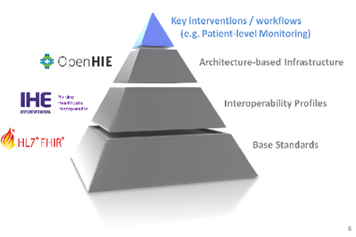
Mapping ST3 Working Groups and Deliverables
“Bringing the Pieces Together”
Working Group 1: Integrated framework model
Working Group 2: Checklist of minimum requirements for technical components
Working Group 3: Summary document of existing public health laws
Working Group 4: Plan for expected use and response from data obtained
Deliverable 1: Development of standards on collecting patient-level data
*Deliverable 2: Development of a technical assistance framework and/or template
*Deliverable 3: Consideration of in-country support systems
Develop a consensus for referencing the WHO supported Health Data Collaborative work product entitled “Health Information Systems Interoperability Maturity Toolkit: Users' Guide”.
Develop consensus on appropriate community engagement models to engage fields stakeholders.
*ST3 Deliverable 2 and 3 will be combined into one deliverable working group

Slide 9
Working Group 2 Approach
The co-champions propose a consensus approach for:
Deliverable 1: Developing the three levels denoted in gray of standards, profiles and infrastructure that will underpin key interventions and workflows.
Deliverable 2 & 3: Developing a technical assistance framework that is grounded in an established maturity model while leveraging a community engagement model that iteratively works to meet PEPFAR's operational needs while recognising that countries are at different maturity levels.

Slide 10
Deliverables and Completion Plans

Slide 11
Participation Methodology and Action Items
Review, truth test, and provide feedback on the proposed technical approach outline in Deliverable 1
Work together to reach consensus via virtual deep dive working sessions, webinars, demos, etc. in deliverable sub-groups
Attend potential in-person working session to discuss and collate sub-group deliverable drafts/outputs to finalize ST3 deliverable

Slide 12
Timeline
Post-meeting activities (e.g. establishing community) and preparation for input into COP guidance in late October
Respond to post-call survey by COB August 12th
Attend overall coordination calls
Deliverable call
August 16th
Kick-off call
August 9th
Materials distribution for each deliverable
Attend scheduled group 2 deliverable group calls
Potential in-person working sessions
(Tentative: Late Sept/Oct)
Series of socialization and communication to the field

Slide 13
Deliverable 1 Completion Approach
Goal
As domain SMEs truth test, validate, point-out flaws and provide feedback to the technical approach
Approach
ST3 activity kick-off call (8/9)
  Purpose: To provide a high-level brief overview of technical approach including standards, profiles and infrastructure
Materials distribution (to sent out after kick-off call)
  Purpose: To provide with detailed information on the toolset, access to demos and associated materials
High-level touch point call (8/16, 9AM-10:30AM)
Purpose: To provide a deep dive into the technical approach, standards, profiles and infrastructure
Deliverable 1 group working sessions (a series of deep-dive calls at date TBD)
Purpose: To provide understanding of how the toolset, standards, profiles fit together to create a complete end-to-end solution that can be applied to multiple clinical domains
Output
A fully documented validated, trust-tested complete end-to-end solution (PHASE 1 toolset supported by reference standards to be addressed in COP guidance materials)

Slide 14
Deliverable 2 & 3 Completion Approach
Goal
To develop a technical assistance framework that is grounded in an established maturity model while leveraging a community engagement model that iteratively works to meet PEPFAR's operational needs
Approach
Advance prep calls with framework and community builder SMEs
  Purpose: To brainstorm and document various community engagement models, perform a quick community stakeholder landscape analysis, fleshing-out the framework using the maturity model
High-level touch point call (8/16, 10:30AM-12PM)
  Purpose: To present on types of potential community engagement models and ideas for leveraging the framework. Engage in an open discussion
Deliverable 2 & 3 group working sessions (a series of deep-dive calls at date TBD)
Purpose: To iterate through potential solutions with ST3 members interested in this sub-task interest area. Gain consensus on the appropriate models and document details on operation and use.
Output
Draft recommendations to present to entire ST3 group on way forward on community engagement model and application of the maturity model at in-person Sept/Oct meeting.

Slide 15
Technical Approach for Deliverable 1

Slide 16
In Scope
This is…
A technical approach that can be applied to any clinical domain use case that requires multiple individual-level records to be aggregated
Includes:
  Aggregate reporting from patient-level EHRs, EMRs, e-Registry systems
  deriving routine M&E data from CRVS, lab, logistics, and HR systems
  case-based surveillance
A standard-based methodology that is platform agnostic
An end-to-end technical solutions with a technology tool set containing pieces that can be fitted together to create a complete solution
A ‘mine-able’ data set leveraging individual-level metadata that will support adjustments to programmatic decision criteria (i.e. changes in MER reporting indicators and disaggregates requirements) in order to minimize impact to data collection tools
Phase 1 of a larger solution that uses an iterative approach that fine-tunes our approach, methodology and technology toolset as we engage with stakeholders at various levels; we provide a pathway for countries

Slide 17
Out of Scope
This is NOT…
A centrally-supported system that can be fully implemented and ready for use immediately
A turn-key solution to resolve every issue within the entire clinical landscape
  Not providing a solution for unique patient identifiers
  However we do make general assumptions of how unique patient identifiers can be handled and anonymized
A prescriptive one-size fits all approach
  Countries are at different systems’ maturity levels and any approach to strengthening case-based surveillance system development, implementation, and the use of the data therein must be step-wise and sensitive to varying levels of maturity of multiple domains (human capacity, infrastructure, data use, etc.)

Slide 18
Key Terms
Term | Description
Data Sharing Specification (DSS) | A Data Sharing Specification (DSS) provides computable means to define: Inclusion and exclusion criteria for a population cohort on which indicators should be calculated. The minimum data set required to calculate the indicator and determine the inclusion/exclusion criteria in terms of HL7 FHIR resources. The calculations required for the numerator and denominator of an indicator.
FHIR | Stands for Fast Healthcare Interoperability Resources. Developed by Health Level Seven International (commonly known as HL7), it's an interoperability specification for the exchange of healthcare information electronically.
Measure | Represents a structured, computable definition of a health-related measure such as a clinical quality measure, public health indicator, or population analytics measure. https://www.hl7.org/fhir/measure.html
Minimum Data Set (MDS) | A Minimum Data Set Message (MDS) is used in the architectural pattern defined in the IHE Quality, Research and Public Health (QRPH) White Paper. The MDS is defined by a data sharing specification (DSS) and the questionnaire.. The pattern allows for the inclusion of only the minimum data set needed to calculate an indicator (or related set of indicators). This data is communicated by a point of service system.
Questionnaire | A data structure that allows point-of-care systems analysts to easily map their minimum data set to the data sharing specification (DSS). It is also used to define the data needed in the minimum data set.
Profile | Describes a set of base resources that are used in many different contexts in healthcare. In order to make this manageable, applications and specifications need to be able to describe restrictions on how one or more resource(s) are used, including defining extensions, and controlling how terminology is used. Is used build the questionnaire. https://www.hl7.org/fhir/profiling.html
FHIR Bundle | A container for a collection of resources. A bundle is useful for: r Returning a set of resources that meet some criteria as part of a server operation Returning a set of versions of resources as part of the history operation on a server Sending a set of resources as part of a message exchange Grouping a self-contained set of resources to act as an exchangeable and persistable collection with clinical integrity - e.g. a clinical document Creating/updating/deleting a set of resources on a server as a single operation (including doing so as a single atomic transaction) Storing a collection of resources https://www.hl7.org/fhir/bundle.html
Mapping/Mapper | A tool used to map the minimum data set that needs to be produced from the Point-of-care application’s data to the data specification for an indicator or indicator set. This is done using a questionnaire.
Bundle Maker | A tool that converts the point-of-service data in the QuestionnaireResponse and expected Profile to be met to create a FHIR Bundle which is the input to and can be processed by the FHIR Engine, or shared or posted to Data Warehouse.
FHIR Engine | A service that takes submitted bundles and, using the DSS for the indicator, generates the FHIR Aggregated data based on the bundle contents.
Terminology Service | Stores the data sharing specification (DSS) for each indicator / set of indicators. The specification includes the paired codes and terminology

Slide 19
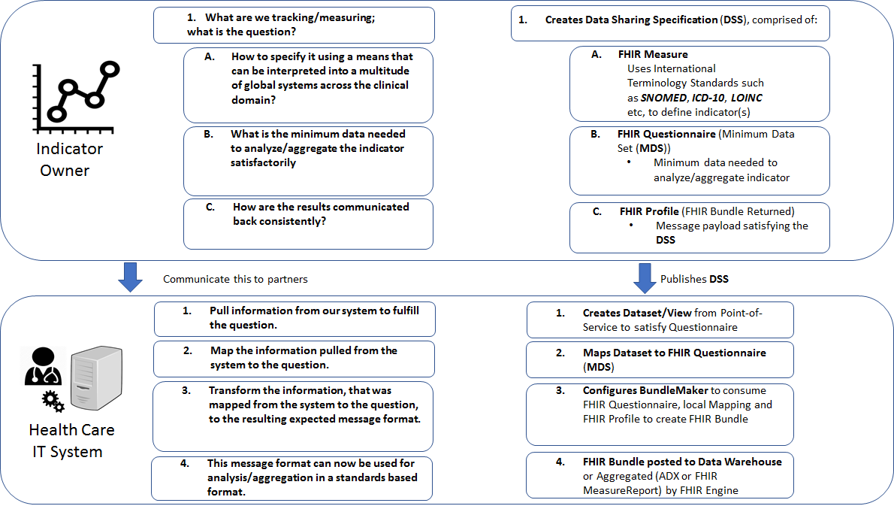
Technical Approach for Deliverable 1

Slide 20
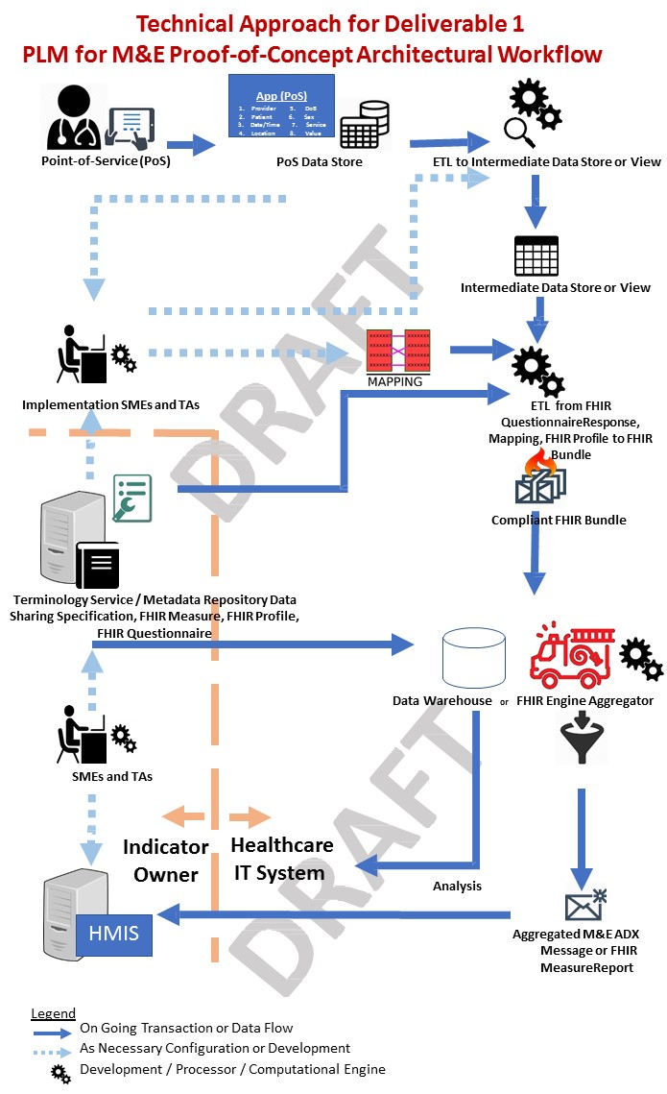

Slide 21
Next Steps

Slide 22
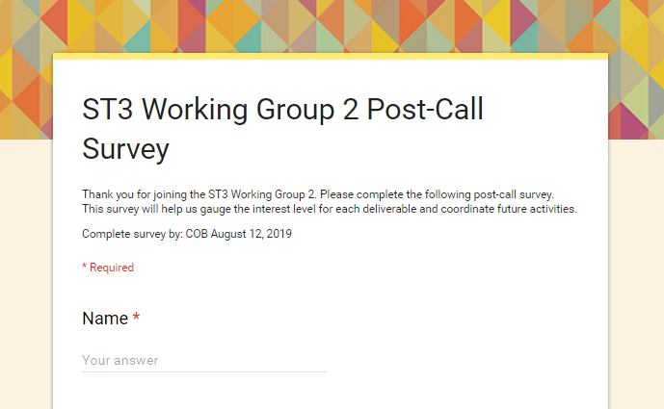
Post-Call Survey
Survey will cover:
Interest in working on specific deliverable(s)
Input and feedback on:
  Deliverables
  Structure of deliverable groups
  Technical approach
  In-person working session
Scheduling for:
  Deliverable groups
  In-person working session
Due: COB August 12, 2019

Slide 23
Deep-Dive Presentations
Once you send in your interest in any of the deliverables, we will be sending over invitations for the “deep-dive” presentation. These presentations will cover a more in-depth overview of the deliverable(s), along with next steps and action items for the group.
Deliverable 1
August 16, 2019
9AM-10:30AM
Deliverable 2 and 3
August 16, 2019
10:30AM-12PM

Slide 24
Potential In-Person Meetings
Purpose
Considering potential in-person working meetings for validation of the technical approach and development of the community and maturity models
Will work with ST3 leadership to determine utility of meeting specifically for our deliverable group and/or for the broader Integrated ST3 group
Dates (Tentative)
Mid-September to Mid-October
Location
Washington, DC

Slide 25
Questions?

