Slide 1
Community of Practice
Secondary Data Usage

Slide 2
Today’s Global Health Challenges...
Challenges understanding impact of specific health interventions across the enterprise (ie, ARVs for viral suppression)
Challenges learning how to build “efficiency” in the health systems we support
Challenges understanding the ever-changing epidemiology of target diseases

Slide 3
Today’s Global Health Challenges...
GH community is attempting new techniques to address:
  next-generation M&E
  case-based surveillance
  syndromic surveillance
These techniques have been challenging to implement at scale
  lack of consensus on tactical approach
  data infrastructure immature, but emerging
  lack of content standardization
No one organization can resolve these issues on their own… so how do we advance this work?

Slide 4
Importance of Communities
Communities of practice are formed by people who want to collectively learn and support each other’s shared interests.
Encourages open collaboration around shared activities and discussions
Place for members to stay in touch and plugged in to common problems and knowledge sharing
Strengthens member ownership and encourages knowledge transfer
Provides tools for curating documentation to strengthen education
Maintain and support problem spaces creating more effective users of your record system

Slide 5












HIS Communities of Practice
‹#›

Slide 6
Today’s Global Health “data economy”
Predominant focus on collection and use of data for M&E
  Systems and processes in place to collect aggregate data within health delivery settings
  Value proposition is focused upon giving health delivery settings insights into how their location is performing in comparison to others
Growing interest in the implementation of patient-level record systems
  Multiple countries have moved from pilot EMR implementations to national level rollouts
  Value proposition is focused upon giving settings tools to improve the efficiency and quality of the care services they deliver

Slide 7
Tomorrow’s “data economy”
Health settings have broadly implemented record keeping systems for the primary purpose of improving efficiency and quality
Global Health Community has built collective understanding and conventions on how these same data can be reused for other secondary purposes:
  Monitoring and Evaluation
  Case Surveillance
  Syndromic Surveillance
  Quality Improvement Initiatives
  Decision Support

Slide 8





Secondary Data Usage
generate de-identified case based reports after sentinel events
Case Surveillance
Health Information Exchange
calculate indicators from anonymized data
MDS
trigger events based on patient care workflow
Health System Monitoring
MDS
MDS
Clinical Decision Support Service
Labs
Dispensing
clinical workflow
data
EMR
digital client register

Slide 9
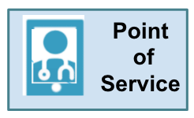
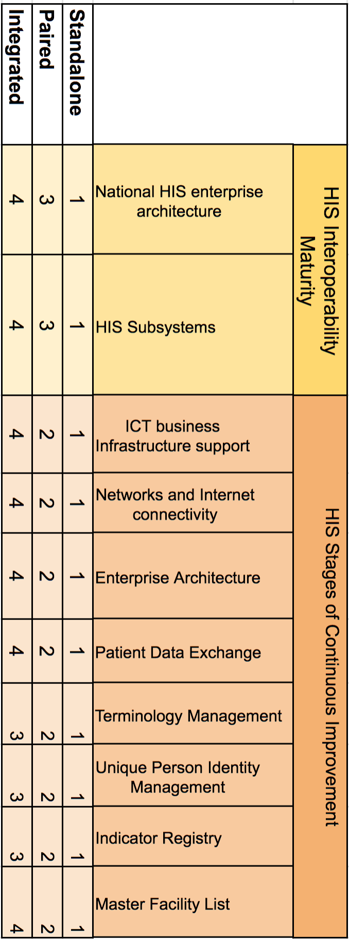
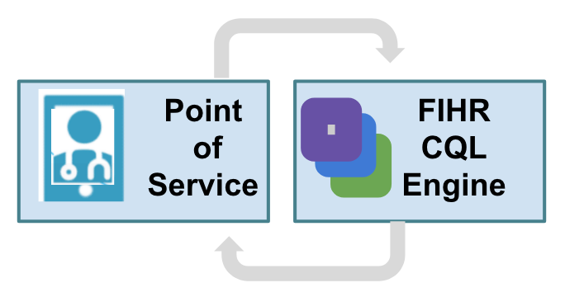
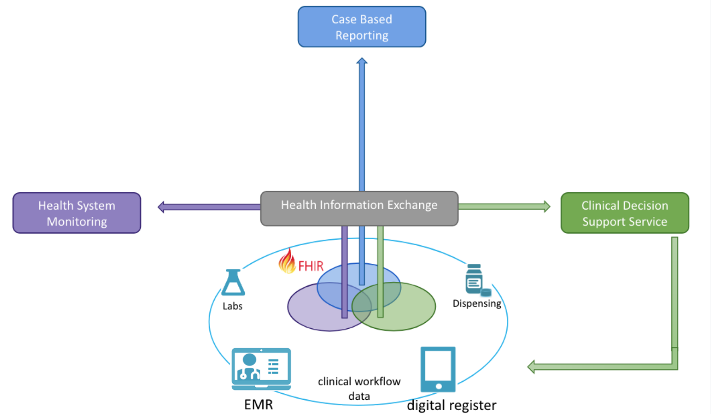
Staged Maturity Model Scenarios
Three scenarios defined in terms of Health Information Systems Interoperability Maturity Toolkit and HIS Stages of Continuous Improvement Toolkit
Standalone - a standalone digital health system using a bespoke data model running on a low-powered and often disconnected device required to send a data extract.
Requires precise definitions for native implementation of an indicator report, care guideline or case report.
Paired - a digital health system that can share data using the an open standards compliant data model and which offloads computation to a locally available service using reusable software components.
Requires profiled data models and computable assets.
Exchanged - a connected digital health system operating within a health information exchange that wants to contribute data to a longitudinal client record on which indicator calculations are performed, case reports are generated, and decision support services are provided.
Requires profiled data models, computable assets and metadata registries and shared operational data.

Slide 10
Challenges to address in realizing secondary use
Limited on the ground experience with secondary uses of data
Lack of standardized processes and conventions
Various stakeholders often unaware of their roles in supporting secondary data uses
Multiple levels of maturities for countries
Building shared understanding around this new data use strategy
Data sharing and usage rights across jurisdictions

Slide 11
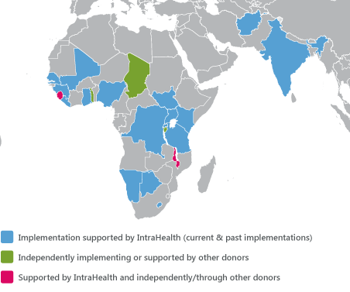
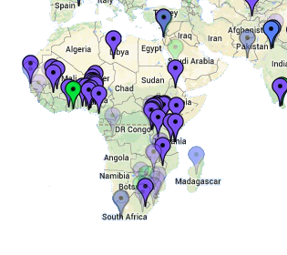
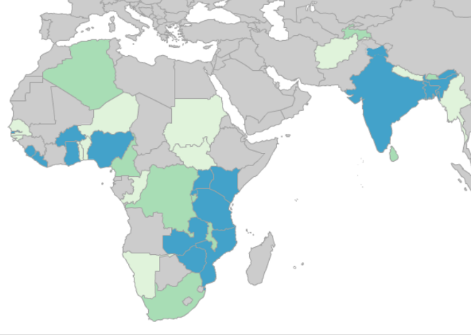
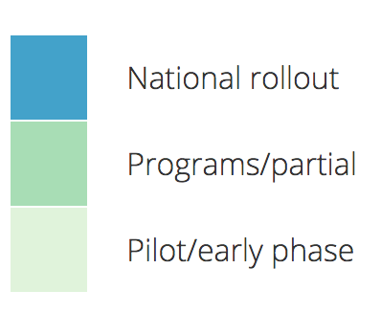
Health Information Landscape
Software monocultures
iHRIS
(health workforce)
OpenMRS
(electronic medical records)
DHIS2
(public health & service delivery indicators)
Potential to achieve interoperability at scale
De-facto authorities for health system metadata
Existing networks of local and regional informaticians, developers, implementers
Part of MOH HIS strategic plans and donor funding requests
Image courtesy
ihris.org, openmrs.org, dhis2.org

Slide 12
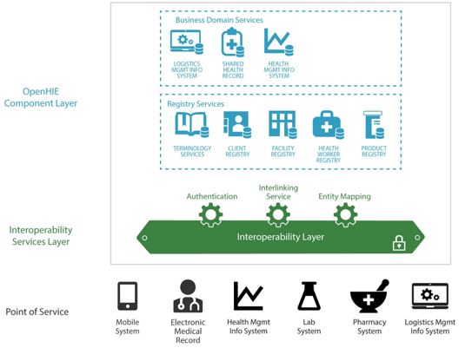

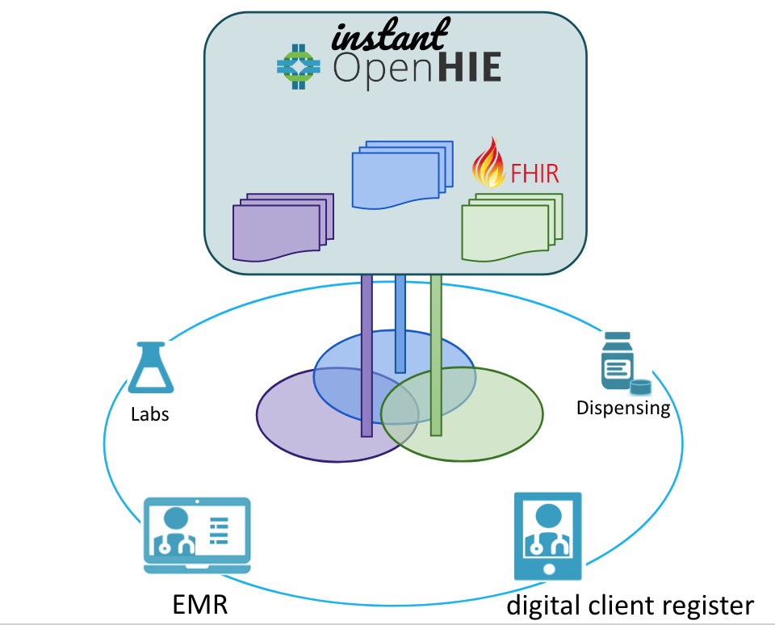

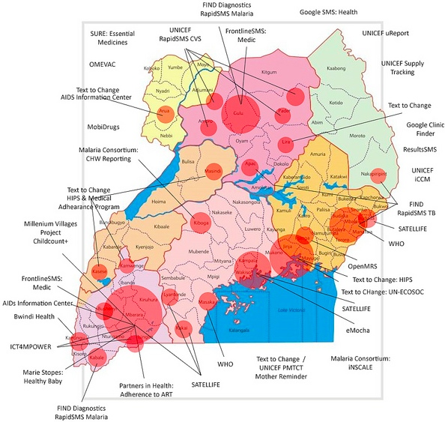

Health information landscape
Curating the garden with health Information exchanges
architecture
reference implementation
and standards
Image courtesy
ihirs.org, Blaschke @ UNICEF, ohie.org

Slide 13
Example: WHO-recommended surveillance of measles
Surveillance used to identify high-risk populations and to predict and prevent potential outbreaks. Countries in which the objective is to completely interrupt measles transmission (or countries with very low incidence) require intensive case-based surveillance to detect, investigate and confirm every suspected measles case in the community
Recommended case definition
Clinical case definition Any person in whom a clinician suspects measles infection, or Any person with fever and maculopapular rash (i.e. non-vesicular) and cough, coryza (i.e. runny nose) or conjunctivitis (i.e. red eyes)
Laboratory criteria for diagnosis Presence of measles-specific IgM antibodies
Recommended types of surveillance
Mortality reduction phase When measles is endemic, routine monthly reporting of aggregated data on clinical measles cases is recommended by district, age group and immunization status. Only outbreaks (not each case) should be investigated...
Low-incidence or elimination phase Case-based surveillance should be conducted and every case should be reported and investigated immediately (and also included in the weekly reporting system). Laboratory specimens should be collected from every sporadic suspect case. ...
Principal uses of data for decision-making
Mortality reduction phase
Monitor incidence and coverage to assess progress (i.e. decreasing incidence and increasing coverage) and identify areas at high risk or with poor programme performance. Describe the changing epidemiology of measles in terms of age, immunization status and interepidemic period. Assist in determination of optimal age groups to be targeted by second opportunity for measles vaccination
Low-incidence or elimination phase
Identify chains of transmission. Monitor the epidemiology (age groups at risk, interepidemic period, immunization status) of measles and accelerate immunization activities accordingly to avert potential outbreaks.
Use epidemiological data to classify cases (see special aspects section). Use performance indicators to assess the quality of surveillance and identify areas that need strengthening
Recommended minimum data elements
Aggregated data
Number of cases by age groups and immunization status
Number of measles vaccine doses administered to infants aged under 12 months and children aged 12-23 months
Case-based data
Unique identifier*
Geographical area (e.g. district and province)*
Date of birth*
Sex 1 = male; 2 = female; 9 = unknown
Date of onset of rash*
Number of prior measles vaccine doses received: 9 = unknown*
Date of receipt of last dose
Date of notification
Date of case investigation**
Date of blood specimen collection*
Date blood specimen sent to laboratory
….
https://www.who.int/immunization/monitoring_surveillance/burden/vpd/surveillance_type/active/measles_standards/en/

Slide 14
What communities need to be successful?
Problem space that individuals/organizations can’t respond to on their own
Inherent resource constraint
Collectively agreed upon and well scoped mission, vision, and values
Real examples of work that the collective can focus on
Secretariat support to convene and harvest conventions
Ability to develop decision-making structures in place as the community grows

Slide 15
Suggested Approach
Convene generalized, non OGAC specific “secondary health data use” community of practice (need better name)
  bring together founding implementers and beneficiaries together to define shared community mission, vision, and values
  allow those founders to declare initial areas of work focus
  form light secretariat to develop community model and harvest conventions
Support pilot implementation of a priority case surveillance secondary data use case within the CoP
Support pilot implementation of a priority (M&E) secondary data use case within the CoP
CoP becomes clearinghouse of where conventions get published, roles are defined within global health data sharing ecosystem

Slide 16
Example First Year Community Activities
Establish priority generic secondary data usage workflows for consideration
  HIV Case Reporting will be a central use case - should fit in as example with other types of case reporting and things similar to case reports
  Other examples such as Aggregate Reporting will be brought in to ensure appropriate data infrastructure
For Case Reporting use case:
  Ensure have representative stakeholder across global health agencies and MOHs for HIV as well as other diseases
  Fully document Minimum Data Set (MDS) needs for Case Reports in at least two health program areas (including HIV) and for HIV document MDS needs for WHO and CDC using the “Digital Health Accelerator Kit” template which includes:
    Defining the MDS in terms of the HL7 FHIR (so we can, for example, ensure compliance)
    Document business process for case reporting from POS to MOH to other health agencies (when does de-identification or anonymization occur? Are the MDS needs different across agencies)
  Review related workflows (e.g. contract tracing) for common patterns
Ensure work products can be used in multiple maturity model scenarios
Provide consensus recommendations for investments is POS applications and Instant OpenHIE stack

Slide 17

Standards for Secondary Data Usage
generate de-identified case based reports after sentinel events
Case Surveillance
use CSD Hooks for triggering sentinel events and use CQL to generate CBR to send to ? according to ?
Health Information Exchange
calculate indicators from anonymized data
trigger events based on patient care workflow
use CQL to identify population cohort and define indicators and report to HMIS according to mADX and IHE White Paper
warehouse & CQL engine
use CQL and CSD Hooks to trigger clinical support
activities in Point of Service system according to CPG Implementation Guide. activities may include a referral, order, alert, suggestion, or questionnaire
MDS
Health System Monitoring
MDS
MDS
Clinical Decision Support Service
HL7 FHIR profiles
  Indicators (mADX)
  Case Reports (?)
  Decision Support (CPG)
Labs
Dispensing
  Health Facility and Worker (mCSD)
  Aggregate Data Exchange (mADX)
  Terminologies (mSVS)
  Alerting (mACM)
  Client Demographics (PRIM)
clinical workflow
data
EMR
digital client register

Slide 18
Additional Content

Slide 19
What can help?
Clearly documented and demonstrated secondary data use cases
Publicly available technical and process conventions
Places where practitioners can share knowledge and learn from each other

Slide 20
Creating Computable Care Assets
L1 Narrative*: Guidelines and policies
are developed by policy and health
experts
L2 Semi-structured: Recommendations
expressed in terms of HL7 FHIR model
as structured business requirements using process flow diagrams, user stories, etc.
L3 Structured: Computable care guidelines expressed as HL7 FHIR and CQL artefacts
L4 Executable: Computable care guidelines implemented in a health jurisdiction
Guidance and Policy
SME, Health Program
Manager, Policy Developer
Business Analyst
Digital Health Architect
Accelerator Kit
Indicators
Case Reports
Decision Support
mADX Data Sharing
Specification
Intake Form
mADX Data Sharing
Specification
Clinical Practice Guideline (CPG) Implementation Guide
Business Analyst
Digital Health Architect
Software Developer
TBD
Computable Care
*Aziz A Boxwala, Beatriz H Rocha, Saverio Maviglia, et al. (2011). “A multi-layered framework for disseminating knowledge for computer-based decision support”. Journal of the American Medical Informatics Association, Volume 18, Issue Supplement_1, Pages i132–i139. https://academic.oup.com/jamia/article/18/Supplement_1/i132/797073

Slide 21
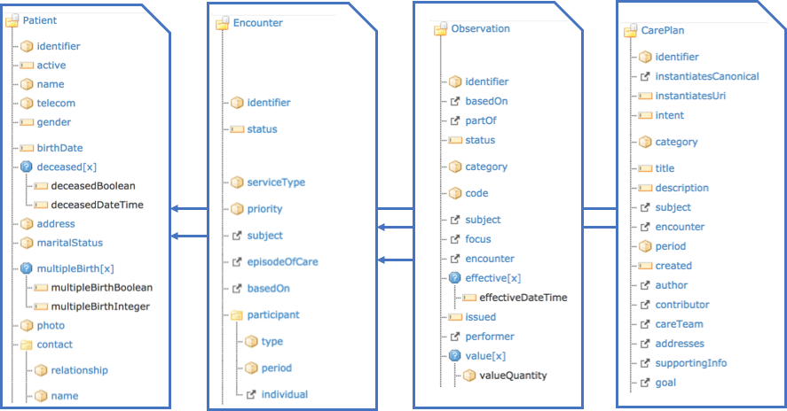
HL7 FHIR Data Model and Clinical Care Workflow

Slide 22
Directions for Instant OpenHIE
Case Based Reporting
instant
Health System Monitoring
Clinical Decision Support Service
Labs
Dispensing
EMR
digital client registration

Slide 23
Client Deduplication and Record De-Identification
Case Based Reporting
Need processes and tools to support client record management within a health agency jurisdiction and and cross-jurisdiction
De-identification or anonymization can occurs at the point of service, inbound to the HIE or out-bound from the HIE to another health agency
instant
Health System Monitoring
Clinical Decision Support Service
Labs
Dispensing
EMR
digital client registration

Slide 24
HL7 FHIR Adoption in Global Goods
OpenMRS: Sync 2.0 module enables two-way synchronization between OpenMRS and FHIR Server for the key FHIR resources (e.g. Observation, Practitioner, Patient, Observation).
DHIS2 Tracker: DHIS2 FHIR adapter has mapping rules to FHIR resources. Rules need to be defined for each Tracker Program implementation.
openIMIIS: Transitioning to FHIR backend for health insurance claims which.
OpenLMIS Support synchronization of facility lists with mCSD. Defining stock related indicators using mADX (planned).
GOFR: Multiply facility lists can be cross-referenced reconciled, and mapped to each other. Uses mCSD.
Instant OpenHIE: Reference implementation of OpenHIE components pre-configured for FHIR profile and with FHIR warehouses interoperability designed for multiple deployment scenarios (starting).
iHRIS: Exports facility and health worker lists with mCSD. Moving to FHIR backend data store.
DHIS2 Aggregate: OrgUnit hierarchy mapped to FHIR Location (mCSD), DataElements represented as FHIR Measure (mADX), CategoryOptions represented as FHIR ValueSets (mSVS) for disaggregation (in early planning phases)
mHero: Two-way communication system with health workers. Supports mACM profile for one-way alerts and reporting data collected as FHIR Questionnaire. Updating to mCSD (starting).

Slide 25
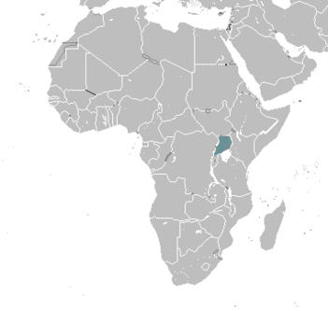
Health information landscape
Let a thousand flowers bloom
Large focus on digitization of paper records and processes
Often focused on disease-specific program (“health verticals”)
Heterogeneous implementing organizations and funders
Arose due to lack of national coordination / eHealth policy
Limited data exchange & sharing policies
Data protectionism (vendors & MOH units)
Often driven by public health & tech innovators
Prioritized functional requirements not limited to EMRs
Uganda digital health projects
x 55-ish
Image courtesy
Blaschke @ UNICEF

