Slide 1

Zambia Digital Health Implementation
OpenHIE eHealth Leaders Forum
Republic Zambia
Ministry of Health
Presented by: Chisanga Louis Siwale
Date: 17 August 2023

Slide 2
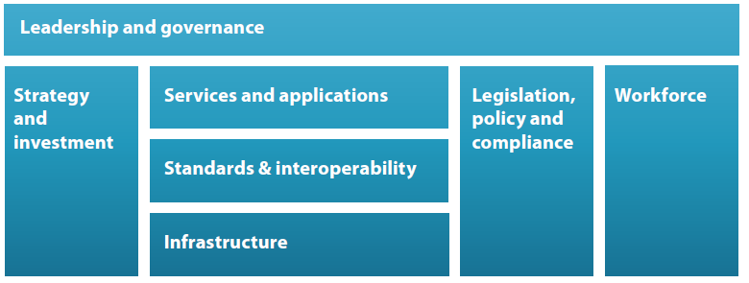
The Digital Health Enabling Environment

Slide 3
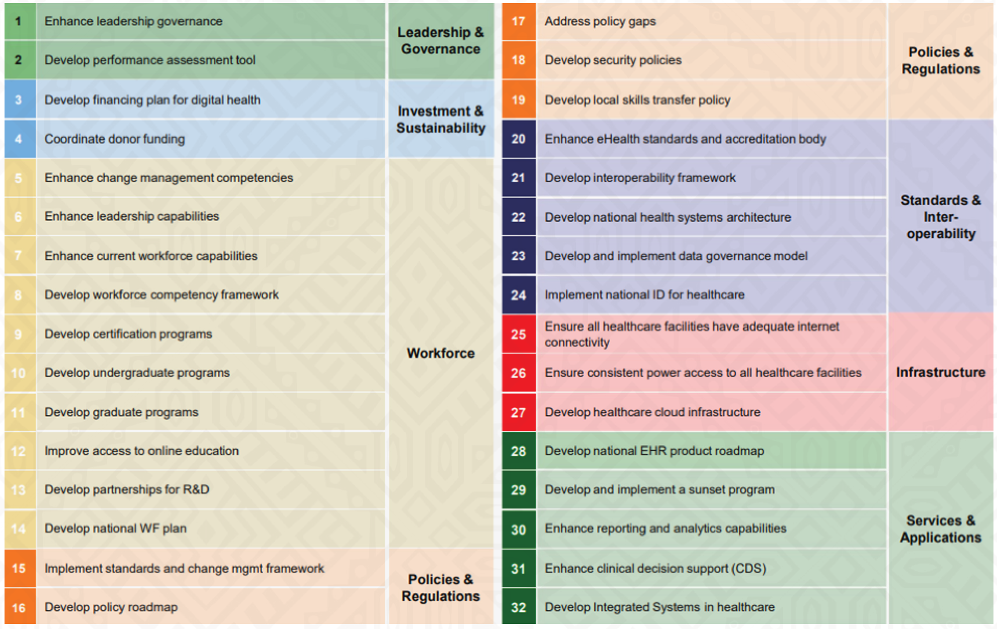
Digital Health Strategy 2022 - 2026

Slide 4
Operationalisation of the Digital Health Strategy and Architecture Governance
Digital Health TWG
Director ICT
SC: Leadership and Gov, Investment and Sustainability
Knowledge Hub
SC: Legislation, Policy and Compliance
SC: Standards and Interoperability
SC: Services and Applications
SC: Workforce
SC: Infrastructure

Slide 5

Leadership and Governance
Leadership and Governance, Investment and Sustainability Sub - Committee
  Ensure that an enabling environment is established in support the Digital Health Strategy
  Ensure that strategic initiatives are addressed:
    Enhance leadership governance
    Develop performance assessment tools for the IAF and the DHS
    Develop a financing plan for digital health
    Co-ordinate donor funding
  Provide feedback to the DH TWG
  Liaise with other working groups, to efficiently co-ordinate the development of components of the IAF;
  Co-ordinate amongst stakeholders working in similar areas to ensure that resources are utilized efficiently;
  Identify other technical areas that need to be addressed to implement the IAF for Zambia
  Update the IAF document on an annual basis, based on deliberations of this committee.

Slide 6

Legislation, Policy and Compliance
Legislation, Policy and Compliance Sub - Committee
  Oversee the review, development and implementation of sound legislation, policies, and compliance activities in support of the IAF
  To ensure that the following strategic initiatives are addressed:
    Develop a policy roadmap to ensure that no gaps exist in current legislation
    Oversee the implementation of the policy roadmap
    Support the development of policies and SOP amongst other sub-committees to ensure that for instance data security policies are accurately implemented

Slide 7

Workforce
Workforce Sub - Committee
  Oversee the definition and implementation of a digitally competent workforce in support of the Architecture
  Ensure that strategic initiatives are addressed:
    Enhance change management competencies
    Enhance leadership capabilities
    Enhance current workforce capabilities
    Develop a workforce competency framework
    Develop certification programs
    Develop undergraduate programs
    Develop graduate programs
    Improve access to online education
    Develop partnerships for R&D
    Develop a national WF plan

Slide 8

Data Standard and Interoperability
Data Standards and Interoperability Sub - Committee
  To co-ordinate the implementation of the Interoperable Architectural Framework for Zambia’
    Define and implement the minimum viable product (MVP) for the Architecture
    Develop a roadmap for the expansion of the Enterprise Architecture
    Oversee the implementation of the roadmap for the IAF
  Ensure that strategic initiatives are addressed:
    Engage with National and Health related Standards and Accreditation Bodies
    Develop an Interoperability Framework for systems in use
    Develop an Integrated Health Systems Architecture
    Develop and implement a data governance model for data use and access
    Implement a National ID for healthcare

Slide 9

Services and Applications
Services and Applications Sub - Committee
  Oversee the definition and implementation of software components of the Enterprise Architecture
  Ensure that strategic initiatives are addressed:
    Develop a national EHR product roadmap
    Develop and implement a sunset program for outdated software solutions and applications
    Enhance reporting and analytics capabilities through the development of specifications, and implementation of an Open National Data Analytics Platform (ONDAP),
    Enhance clinical decision support (CDS)
  Develop guidelines for:
    A sunset program for outdated software solutions and applications
    The Master Facility List and other core registries
    Development and implementation of an ONDAP

Slide 10

Infrastructure
Infrastructure Sub - Committee
  Oversee the definition and implementation of infrastructural components of the Enterprise Architecture
  Ensure that strategic initiatives are addressed:
    Health facilities have adequate internet connectivity
    Health care facilities have consistent power
    Healthcare cloud infrastructure is adequately developed
    Develop standards, for each level of the health system for all aspects of infrastructure including internet, hardware, and server management

Slide 11
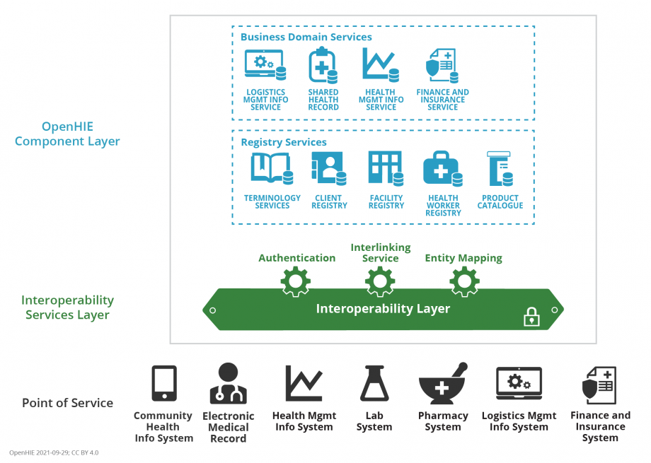
Architecture Work
Health data exchange architectures, application interfaces and standards to enable data to be accessed and shared appropriately and securely across the complete spectrum of care, within all applicable settings and with relevant stakeholders, including the individual.

Slide 12
Current systems
Census, population information & data warehouse
National Data Warehouse (CDC/IHM)
Zenysis Harmony (GF/Zenysis)
Palantir Foundry (CDC/Palantir)
Health Situation Room (UNAIDS/Sisense)
Survey systems (ZAMSTATS)
Health management information system (HMIS)
DHIS2 – Routine services/Disease aggregation/Vaccination
DHIS2 - NMEC
Electronic Medical Records
SmartCare Legacy (CDC/IHM)
SmartCare+ (CDC/IHM)
ZEIR
Community-based information system
DHIS2 (Malaria Rapid Reporting System) (PATH)
Health finance and insurance information system
Microsoft Dynamics NAV (GF/CDC/SIDA/USAID)
IFMIS (GRZ)
OBB (GRZ)
Compl/Perfm Audit (WB/OAG)
Geographic information system (GIS)
GRID3 Maps – (Akros)

Slide 13
Current systems
Data interchange interoperability and accessibility
Open InterOp
Kafka Message Broker
rGPC Server
Civil registration and vital statistics
ODK Central
VA Explorer (CDC/Mitre)
Laboratory and diagnostics information system
DISA Lab (CDC/APHL)
OpenLDR (CDC/APHL)
eLABs (Right-to-Care)
Logistics management information system (LMIS)
eLMIS
Logistimo
Human resource information system
IHRIS (CDC)
PMEC Payroll (GRZ)
rHRIS
Registries
MFL
PCMT
Provider Registry
Client Registry

Slide 14
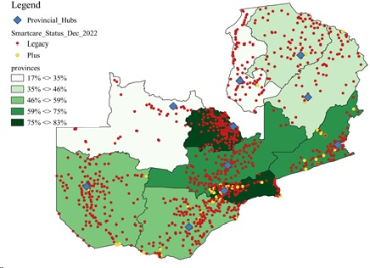
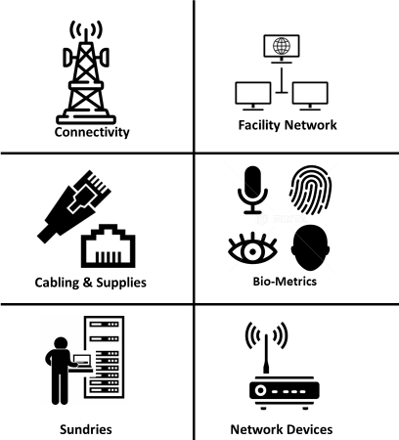
SmartCare EMR – Digitized Platform for Extensibility, Exchange, and Interoperability
1694 SC Facilities -- Scaling SC+ & retiring legacy eLast & eFirst
SC+ was in 31 sites as of March 2022 with a scale to 311 high volume sites by September 2023 and 800 by 2024.
Centralized web-based database design
Distributive at the facility level & used at differing points of care
Real-time data synchronization within a facility and with NDW
Global search function using unique patient identifier
Transfer of patient level data between facilities
Interoperable with eLMIS, Lab, DHIS2

Slide 15
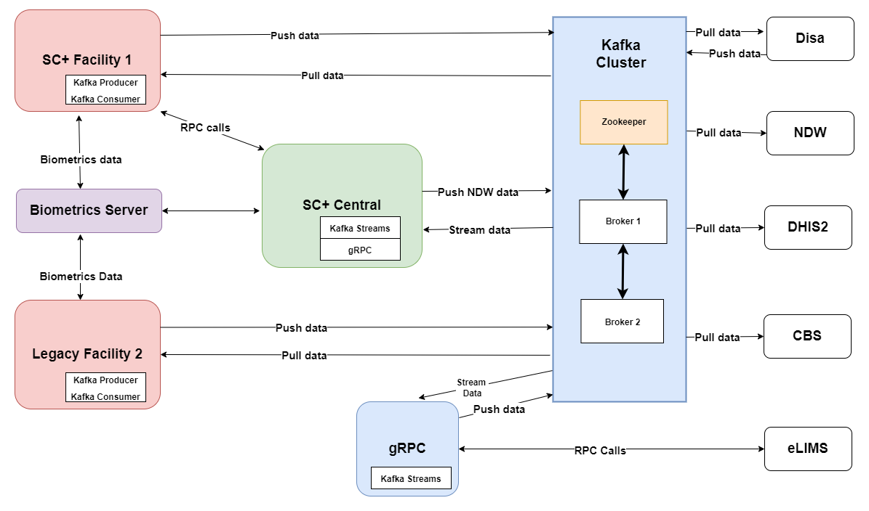
Health Information Exchange Architecture

Slide 16
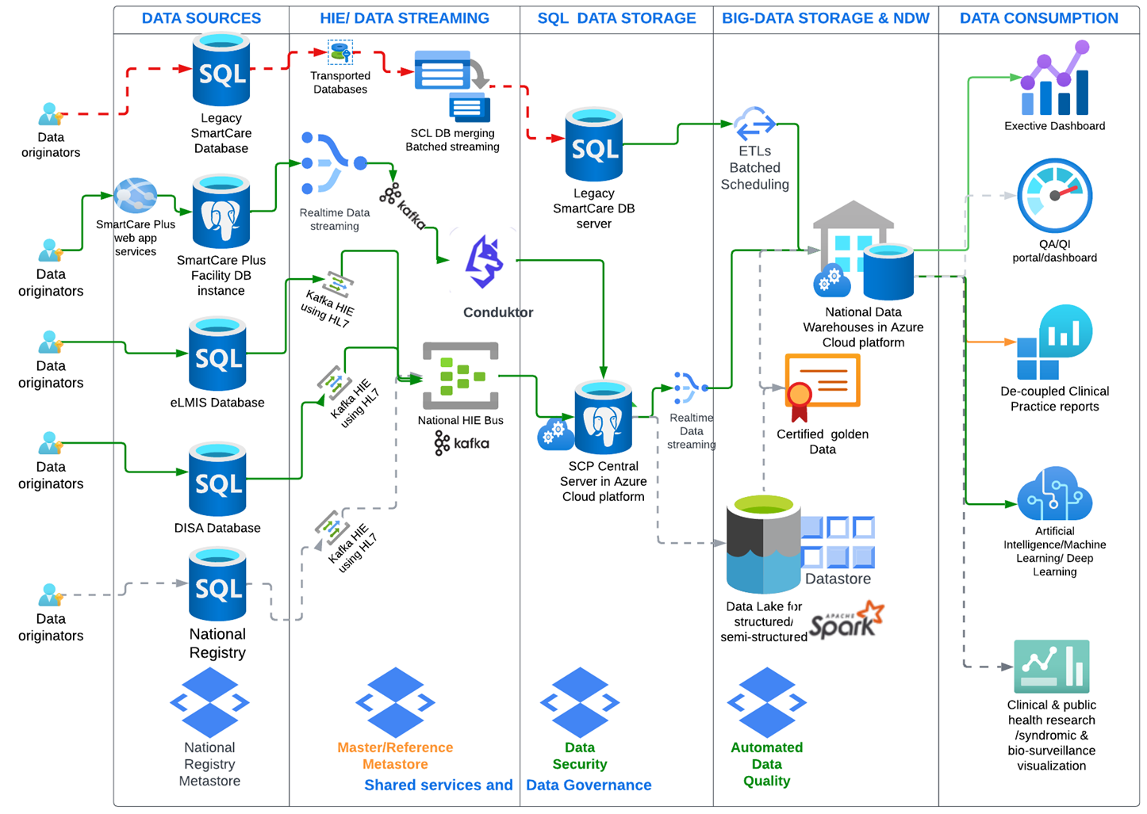
National Data Pipeline Architecture – IHM/Palantir Collaboration Collaboration

Slide 17
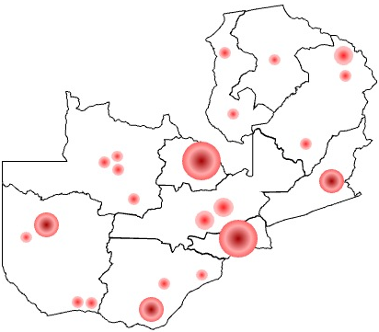










Optimizing National Health Information Systems for Improved Integrated Disease Surveillance & Timely Response
Community awareness campaigns
Vaccination campaigns
Case-Based
Event Based
Community-Based
AI & ML Algorithms
Covid-19
Polio
Monkey Pox
Future Outbreaks
ZNPHI Surveillance Center
Disease Outbreak
Vaccinations, etc
Shared Services / HIEs
SC+/SCL
SC+ /NRIS / Mortality Data
SC+ / eIDSR / DHIS 2.0
Legend
ILI / SARI / DISA
Disease outbreak flow of information
eLMIS
Notification System adapted to include SC+/LSC & eLMIS
SC+ / eLMIS
Malaria DHIS / eIDSR
Response actions & information flow
DISA/eLabs
NALEIC / eIDSR
SC+ HIV-TB / eIDSR
Notification actions
DHIS2/HIA₁₊
SC / DISA / elabs
Data pathways
Laboratory Network

Slide 19

Opportunities
MPI for patient linkage for EHR-Lab data at NDW and Executive Dashboards
Priority data integration to send missing data from source to NDW required by Exec Dashboards
Terminology service / National Health Data Dictionary
Implement API Gateway
FHIR Capacity building
Implement FHIR validation server
Client Registry
EA Security assessment
Cloud hosting assessment

Slide 20
The End
Questions???

