Slide 1


Digital Health Support
COVID-19 Technologies
September 21, 2020

Slide 2
Content
1
Background & Objectives
2
Overall Digital Support Architecture
3
Digital Products
4
Data Analytics
5
Public Health Emergency Operations Center
6
Public Communication
7
Next Steps

Slide 3



On March 17, 2020, QMD’s Digital Health Division rapidly developed a technical implementation plan organized into 3 key clusters:
Digital
Platforms
Data
Analytics
Knowledge
Translation & Support

Slide 4

COVID-19 Website

Slide 5
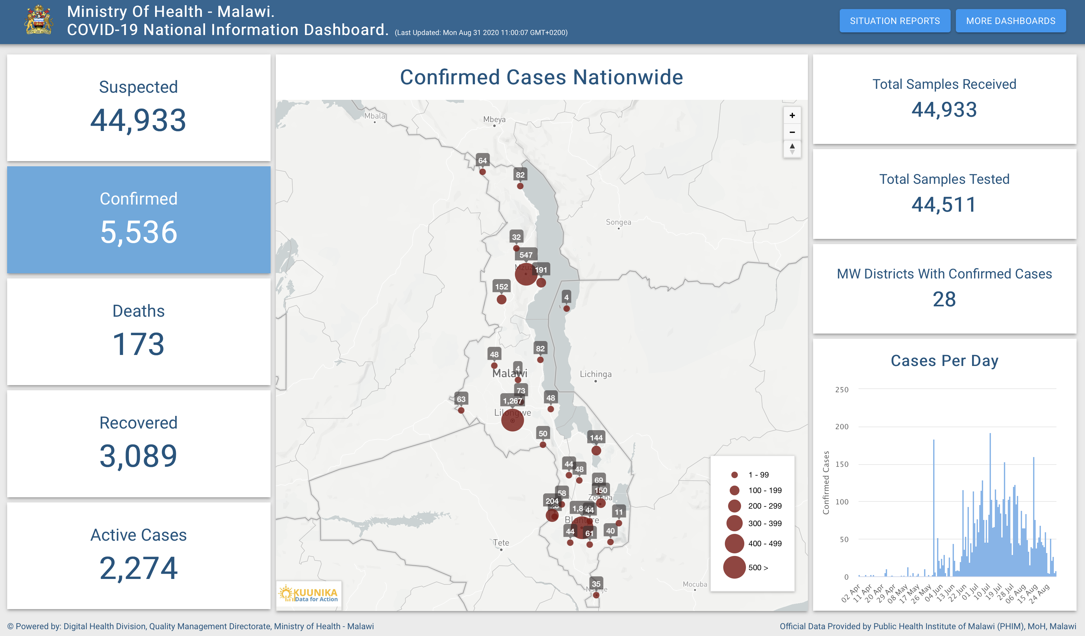

Slide 6

Key Features
 | Provides near real time updates on Covid-19 in Malawi A breakdown of statistics at the national and district level
 | Dashboards on traveller summary statistics
 | Internal dashboards only accessible to the PHIM EOC

Slide 7
Dashboard Metrics: Active Users on the Website and Sessions
22,424 | 22,292 | 60,001 | 2.7
All Users | New Users | Sessions | Sessions Per User
1.46 | 1:32” | 82,512 | 77%
Pages / Session | Avg. Session Duration | Pageviews | Bounce Rate

Slide 8
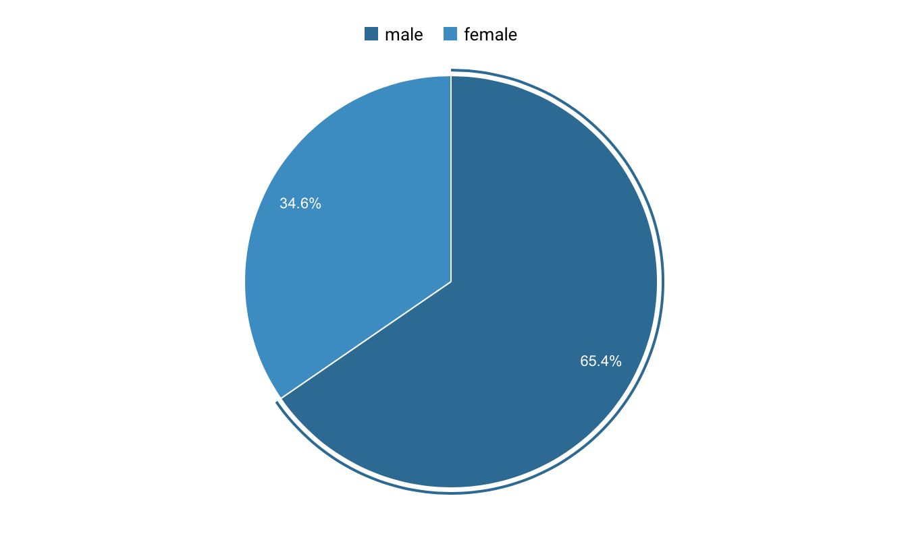
User Behaviour (New vs Returning Visitors)
Interpretation
Pie chart showing website access by gender.
165 Females (34.6%) vs 312 Males (65.4%) accessed the website in August 2020
8

Slide 9
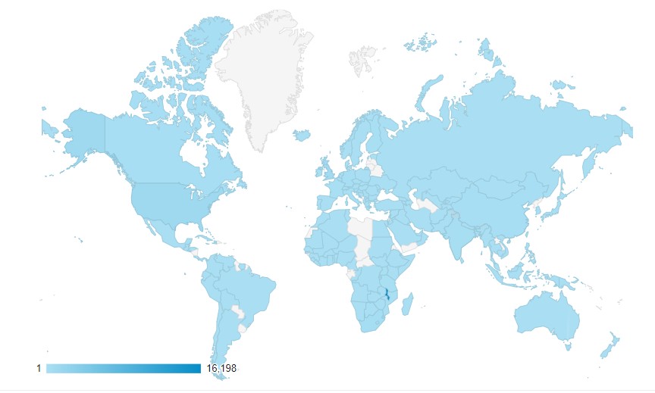
Access by Country
Shows countries that are accessing the site. The website has been accessed by almost all countries around the globe

Slide 10
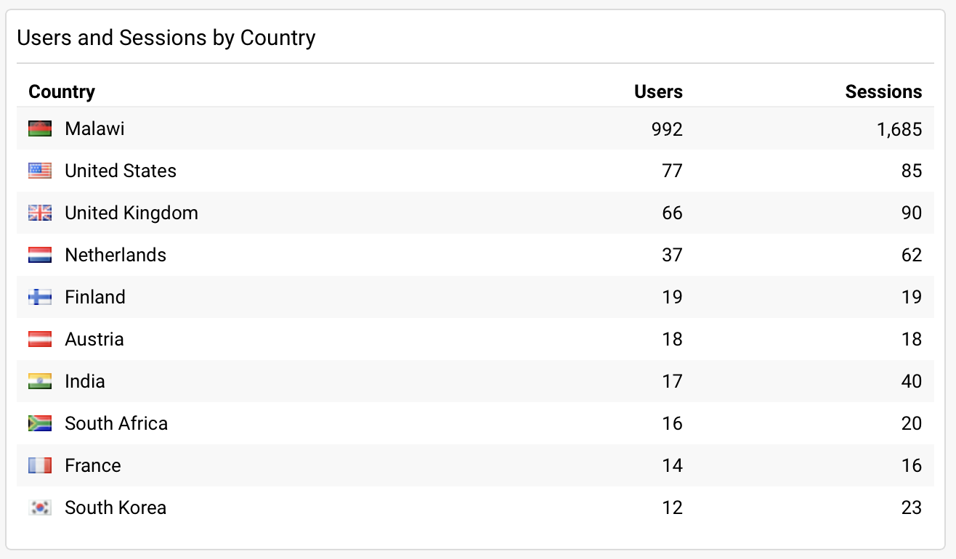
Top 10 Countries
Shows countries top 10 countries by the number of users by Sessions during August 2020

Slide 11
One Health Surveillance Platform (OHSP)

Slide 12
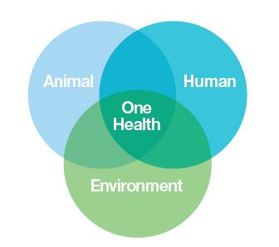
Surveillance Data Usage
MoHP (Local Response)
AFRO (Regional)
WHO, OIE, FAO
(International)
One Health
Human Health
Animal Health
Ecosystem Health
Surveillance Data
IDSR
Disease Programs
AMR Lab Data
Surveillance Data
Vectors
WASH, Soil
Air Pollution
Surveillance Data
Rabies, Avian Flu
AMR Data

Slide 13
Key Features
 | Single source of truth for all surveillance related data Human data : IDSR, Case Based Surveillance Animal data Environmental data COVID19 Response: Case Based Surveillance Contact Registration and Follow up Port of Entry

Slide 14
So Far
 | Upgraded server performance Design and customization IDSR aggregate reporting (weekly and monthly) COVID19 programs Interoperability NLIMS WhatsApp Chatbot, SMS RapidPro, USSD COVID-19 Commodity reporting USSD Survey Deployment/training 19 districts Partner onboarding (ONSE)/CHAI/ToT

Slide 15
WhatsApp ChatBot, SMS RapidPro, USSD
(mQuarantine Combo)

Slide 16
Key Features
 | Self assessment for COVID-19 signs and symptoms Report daily signs and symptoms for 14 days View general information about COVID-19
 | Glance COVID-19 stats at the national and global level
 | Real time notifications to Rapid Response Teams

Slide 17
Digital Health Support
Enterprise Architecture and DHD Products
September 21, 2020

Slide 18
Master Health Facility Registry

Slide 19
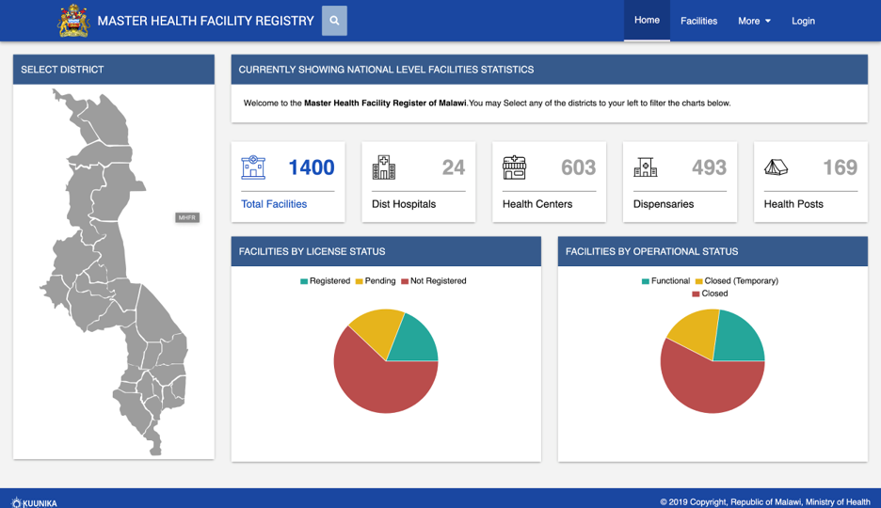

Slide 20
Key Features
 | Centralized access to all health facilities Generation of New Unique Facility Codes
 | Interoperability with Other Systems
 | Querying & Visualization
 | Public Reporting Portal

Slide 21
MHFR User Metrics to Date
282 | 491 | 1636 | 3.33 | 4:09’’ | 1.79
All Users | Sessions | Page Views | Pages/Session | Avg. Session Duration | Sessions per User

Slide 22
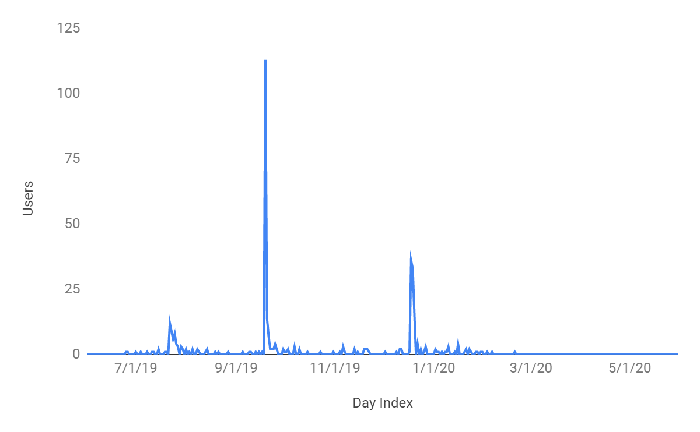
Annual Usage Trendline
Increased number of Users during data updates at user level

Slide 23
Interoperability Layer

Slide 24
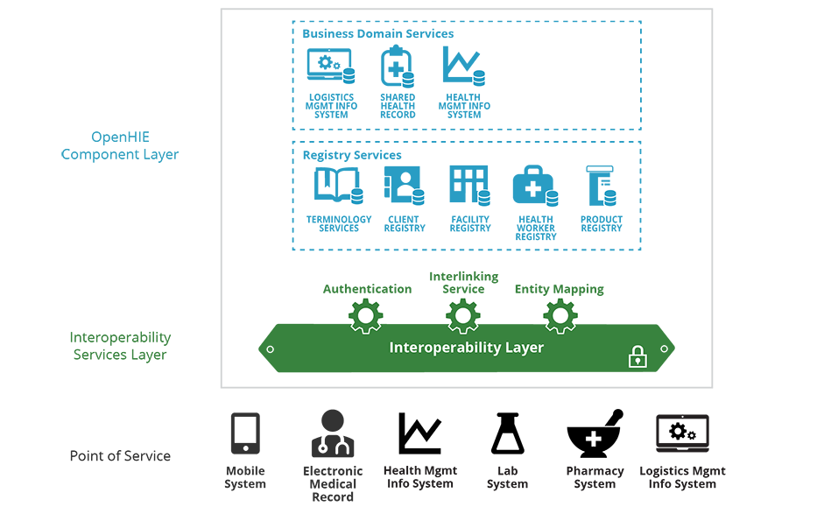

Slide 25
Key Features
 | Digital Health Access Point Secure Data Access Data Exchange Monitoring & Evaluation HMIS Extensions

Slide 26

Use Cases
 | Link OpenLMIS to DHIS2 Link DHAMIS to DHIS2
 | Link WhatsApp Bot, USSD, SMS RapidPro to DHIS2
 | Link TNM USSD Survey for COVID-19 Weekly Commodity Reporting with OHSP

Slide 27
OpenLMIS Interoperability with DHIS2

Slide 28
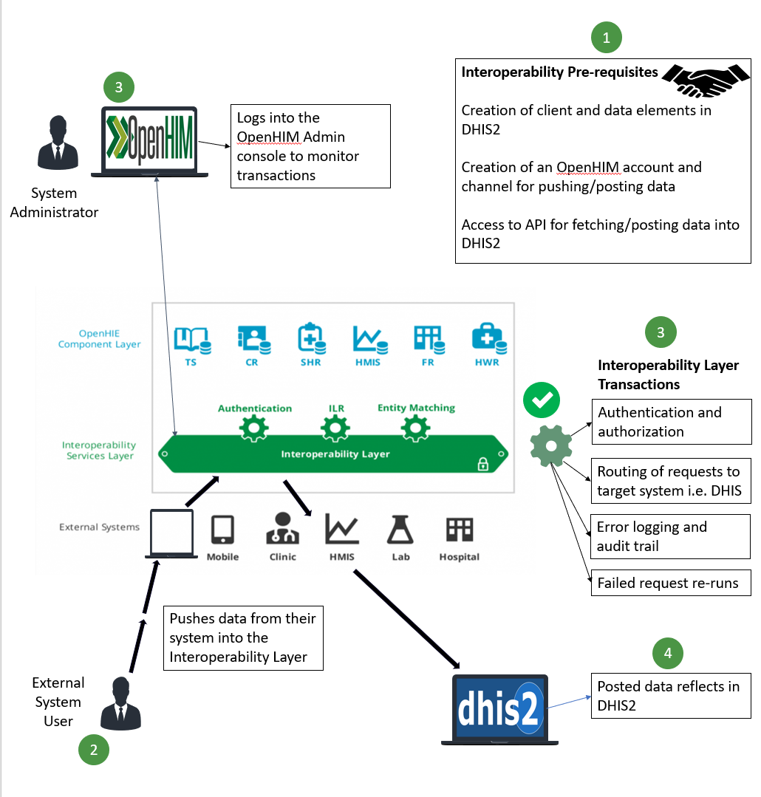

Slide 29
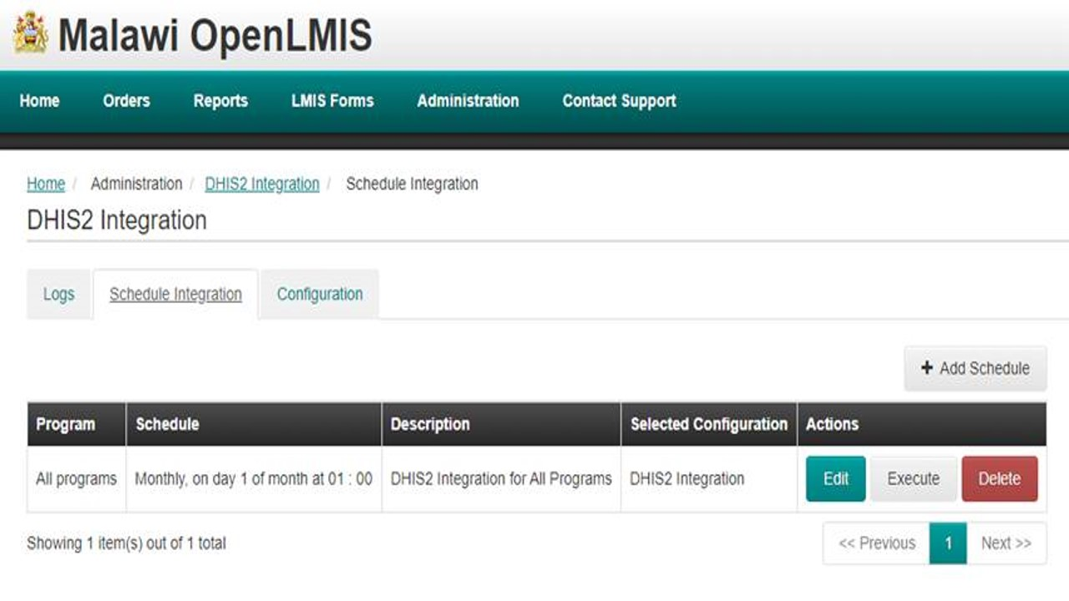

Slide 30
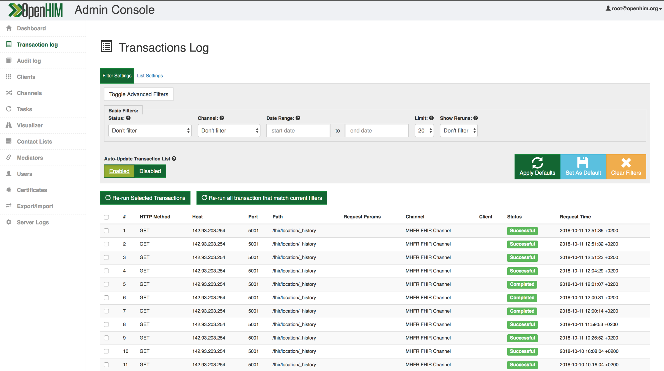

Slide 31
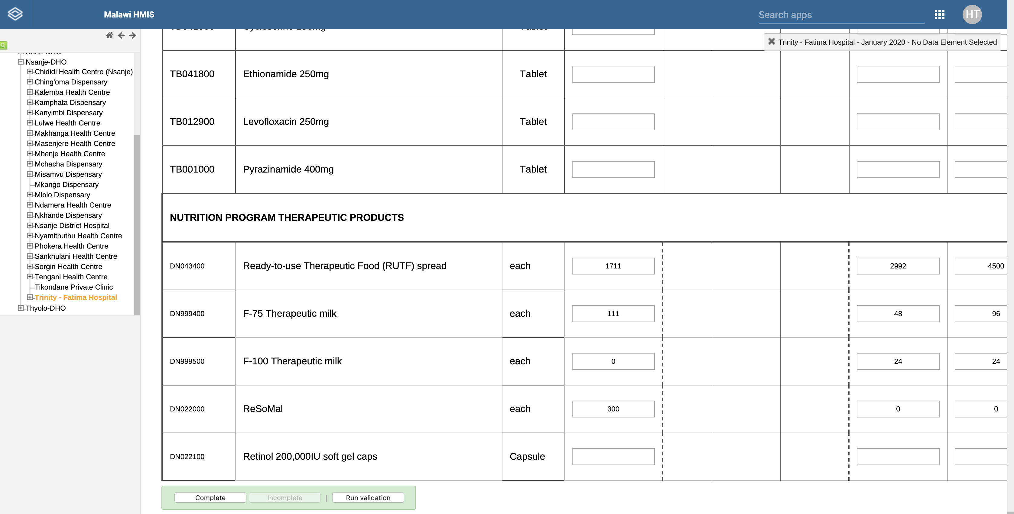

Slide 32
Terminology Service

Slide 33
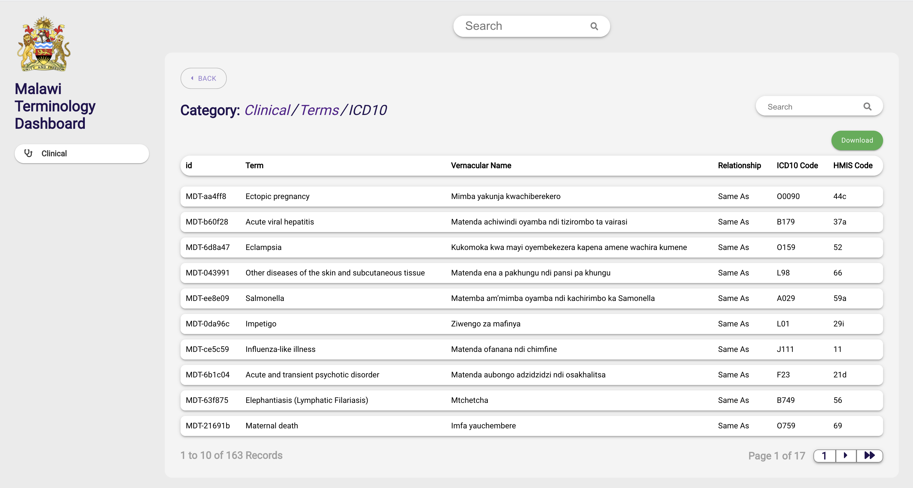

Slide 34
Key Features
 | Decision support tool for care providers Shared understanding of clinical terminologies Data of meaning leading to better reporting Tool to guide consistent healthcare delivery

Slide 35
Product Master

Slide 36
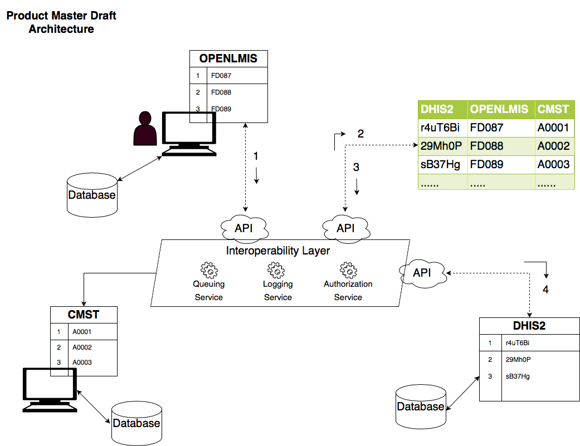
Independent systems maintaining their own clinical definition
Costly medication errors

Slide 37
Mobile Supervision Toolkit (MST): Case of HIV Quarterly Supervision

Slide 38
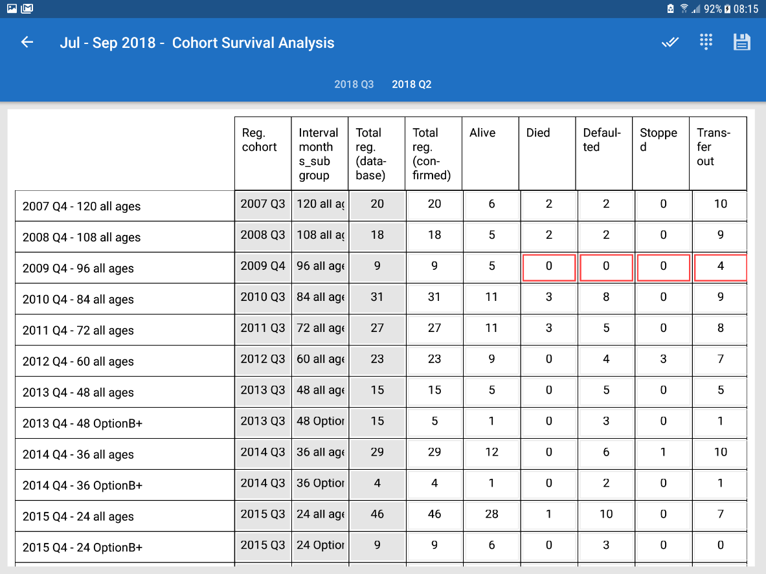

Slide 39
Key Features
Customised DHIS2 Data Capture Mobile App
Data validation
Offline data storage
DHAMIS historical data integration
Team integration
Hotspot data sharing for supervisors and team members
Table and list forms
Signature signing

Slide 40
Other Initiatives

Slide 41
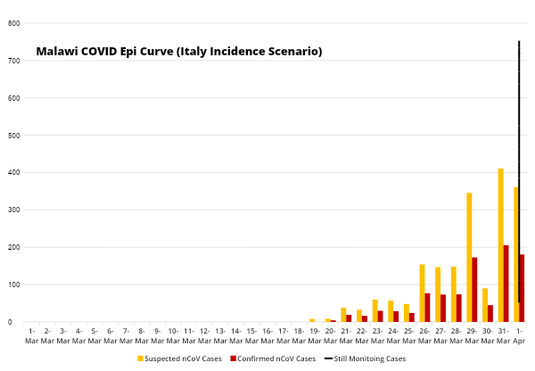
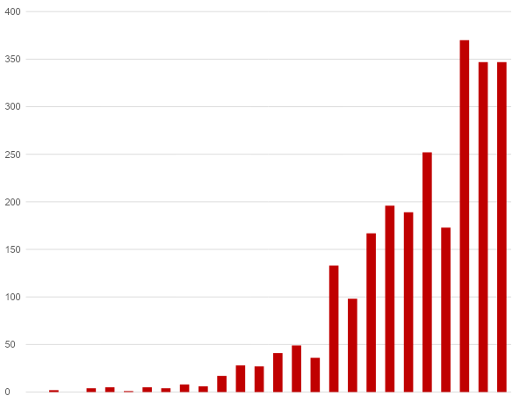
African CDC Recommended COVID-19 Response Phases
PHASE 0
No COVID-19 Cases
PHASE 1
Early Stage Outbreak
PHASE 2
Expanding Outbreak
PHASE 3
Advancing Outbreak
PHASE 4
Large Outbreak
Malawi COVID Epi Curve (Italy Incidence Scenario)
Actual monitoring of cases in Malawi with projections of no change of incoming travelers
Italy confirmed cases adjusted with population size of Malawi to hypothesize COVID Confirm Cases
50% positive rate to estimate suspected cases

Slide 42




Local Epidemic Stages – based on African CDC recommendations for a stepwise response to COVID-19
Early & Expanding Outbreak (PHASE 1-2): Imported Case period (few cases identified)
PHASE 1: One or more imported cases, and limited local transmission related to imported cases | PHASE 2: Increasing numbers of imported cases Increased local spread, but all cases linked to known transmission chains Outbreak clusters with a known common exposure
PHASE 3: Localized outbreaks start to merge One or more cases or deaths occur outside known transmission chains Sustained person to person transmission – multiple generations in transmission chains Cases are detected among SARI case with no known exposure | PHASE 4: Widespread sustained community transmission Multiple generation transmission chains can be identified, but most cases occur outside of chains Community-wide transmission throughout all or nearly all the country
Advancing and Large Outbreak (PHASE 3-4): Local and nationwide transmission

Slide 43
Malawi HIS Architecture & Application Concept Standards, 2016
LEVEL OF DATA COLLECTION
QUANTITY OF DATA
INFORMATION NEEDS
INFORMATION TOOLS
Global/Regional
Less Data
Summary Indicators for global reporting et. MDGs, UNGASS
AGGREGATED LEVEL
Heath Management Information System
(HMIS/DHIS2)
National
Summary indicators for national needs, e.g. strategic planning and resource allocation
District
Indicators for district and national reporting and planning
National Electronic Medical Record
System Platform
Facility
Facility management, audits, planning, drug procurement
INDIVIDUAL LEVEL
Patient
Patient Care
Understanding population burden of disease and risk: Monitoring and Evaluation of CBOS
Mobile Health Applications
Household and Community
More Data

Slide 44
Malawi HIS Architecture & Application Concept Standards, 2016
LEVEL OF DATA COLLECTION
APPLICATION
QUANTITY OF DATA
INFORMATION NEEDS
INFORMATION TOOLS
Global/Regional
Global/Regional
Less Data
Summary Indicators for global reporting et. MDGs, UNGASS
AGGREGATED LEVEL
Heath Management
Information System
(HMIS/DHIS2)
National
OHSP, IMS & EOC Dashboards
Summary indicators for national needs, e.g. strategic planning and resource allocation
District
COVID-19 Website
Indicators for district and national reporting and planning
National Electronic
Medical Record
System Platform
Facility
CCPF
Facility management, audits, planning, drug procurement
INDIVIDUAL LEVEL
Patient
HFD Survey
Patient Care
Understanding population burden of disease and risk: Monitoring and Evaluation of CBOS
Mobile Health
Applications
Household and Community
WhatsApp, SMS, USSD
More Data

Slide 45


Malawi COVID Response Digital Solutions/Services Architecture
RESPONSE MEASURE SECTIONS
Version 2, 27.May.2020
A. CENTRAL COORDINATION
B. SURVEILLANCE
C. LABORATORY
D. CLINICAL CARE & TREATMENT AND IPC
E.COMMUNICATION AND COMMUNITY MOBILIZATION
MAJOR RESPONSE ACTIVITIES
A.1 Public Health Emergency Operation Centre (PHEOC)
B.1 Port of Entry Surveillance
B.2 Traveler quarantine surveillance
B.3 Case-Base Surveillance
B.4 Confirmed-case Contacts surveillance
B.5 (Nearly) Real-time syndromic and community surveillance (both facility and community based)
C.1 Receiving COVID Sample
C.2 Process COVID sample (tests)
C.3 Release COVID test results
D.1 COVID case management
D.2 Infection prevention control (IPC)
D.3 COVID case treatment outcomes
E.1 Risk communication and public education
DIGITAL SOLUTIONS/SERVICES
A.1.1 Admin / Finance Digital Support
A.1.2 Operation Digital Support
A.1.3 Planning Digital Support
A.1.4 Logistics Digital Support
B.1.1 DHIS2/OHSP App: 4.0 COVID-19 Point of Entry Tracker
B.2.1 DHIS2/OHSP App: 5.0 COVID-19 Contact Registration & Follow-Up
B.3.1 DHIS2/OHSP App: 6.0 COVID-19 Case-Based Surveillance
B.4.1 DHIS2/OHSP App: 5.0 COVID-19 Contact Registration & Follow-Up
B.5.1 Syndromic Surveillance System: EMR POC, USSD, Chatbot, CCPF, eDRS
B.5.2 MNO data for population surveillance
B.5.3 Integrated Community Health Information System
B.5.4 Community/Facility Screening
C.1.1 DHIS2/OHSP App and LIMS integration for sample received
C.2.1 LIMS to support tests
C.3.1 DHIS2/OHSP App and LIMS integration for lab results
D.1.1 HIS/EMR/OPD Module
D.1.2 eRegister solution
D.2.1 OpenLMIS
D.2.2 HIS
D.3.1 DHIS2/OHSP App: 6.0 COVID-19 Case-Based Surveillance
D.3.2 eDRS
E.1.1 Public COVID dashboard/portal
E.1.2 Pull and push information - Chat Bot & USSD
E.1.3 CCPF
ADDITIONAL DIGITAL SUPPORTS/FUNCTIONS
Infrastructure / functional structure / operating procedures
IMS, Hotline for EOC operation
Analytic, epi modeling, policy suggestion
LMIS, transports, PPE, medicine inventories
Monitoring all entered travelers (source: immigration, airline, bus, MNO)
SMS/USSD alerts to people under quarantine
Monitoring all people under quarantine
SMS/USSD alerts to people under quarantine
Monitoring all people under quarantine
SMS/USSD alerts to people under quarantine
Monitoring all people under quarantine
ILI, SARI information from community
ILI, SARI information from facilities
Population density and movement information
Sample request from DHIS2/OHSP to LIMS to provide sample registration
LIMS provide machine linkage
LIMS provide result release and send to DHIS2/OHSP
Detailed clinical records in digital format
PPE Inventory
Detailed clinical records with final outcome
Security control
Data integration to EOC
FOUNDATION OF DIGITAL SUPPORTS
CONNECTIVITY: reliable network connection for all services
DATA HOSTING: Container-type data centers

Slide 46

Data Use Cases and Products
COVID-19 RESPONSE DATA USE CASES
EXISTING
DEVELOPING
RECOMMENDED
Facility Resourcing
Case Identification
Managing Community Partners
FACILITY LEVELS
Communication at sub-National Levels
Community Engagement
Alerting Stockouts & Supply Shortage
eLearning
Rapid Community Surveys
Lab Testing & Results
Following Guidelines & Protocols
Dispelling Rumors
Border Screenings
Contact Tracing
Coordinating Partners
SUB-
NATIONAL LEVELS
Public Data Dashboards & Data Visualizations
High Frequency Facility Data for Syndromic Surveillance
Health Center by Phone (CCPF)
Surveillance & Case Management System (DHIS2)
Master Health Facility Registry (MHFR)
Partner Coordination Platform
Mobile app for guidelines & protocols
Last Mile Critical Supply Chain Tracking
Case Surveillance
Community Engagement
Financial Management
Mass Communications
Local Decision Making
Distributing Guidelines & Protocols
Dispelling Rumors
PHEOC Dashboards
Modeling & Scenario Analysis Platform
Incident Management System
Financial Management System
Pandemic Response Strategy
Media Education & Communication
Human Resource Management
Online Media Monitoring
NATIONAL
LEVEL
Regulating Laboratories and Facilities
Response Coordination - IMS PHEOC
Financial Management
Coordination of Critical Supplies
Developing
Guidelines & Protocols
Existing products currently being operationalized
Products in development
Products recommended

Slide 47
COVID- 19 Reporting Structure
The Ministry of Health and Population (MOHP) has adopted the following reporting structure for COVID-19 preparedness and response.
Cabinet Committee on COVID
Minister of Health and Population
Coordination and Monitoring of Implementation Secretary for Health and Population (PHIM)
Health Cluster Meeting
Clinical Care Management - Director of Clinical Services/Director of Nursing and Midwifery
Supply Chain & Stockpiles - Director of HTSS
Risk Communication and Community Engagement - DPHS (HES)
Laboratory Services - Head of Public Health Reference Laboratory
Budget Implementation/ Funding - DOF
Surveillance, Screening, & Follow-up - Head of Epidemiology
Infection Prevention and Control - Director of Quality
Resource Mobilization - Director of Planning
Renovation - Director of Planning

Slide 48














Alignment of products within the reporting structure
While the Digital Health Division falls under QMD in the MOHP structure, digital products will support various departments and activities in the COVID-19 preparedness and response efforts.
EXISTING
Cabinet Committee on COVID
Minister of Health and Population
RECOMMENDED
Modeling and Scenario Analysis
DEVELOPING
Public Health Emergency Operations Center (PHEOC)
Coordination and Monitoring of Implementation Secretary for Health and Population (PHIM)/Public Health Emergency Operations Center (PHEOC)
Health Cluster Meeting
Partner Coordination Platform
Incident Management System
Clinical Care Management - Director of Clinical Services/Director of Nursing and Midwifery
Supply Chain & Stockpiles - Director of HTSS
Risk Communication and Community Engagement - DPHS (HES)
Laboratory Services - Head of Public Health Reference Laboratory
Budget Implementation/ Funding - DOF
Surveillance, Screening, & Follow-up - Head of Epidemiology
Infection Prevention and Control - Director of Quality
Resource Mobilization - Director of Planning
Renovation - Director of Planning
Last mile critical supply chain tracking
Health Center by Phone (CCPF)
Mass Communications
Online Media Monitoring
Rapid Community Surveys
Financial Management System
Disease Surveillance & Case Management System (DHIS2)
Mobile app for treatment guidelines & Protocols
High Frequency Facility Data
Master Health Facility Registry (MHFR)
Public dashboards and data visualizations used by and available to everyone.

Slide 49
One Health Surveillance Platform
(OHSP)

Slide 50



OHSP Case-Based Surveillance (CBS) System
 | Developed in the DHIS2 platform as a mobile and web-based application
 | Key functions include: Patient screening at all ports of entry Tracking and follow-up of exposed/suspected cases Contact tracing of exposed individuals Case Investigation Sample tracking and feedback on lab test results
 | Prioritized training for the Points of Entries, District Health Surveillance Teams, and Health Facility IDSR Coordinators

Slide 51






















OHSP CBS Interoperability
1
End users engage using WhatsApp and SMS.
2
Encrypted notifications are processed for action and aggregate data is transferred via Application Program Interfaces (APIs) to the Interoperability Layer (IL).
3
Notifications are received for action and data is processed through the
Interoperability Layer (IL).
4
Actions are taken and the data is stored in the One Health Surveillance Platform (OHSP/DHIS2) central repository.
Suspected
Cases
Self Quarantine
Public Health Emergency Operations Center (PHEOC)
WhatsApp User Categories
NOTIFICATION
Incident Management System (IMS)
Angle Dimension
Persons Seeking Information
HTTPS Encrypted Message
District Rapid Response Team
Contact Tracing and Follow-up
Suspected
Cases
WhatsApp Chatbot API
Self Quarantine
UNICEF
SMS User Categories
Persons Seeking Information
HTTPS Encrypted Message
UNICEF/
RapidPro API
Interoperability Layer (IL)
OHSP/DHIS2 API
Central Repository for One Health Surveillance Platform (OHSP)
This includes:
Data staging
Record verification and approval
Assignment to relevant programs
National Laboratory Information Management System (LIMS)
Lab Order Notification
Lab result
UNICEF/
LMIS API
HTTPS Encrypted Lab Order
EGPAF
EID VL LIMS
COVID-19 Test Machines
Facility

Slide 52

Deployment & Training Summary
19 | districts oriented
XXX | users trained
758 | devices deployed
XX | supervisions conducted
Notes:
List XX Districts:

Slide 53
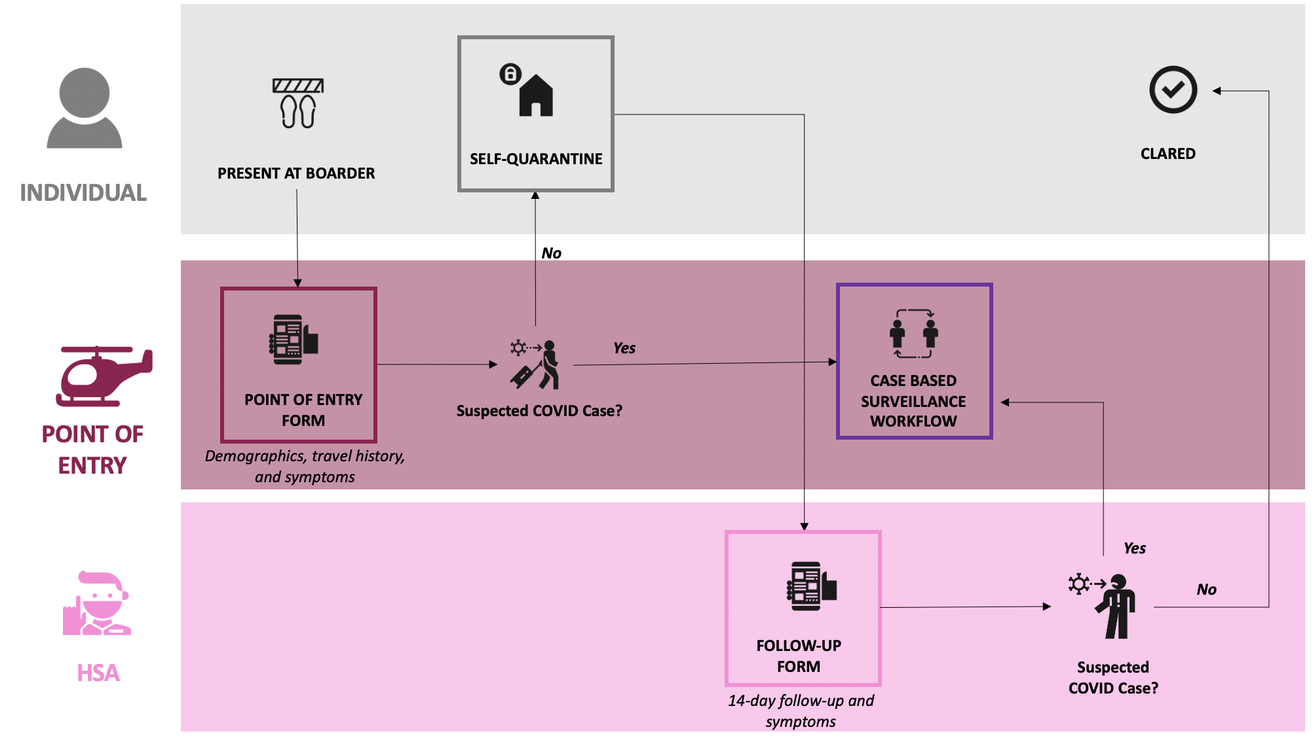
Point-of-Entry

Slide 54
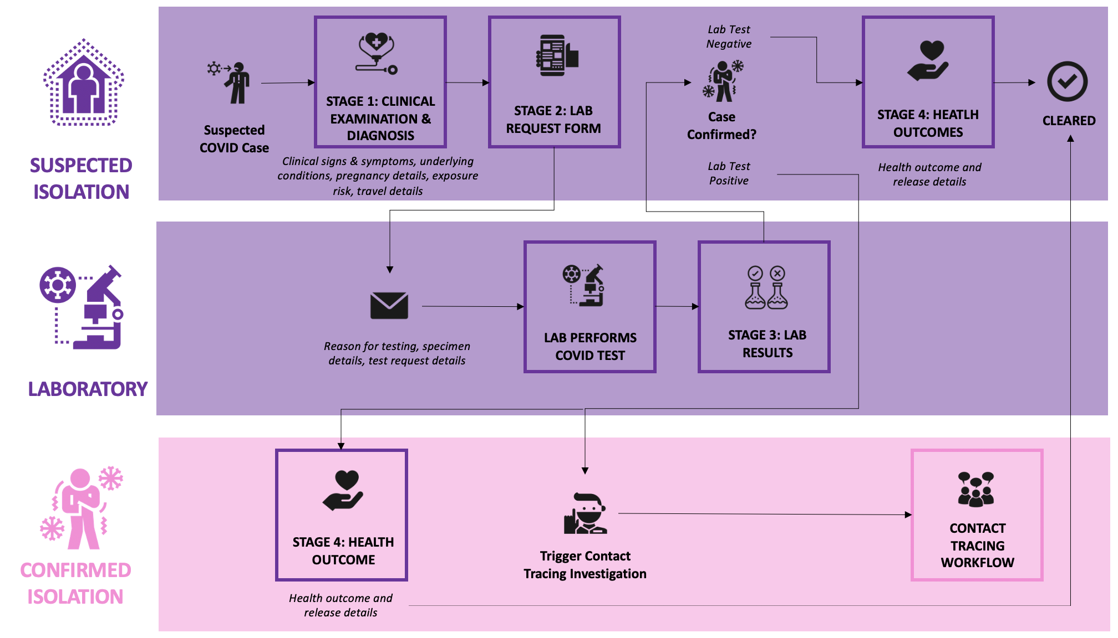
Case-Based Surveillance

Slide 55
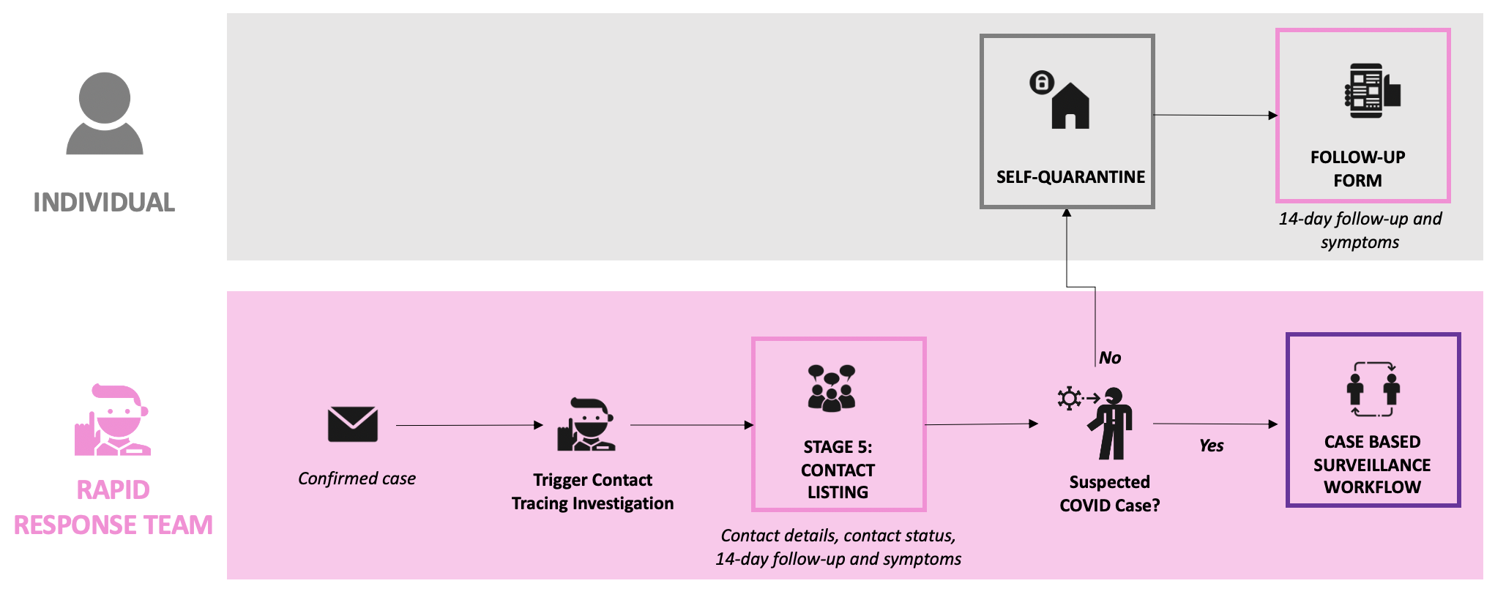
Contact Tracing

Slide 56
Community Applications

Slide 57
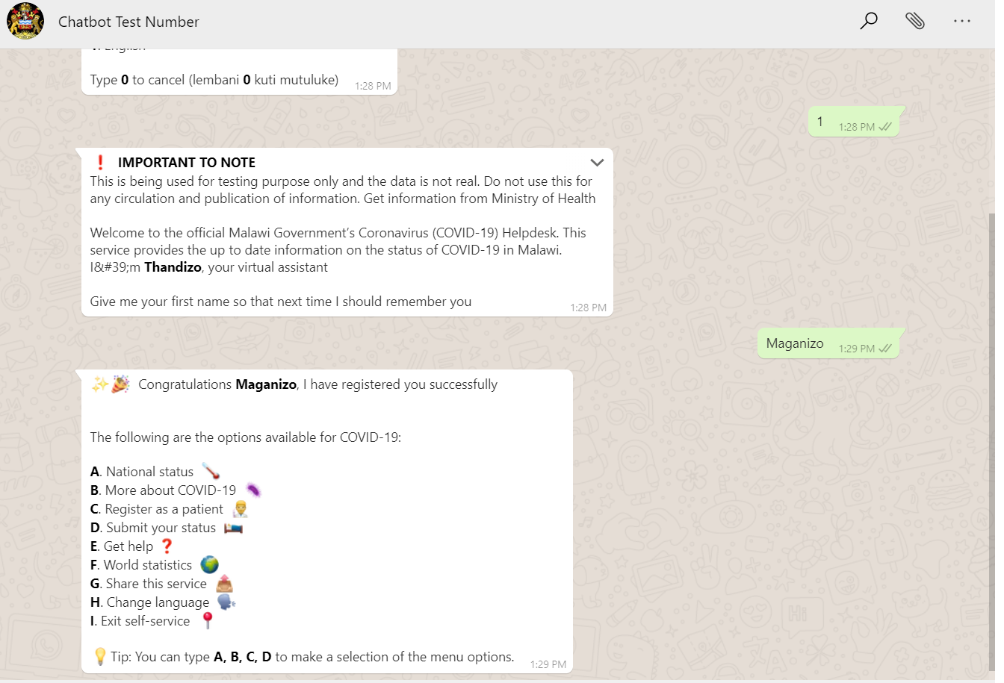
Community Applications
WhatsApp Chatbot Screen Shot
RapidPro
USSD
WhatsApp Chatbot
Mobile Application

Slide 58
End User Application Combo
MACRA issued MOH a ShortCode 929 for COVID-19 response
ShortCode to be used by the public to access COVID-19 information and self report COVID-19 signs and symptoms
Self Report – All suspected and confirmed cases can self report their status on a daily basis for up to 14 days

Slide 59
High Frequency Data Collection

Slide 60



High Frequency Data Collection
 | Call Data: Utilization of CCPF data for trend and cluster monitoring
 | Patient-level Data: Utilization of EMR data from data lake for ILI/RI case identification, trend and cluster monitoring
 | Other Sources: Explore and utilize other means of collection high frequency data (HFD) for syndromic surveillance purposes

Slide 61
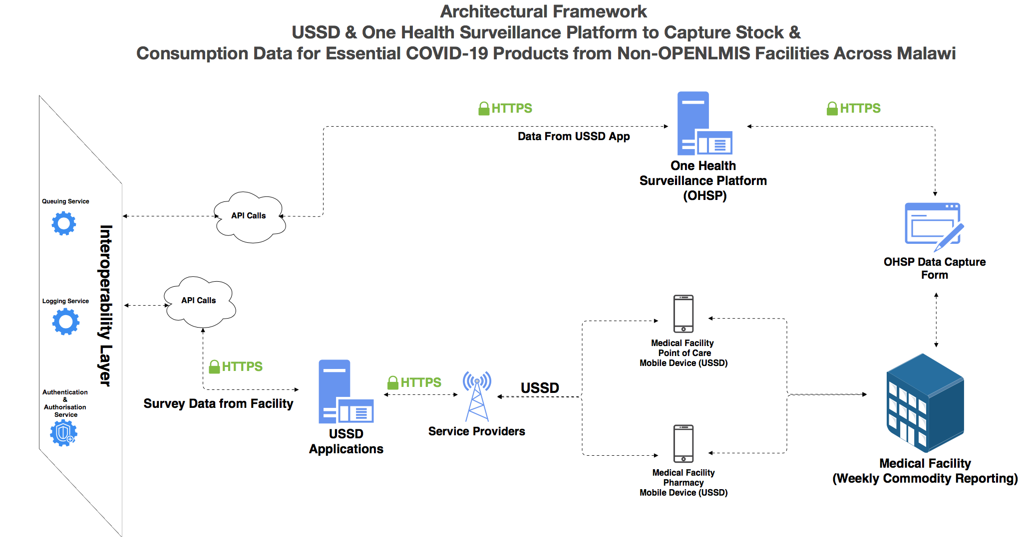

Slide 62

USSD Daily Updates from Health Facilities

Slide 63
On March 17, 2020, QMD’s Digital Health Division rapidly developed a technical implementation plan organized into 3 key clusters:
Digital
Platforms
Data
Analytics
Knowledge
Translation & Support

Slide 64
Help Desk

Slide 65

Purpose
Provide technical, analytical, and product support to PHIM’s Emergency Operations Center 7 days a week, 24 hours a day.
24/7 Emergency Operations Support
Case-Based Surveillance Data Collection Support
Effectively provide end user support to address issues that may hinder case-based surveillance data collection for the COVID-19 response.

Slide 66
Modeling

Slide 67
COVID-19 Modelling
Disease forecasting to provide oversight on disease propagation, availability of essential resources etc
Epidemiologic and Relative Risk Models aimed at understanding and measuring transmission potential

Slide 68
Contact Tracing

Slide 69
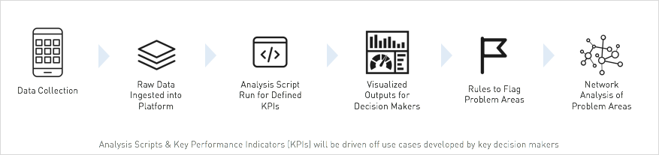
Data Process - Raw to Decision Making Format
Notes:
Data Collection–Standardize data collection tools and forms to collect pertinent information in the One Health Surveillance Platform (OHSP). The raw data from OHSP will be exported into a platform, such as Foundry (Palantir) or R, for analysis. During this process protocols will be followed to ensure the security of private and sensitive data.
Analysis Script–An analysis script will be run on the raw data. The script will aggregate and organize data in a way that lines up with the defined Key Performance Indicators (KPIs), which will come out of the use cases.
Dashboard–The data tables output from the script will be connected to a dashboard or visualization software (e.g. Tableau) in an easily digestible format for key decision makers. This will be updated in real-time and/or as the data becomes available.
Rules & Flags–Validation rules will be established to flag specific problem areas and help decision makers prioritize intervention areas. This can include, for example, criteria for what is deemed a hotspot or individuals who attended a large gathering.
Network Analysis–A network analysis can be conducted on flagged data sets to hone-in-on a specific region, event or relation.

Slide 70
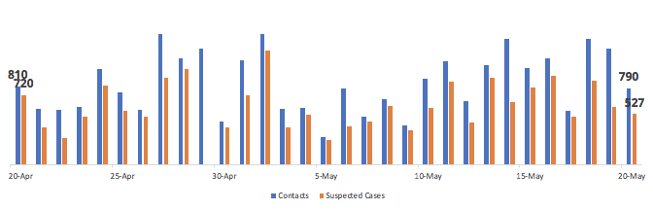
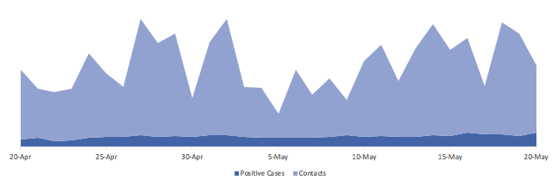
EXAMPLE BLANTYRE DISTRICT CONTACT TRACING Last updated: 20 May 2020
DAILY totals for COVID-19 in Blantyre
NEW CONTACTS
474 ⬇45%
CONTACTS WITH SYMPTOMS
527 ⬇21%
% OF CASES FOLLOWED-UP
85% ⬇10%
% OF CONTACTS FOLLOWED-UP
87% ⬆3%
NEW CONTACTS FROM CASES
SUSPECTED CASES FROM CONTACTS
Notes:
THIS IS FAKE DATA
Based on the Dimagi/Ebola Contact Tracing Dashboards
https://public.tableau.com/profile/dimagi.demo#!/vizhome/V1FFXtemplatedashboard/TEMPLATEV_1

Slide 71
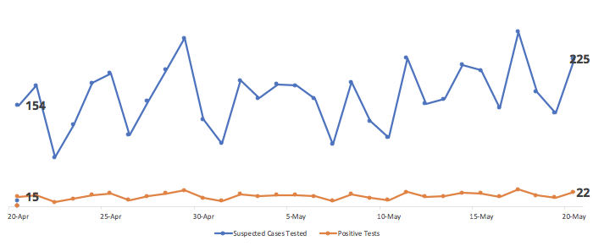
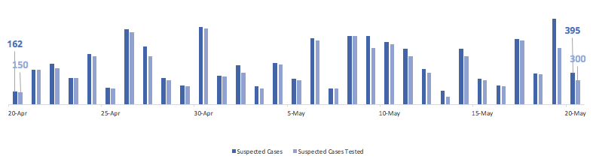
EXAMPLE BLANTYRE DISTRICT CONTACT TESTING Last updated: 20 May 2020
DAILY totals for COVID-19 in Blantyre
CONTACTS WITH SYMPTOMS TESTED
395 ⬇22%
POSITIVE TESTS
22 ⬆1%
% OF SUSPECTED CASES TESTED
75% ⬇10%
% OF SUSPECTED CASES TESTED POSITIVE
87% ⬆3%
SUSPECTED CASES TESTED
SUSPECTED CASES TESTED POSITIVE
Notes:
THIS IS FAKE DATA
Based on the Dimagi/Ebola Contact Tracing Dashboards
https://public.tableau.com/profile/dimagi.demo#!/vizhome/V1FFXtemplatedashboard/TEMPLATEV_1

Slide 72








EXAMPLE CONTACT TRACING INVESTIGATION Last updated: 20 May 2020
Outbreak Investigation for Case #1
Positive Case
Work together
Attended event together
Friends or Neighbors
Household member
March 20, 2020
Household
March 22, 2020
Grocery store
March 25, 2020
Choir Practice
Household
44 year old male
63 year old female
Case #4 65 year old female
47 year old male
Case #2 42 year old female
57 year old female
Case #5 54 year old male
Case #7 11 year old female
7 year old male
Case #1
19 yr old, female
52 year old male
Case #6 52 year old female
21 year old male
Neighbors
Case #3 44 year old male
48 year old female
15 year old female
Case #8 48 year old male
14 year old male
29 year old male
52 year old female
21 year old female
10 year old female
21 year old male
Notes:
Based on Sigapore’s Contact Tracing diagrams: https://thediplomat.com/2020/03/how-singapore-connected-the-dots-on-coronavirus/

Slide 73
On March 17, 2020, QMD’s Digital Health Division rapidly developed a technical implementation plan organized into 3 key clusters:
Digital
Platforms
Data
Analytics
Knowledge
Translation & Support

Slide 74



Three Areas of Support:
Emergency Operations Center
Incident Management System
Internal Dashboards

Slide 75
Emergency Operations Center

Slide 76
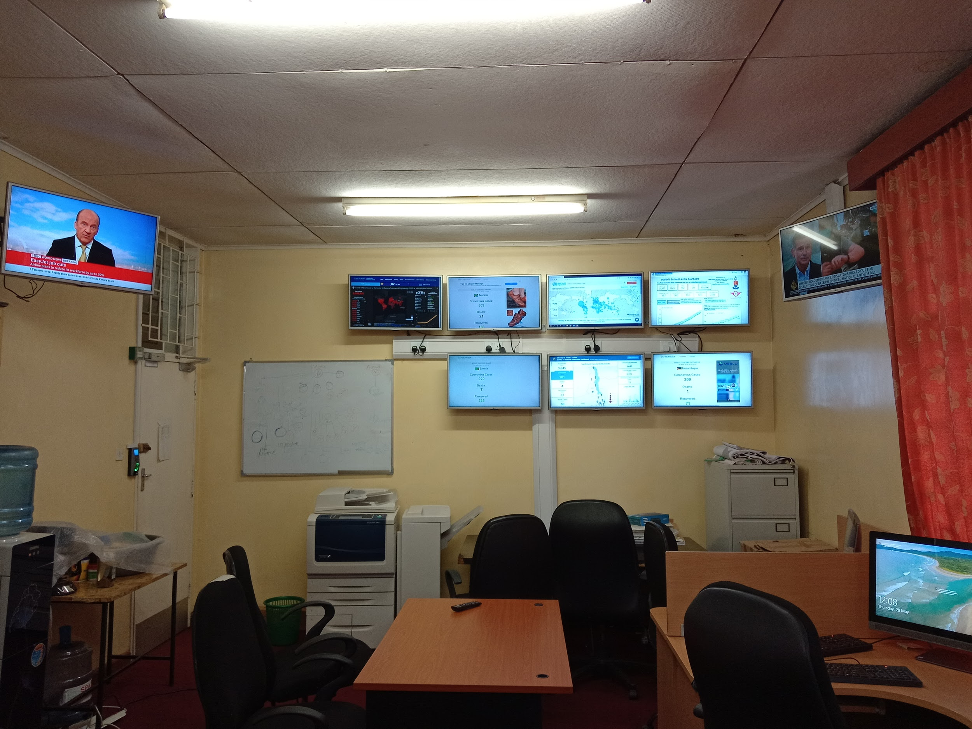
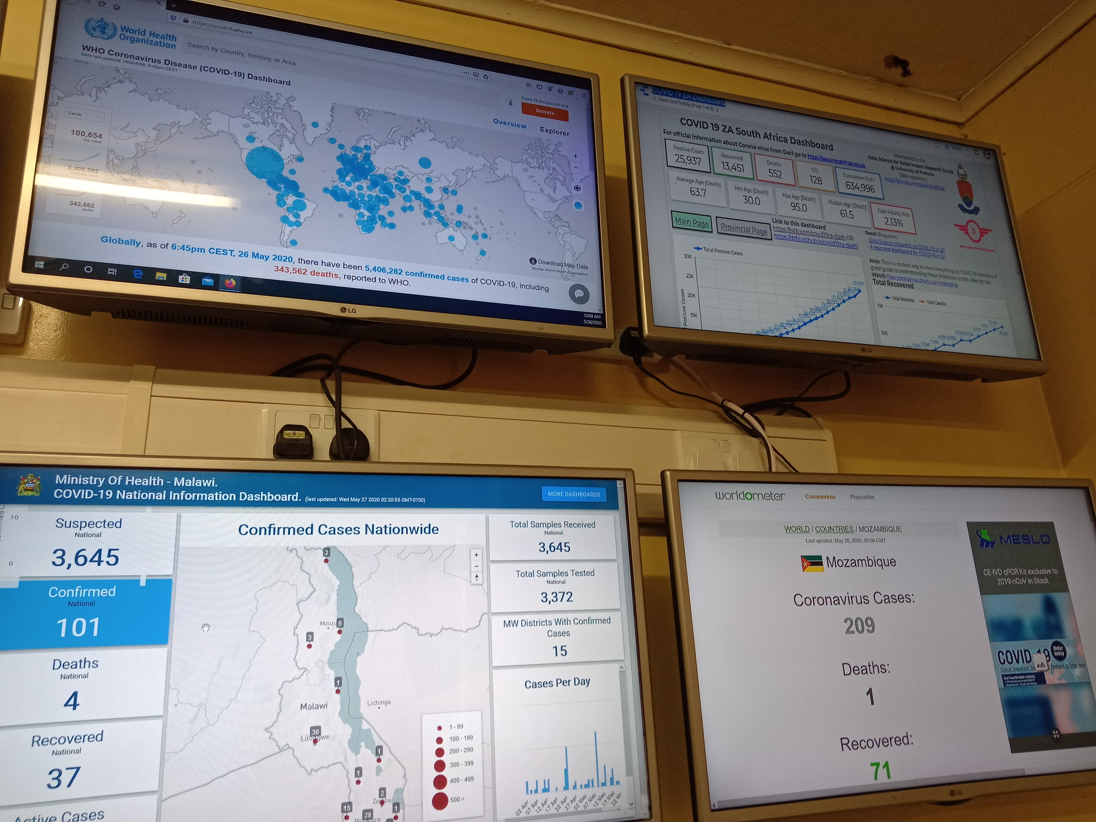
Emergency Operations Center
 | Command Hotline
 | Provided and mounted screens and whiteboards
 | DStv and Skyband fiber installation
 | Maintenance printers and air conditioners
 | Fumigation

Slide 77
Incident Management System

Slide 78
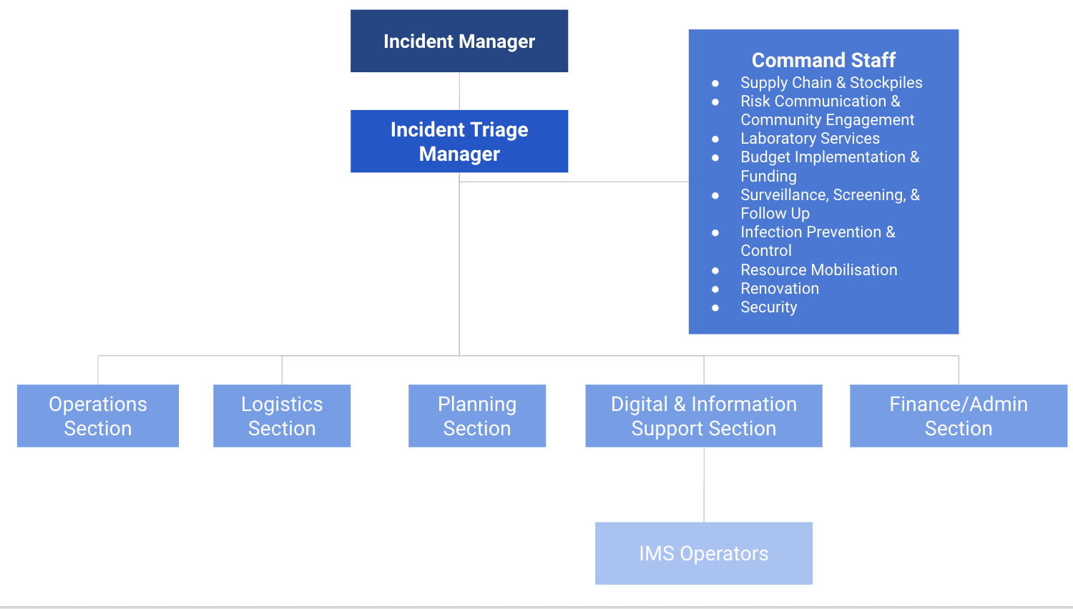
Command Structure

Slide 79
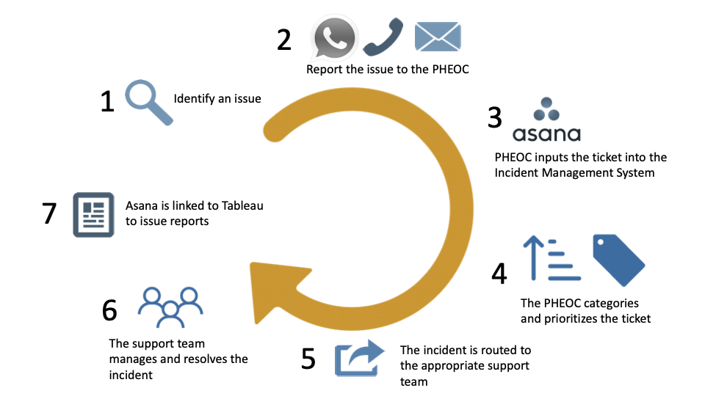
Incident Management Workflow Overview

Slide 80
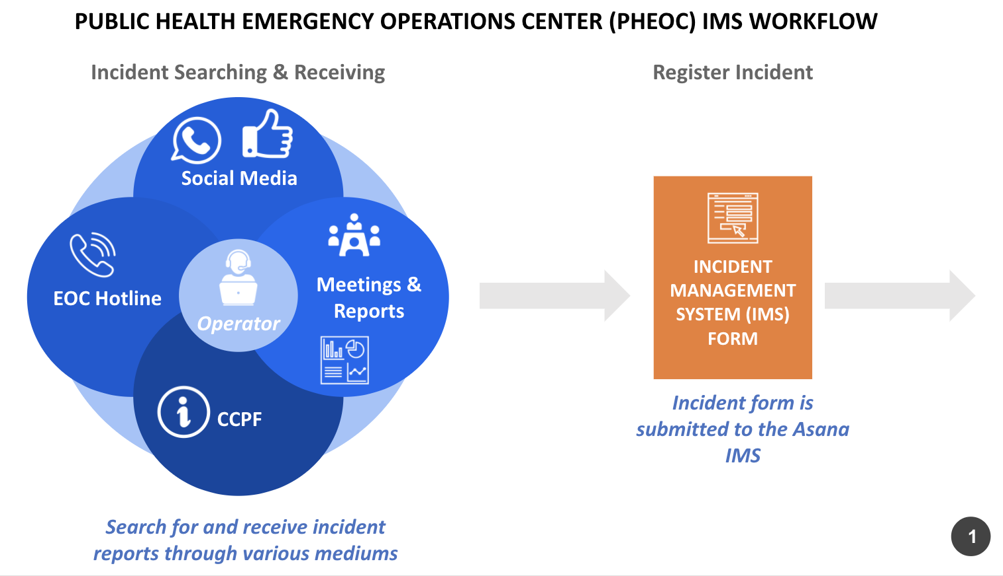
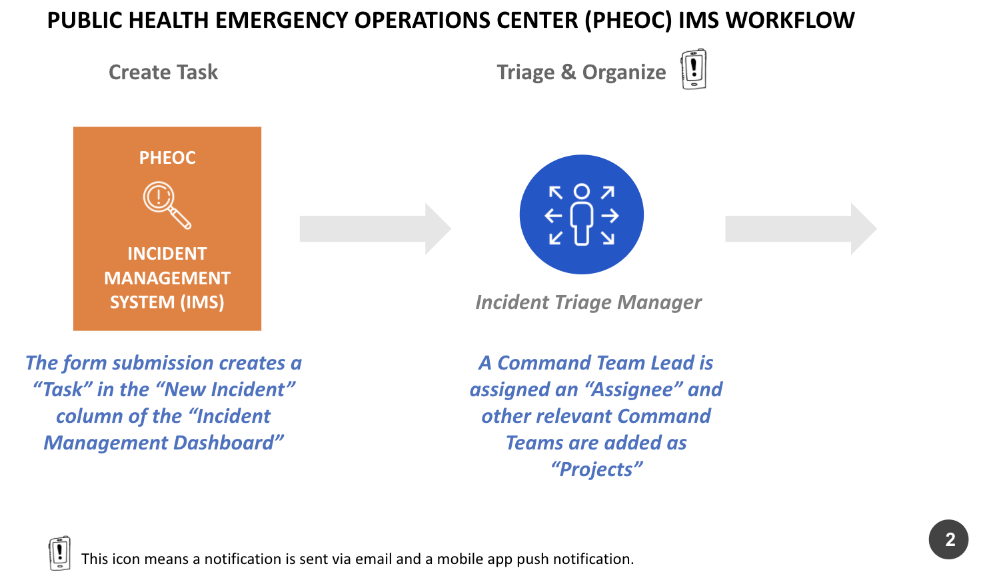
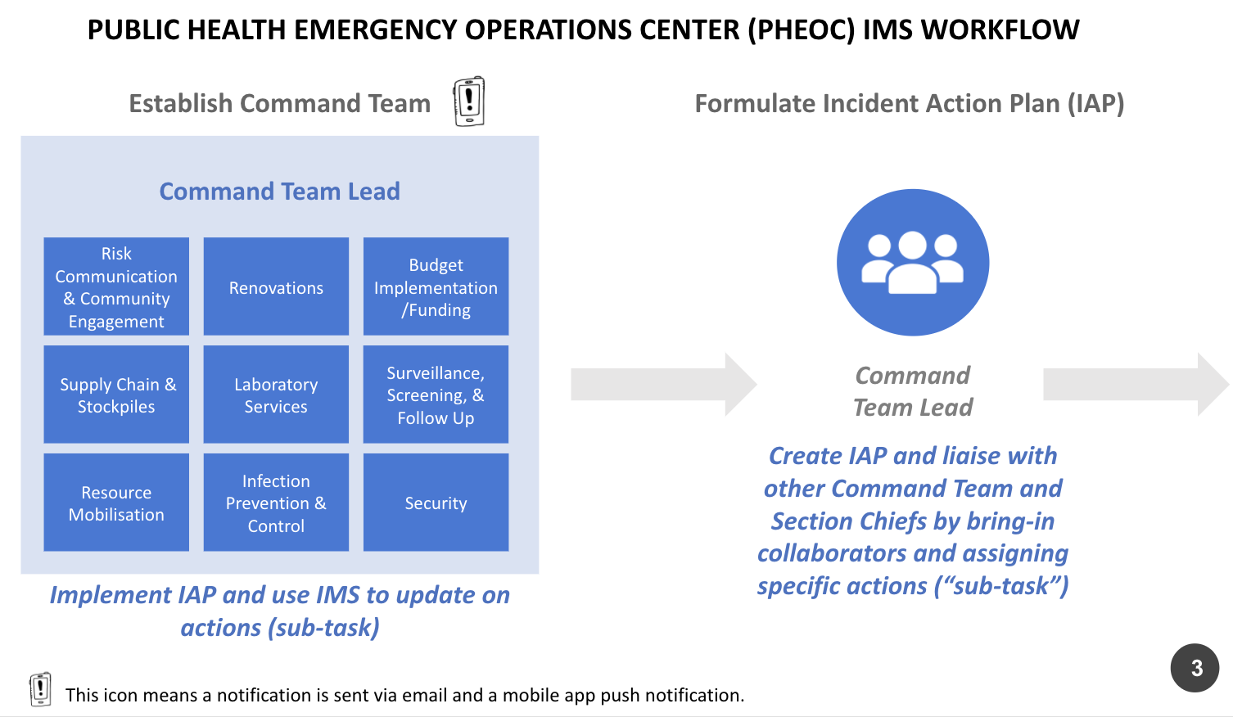
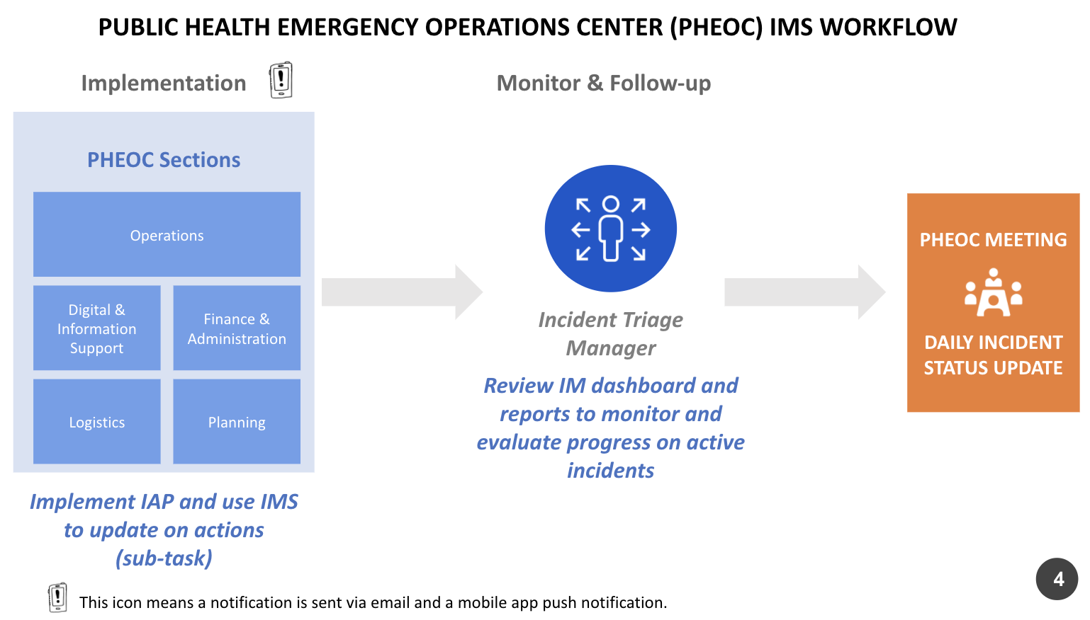
Incident Management Workflow

Slide 81
Internal Dashboards

Slide 82
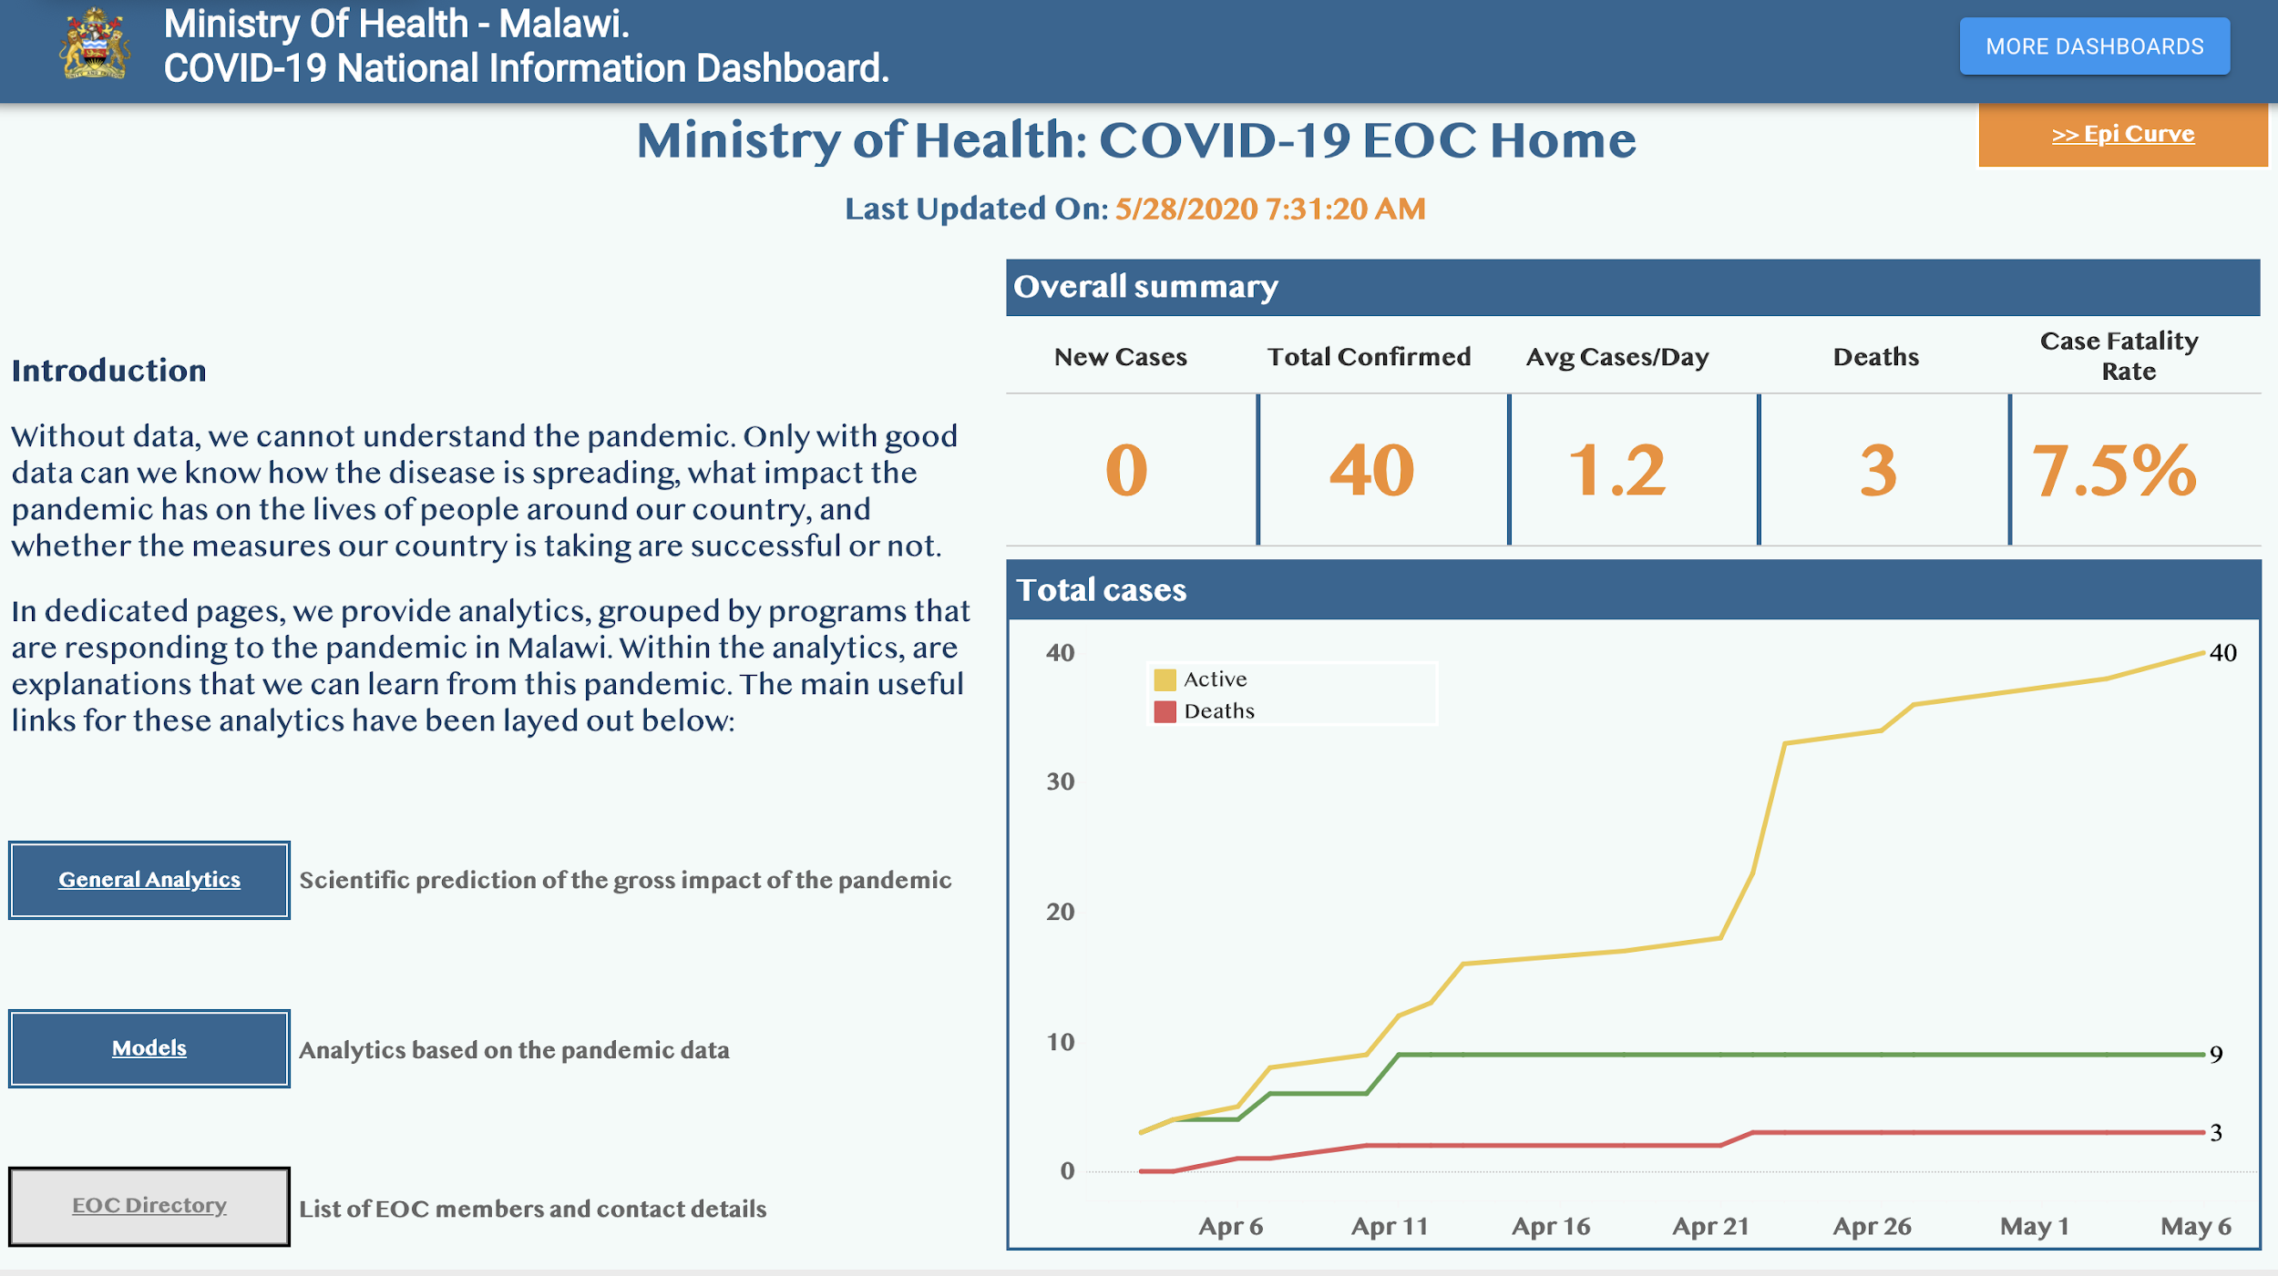

Slide 83
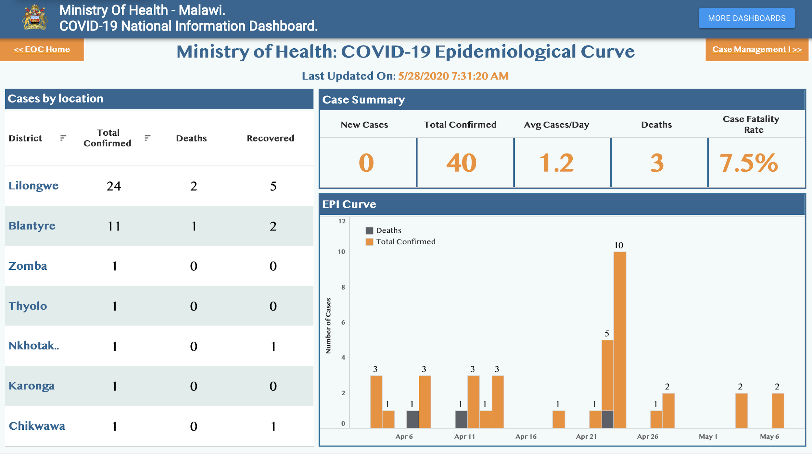

Slide 84
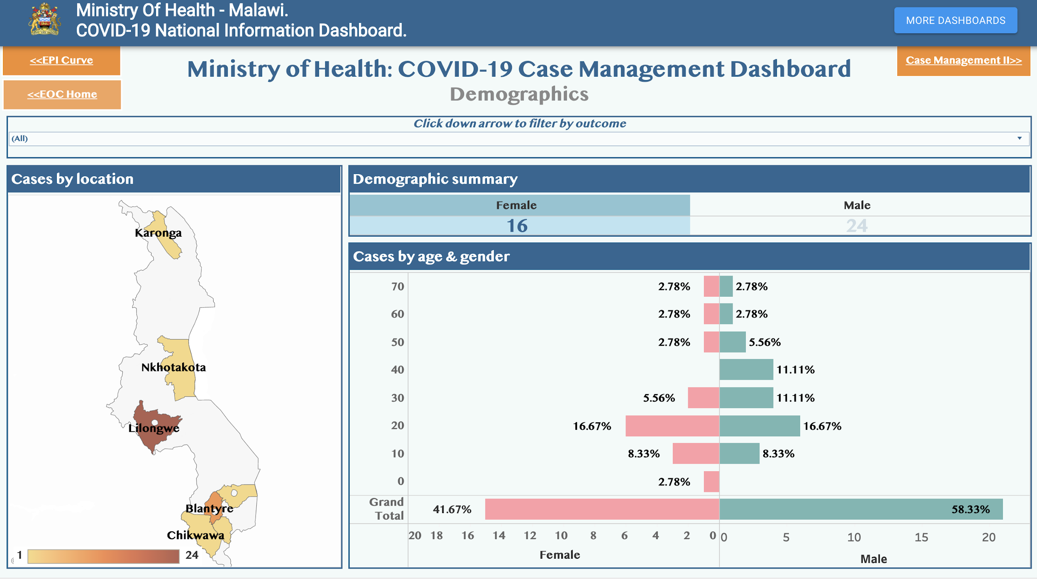

Slide 85
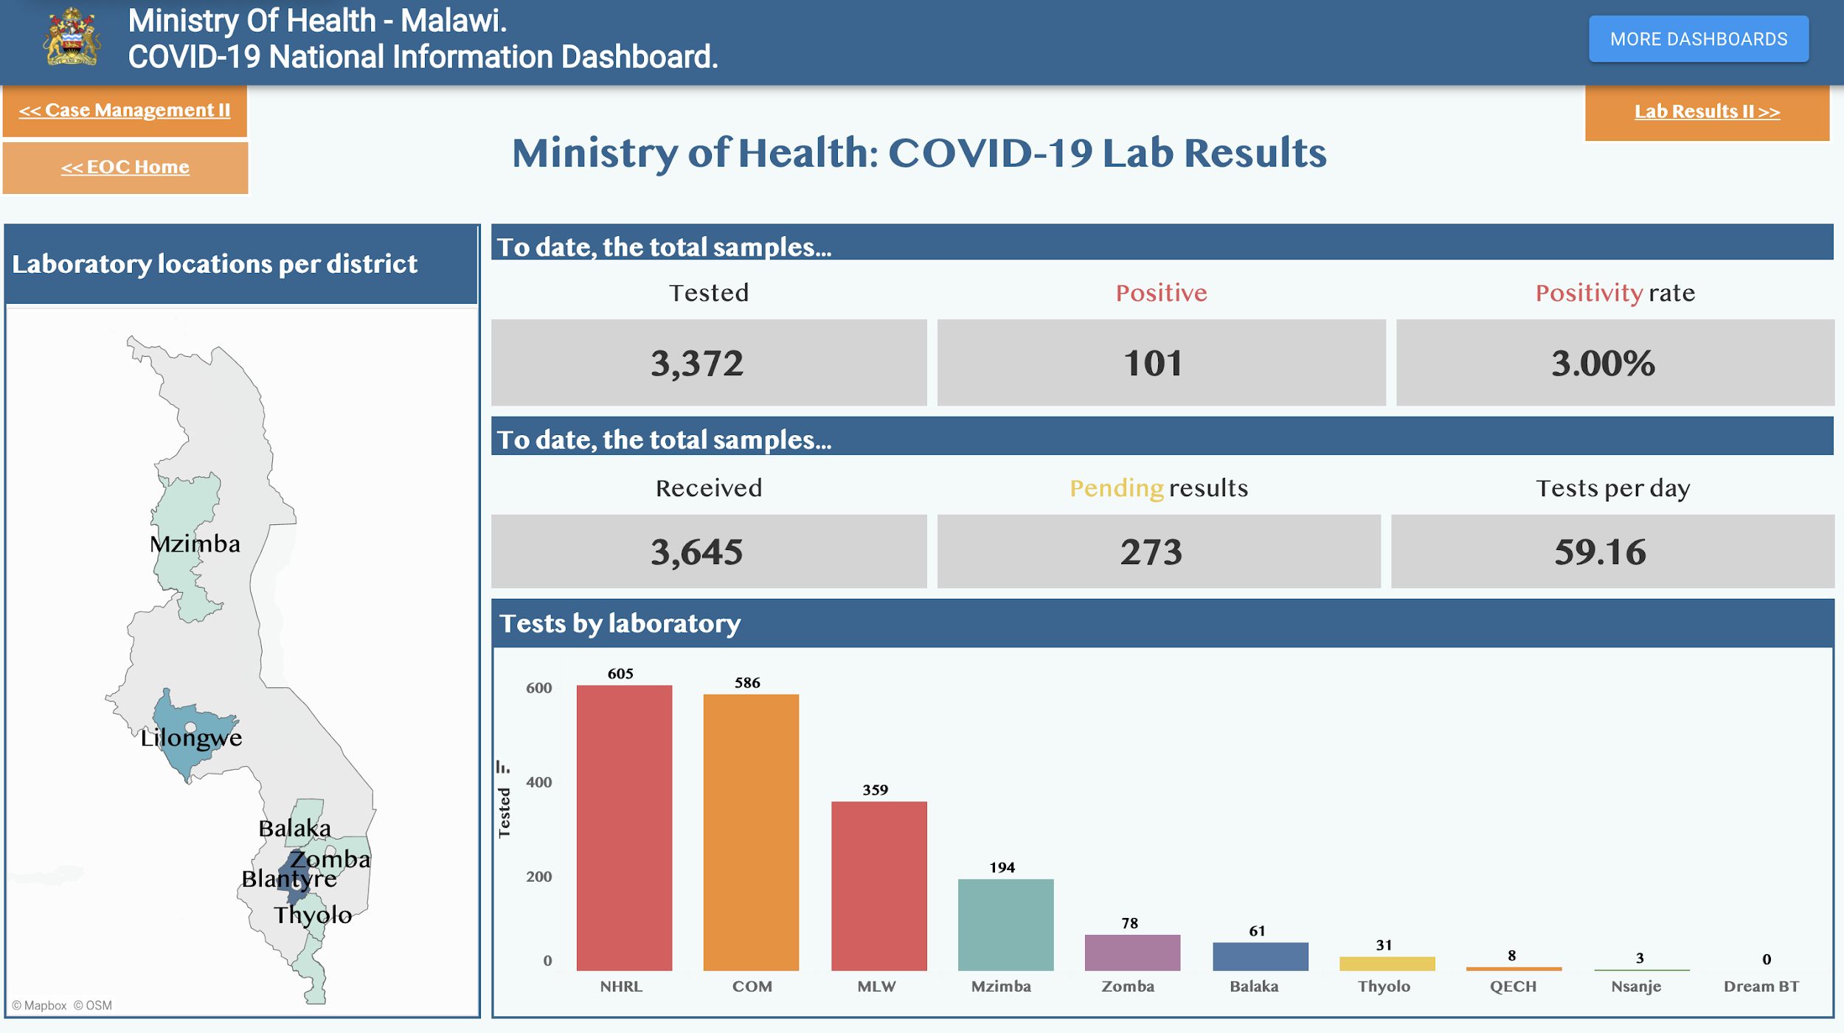

Slide 86
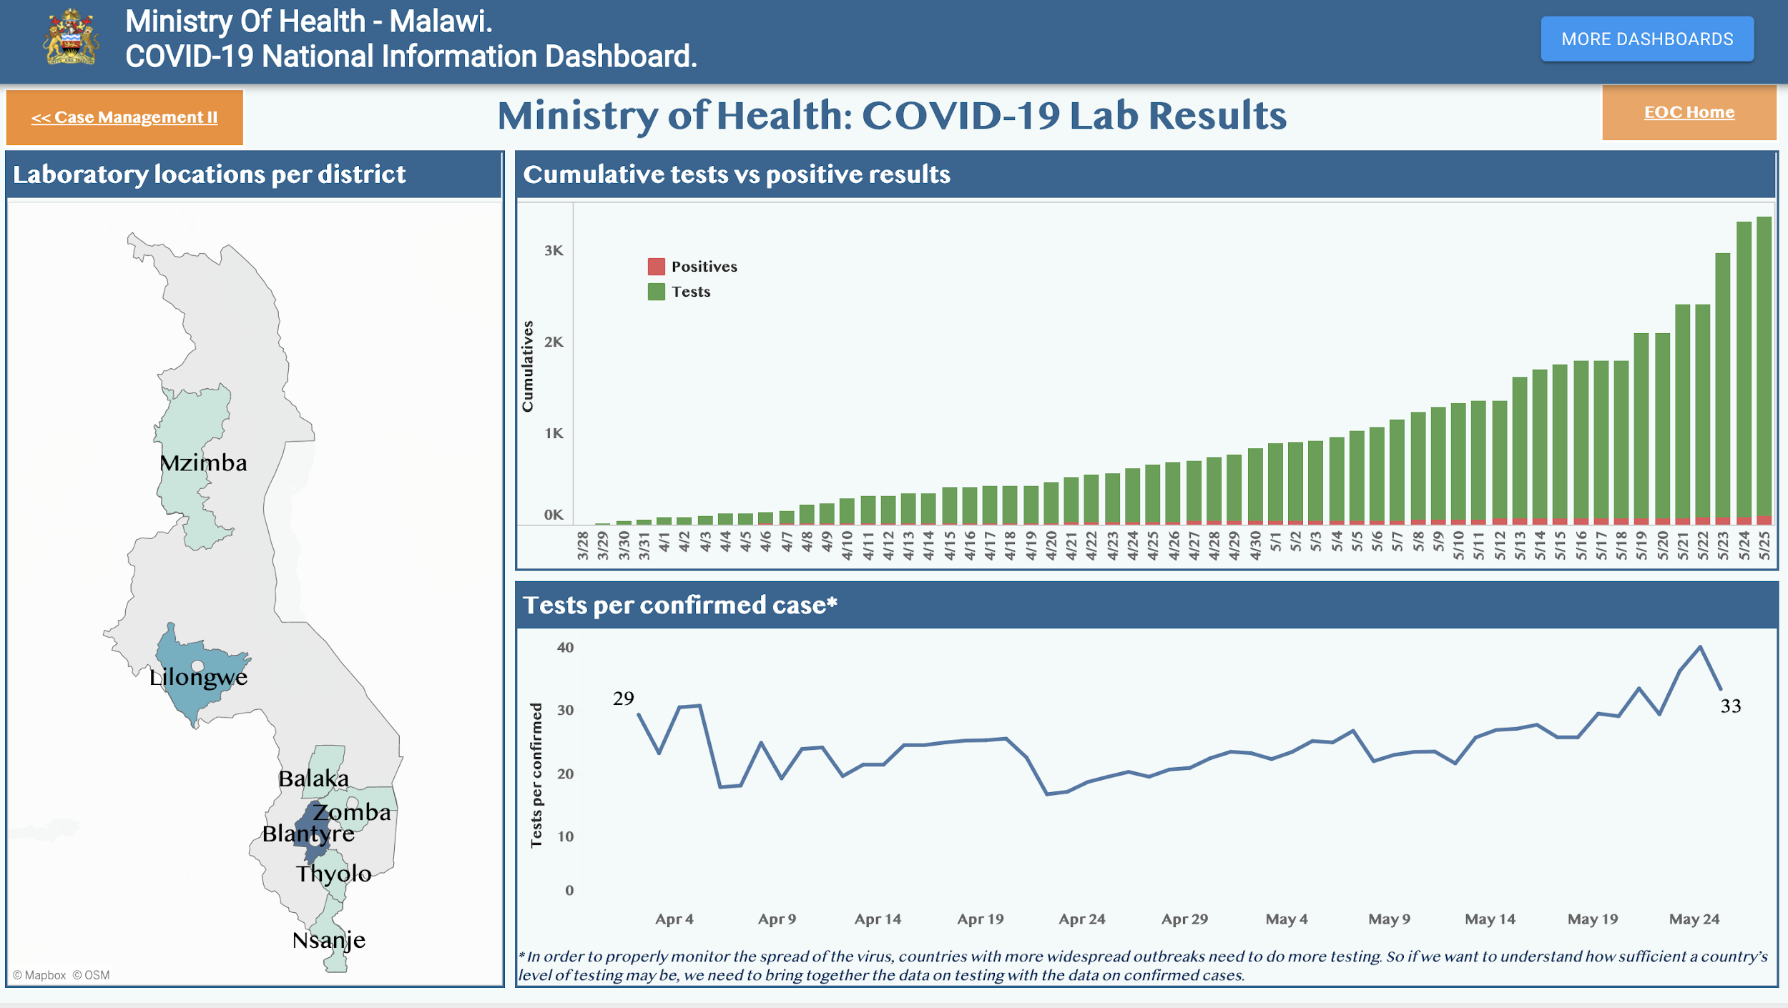

Slide 87
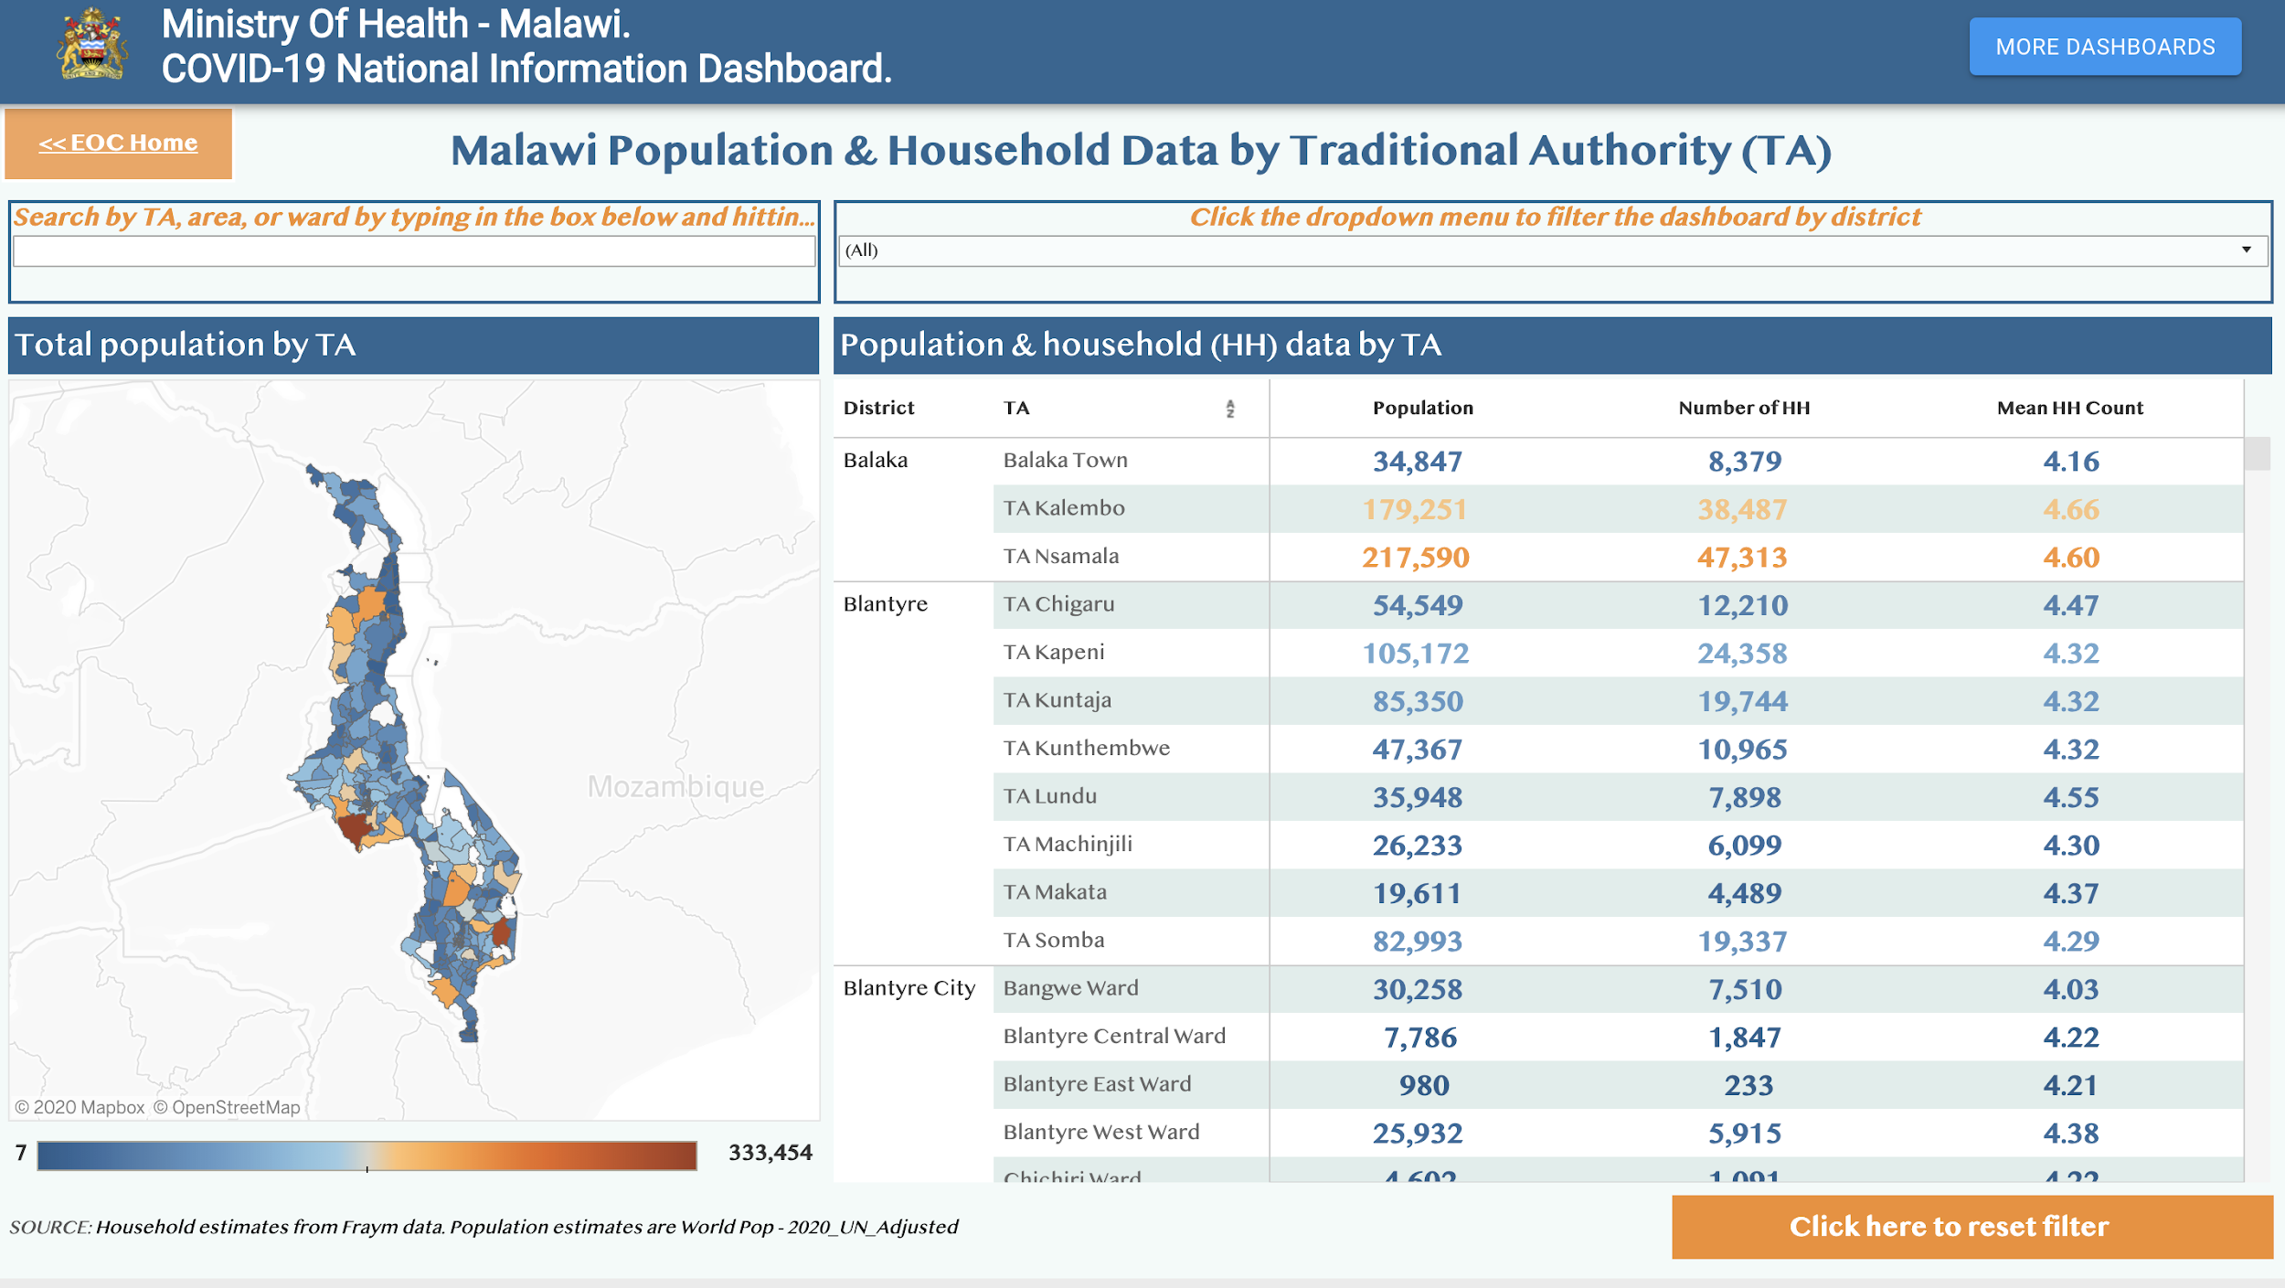

Slide 88
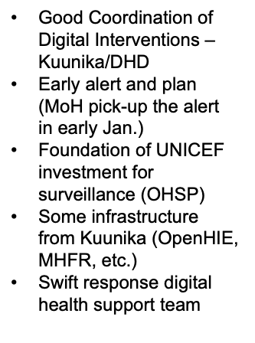
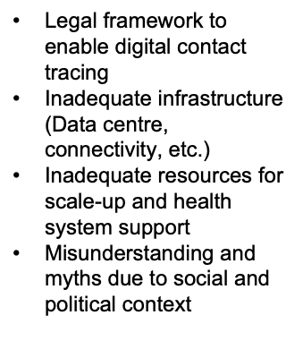
SUCCESSES
CHALLENGES

Slide 89



Continued digital health support:
Integrate OpenLMIS data to monitor all response related commodities in higher frequency
District, epidemiologic model and risk model dashboard development
Provide IMS Asana training to the incident manager and extended user training and support
Integrate bed capacity data to inform decision making

Slide 90
Thank You

